Slide 1
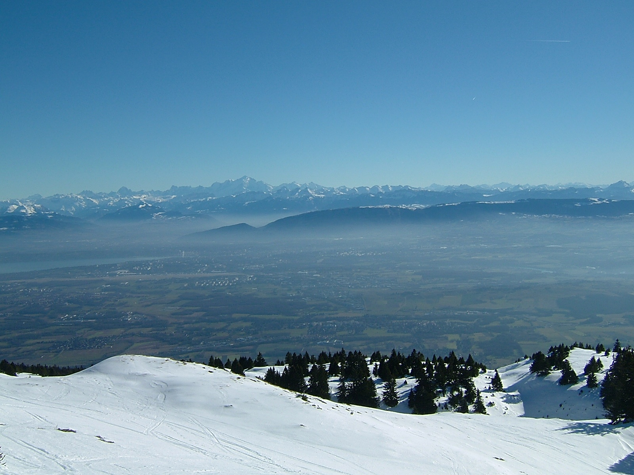
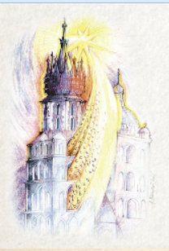

FCC-ee (TLEP)
Design Study of Future Circular Colliders
Acknowledgments to all my FCC-ee colleagues for material and ideas (and hard work)
in particular: J.Wenninger, F. Zimmermann, P. Lebrun, E. Jensen, R. Thomas, B. Harer, R. Martin, N. Bacchetta,
P. Janot, B. Holzer, H. Burkhardt (CERN) M. Koratzinos (UNIGE), U. Wienands (SLAC) E. Gianfelice (FNAL), M. Boscolo (LNF)
A.Bogomyagkov, I. Koop, E. Levichev, D. Shatilov, I. Telnov (BINP Novosibirsk) K. Ohmi, K. Oide (KEK) ... ...

Slide 2
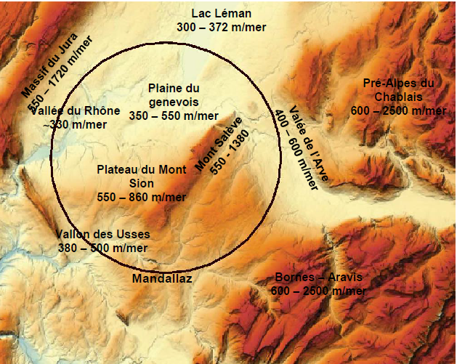
Future Circular Collider Study - SCOPE
CDR and cost review for the next ESU (2018)
International collaboration to study:
100 TeV pp-collider (FCC-hh) Ultimate goal
→ defining infrastructure requirements
e⁺e⁻ collider (FCC-ee) as potential intermediate step
p-e (FCC-he) option
80-100 km infrastructure in Geneva area

Slide 3
possible long-term strategy
FCC-ee (80-100 km,
e⁺e⁻, 90-350 GeV
Interm. step
LEP
PSB
PS (0.6 km)
LHC (26.7 km)
HL-LHC
SPS (6.9 km)
FCC-hh
(pp, up to
100 TeV c.m.)
Ultimate goal
& e± (120 GeV)–p (7, 16 & 50 TeV) collisions FCC-eh)
≥50 years of e⁺e⁻, pp, ep/A physics at highest energies

Slide 4
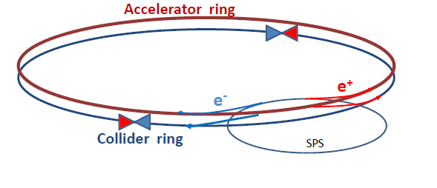
Original motivation (end 2011): now that m_H and m_top are known,
explore EW region with a high precision, affordable, high luminosity machine
➔ Discovery of New Physics in rare phenomena or precision measurements
ILC studies → need increase over LEP 2 (average) luminosity by a factor 1000
How can one do that without exploding the power bill?
Answer is in the B-factory design: a low vertical emittance ring with
higher intrinsic luminosity, and small β*_{y} (1mm vs 5cm at LEP)
Electrons and positrons have a much higher chance of interacting
➔ much shorter lifetime (few minutes)
➔ top up continuously with booster ==> increase operation efficiency
Increase SR beam power to 50MW/beam
50
5
4
1000
at ZH threshold
in LEP/LHC tunnel
X 4 in FCC tunnel
X 4 interaction points
EXCITING!

Slide 5
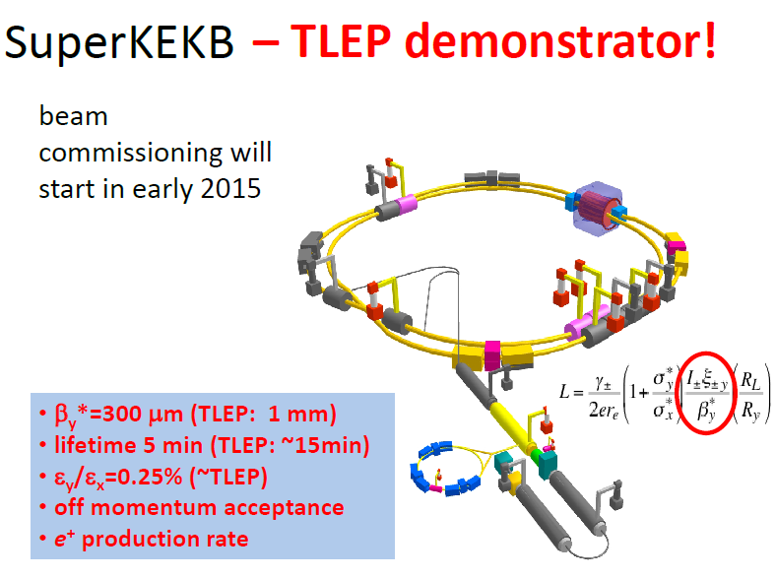
beam commissioning
will start in 2016
K. Oide

Slide 6
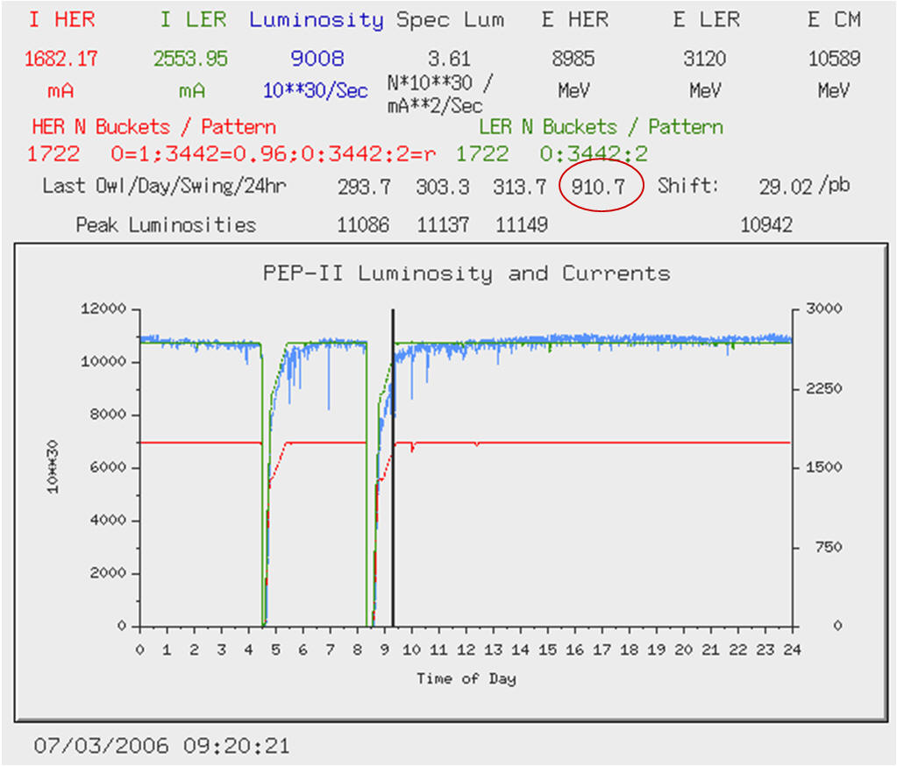
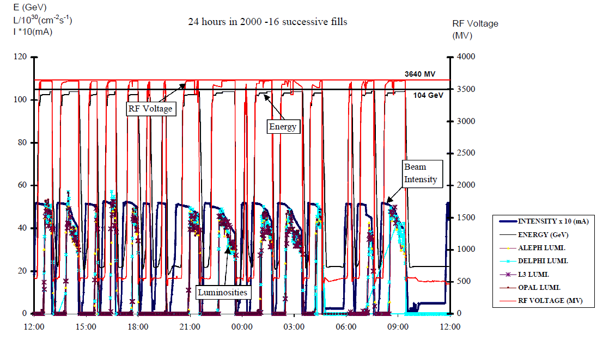
Toping up ensures constant current, settings, etc...
and greater reproducibility of system
LEP2 in 2000 (12th year!):
fastest possible turnaround but
average luminosity ~ 0.2 peak luminosity
B factory in 2006 with toping up
average luminosity ≈ peak luminosity

Slide 7
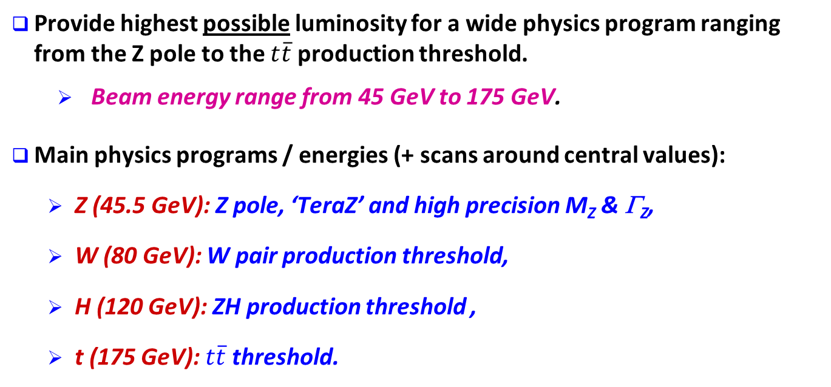
Physics goals of FCC-ee
Provide highest possible luminosity for a wide physics program ranging from the Z pole to the $t\overline{t}$ production threshold.
  Beam energy range from 45 GeV to 175 GeV.
Main physics programs / energies (+ scans around central values):
  Z (45.5 GeV): Z pole, ‘TeraZ’ and high precision M_{Z} & Γ_{Z},
  W (80 GeV): W pair production threshold,
  H (120 GeV): ZH production threshold ,
  t (175 GeV): $t\overline{t}$threshold.
E_{b} calibration with
transverse polarization
for M_{Z}, Γ_{Z}, M_{W}
In principle (at a cost!) higher energy (<500)could be achievable
iff compelling physics case.
FCC Physics and experiments will be described on friday
All energies
in this presentation
refer to BEAM energies

Slide 8
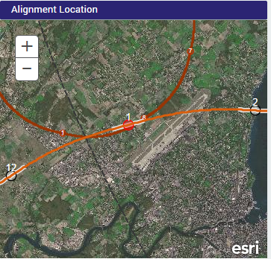
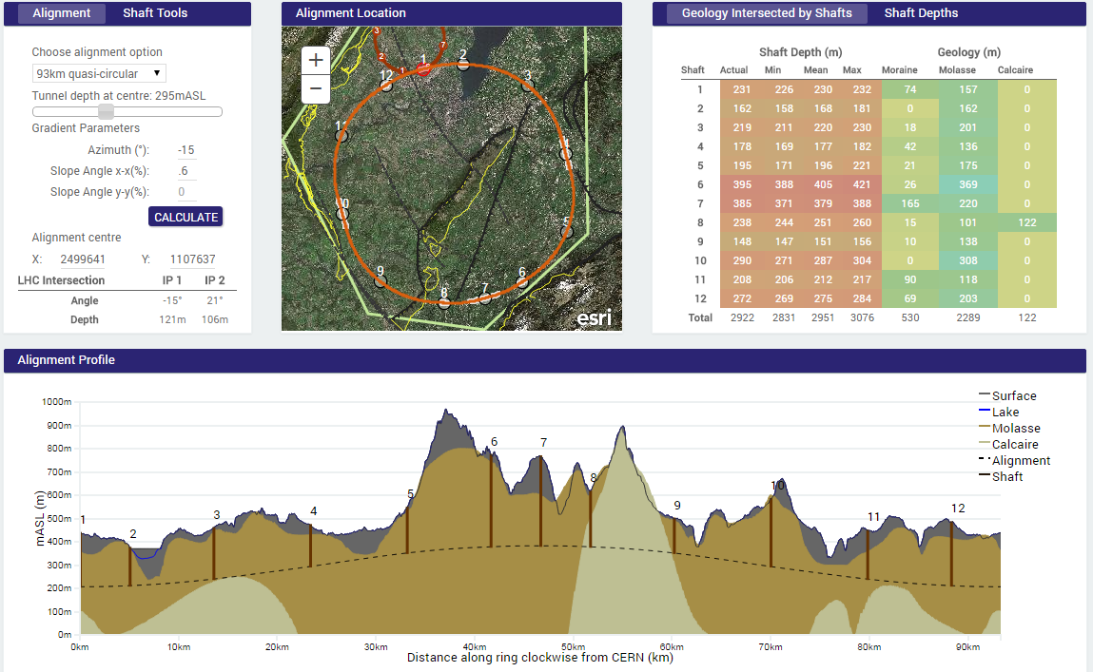
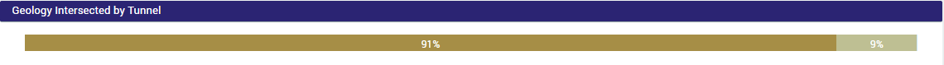
93 km option – current baseline
LHC P1/P8 extraction (avoids Jura limestone)
Deepest shaft close to 400 m
(not optimized)
10,500m

Slide 9
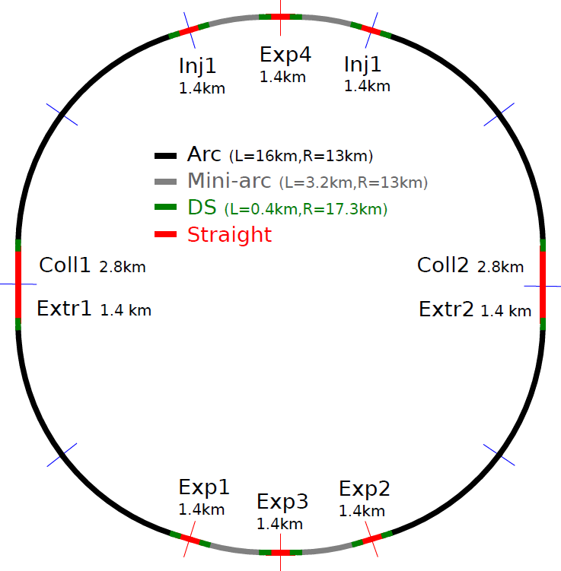
First layout hh – ee
FCC-hh relies on a modified LHC as a ~3 TeV injector.
  Connection to LHC at IR1 (ATLAS) or at IR8 (LHCb).
  Minimize transfer line length → racetrack-like shape.
First baseline layout is close to a circular machine with two symmetry planes.
  Consider lengths as preliminary !
Circumference is a rational multiple of LHC: 80, 86.6, 93.3 or 100 km (¼ LHC).
  Baseline is the 93.3 km version → average machine radius of 12 km.
Beam crossings only at the experiments.
Machine is planar (no kinks), the two rings are side by side.
  Good for vertical emittance, polarization.
LHC IR1/8

Slide 10
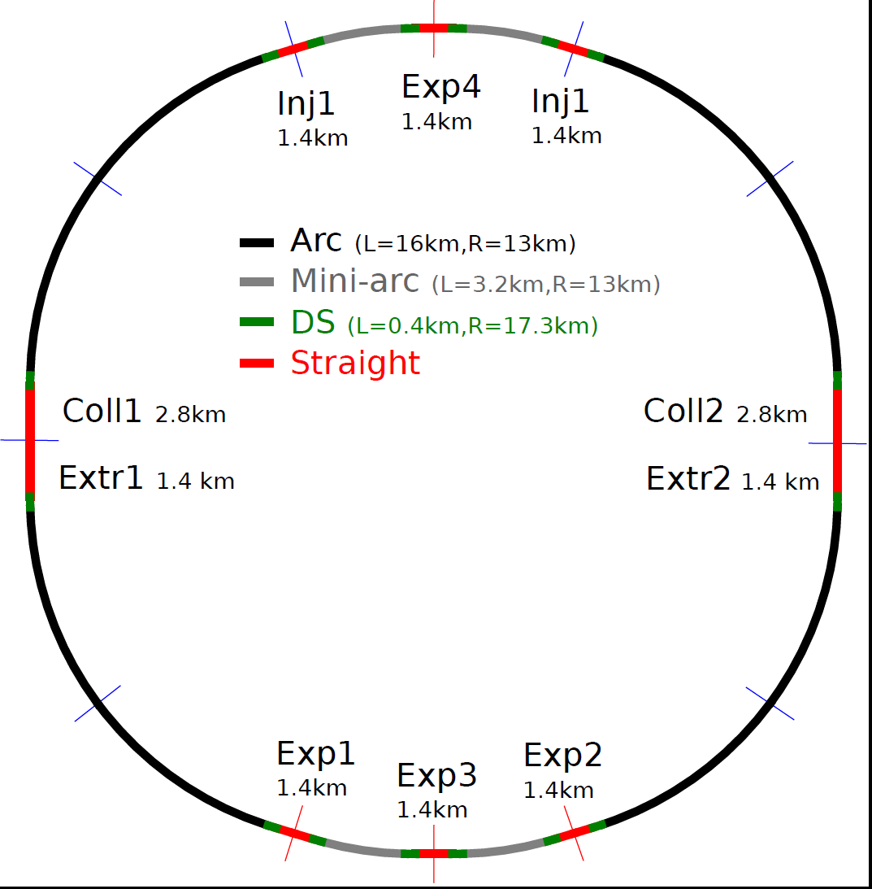
FCC-ee
At the FCC-ee energies, injection, collimation and dump (extr) systems have reduced space requirements.
  Injection, collimation and extraction of both rings may fit in 2-3 of the long straight sections.
  This layout is only indicative.
  The length of the straights may change!
The main FCC-ee requirement is an RF system distributed over as many locations as possible.
  Minimize: energy offsets, orbit offsets in the sextupoles… ⇔ optics perturbations.
  In this layout roughly one RF station every ~1/5 of the ring. Voltage distribution will be asymmetric (reflect the ring (a)symmetry).
  Simulations must confirm whether additional RF stations are required in the middle of the long arcs (175 GeV !).
EXP + RF
INJ + RF
INJ + RF
RF
RF
COLL + EXTR + RF
COLL + EXTR + RF
RF
RF
EXP + RF
EXP + RF
EXP + RF
RF = length ~ 200 m

Slide 11
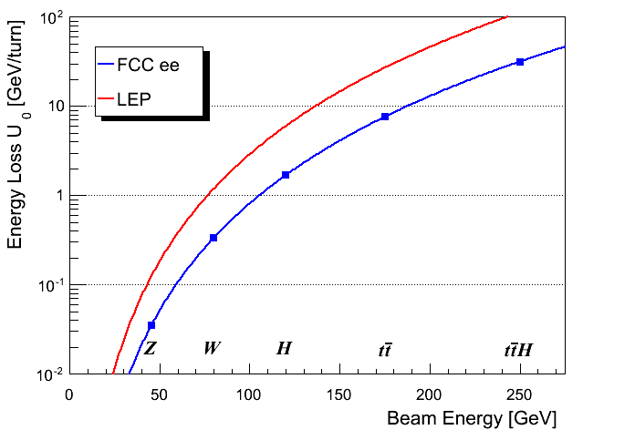
Synchrotron radiation power
The maximum synchrotron radiation (SR) power P_{SR} is set to 50 MW per beam – design choice ⇔ power dissipation.
  defines the maximum beam current at each energy.
  Note that a margin of a few % is required for losses in straight sections.
  ρ = 3.1 km
100 km circular
V_{RF} ~35 GV
V_{RF} ~10-11 GV
  ρ = 11 km
V_{RF} ~3 GV
Like many other numbers the energy loss will change slightly for the 93.3 km racetrack layout !

Slide 12
Key parameter table
Parameter | FCC-Z | FCC-WW | FCC-ZH | FCC-tt | LEP2
E (GeV) | 45 | 80 | 120 | 175 | 104
I (mA) | 1400 | 152 | 30 | 7 | 4
No. bunches | 16’700 | 4’490 | 1’330 | 98 | 4
β*_{x/y} (mm) | 500 / 1 | 500 / 1 | 500 / 1 | 1000 / 1 | 1500 / 50
ε_{x} (nm) | 29 | 3.3 | 1 | 2 | 30-50
ε_{y} (pm) | 60 | 7 | 2 | 2 | ~250
ξ_{y} | 0.03 | 0.06 | 0.09 | 0.09 | 0.07^{*)}
L (10³⁴ cm⁻²s⁻¹)/IP | 28 | 12 | 6.0 | 1.8 | 0.012
*) LEP2 was not at beam-beam limit, estimated beam-beam limit around 0.12
Basic assumption: use all 100 MW SR beam power at all energies
→ At the Z : 20 ns (or smaller) spacing
N_{b} > Q_{x} ➔ requires separate vacuum chambers for e+ and e-
Magnetic field in ring magnets is 0.015 to 0.07 T ( < LEP )
Will be revised for March 2015

Slide 13
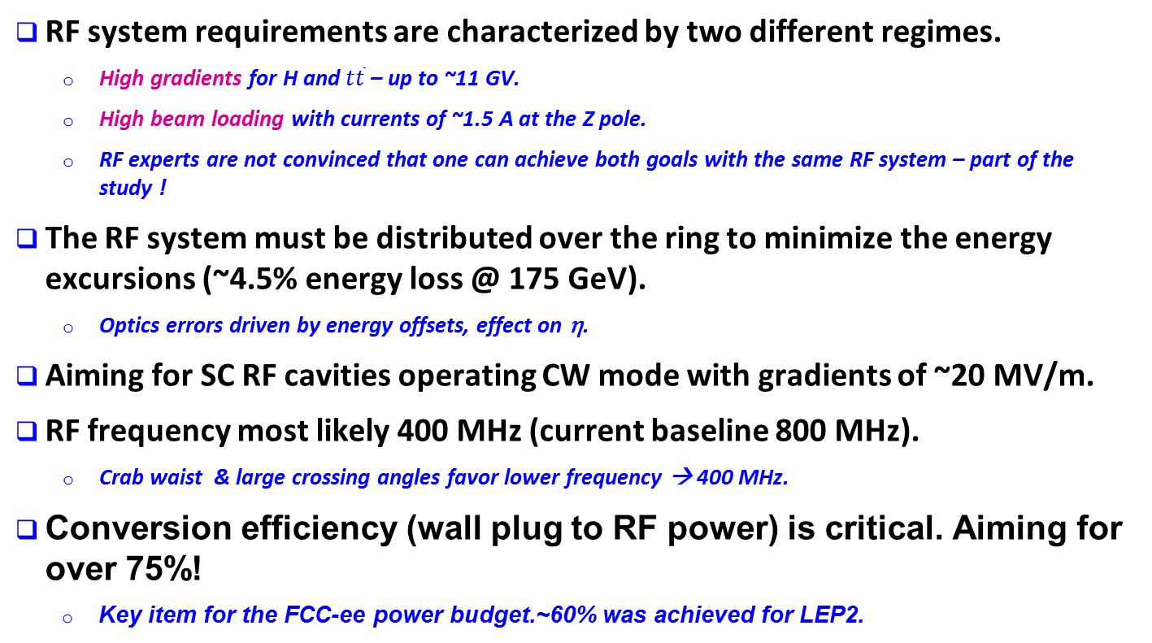
SC RF System
RF system requirements are characterized by two different regimes.
  High gradients for H and $t\overline{t}$ – up to ~11 GV.
  High beam loading with currents of ~1.5 A at the Z pole.
  RF experts are not convinced that one can achieve both goals with the same RF system – part of the study !
The RF system must be distributed over the ring to minimize the energy excursions (~4.5% energy loss @ 175 GeV).
  Optics errors driven by energy offsets, effect on η.
Aiming for SC RF cavities operating CW mode with gradients of ~20 MV/m.
RF frequency most likely 400 MHz (current baseline 800 MHz).
  Crab waist & large crossing angles favor lower frequency → 400 MHz.
Conversion efficiency (wall plug to RF power) is critical. Aiming for over 75%!
  Key item for the FCC-ee power budget.~60% was achieved for LEP2.
This is a very important R&D of general interest

Slide 14

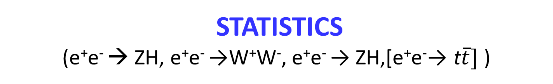
STATISTICS
(e⁺e⁻ → ZH, e⁺e⁻ →W⁺W⁻, e⁺e⁻ → ZH,[e⁺e⁻→ t$\overline{t}]$ )
 | TLEP-4 IP, per IP | statistics (4 exp)
circumference | 100 km
max beam energy | 175 GeV
no. of IPs | 4
Luminosity/IP at 350 GeV c.m. | 1.8x10³⁴ cm⁻²s⁻¹ | 10⁶ ‾tt pairs /5yrs
Luminosity/IP at 240 GeV c.m. | 6.0x10³⁴ cm⁻²s⁻¹ | 2 10⁶ ZH evts/5yrs
Luminosity/IP at 160 GeV c.m. | 1.2x10³⁵ cm⁻²s⁻¹ | 10⁸ WW pairs/1yr
Luminosity/IP at 90 GeV c.m. | 2.8 10³⁵ cm⁻²s⁻¹ | 10¹² Z decays /2yrs

Slide 15
Luminosity optimisation
Ideal situation is that beam lifetime is driven by particle-particle interactions
-- dominated by radiative Bhabha scattering e+e- → e+e-γ (typically 150 mb)
with e^{+/-} out of energy acceptance (improved with larger acceptance)
At high luminosity considered in FCC-ee, Beamstrahlung (particle-opp. beam interaction)
becomes important.
-- requires very flat beams and +- 2% energy acceptance
-- reduces beam lifetime
-- increases energy spread and bunch length
This is the case in FCC-tt
At lower energy the beams are blowing eachother (beam-beam interaction)
-- this can be fought with ‘crab waist’ crossing
This is the case at all lower energies operating points
Numbers in main parameter list include beamstrahlung treatment, but have not considered
crab waist operation.

Slide 16
Luminosity
H ≤ 1
Hour-glass
F ≤ 1
Crossing angle
2Φ
Beam-beam parameter

Slide 17
Crab Waist Scheme
P. Raimondi, 2006
x
β_{y}
e⁺
e⁻
θ
– Piwinski angle
z
Large Piwinski angle: φ >> 1
β_{y} approx. equals to overlapping area: β_{y} ∼ σ_{z} / φ
Crab Waist: minimum of β_{y} along the axis of the opposite beam
Advantages:
Impact of hour-glass is small and does not depend on bunch lengthening
Suppression of betatron coupling resonances allows to achieve ξ_{y} ∼ 0.2
As a result, luminosity can be significantly increased especially at Z, otherwise ξ_{y} ∼ 0.03

Slide 18
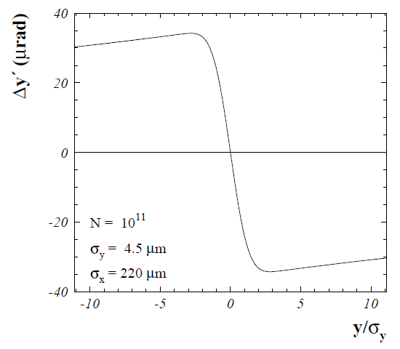
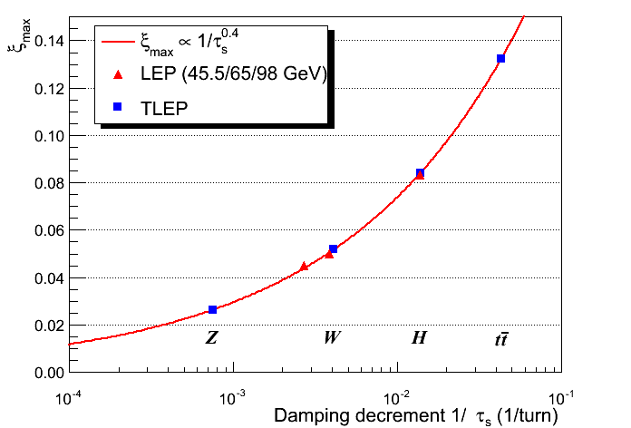
Beam-beam parameter
The beam-beam parameter ξ measures the strength of the field sensed by the particles due to the counter-rotating bunch.
Beam-beam parameter limits are empirically scaled from LEP data (also 4 IPs).
In reasonable agreement with first simulations for FCC ee
ξ_{y} and L may be raised significantly (x 4) with Crab-Waist schemes !

Slide 19
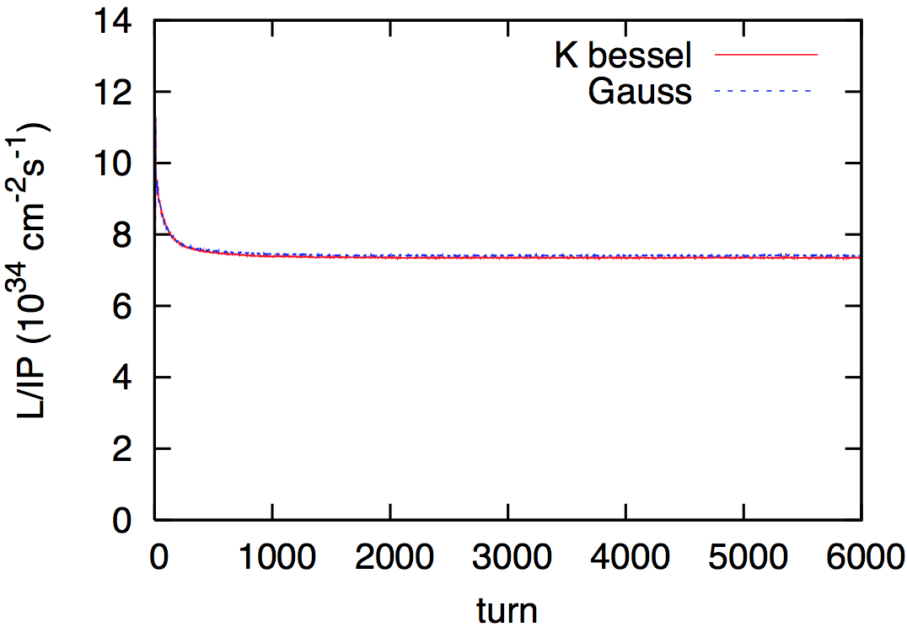
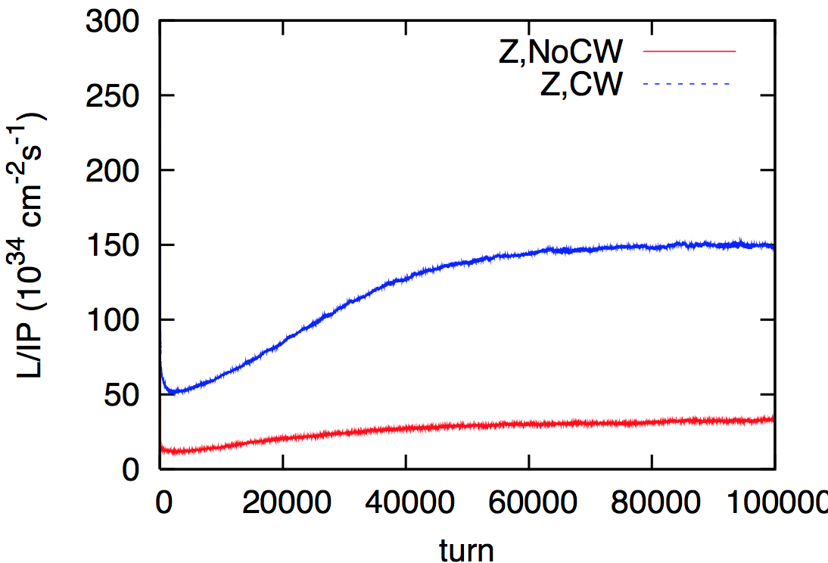
Beam-beam simulations
BBSS strong-strong simulation
with beamstrahlung
FCC-ee at 120 GeV:
L≈7.5x10³⁴ cm⁻²s⁻¹ per IP
design
FCC-ee in crab-waist mode
at the Z pole (45.5 GeV):
L≈1.5x10³⁶ cm⁻²s⁻¹ per IP
crab waist
baseline design
Tracking confirms assumptions!
K. Ohmi, A. Bogomyagkov, E. Levichev, P. Piminov

Slide 20

Beamstrahlung
Hard photon emission at the IPs, ‘Beamstrahlung’, can become a lifetime / performance limit for large bunch populations (N), small hor. beam size (σ_{x}) and short bunches (σ_{s}) .
e
γ
e
ρ : mean bending radius at the IP (in the field of the opposing bunch)
η : ring energy acceptance
Lifetime expression by V. Telnov
To ensure an acceptable lifetime, ρ×η must be sufficiently large.
  Flat beams : large σ_{x} and small σ_{y} !
  Bunch length !
  Large momentum acceptance of the lattice: 1.5 – 2% required.
    LEP had < 1% acceptance, SuperKEKB ~ 1-1.5%.

Slide 21
Beamstrahlung lifetime
Reasonable agreement between tracking and analytical estimates.
E_{beam} =175 GeV (most critical case)
formula of
A. Bogomyagkov
simulation
by K. Ohmi
formula of
V. Telnov
calculations include dynamic β* function
M. Koratzinos, K. Ohmi,
V. Telnov, A. Bogomyagkov,
E. Levichev, D. Shatilov

Slide 22
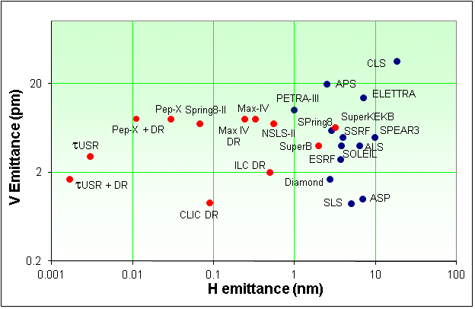
Emittances
FCC-ee is a very large machine, scaling of achievable emittances (mainly vertical) is not straightforward.
  Coupling, spurious vertical dispersion.
Low emittances tend to be more difficult to achieve in colliders as compared to light sources or damping rings – beam-beam !
FCC-ee parameters:
  ε_{y}/ε_{x} ≥ 0.001 ,
  ε_{y} ≥ ≈2 pm
  with a ring ~50-100 larger than a typical light source.
LEP2
FCC-ee
Very challenging target for a ring of that size!
LEP2 achived routinely 0.004
beam corrections are much better now.
R. Bartolini, DIAMOND

Slide 23
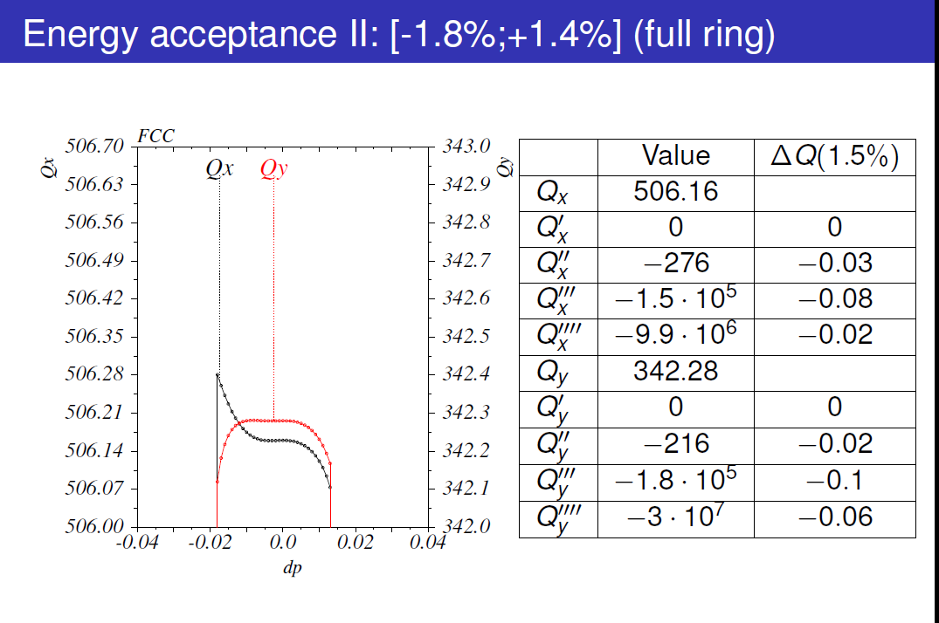
Full Ring Tracking → Ring Energy Acceptance (Bogomyagkov)
For the moment 1.5% acceptance reached -- work to continue towards >2% target

Slide 24
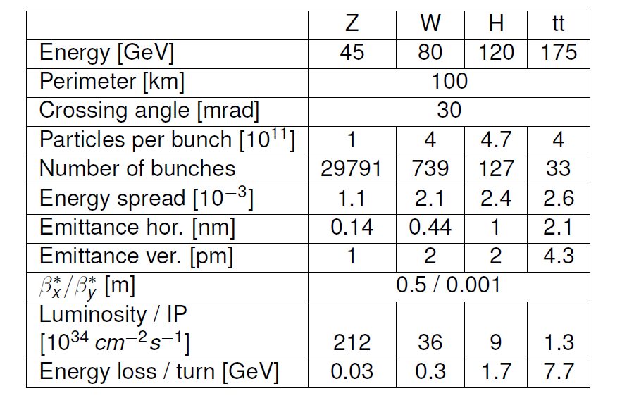
PARAMETERS FOR CRAB WAIST OPERATION
Nominal :
28 | 12 | 6.0 | 1.8
Important scope for improvement in luminosity.

Slide 25

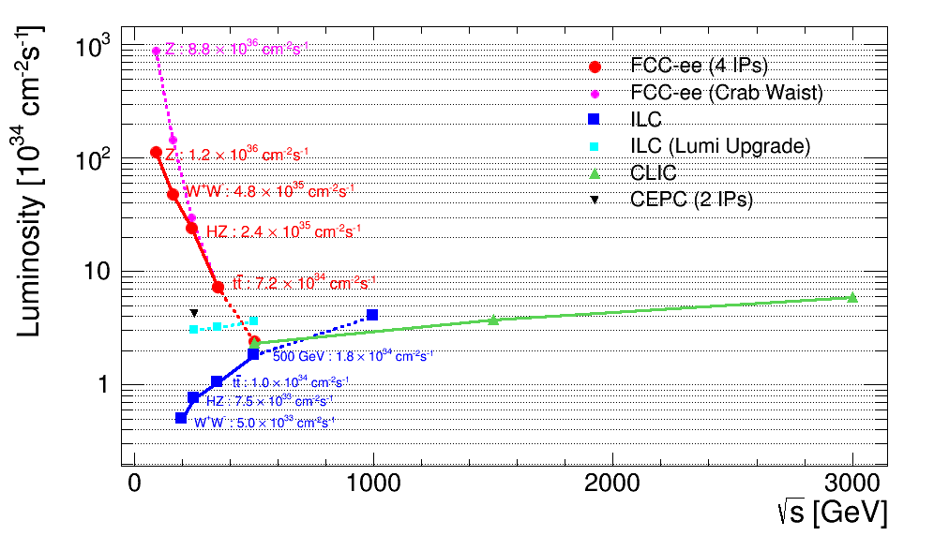
Goal performance of e+ e- colliders
WOW!
complementarity with ILC/CLIC
complementarity
    Luminosity : Crossing point between circular and linear colliders ~ 4-500 GeV
    As pointed out by H. Shopper in ‘The Lord of the Rings’ (Thanks to Superconducting RF…)
Combined know-how {LEP, LEP2 and b-factories} applied for large e+e- ring collider
High Luminosity + Energy resolution and Calibration ➔ precision on Z, W, H, t
CAN WE DO IT? Many accelerator and experimental challenges!

Slide 26
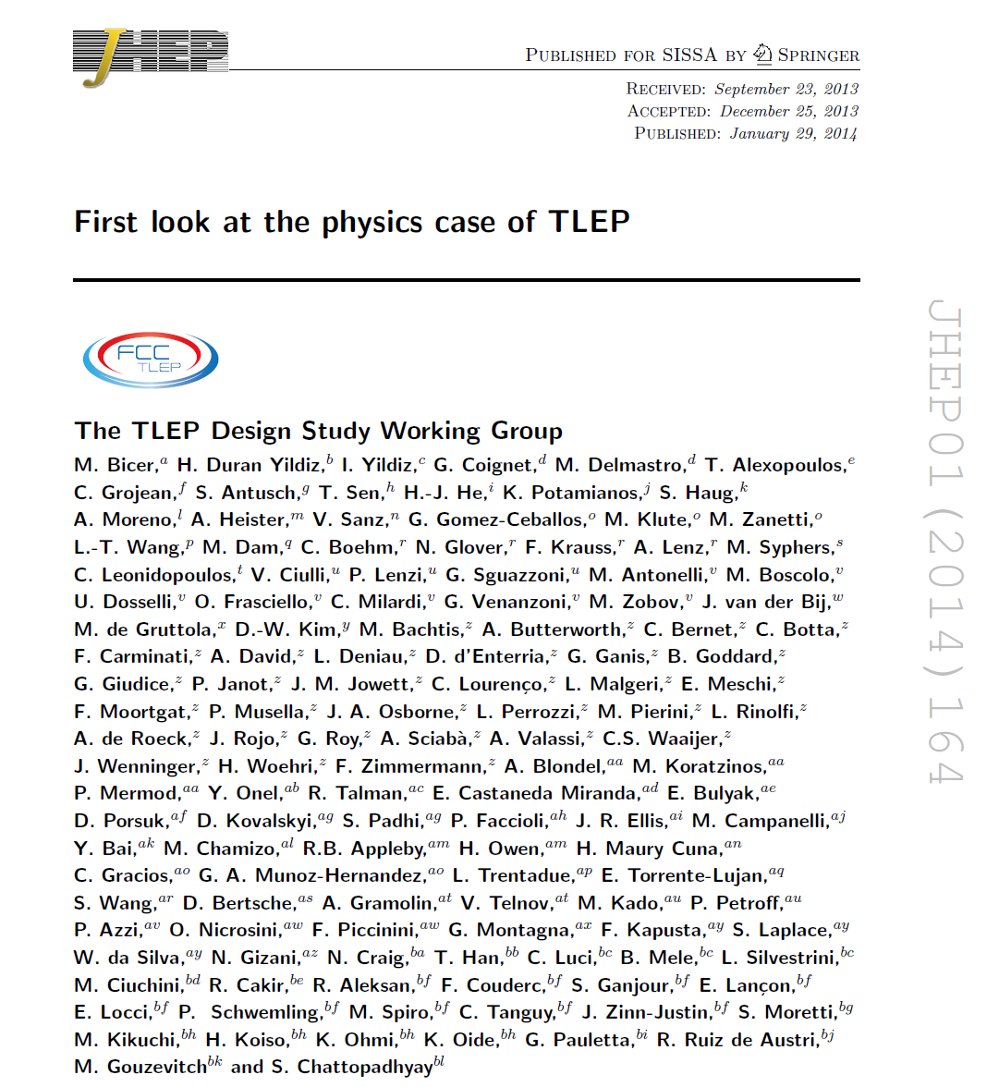
PUBLISHED

Slide 27
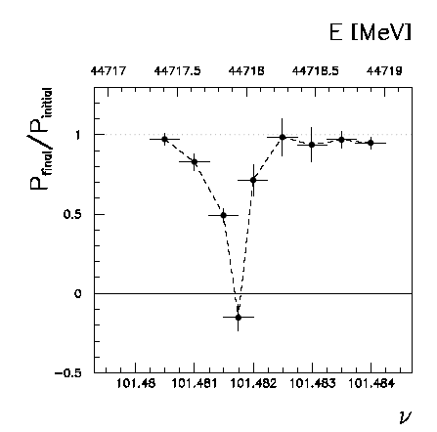
Beam polarization and E-calibration @ FCC-ee
Precise meast of E_{beam} by resonant depolarization
~100 keV each time the meast is made
At LEP transverse polarization was achieved routinely at Z peak.
instrumental in 10⁻³ measurement of the Z width in 1993
led to prediction of top quark mass (179+- 20 GeV) in March 1994
Polarization in collisions was observed (40% at BBTS = 0.04)
At LEP beam energy spread destroyed polarization above 60 GeV
σ_{E} ∝ E²/√ρ ➔ At FCC-ee transverse polarization up to at least 80 GeV
to go to much higher energies requires spin rotators and siberian snake
FCC-ee: use ‘single’ bunches to measure the beam energy continuously
no interpolation errors due to tides, ground motion or trains etc…
but saw-toothing must be well understood! require Wigglers to speed up pol. time
<< 100 keV beam energy calibration around Z peak and W pair threshold.
Δm_{Z} ~0.1 MeV, ΔΓ_{Z} ~0.1 MeV, Δm_{W} ~ 0.5 MeV

Slide 28
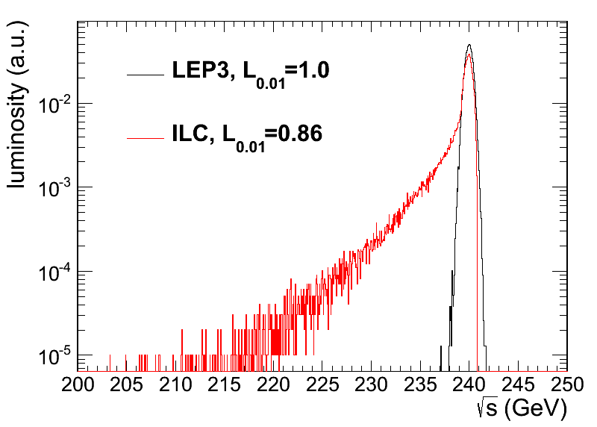
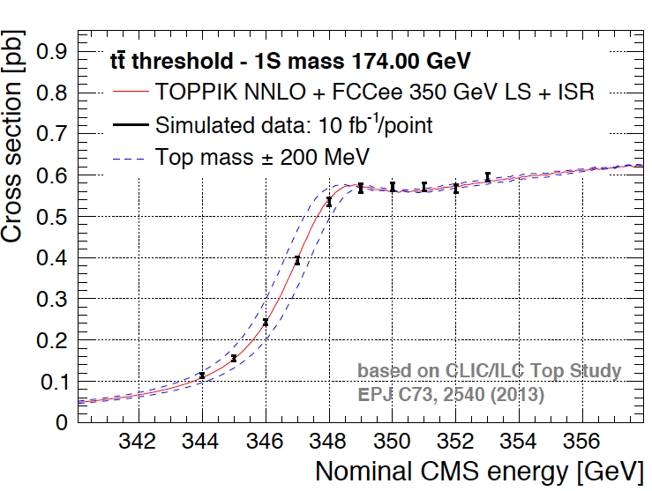
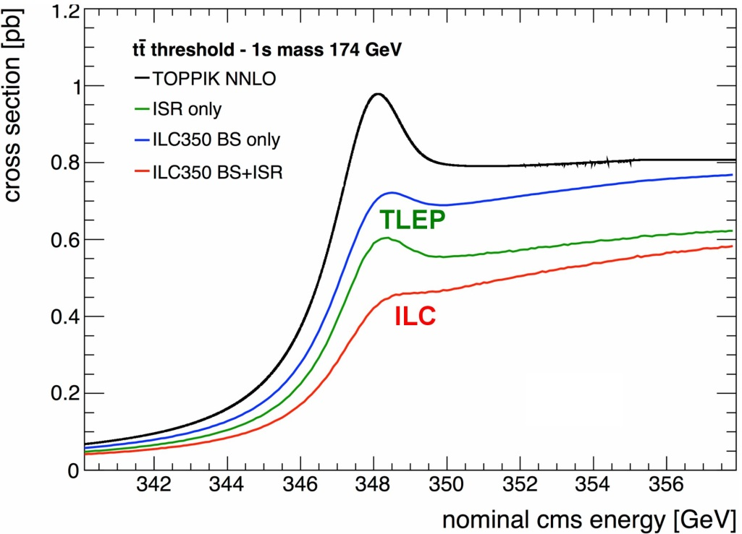
BEAMSTRAHLUNG
Luminosity E spectrum
Effect on top threshold
➔
FCC-ee (top)operates at Beamstrahlung limit, this is a dominant factor for accelerator design.
Beamstrahlung @FCC-ee is benign for physics: particles are lost over 10⁶ collisions and recycled on a synchrotron oscillation
➔ some increase of energy spread
but no change of average energy
Little EM background in the experiment.

Slide 29
Arc lattice (circular machine)
Lattice V12b-s
arc cell layout
BPM
Corrector
Q
Q
S
B
B
Q
S
B
B
B = bending magnet, Q = quadrupole, S = sextupole
FODO cell optics
cell length 50 m
100
80
m
60
n
i
x
t
e
b
40
Circumference: 100 km
Arc length: 2 × 3.4 km
Straight section: 1.5 km
20
0
0
2
4
6
8
10
12
s in km
B. Harer, B. Holzer

Slide 30
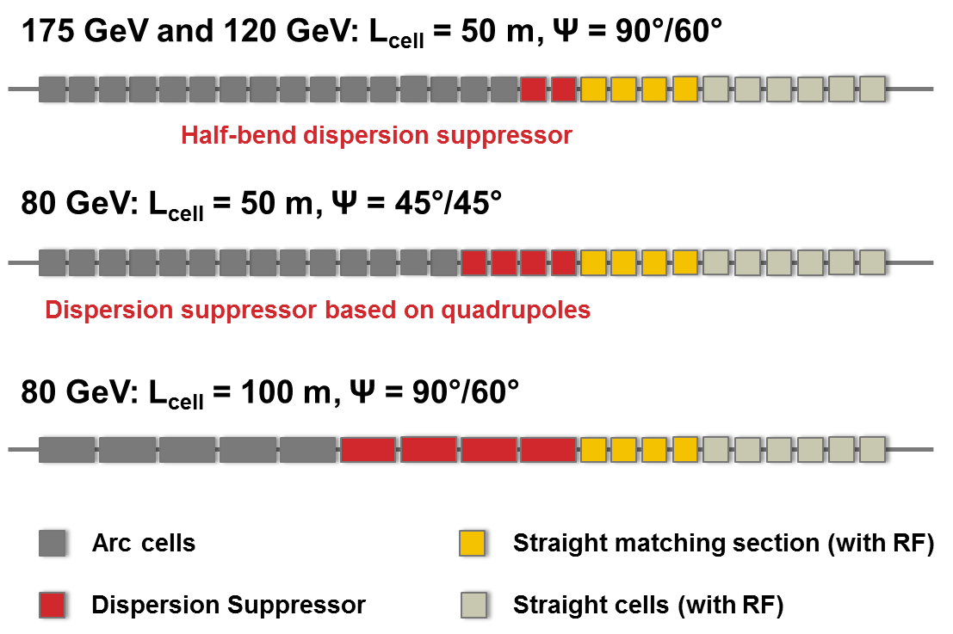
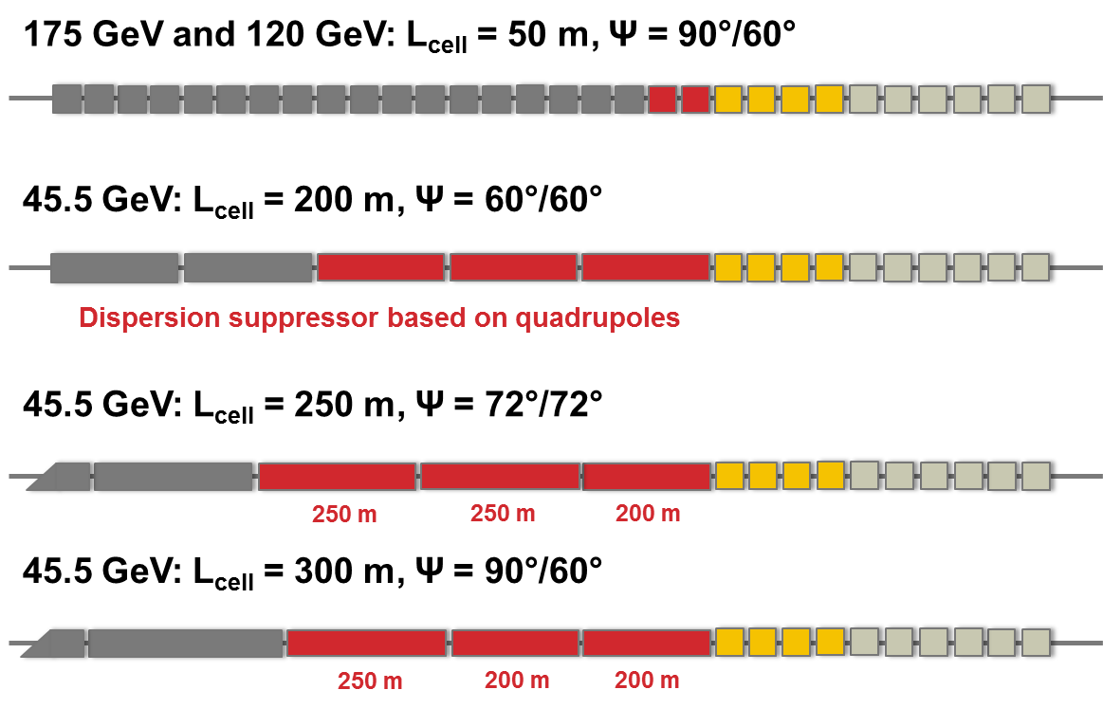
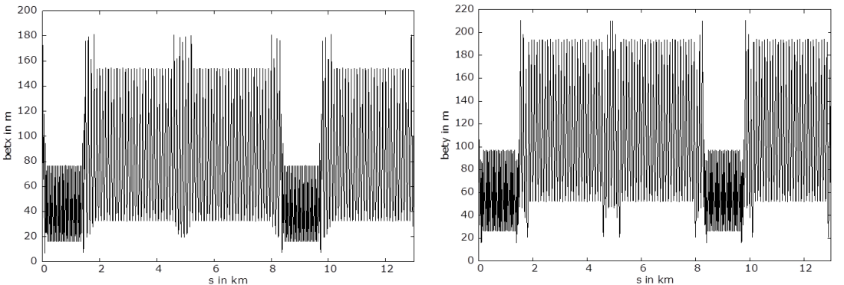
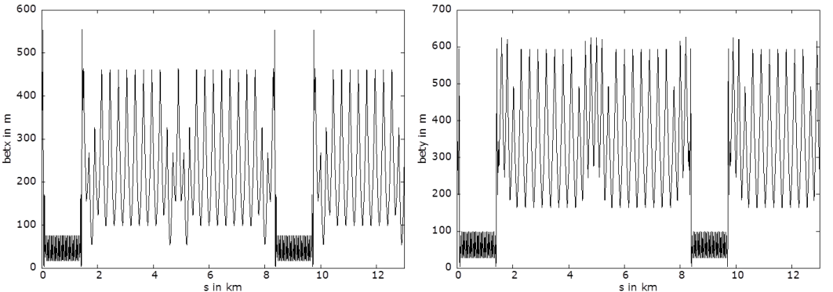
Lattice options for lower energies
80 GeV
45.5 GeV
example: 100 m cell length
example: 300 m cell length
In all cases ε_{x} ≤ 0.5 baseline ⇔ cell optimization

Slide 31
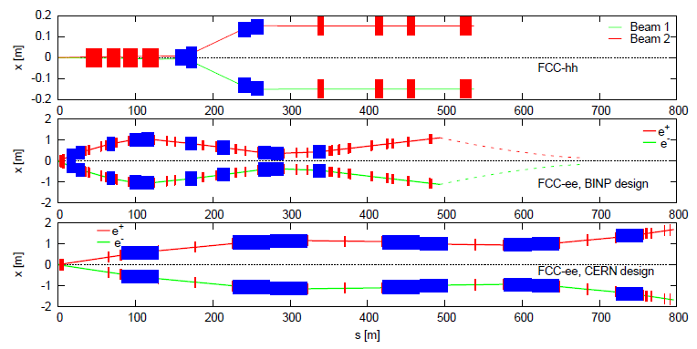
IR layouts
Dipoles in blue
Quadrupoles in red
Tunnel transverse width of both FCC-ee designs ~3-4 m.
Additional length is required to bend beams back, plus room for RF.
Synchrotron rad. power per IP: CERN 140 kW, BINP 1400 kW.
  Optimum between length and power loss to be identified !

Slide 32
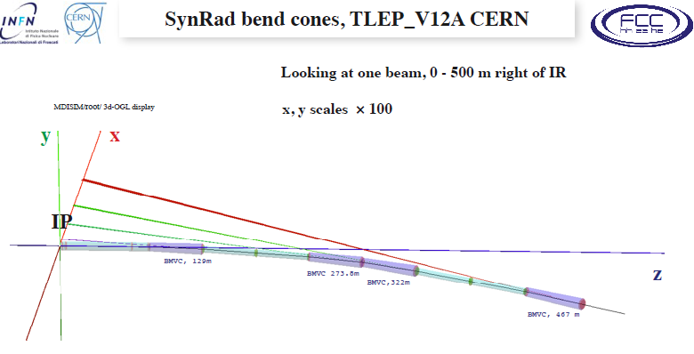
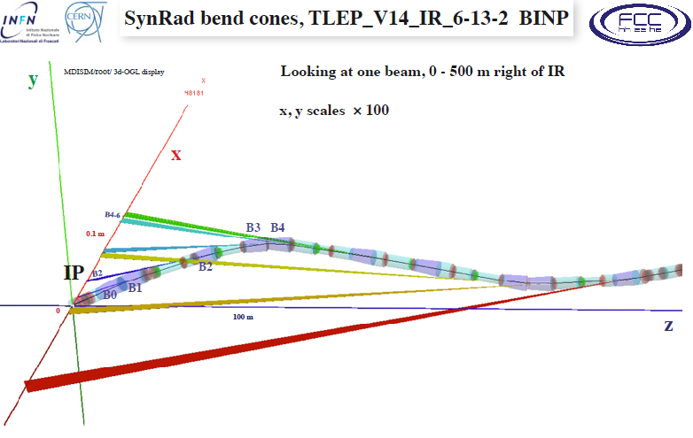
Synchrotron radiation in the IR region is a major issue for TLEP @ top energy
Photon energy very similar to LEP2 (E_{crit}~1 MeV) where this was acceptable with IRs designed for
low synrad + ~100 collimators and local masks, ( L ~ 1.e32cm-2s-1 )
Work for FCC-ee / TLEP only started --- much more to do!
Burkhadrt, Boscolo

Slide 33
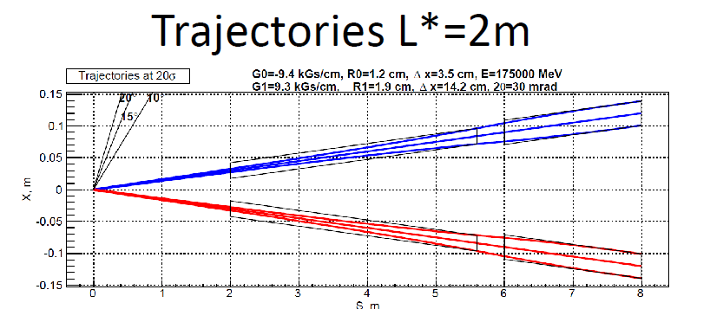
Integration of
-- Luminosity monitors,
-- detector magnetic field and compensation solenoid
-- Vertex detector and beamstrahlung product simulation

Slide 34
Conclusions
adapted from J. Wenninger
A baseline racetrack-like layout has now been defined to begin integration and infrastructure studies. Details like straight section lengths will require more studies for both ee and hh.
  FCC-ee parameter set will be adapted to this layout.
FCC-ee study is in the ‘scoping phase’: identifying issues and possibilities. For now it is “a set of plausible target parameters”.
We can see that it holds great promises... and loads of challenges,
from the layout through the optics to the SC RF system.
The IR is a key item
There is great expertise in the world on these machines. Simulations of the accelerator have started and work on many aspects, in particular the design of the IR, is gaining momentum.
in one year from now we will have a clearer idea on the achievable β* and on the (im-)possible IR layouts !

Slide 35

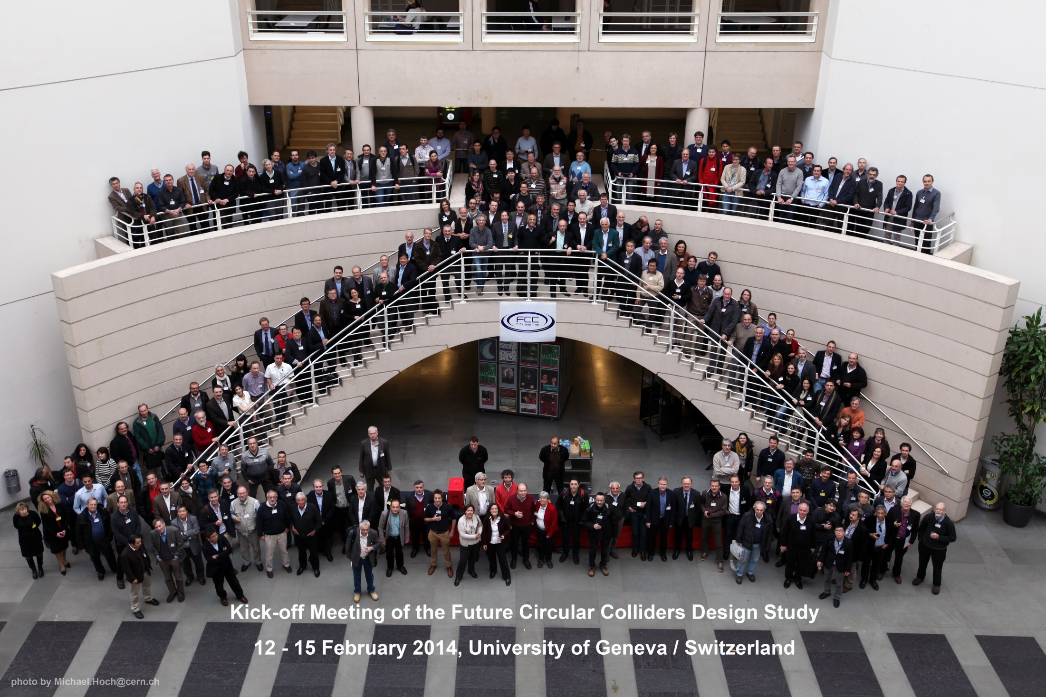
LETS GO AHEAD!
330 registered participants

Slide 36

Proposal for FCC Study Time Line
2014 |  |  |  | 2015 |  |  |  | 2016 |  |  |  | 2017 |  |  |  | 2018
Q1 | Q2 | Q3 | Q4 | Q1 | Q2 | Q3 | Q4 | Q1 | Q2 | Q3 | Q4 | Q1 | Q2 | Q3 | Q4 | Q1 | Q2 | Q3 | Q4
Prepare
Kick-off, collaboration forming,
→study plan and organisation
Ph 1: Explore options
“weak interaction”
Workshop & Review →identification of baseline
Ph 2: Conceptual study of baseline “strong interact.”
Workshop & Review, cost model, LHC results → study re-scoping?
Ph 3: Study
consolidation
4 large FCC Workshops distributed over participating regions
Workshop & Review
→ contents of CDR
Report
Release CDR & Workshop on next steps

Slide 37
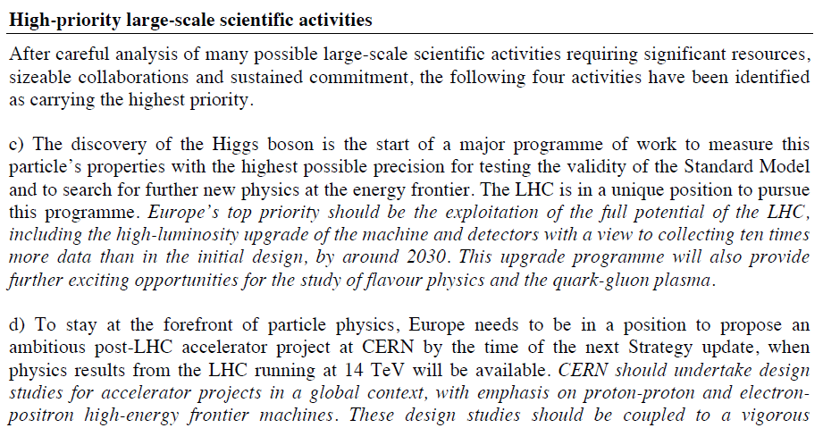
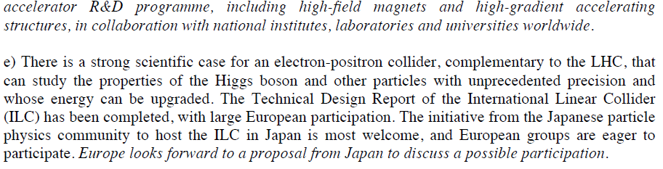
European strategy
LHC and HL-LHC
100 TeV and CLIC
Precision e+e-

Slide 38
FCC-ee design challenges
Short beam lifetime from high luminosity (radiative Bhabha scattering)
Top-up injection (single injector booster in collider tunnel)
Additional lifetime limit from beamstrahlung at top operation energy
Flat beams (small vertical emittance, small vertical β* ~ 1 mm)
Final focus with large (~2%) energy acceptance to reduce losses
Machine layout for high currents, large #bunches at Z pole, WW, H
Two ring layout and configuration of the RF system.
Polarization for high precision energy calibration at Z pole and WW with long natural polarization times (WW: ~10 hours, Z: ~200 hours)
Important expertise available worldwide and potential synergies:
IR design, experimental insertions, machine detector interface, (transverse) polarization
  RHIC, VEPP-2000, BEPC-II, SLC, LEP, B- and Super-B factories, CEPC, ILC, CLIC

