Slide 1
Status of CEPC design
H. Geng, G. Xu, W. Chou, Y. Guo, N. Wang, Y. Peng, X. Cui, Y. Zhang, T. Yue, Z. Duan, Y. Wang, D. Wang, S. Bai, Q. Qin, J. Gao, F. Su, M. Xiao
IHEP, CAS, China
XXI Cracow EPIPHANY Conference on Future High Energy Colliders, Cracow, Poland
January 8-10, 2015

Slide 2
Outline
Introduction on CEPC activities at IHEP
Accelerator physics design
Technical system design
Pre-CDR status
Concluding remarks

Slide 3
Introduction on CEPC activities at IHEP

Slide 4
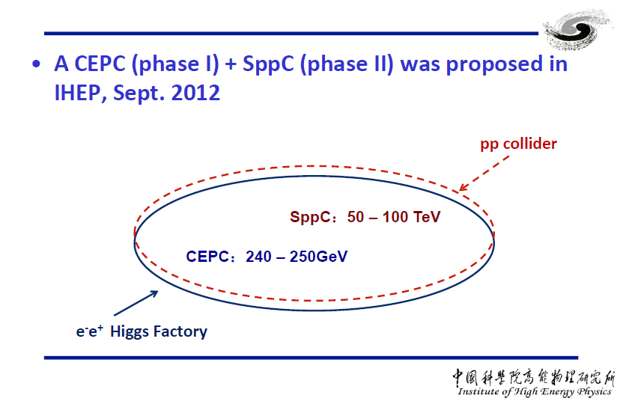
CEPC + SppC was proposed
See Q. Qin’s talk at HF2012

Slide 5
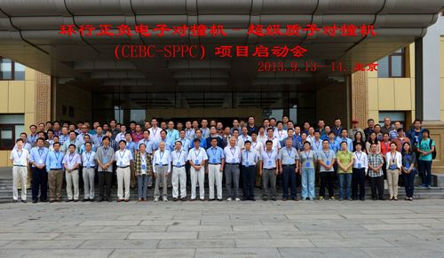
CEPC+SppC Kick off
CEPC+SppC Kick off Meeting, Sept. 13-14,2013, Beijing）
About 110 participants and 20 institutions registered.

Slide 6
CEPC+SppC organization formed
Steering Committee
Y.F. Wang(IHEP) , Y.N. Gao (TU), J. Gao (IHEP), X.C. Lou (IHEP), Q. Qin (IHEP), H.J. Yang (SJTU)，L. Han (USTC), S. Jin (IHEP), H.J. He (TU),
S.H. Zhu (PKU), Y.J. Mao (PKU)
Institutional Board
Y.N. Gao (TU)
J. Gao (IHEP)
Project Directors
X.C. Lou(IHEP)
Q. Qin (IHEP)
Theroy
H.J. He (TU)
S.H. Zhu (PKU)
Accelerator
Q. Qin (IHEP)
J. Gao (IHEP)
Detector
S. Jin (IHEP)
Y.N. Gao (TU)

Slide 7
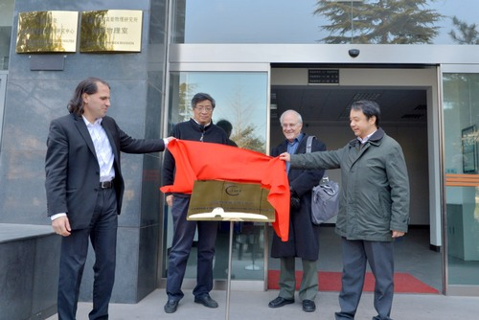
CFHEP was founded
Center for Future High Energy Physics was founded on December 17, 2013
Director: Nima Arkani-Hamed (IAS, USA)
Deputy Director: Cai-Dian Lu (IHEP, China)
Academic Committee:
Sally Dawson (BNL, USA), Tao Han (U. Pittsburgh/Tsinghua U.), et. al.
Advisory Board:
Chao-Hsi Chang (ITP), Kuang-Ta Chao (Peking U.) , et. al.
Administration secretary:
CHEN Li chenli@ihep.ac.cn , 88236147, Room203
DANG Lei dangl@ihep.ac.cn , 88200974, Room303

Slide 8
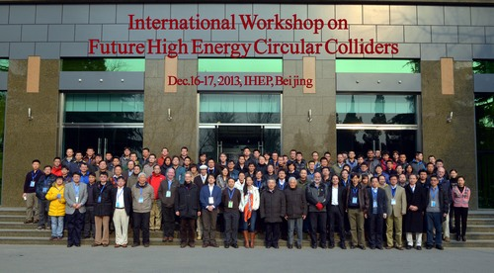
CFHEP workshops
Workshop on Future High Energy Circular Colliders---December 16-17, 2013 Beijing, China
1st CFHEP Symposium on circular collider physics---February 23-25, 2014 Beijing, China
2nd CFHEP Symposium on circular collider physics---August 11-15, 2014 Beijing, China
Flavor and top physics @ 100 TeV workshop---March 4-7, 2015 Beijing, China

Slide 9
Pre-CDR for accelerator design
4 | CEPC - accelerator physics
4.1 | Main parameters | Guo Yuanyuan, Geng Huiping, Wang Dou, Xiao Ming, Gao Jie
4.2 | Lattice | Geng Huiping, Wang Dou, Guo Yuanyuan, Wang Na,
 |  | Wang Yiwei, Xiao Ming, Peng Yuemei, Bai Sha, Su Feng, Xu Gang, Duan Zhe, Gao Jie
4.3 | IR and MDI | Wang Dou, Geng Huiping, Wang Yiwei, Bai Sha, , Gao Jie
4.4 | Beam instability | Wang Na, Wang Yiwei
4.5 | Beam-beam effects | Zhang Yuan, Guo Yuanyuan, Wang Dou, Xiao Ming, Gao Jie
4.6 | Synchrotron radiation | Ma Zhongjian, Geng Huiping
4.7 | Injection and beam dump | Cui Xiaohao, Su Feng, Xu Gang
4.8 | Background | Yue Teng
4.9 | Polarization | Duan Zhe
Visitors from other labs in the world participate the Pre-CDR joint works

Slide 10
Accelerator activities
Visitors name | Period | Topics
Dick Talman | April 13th –May 15th | Parameters and other topics
Armen Apyan | April 1st –April 30th | GuineaPig and CAIN
Yoshihiro Funakoshi | April 1st-April 15th | Parameter, injection and others
Dmitry Shatilov | April 1st- April 16th | Beam-beam simulation
Kazuhito Ohmi | April 16th-April 30th | Beam-beam simulation
Yunhai Cai | April 16th –April 30th | Lattice and FFS
Yuhong Zhang | April 16th-April 30th | Electron proton collider

Slide 11

HF2014 is hosted by IHEP
HF2014 is focused on a circular e+e- collider design for a Higgs factory.

Slide 12
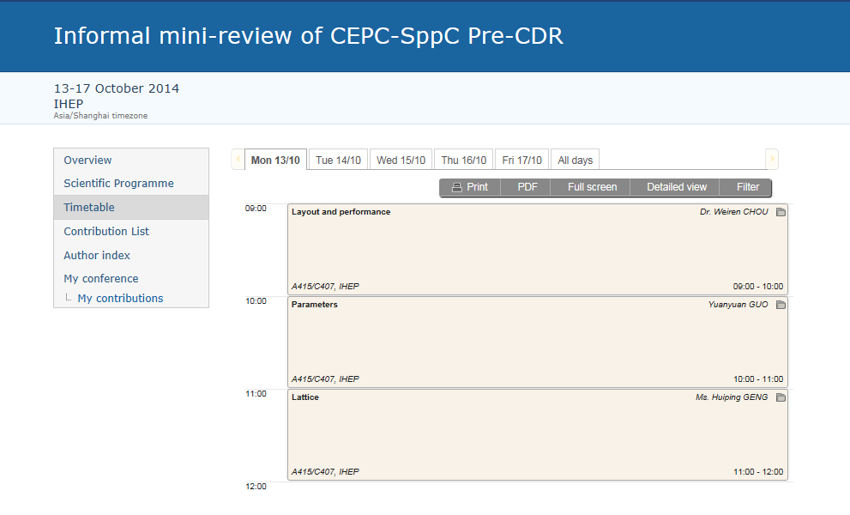
CEPC informal mini-revew
Both accelerator physics and technical systems were reviewed.

Slide 13
Accelerator physics design

Slide 14
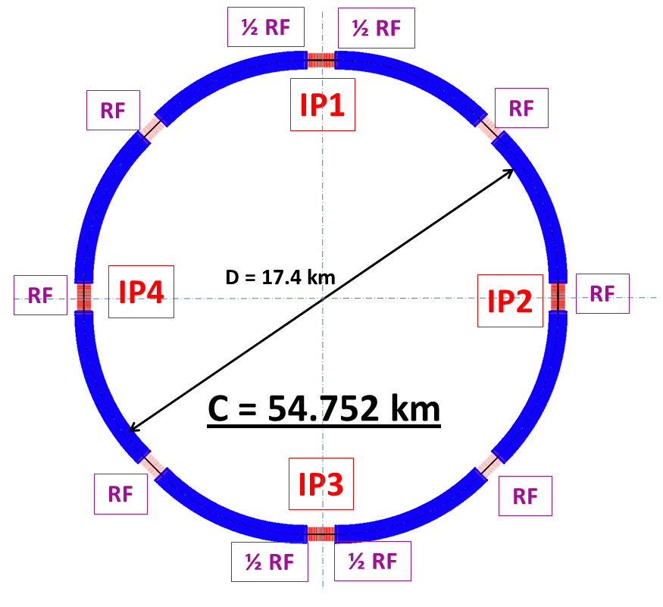
General info of CEPC
CEPC is a Circular Electron Positron Collider to study the Higgs boson
Critical parameters:
  Beam energy: 120GeV
  Circumference: 54 km
  SR power: 51.7 MW/beam
  8*arcs
  2*IPs
  8 RF cavity sections (distributed)
  Filling factor of the ring: ~70%
Length of the straight sections are compatible with SppC requirement

Slide 15
Priliminary CEPC parameter list
Parameter | Unit | Value | Parameter | Unit | Value
Beam energy [E] | GeV | 120 | Circumference [C] | m | 54752
Number of IP[N_{IP}] |  | 2 | SR loss/turn [U₀] | GeV | 3.11
Bunch number/beam[n_{B}] |  | 50 | Bunch population [Ne] |  | 3.79E+11
SR power/beam [P] | MW | 51.7 | Beam current [I] | mA | 16.6
Bending radius [ρ] | m | 6094 | momentum compaction factor [α_{p}] |  | 3.36E-05
Revolution period [T₀] | s | 1.83E-04 | Revolution frequency [f₀] | Hz | 5475.46
emittance (x/y) | nm | 6.12/0.018 | β_{IP}(x/y) | mm | 800/1.2
Transverse size (x/y) | μm | 69.97/0.15 | ξ_{x,y}/IP |  | 0.118/0.083
Beam length SR [σ_{s.SR}] | mm | 2.14 | Beam length total [σ_{s.tot}] | mm | 2.65
Lifetime due to Beamstrahlung (simulation) | min | 47 | lifetime due to radiative Bhabha scattering [τ_{L}] | min | 52
RF voltage [V_{rf}] | GV | 6.87 | RF frequency [f_{rf}] | MHz | 650
Harmonic number [h] |  | 118800 | Synchrotron oscillation tune [ν_{s}] |  | 0.18
Energy acceptance RF [h] | % | 5.99 | Damping partition number [Jε] |  | 2
Energy spread SR [σ_{δ.SR}] | % | 0.132 | Energy spread BS [σ_{δ.BS}] | % | 0.119
Energy spread total [σ_{δ.tot}] | % | 0.163 | n_{γ} |  | 0.23
Transverse damping time [n_{x}] | turns | 78 | Longitudinal damping time [n_{ε}] | turns | 39
Hourglass factor | Fh | 0.658 | Luminosity /IP[L] | cm⁻²s⁻¹ | 2.04E+34

Slide 16
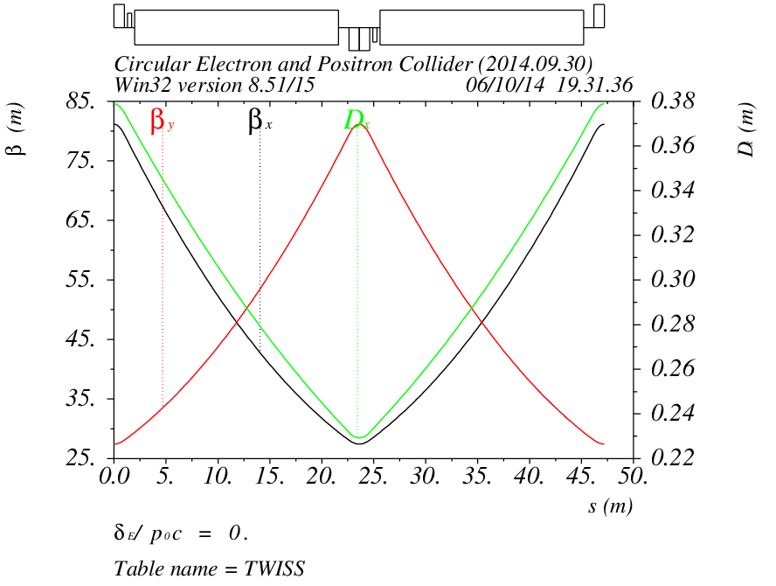
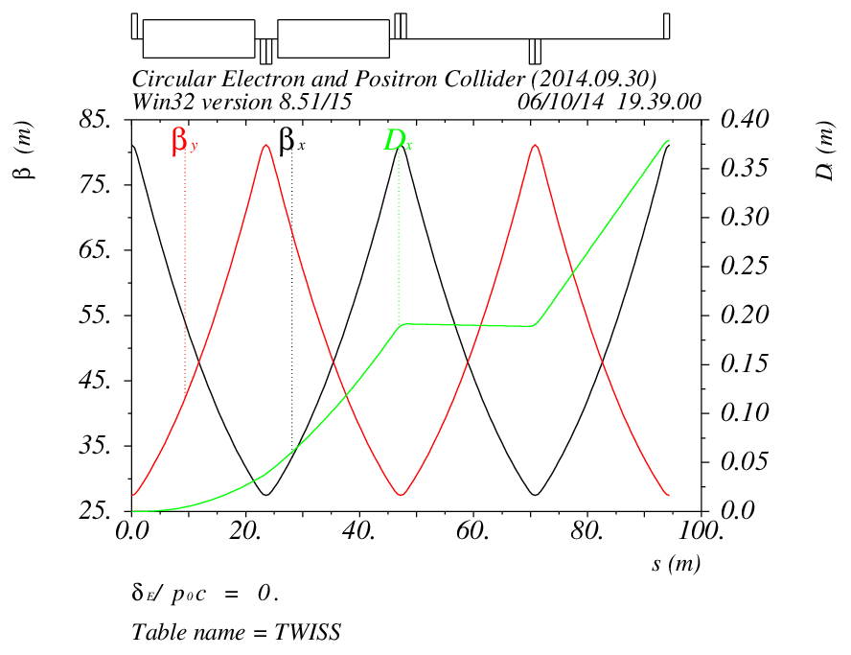
Lattice of arc sections
Length of FODO cell: 47.2m
Phase advance of FODO cells: 60/60 degrees
Dispersion suppressor on each side of every arc
Length: 94.4m

Slide 17
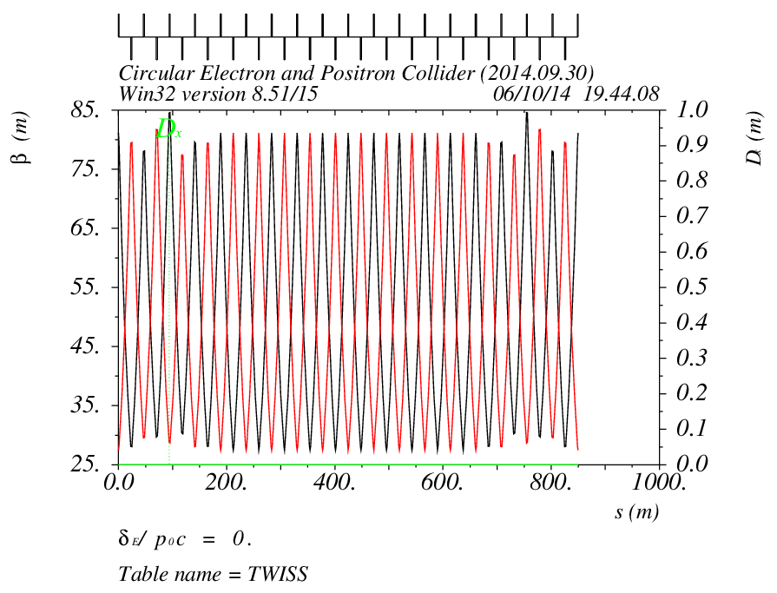
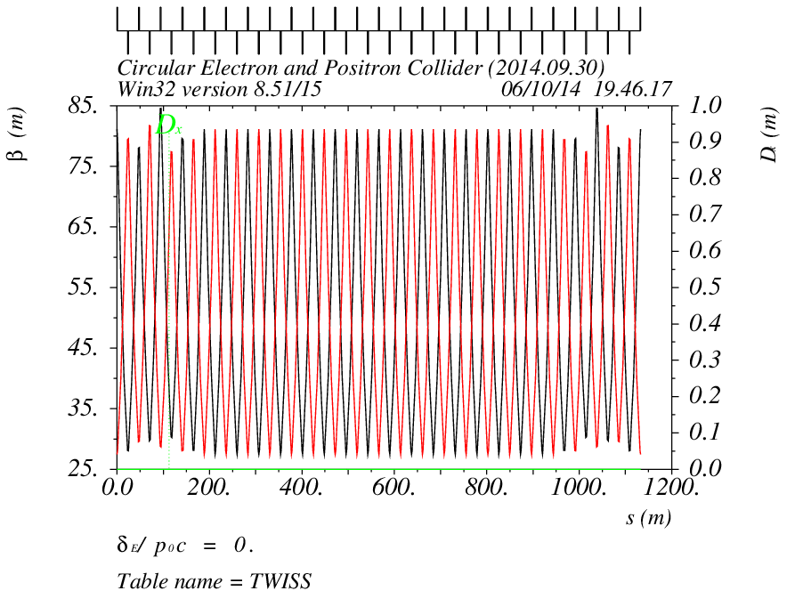
Lattice of straight sections
Short straight: 18 FODO cells
Length: 849.6
Long straight: 24 FODO cells
Length: 1132.8m

Slide 18
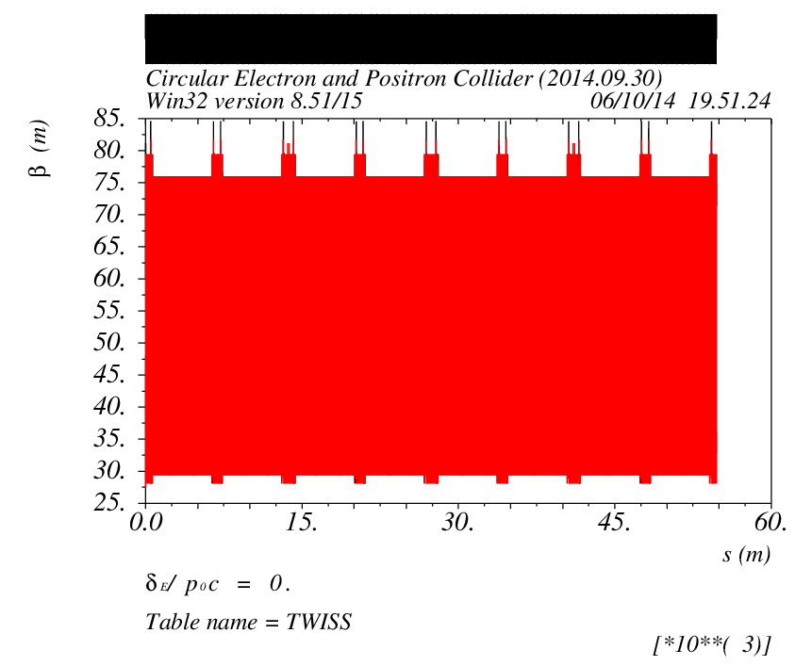
Lattice of the main ring
Four superperiod, with 2 IPs
Total length is 54.752km

Slide 19
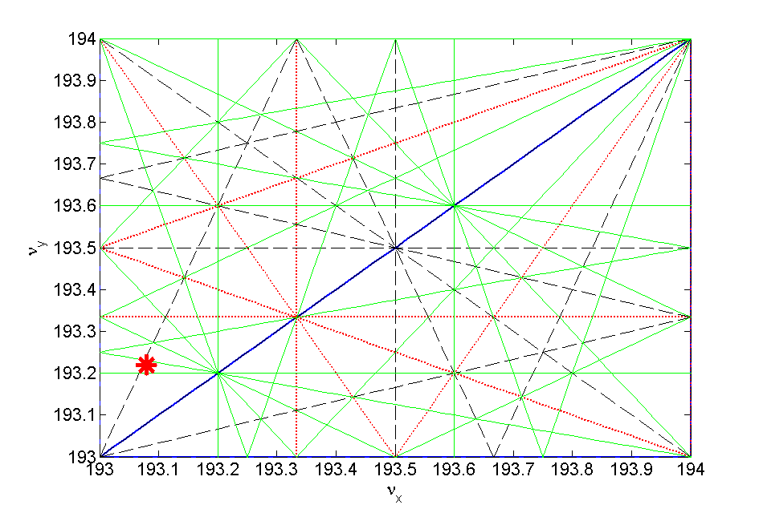
Work point
The working point is chosen as: 193.08/193.22 in horizontal and vertical
Optimization is done with beam-beam simulations, to have a high luminosity

Slide 20
Chromatic correction (1)
Two families of sextupoles: one family for horizontal, one family for vertical plane
One sextupole next to each quadrupole in the arc section

Slide 21
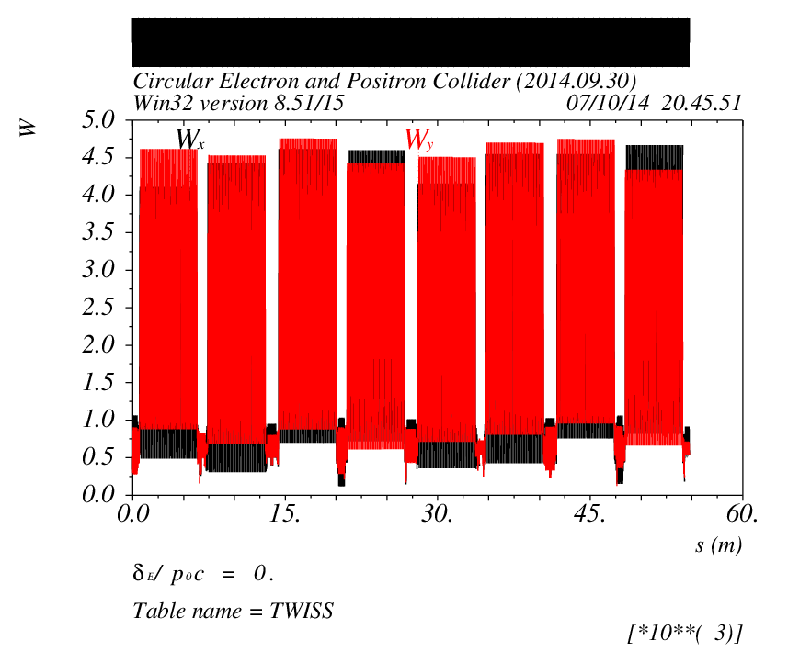
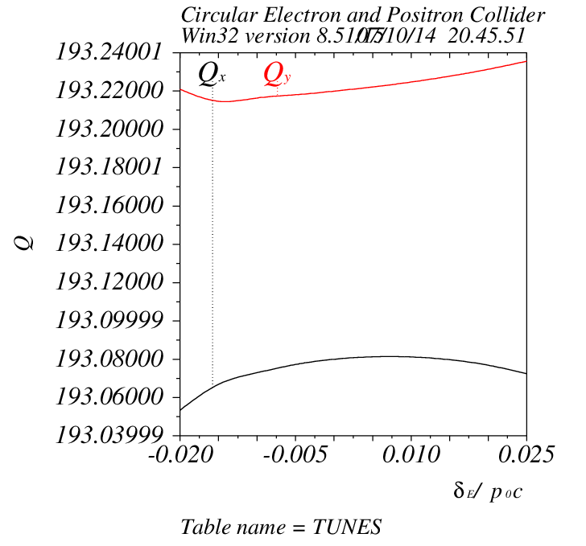
Chromatic correction (2)
The W function for the ring is only a few
The chromaticity in both planes has been corrected to a positive value

Slide 22
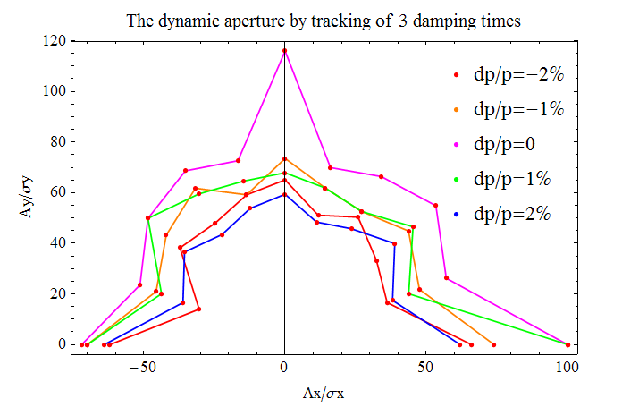
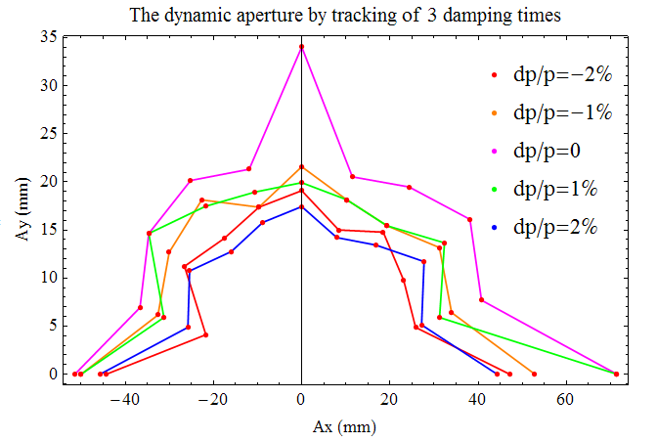
Dynamic aperture
240 turns is tracked for dynamic aperture
Full coupling is assumed for vertical plane
The dynamic aperture is: ~ 60σ_{x}/60σ_{y} or 40mm/16mm in x and y for ±2% momentum spread

Slide 23
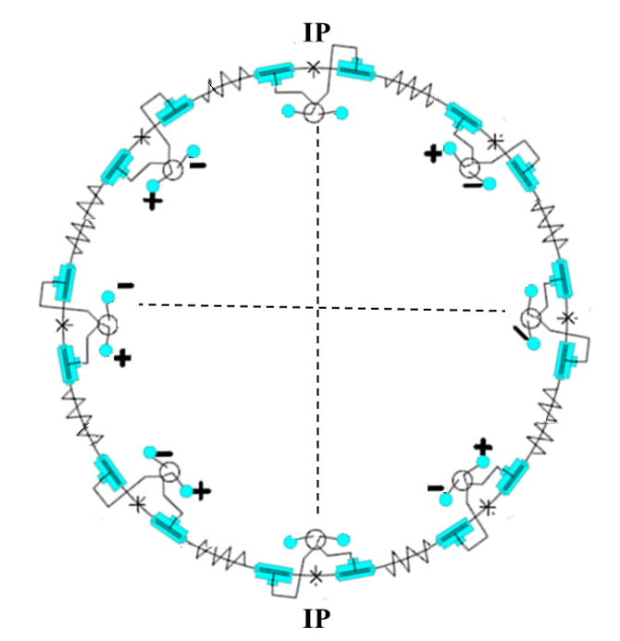
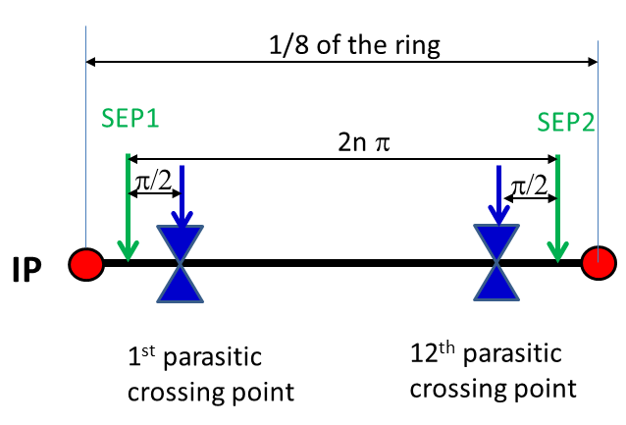
Pretzel scheme
Horizontal separation is adopted to avoid big coupling
No orbit in RF section to avoid beam instability and HOM in the cavity
One pair of electrostatic separators for each arc

Slide 24
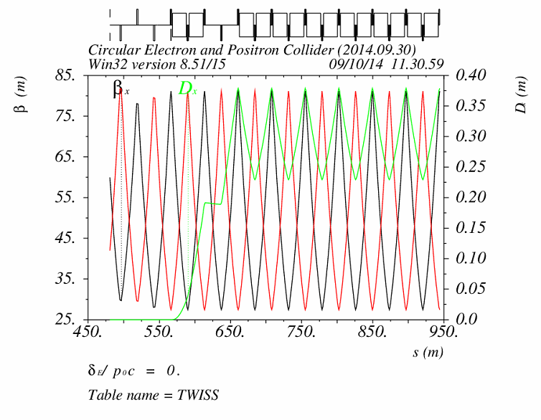
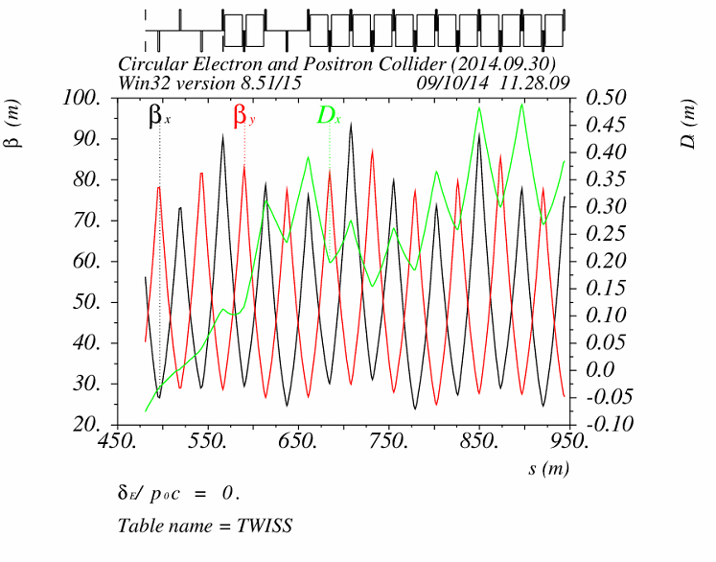
Effects of pretzel orbit
Pretzel orbit has effects on:
  Beta functions, thus tune
  Dispersion function, thus emittance
  Dynamic aperture
Sextupoles ON
w/o pretzel orbit
w/ pretzel orbit

Slide 25
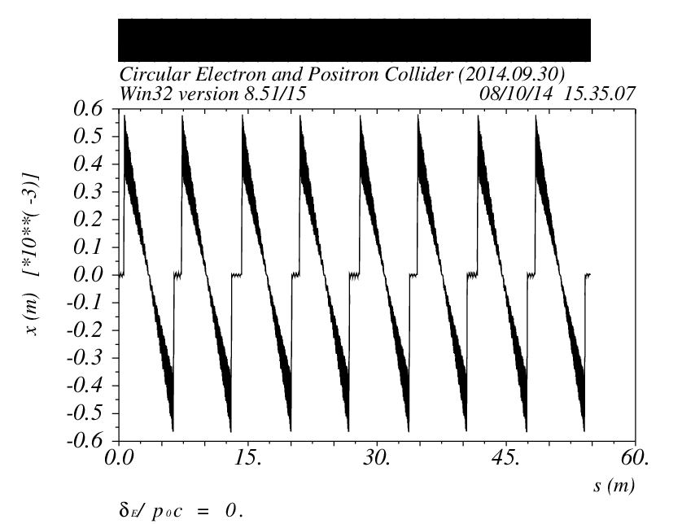
Sawtooth orbit
The energy sawtooth phenomenon has been raised and studied by K. Oide in HF2012
The total synchrotron radiation energy loss in CEPC ring is 3GeV
The beam will have 0.3% energy difference between the entrance and exit of each arc
The maximum orbit distortion is ~0.6 mm

Slide 26
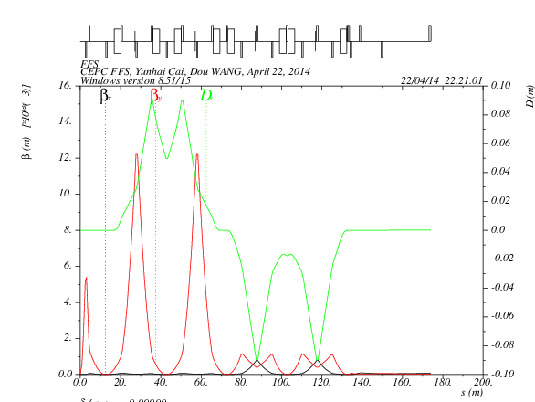
Final Focus System
DX=DPX=0
αx=αy=0
betax=84m
betaY=28m
betaX*=0.8m
betaY*=0.0012m
L*=2.5m
On momentum
Total length: 170 m
Off momentum:
±2%, ± 1%
No enough dynamic aperture yet w/o pretzel orbit.

Slide 27
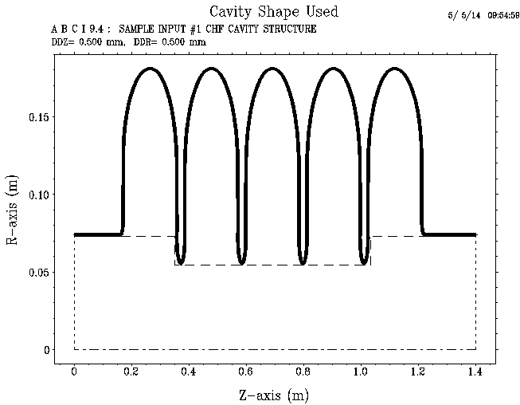
Impedance budget
Resistive wall impedance is calculated with analytical formulas
Impedance of the RF cavities is calculated with ABCI
Object | Contributions
 | R [kΩ] | L [nH] | k_{loss} [V/pC] | |Z///n|_{eff} [Ω]
Resistive wall (Al) | 16.8 | 214.4 | 552.1 | 0.0075
RF cavities (N=378) | 40.1 | -- | 1313.6 | ---
Total | 56.9 | 214.4 | 1865.7 | 0.0075

Slide 28
Single-bunch effects
Parameter | Symbol, unit | Value
Beam energy | E, GeV | 120
Circumference | C, km | 53.6
Beam current | I₀, mA | 16.6
Bunch number | n_{b} | 50
Natural bunch length | σ_{l0}, mm | 2.58
Emittance (horz./vert.) | ε_{x}/ε_{y}, nm | 6.79/0.02
RF frequency | f_{rf}, GHz | 0.7
Harmonic number | h | 125208
Natural energy spread | σ_{e0} | 1.5E−3
Momentum compaction factor | α_{p} | 4.15E−5
Betatron tune | ν_{x}/ν_{y} | 179.08/179.22
Synchrotron tune | ν_{s} | 0.206
Damping time (H/V/s) | τ_{x}/τ_{y}/τ_{z}, ms | 14/14/7

Slide 29
Coherent synchrotron radiation
  σ_{z}ρ^{1/2}/h^{3/2}=35.2 (=> CSR shielded)
  The threshold of bunch population for CSR is given by
  The CSR threshold in BAPS is N_{b,Th} = 1.5×10¹³ >> N_{b} = 3.7×10¹¹.
  CSR is not supposed to be a problem in BAPS.
(K. Bane, Y. Cai, G. Stupakov, PRST-AB, 2010)
Space charge tune shift
Δν_{y} = −1.8e−4, Δν_{x} = −5.2e−6

Slide 30
Transverse mode coupling instability (TMCI)
  The threshold of transverse impedance is |Z⊥| < 11.7 MΩ/m.
  The equivalent longitudinal impedance is 0.18 Ω, which is much larger than that of the longitudinal instability.
Eigen mode analysis
  Considering only resistive wall impedance
  Beam current threshold:
  I_{b}^{th}=0.76mA (I₀th=38mA)

Slide 31
Multi-bunch effects
Transverse resistive wall instability
with ω_{pn} = 2πf_{rev} × (pn_{b} + n + ν_{x,y})
The growth rate for the most dangerous instability mode is 36 Hz (τ=28 ms) in the vertical plane with mode number of μ = 21.
The growth time is higher than the transverse radiation damping time.
The resistive wall instability is not supposed to happen in the main ring!
Growth rate vs. mode number in the vertical plane

Slide 32
Electron cloud instability
 | KEKB | SuperKEKB | SuperB | CEPC
Beam energy E, GeV | 3.5 | 4.0 | 6.7 | 120
Circumference L, m | 3016 | 3016 | 1370 | 53600
Number of e⁺/bunch, 10¹⁰ | 3.3 | 9 | 5.74 | 37.1
Emittance H/V ε_{x}/ε_{y}, nm | 18/0.36 | 3.2/0.01 | 1.6/0.004 | 6.79/0.02
Bunch length σ_{z}, mm | 4 | 6 | 5 | 2.58
Bunch space Lsp, ns | 2 | 4 | 4 | 3575.8
Single bunch effect
Electron freq. ω_{e}/2π, GHz | 35.1 | 150 | 272 | 191.4
Phase angle ω_{e}σ_{z}/c | 2.94 | 18.8 | 28.5 | 10.4
Threshold density ρ_{e,th}, 10¹²m⁻³ | 0.7 | 0.27 | 0.4 | 1.15
Multi-bunch effect
p-e per meter n_{γ}, p/(m) | 5.0E8 | 1.5E9 | 3.6E9 | 1.1E10
Characteristic frequency ω_{G}, MHz | 62.83 | 87.2 | 69.6 | 5.92
Phase angle ω_{G}L_{sp}/c | 0.13 | 0.35 | 0.28 | 21.2
Threshold density for the single bunch effect is considerable high.
The phase angle for the multi-bunch effect is about two orders higher, so the electrons are not supposed to accumulate and the multipacting effects is low.

Slide 33
Beam ion instability
Ion trapping
  With uniform filling pattern, the ions with a relative molecular mass larger than A_{x,y} will be trapped.
Fast beam ion instability
  With uniform filling, the growth time considering ion oscillation frequency spread is 11ms, which is lower than the damping time.
  Fast beam ion instability could occur with uniform filling.
  The ions will not be trapped by the beam.

Slide 34
Beam lifetimes caused by different
sources in CEPC
  Quantum lifetime
  Radiation Bhabha lifetime
  Simulated by BBBREM

Slide 35
Beam lifetimes caused by different
sources in CEPC
  Beam-gas lifetime
  Touschek lifetime
Courtesy of N. Wang

Slide 36
Detailed Luminonisty/Beam Sizes evaluation were performed, thanks to K. Ohmi, D. Shatilov and Y. Zhang
Beam beam simulations
Courtesy of K. Ohmi

Slide 37
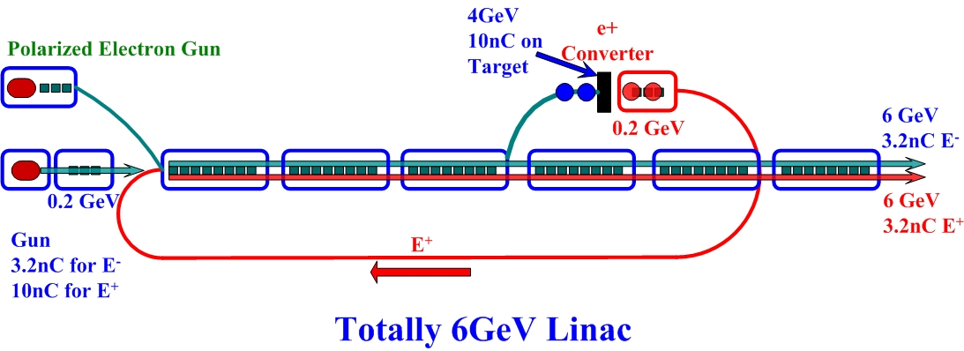
Booster design
Courtesy of C. Zhang
FODO cell
ARC

Slide 38
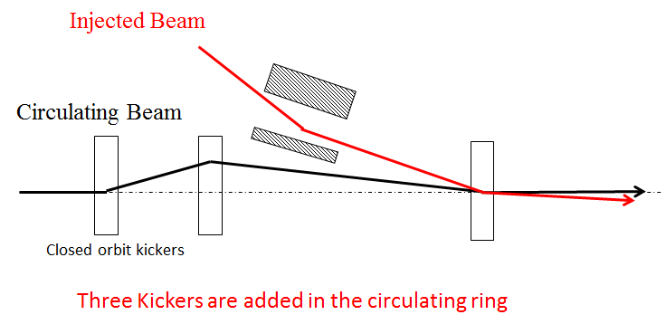
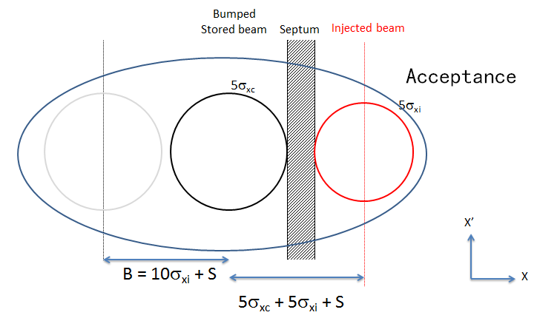
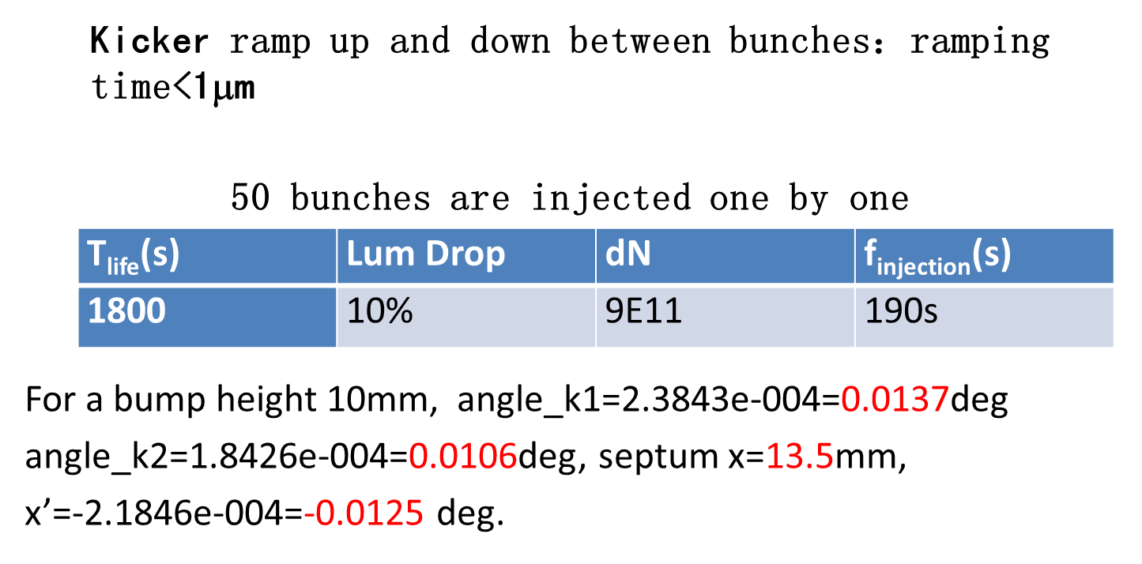
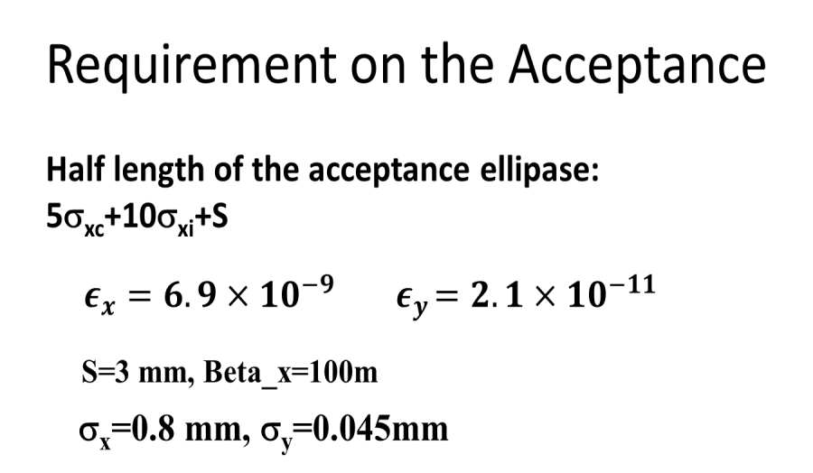
Beam injection scheme
Courtesy of X. Cui

Slide 39
Injection linac-1
Beam energy:
E_{linac} = 6GeV
Energy Spread:
s_{E}<1×10⁻³；
Bunch population:
N_{bunch, booster}=(5%× N_{bunch,collider})/0.9=2×10¹⁰
Bunch structure:
f_{rep}= 50-100Hz, Dt=0.7 ns,
Emittance:
Depending on aperture selection of the booster. A=Y²/b_{max}. Y=16mm, b_{max}=130m, A～2 mm⋅mrad, e～0.05A～0.1 mm ⋅ mrad
Polarized beams?
Courtesy of X. Li

Slide 40
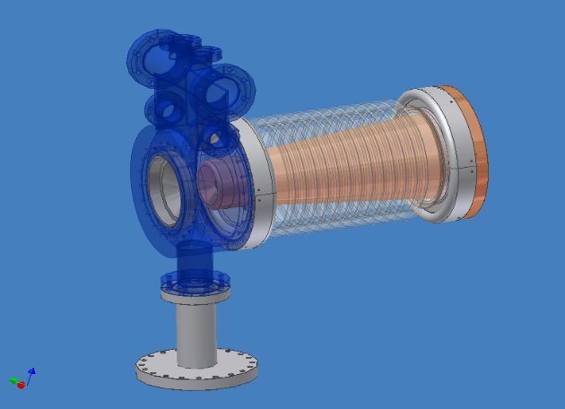
Electron Source
Unpolarized Conventional Electron Source
High Voltage = 150 kV
Beam Radius ~ 3.0mm (at gun anode, beam current is 6.0A)
Courtesy of X. Li
BII Electron Gun

Slide 41
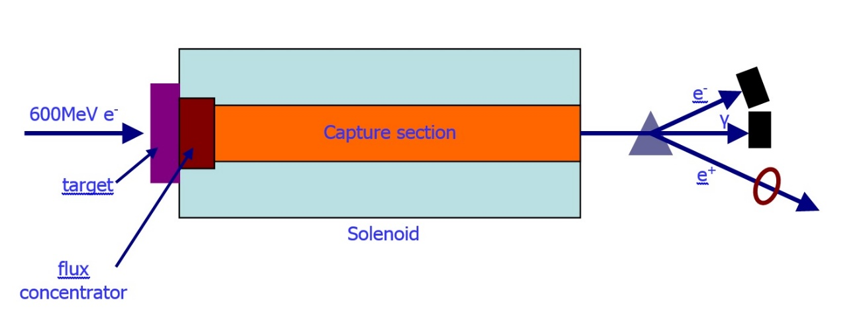
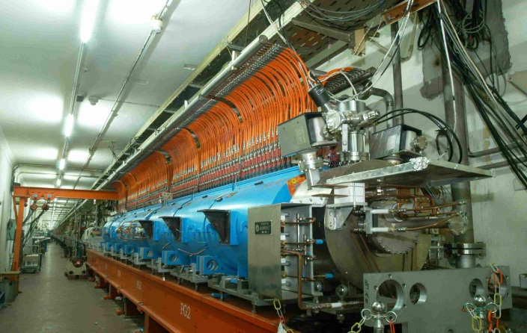
Positron Source
Unpolarized Positron Source
Conventional Positron Source
Courtesy of X. Li
For BII
Electron beam at Target 240MeV, 8A
Positron beam 80mA
For CEPC
Electron energy at Target 600MeV
Positron beam
BII Positron Source

Slide 42
Technical system design

Slide 43
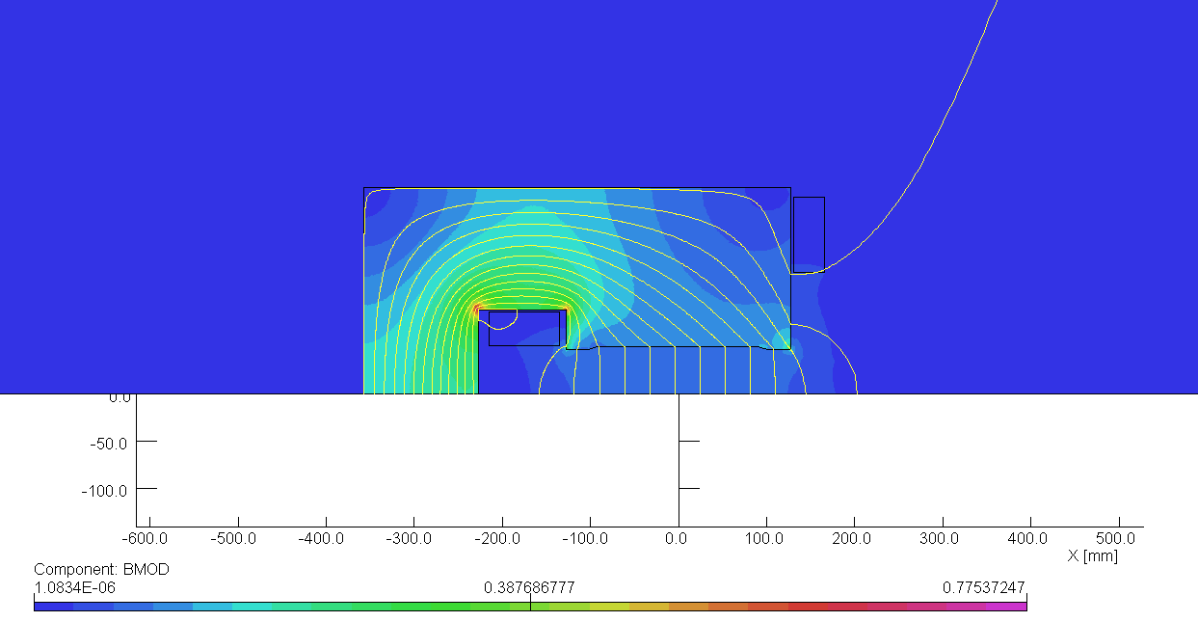
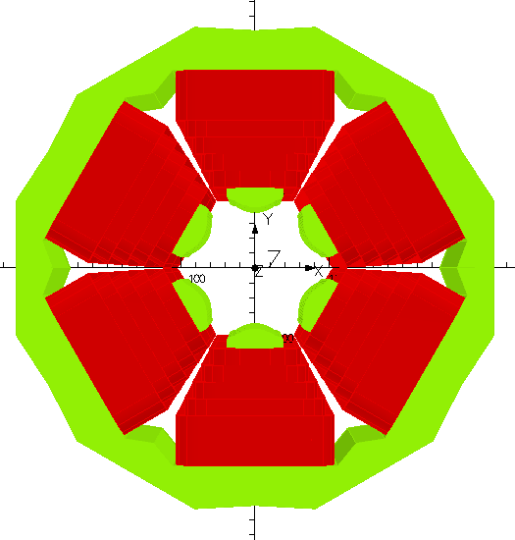
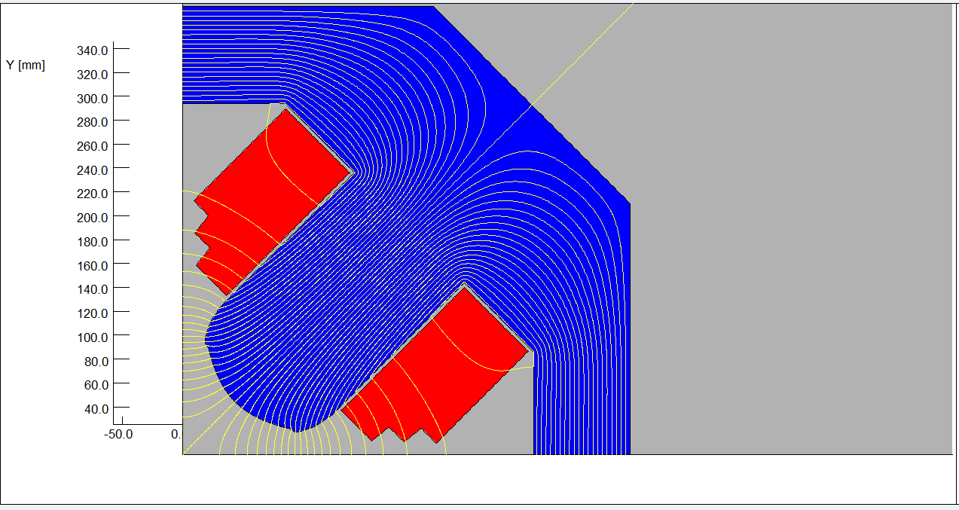
CEPC magnet deisgn
Dipole
2432 dipole magnets, length 19m
1436 quadrupole magnets, length: 1m
1280 sextupole magnets, length: 0.4m
Prototype will be made and tested first
Sextupole
Quadrupole
Courtesy of W. Kang

Slide 44
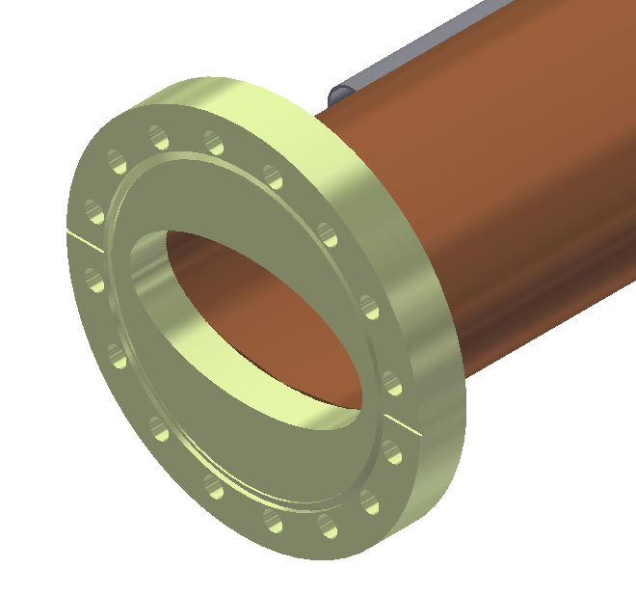
Vacuum chamber material
Courtesy of H. Dong
CEPC copper vacuum chamber
(elliptical100×55, thickness 6, length 8000)
LEP aluminum vacuum chamber (11.7m long)
Copper is prefered in CEPC dipole chamber design.
SR power, gas load, pumping system, vacuum measurement and control were considered and designed in detail.

Slide 45
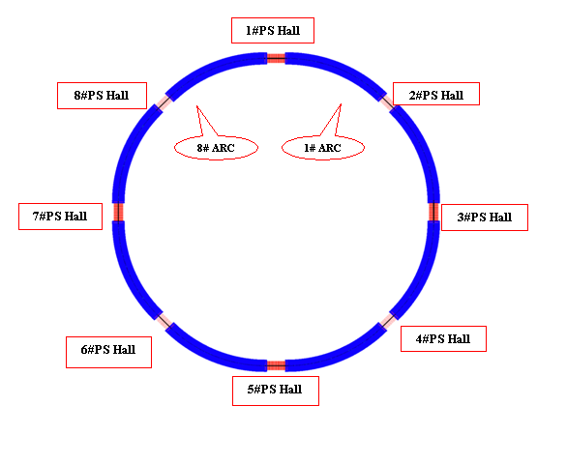
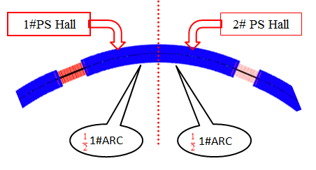
Power supply considerations
On surface
In order to save magnet cables, power supplies at each arc will be provided by two adjacent PS halls.
Power supplies for bending magnets, quadrupoles, sextupole and correctors are considered.
The number of power supplies and the required power are calculated.
Courtesy of F. Long

Slide 46
Beam instrumentation system
Beam position monitor
Beam current monitor
Beam loss monitor
Beam profile and length measurement
Beam collimator
Tune measurement system
Feedback system
Luminosity measurement system
Courtesy of J. Yue

Slide 47
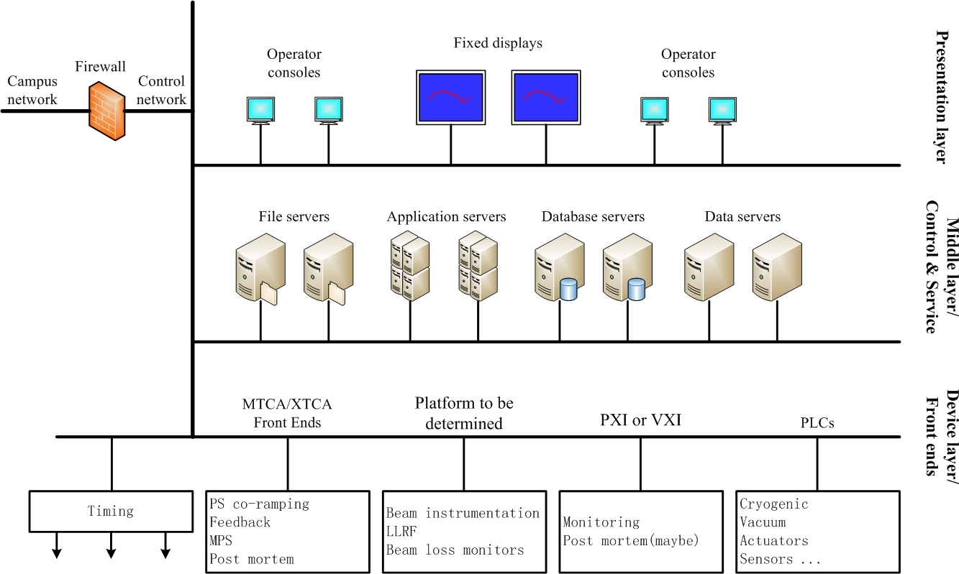
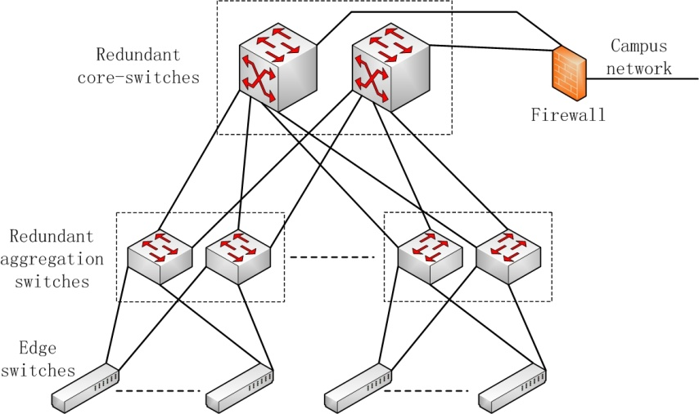
Control system design
Large scale control platform, including software and hardware
Synchronized acceleration in the booster ring.
Large scale and high accuracy timing.
Machine protections.
Post mortem recording and analysis...
Courtesy of D. Jin

Slide 48
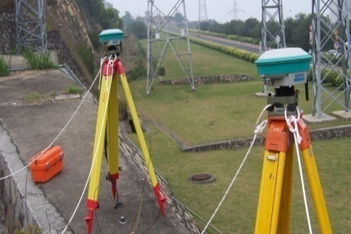
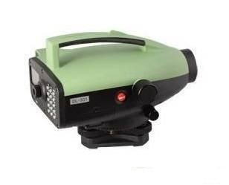
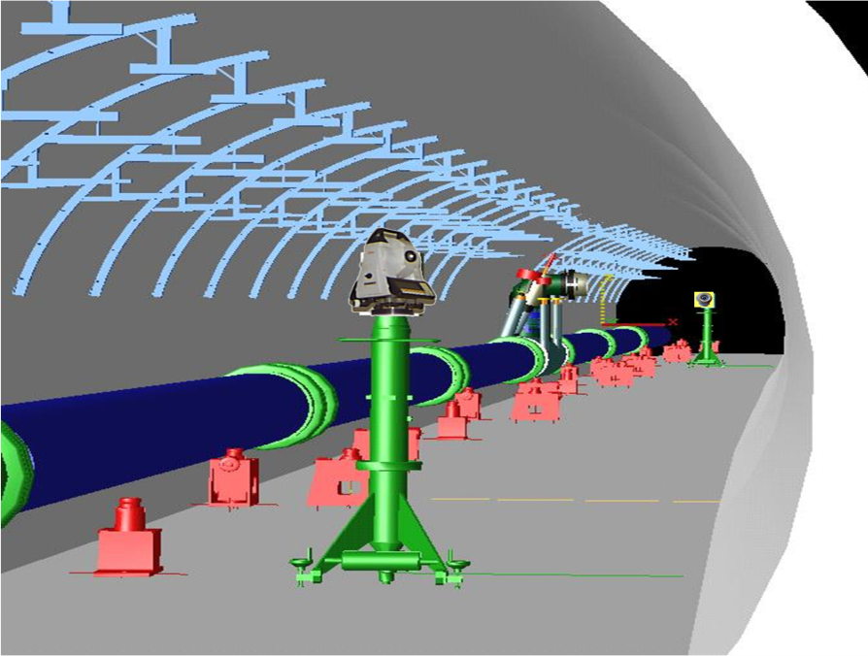
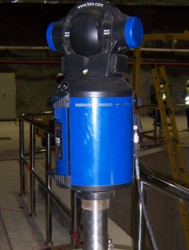
Survey and Alignment system
CEPC Geodetic Control Network Design
CEPC Tunnel Control Network Design
Fiducialization Scheme for the Major Components
Alignment Scheme for Accelerator Components in Tunnel
Courtesy of L. Dong

Slide 49
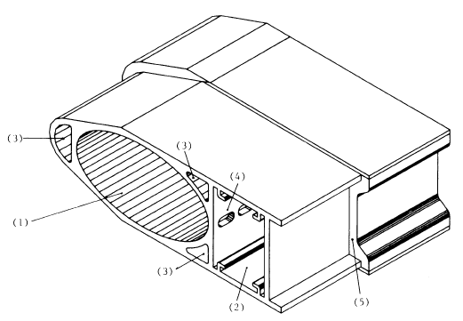
Shielding system design
  Synchrotron Radiation Parameters calculated
  realizable shielding structure design for the beam pipe can be critical
    LEP vacuum chamber structure was adopted preliminary
  Shielding model and method were important
    Simulation programs: FLUKA & MCNP
    Model building and simulation were independently for verification
Courtesy of Z. Ma
  Primary shielding simulating results focus on
    The correct method/model for shielding simulation
    Gamma flux/spectrum/attenuation VS different Pb thickness

Slide 50
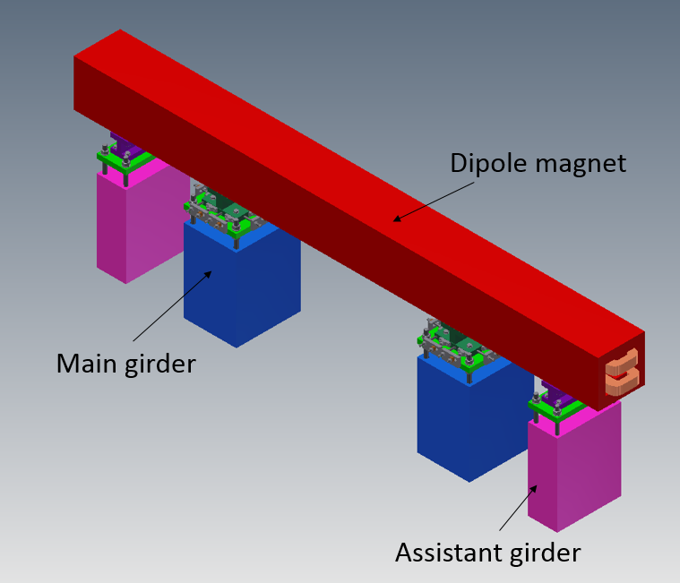
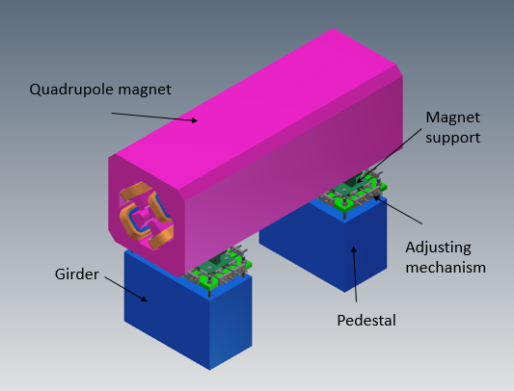
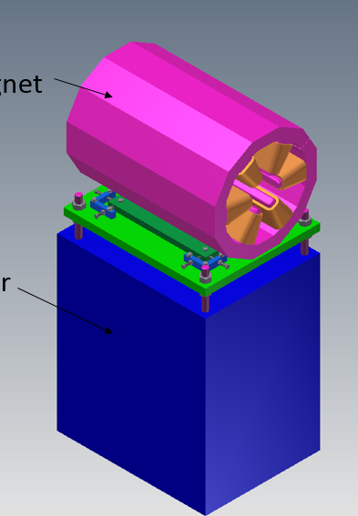
Girder system design
Dipole girder system
Quadrupole girder system
Sextupole girder system
Booster girder system
Courtesy of W. Kang

Slide 51
Cryogetic system design
The total heat loads of CEPC cryogenic system was estimated.
The required refrigeration capacity is similar as that in LHC cryogenic system, which is the biggest in the world.
The helium inventory is not so large and it is about 9.6% of LHC.
The electric power consumption is huge and about 5.6% of CEPC.
Courtesy of S. Li

Slide 52
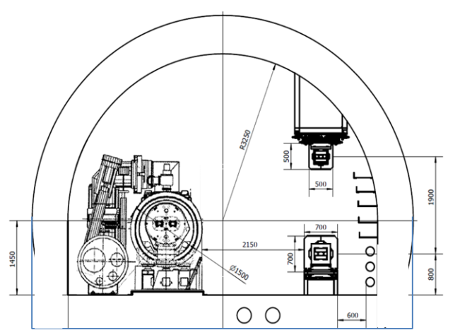
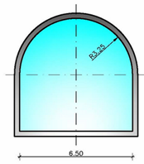
Conventional facilities design
  The normal tunnel cross-section is divided into three parts:
    The outer side of the main ring:
      where the CEPC machine components and services will be installed. The booster machine components will be installed on the top of CEPC machine ring.
    The inner side of the main ring (reserved for SppC)
    Middle area of the main ring:
      which is set aside for handling and transporting equipments
Courtesy of G. Lin
Portal-shaped cross section

Slide 53
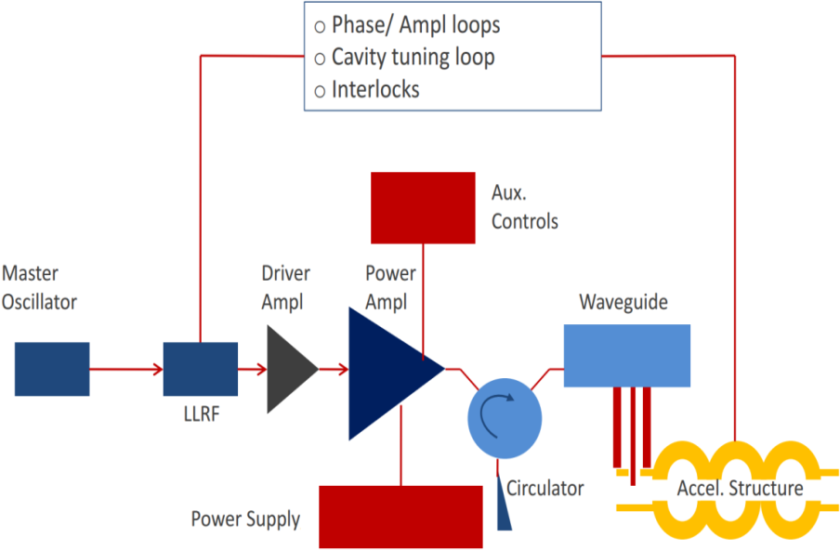
Power source design
Collider ring
Booster ring
Source options @1.3GHz/20kW level
  Klystrons become costly per W at low power and lowest cost verisons only ~ 40 % efficient;
  IOTs have higher efficiency (~ 60 %) but higher cost;
  Solid State Amplifiers (SSAs) cost competitive but currently have low efficiency (35%) - however, high availability (modular), and cost likely to decrease and efficiency increase (expect > 40 % soon).
The RF power delivered by the klystron will be fed into the cavity via a WR1500 waveguide as well as a circulator.
So Booster source option is Solid State Amplifier (SSA)
Courtesy of Z. Zhou

Slide 54


SC RF system design
Energy acceptance, bunch length (~ f ^{-0.5} )
HOM impedance and power (∥ ~ f ², ⊥~ f ³)
Cavity size and cost (~ f ⁻² )
Cryogenic heat load (~ f ^{-0.5} @ low T, ~ f @ high T)
Booster current 1/20 of collider (higher f)
Use mature tech and synergy with other projects (ILC, XFEL, ADS…)
Thus
CEPC collider RF frequency = 650 MHz
CEPC booster RF frequency = 1.3 GHz
But, booster has lower energy and very weak radiation damping =>
beam instability caused by the 1.3 GHz cavity should be studied =>
Longer collider beam life time may reduce booster bunch charge (3 to < 1 nC)
Courtesy of Y. Sun

Slide 55
Pre-CDR status

Slide 56
Draft of Pre-CDR is completed
Introduction
Sciences of CEPC and SPPC
Machine Layout and Performance
CEPC – Accelerator Physics
CEPC – Technical Systems
CEPC – Injectors
Upgrade to SPPC
Option for e-p and e-A Colliders
Conventional Facilities
Environment, Safety and Health Consideration
R&D Program
Project Plan and Cost Estimate
Appendix 1: One beam pipe vs. two beam pipes
Appendix 2: 50 km vs. 100 km
Appendix 3: Operation for Super Z
Appendix 4: Operation for synchrotron light source
Appendix 5: Option for FEL

Slide 57

Cover and namelist
Cover designed (simple while paper style)
183 names from 27 institutions in namelist

Slide 58
Concluding remarks
1. CEPC accelerator design is now under study at IHEP, China
2. Many progress has been made in both accelerator physics and technical system design
3. Pre-CDR for CEPC-and SppC is in finalization, and will be finished at the end of lunar year 2014
4. The pretzel scheme and FFS design need time and effort to study and optimize
5. There are still many work to be done in order to make the design completely self-consistent

Slide 59
Acknowledgement
We would like to thank Yunhai Cai, Richard Talman, Dave Rice, Yoshihiro Funakoshi, Dmitry Shatilov , Kazuhito Ohmi , Yuhong Zhang, and those who are not mentioned here, for their help and useful discussions !

Slide 60
Thank you !

