Slide 1
ILC detectors
Imad Laktineh
Institut de Physique Nucléaire de Lyon, France

Slide 2

History of ILC concepts
LDC(Tesla) & GLD
→ ILD
Tesla, GLD
First document
SiD proposed
DBD
delivered
1998
2003
2007
2013
2001
2006
2009
20??
Tesla TDR
Report of 4 concepts
LDC, GLD, SiD,4th
LOI delivered
ILD & SiD validated
Decision

Slide 3
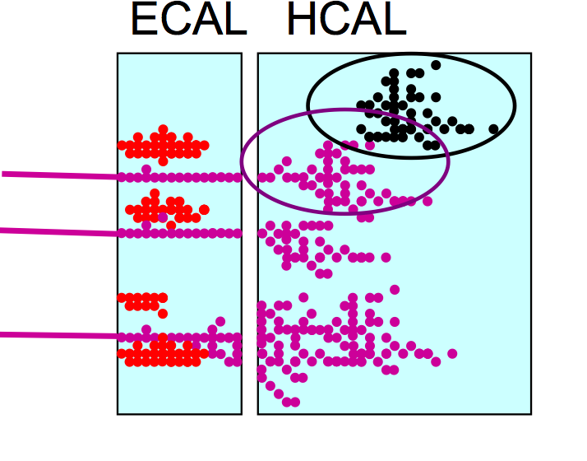
Philosophy of the ILC detectors
Detectors should be precision and discovery
tools beyond the LHC scope.
Relevant Physics phenomena in the TeV
energy range are associated to multi jet
final states → Jet energy measurement
is the most important item.
Particle Flow Algorithm is adopted in both
SiD and ILD concepts. PFA: Construction of individual
particles and estimation of their energy/momentum
in the most appropriate sub-detector.
PFA requires the different sub-detectors including calorimeters to be highly granular.
PFA uses their granularity to separate neutral from charged contributions and exploits
the tracking system to measure with precision the energy/momentum of charged particles.

Slide 4
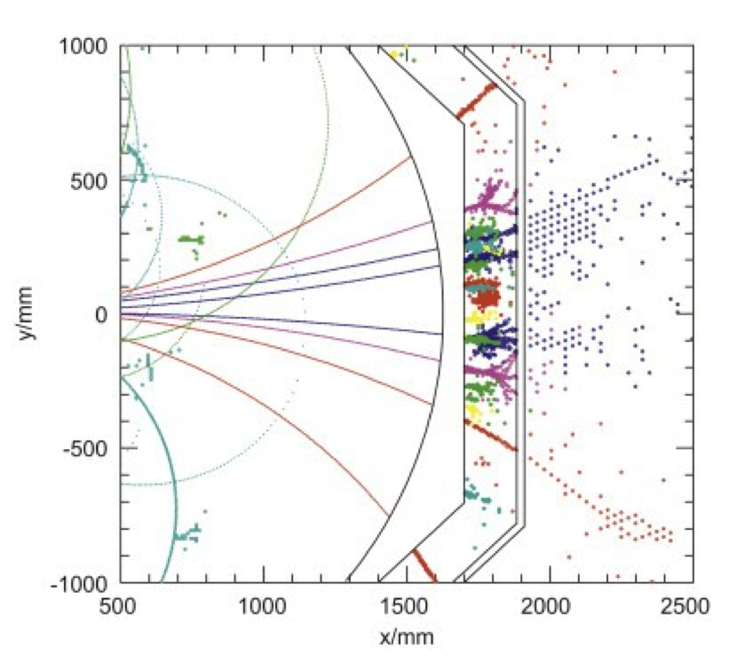
Philosophy of the ILC detectors
Detectors should be precision and discovery
tools beyond the LHC scope.
Relevant Physics phenomena in the TeV
energy range are associated to multi jet
final states → Jet energy measurement
is the most important item.
Particle Flow Algorithm is adopted in both
SiD and ILD concepts. PFA: Construction of individual
particles and estimation of their energy/momentum
in the most appropriate sub-detector.
PFA requires the different sub-detectors including calorimeters to be highly granular.
PFA uses their granularity to separate neutral from charged contributions and exploits
the tracking system to measure with precision the energy/momentum of charged particles.

Slide 5
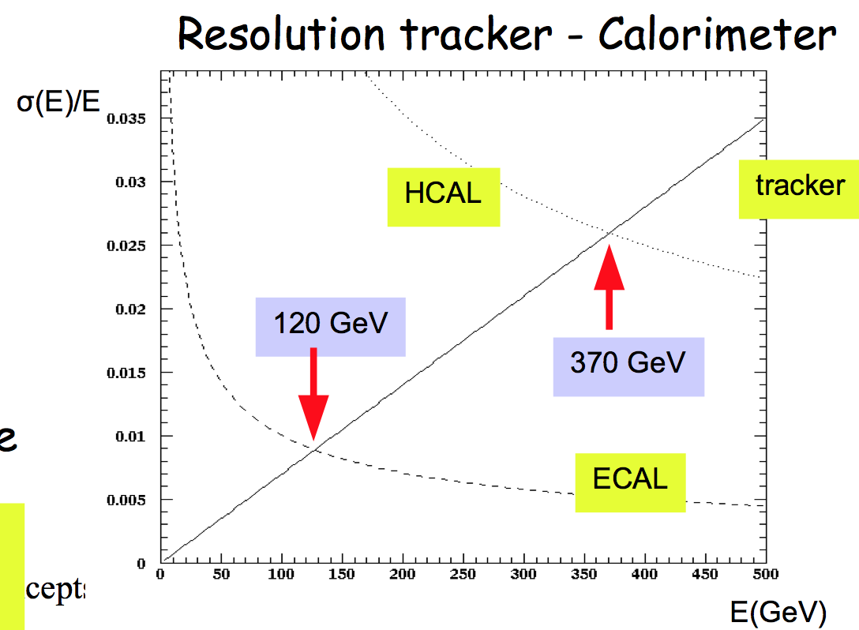
Why tracking is so important?
E_{jet} = E_{charged t} + E_{γ} + E_{h0}
fraction 65% 26% 9%
Charged tracks resolution ∆p/p ~ few10⁻⁵
Photon(s) energy resolution ∆E/E ~ 12% / √E
Neutral hadrons energy resolution ∆E/E ~ 45% / √E

Slide 6
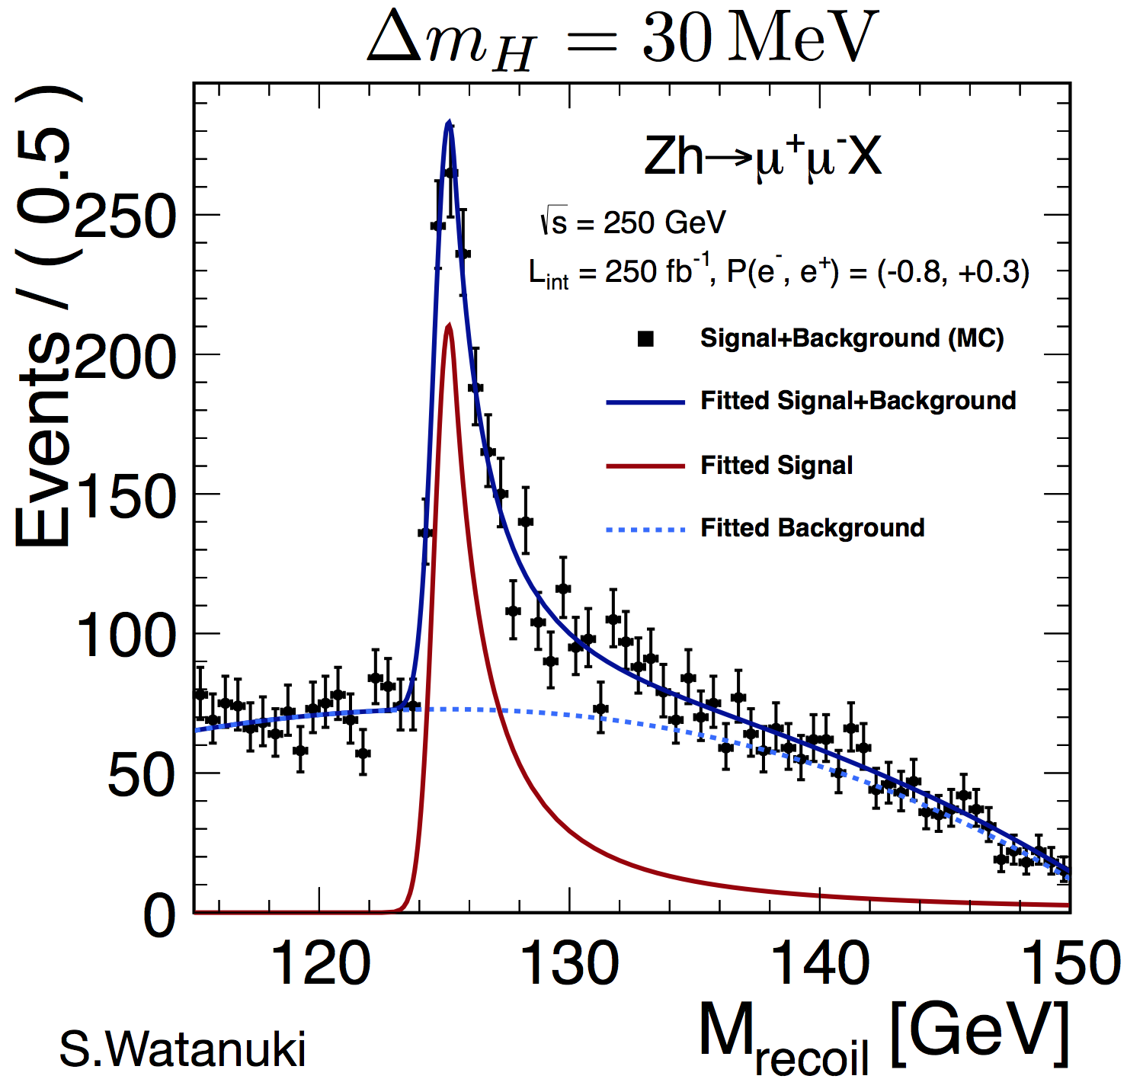
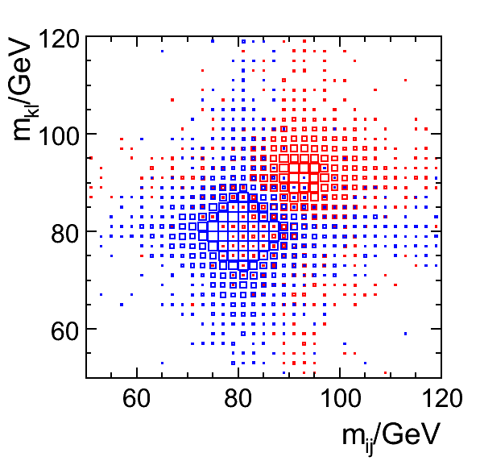
Philosophy of the ILC detectors : Requirements
Vertex detector : excellent resolution
σ_{IP}(rφ) = 5+10/(p sin^{2/3}(θ)) μm
b-tag, c-tag,… for H → bb, cc, ττ studies
Τracker : excellent precision measurement of p_{t}
σ(1/p_{t}) =10⁻⁵ GeV⁻¹
H mass recoil, e⁺ e⁻ → H Z→ μ⁺ μ⁻ + anything
Calorimeters : highly granular but still providing
good measurement of neutrals
σ_{E}/E = 30%/√E
The whole detector should be hermitic, compact
with moderate power consumption
30%/√E

Slide 7
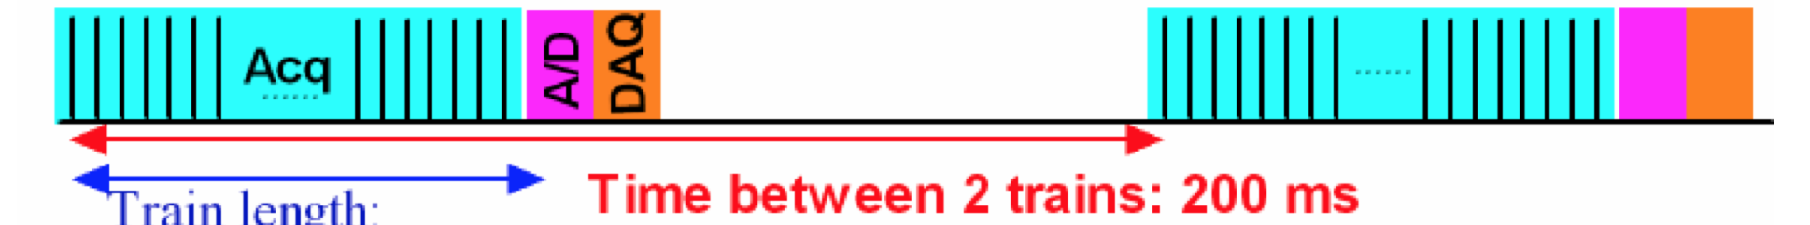
Power-Pulsing
Important feature of ILC detectors to reduce power consumption and heating for highly-granular detectors
Electronics switched on just before the bunches train and off after
A factor 100-200 power reduction could be achieved.

Slide 8
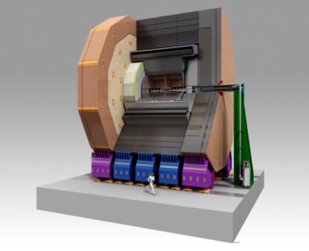
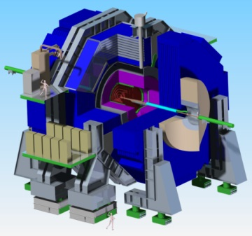
ILD SiD

Slide 9
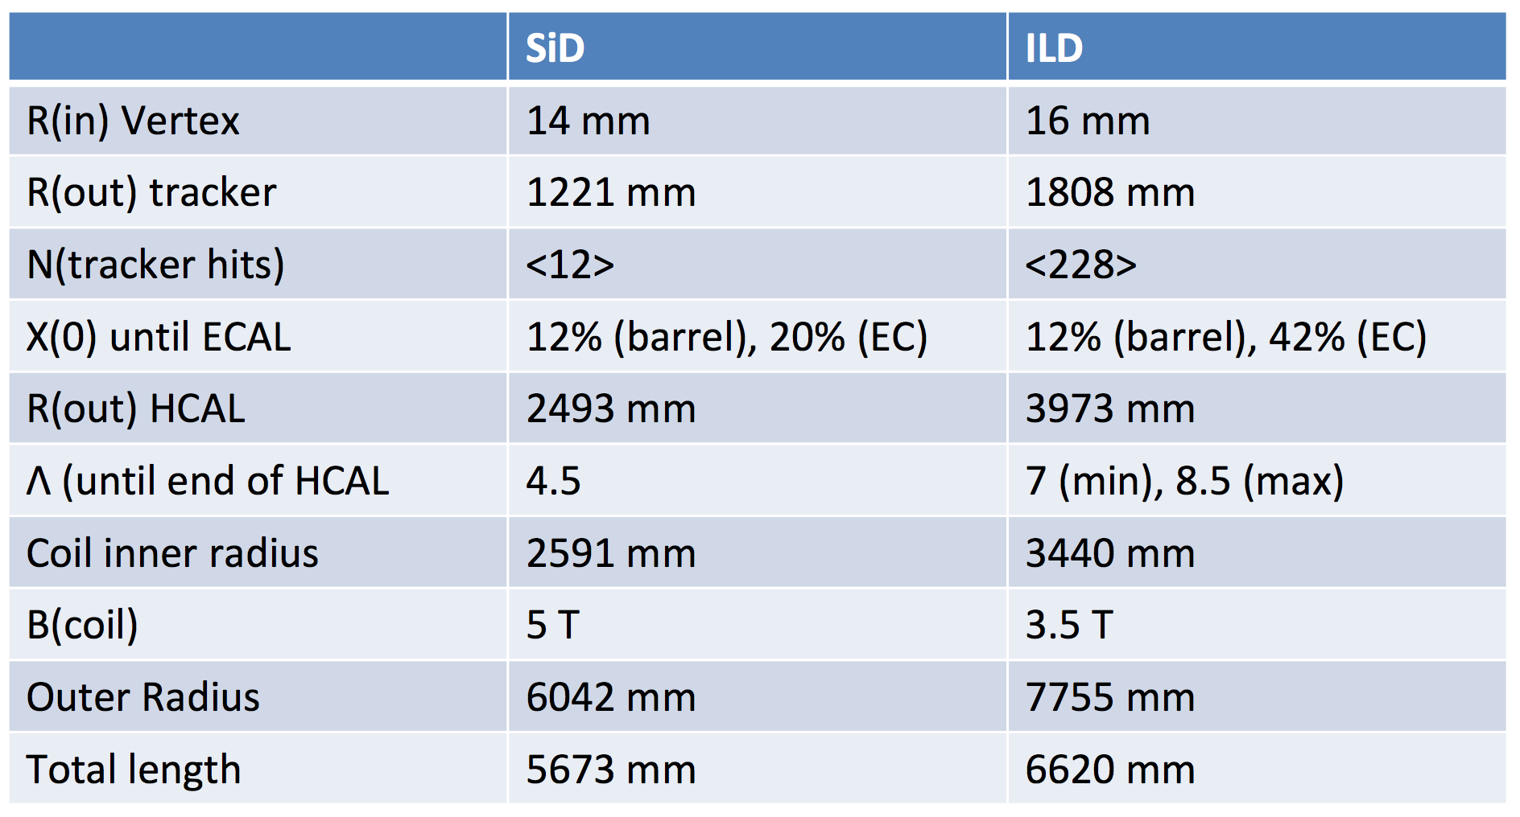
)

Slide 10
ILD SiD
Precision vertex detectors
CMOS MAPs, FPCCD, DEPFET 3D, chronopixel,DEPFET, MAPs
Tracker
TPC (GEM,MMEGAS,MAPs) Silicon
many measurement points Few points but very precise
Calorimeters
ECAL: Si-W, Sc-W ECAL: Si-W
AHCAL: Sc-Steel, SDHCAL-GRPC,.. DHCAL-GRPC
Size&Magnet
Large size, 3.5 Tesla Compact, 5 tesla

Slide 11
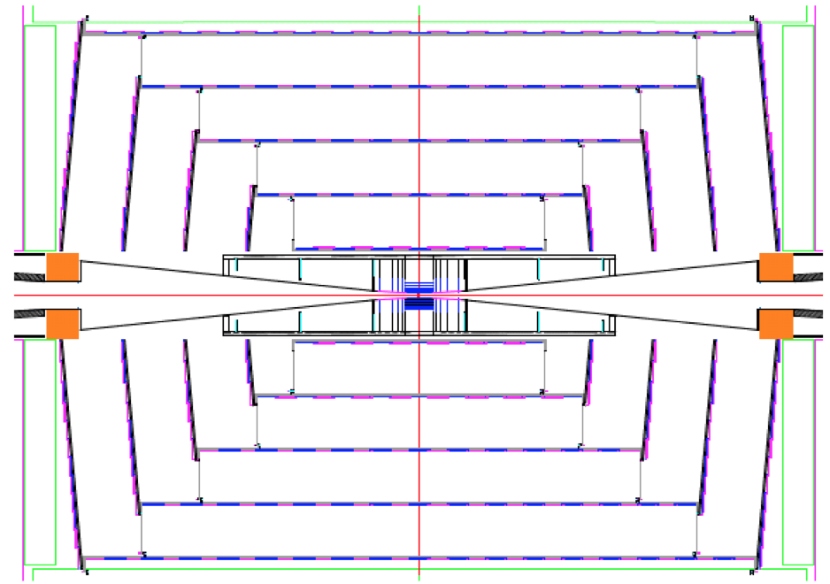
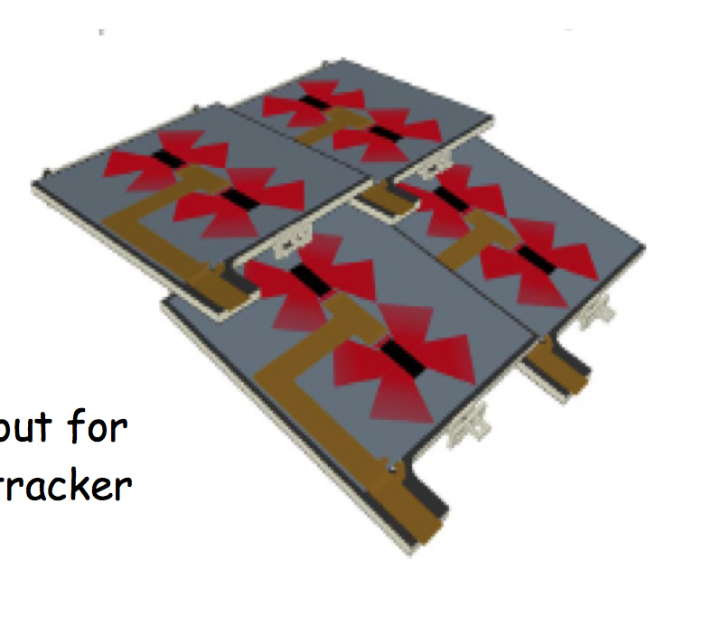

Tracker Silicon detectors : SiD
Vertex detector
Pixel Silicon
5 Barrel layers, 4 Disk, 3 forward Disks
Resolution better than 5 μm
Total power consumption 20 W
Air-cooled, DC-DC or serial powering.
Tracker : All-Silicon
Micro-strip detectors
5 Barrel layer, 4 Disks
Gas-cooled
Ladder structure

Slide 12
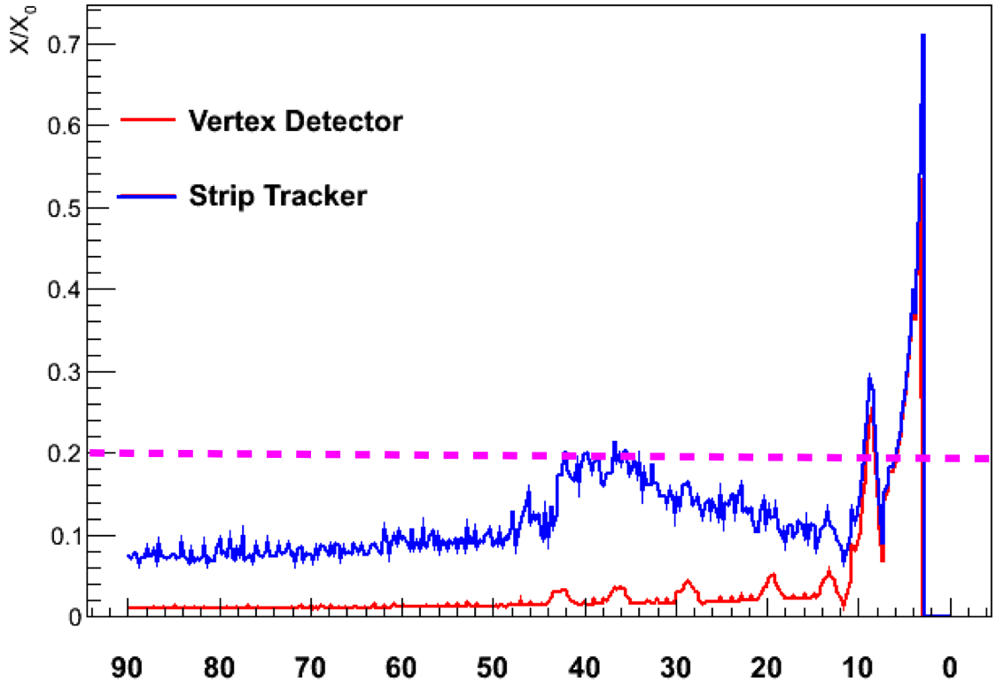
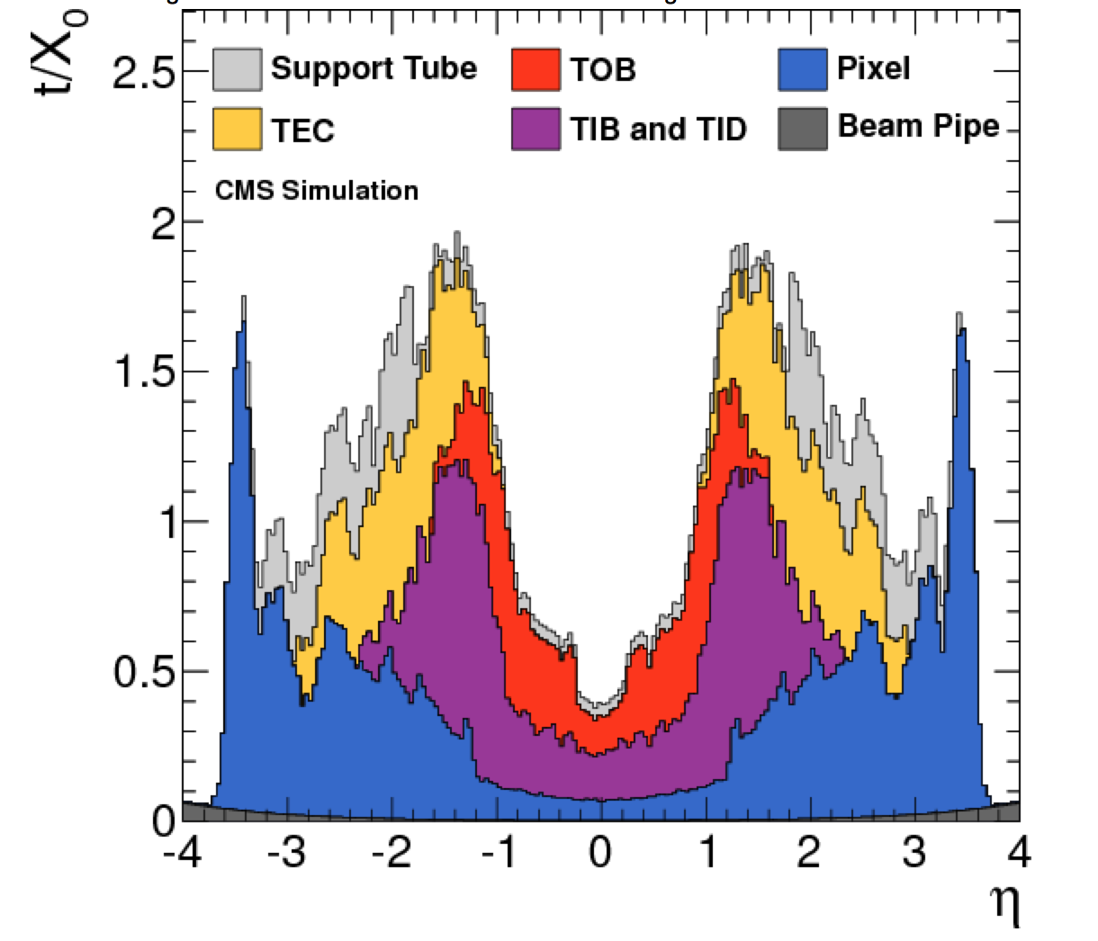
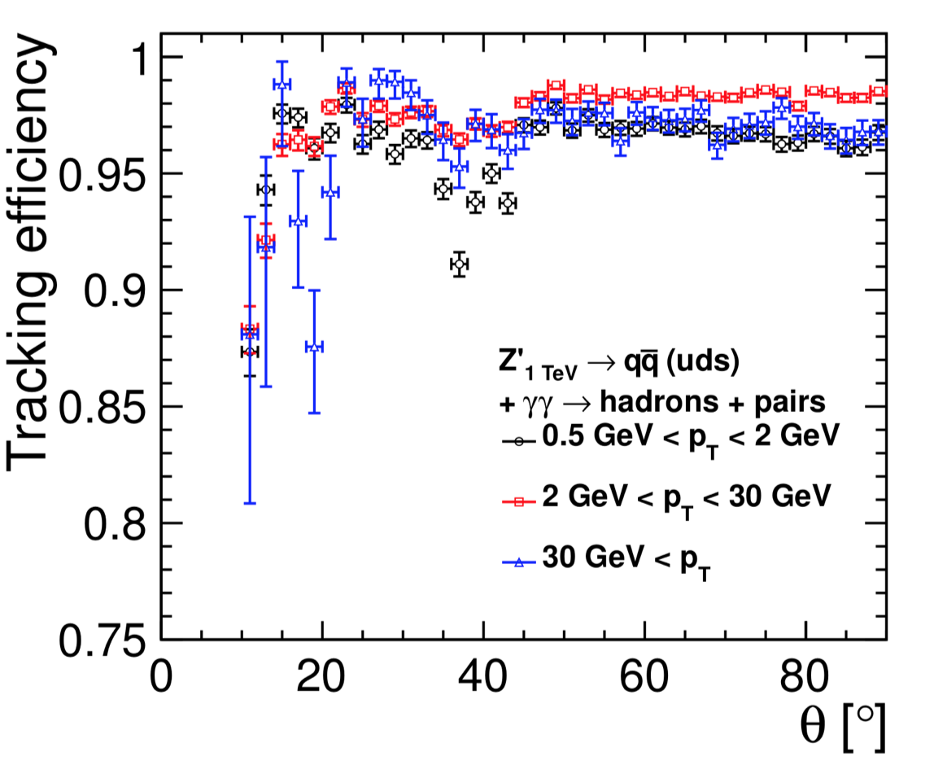
Tracker Silicon detectors : SiD
Less than 20% X₀ in the active area.
θ
σ(1/p_{t}) is better than 1.5 10⁻⁵ GeV⁻¹
99% efficiency over most of the phase space
Impact parameter resolution of 2 μm
Robustness against background

Slide 13
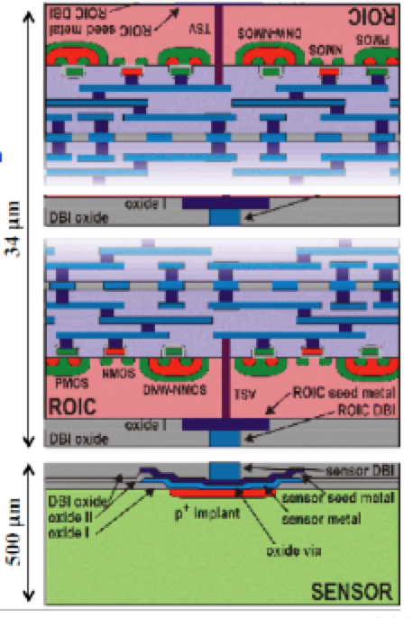
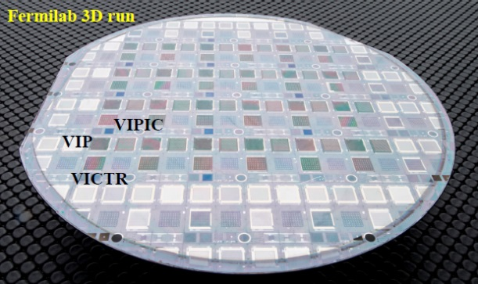
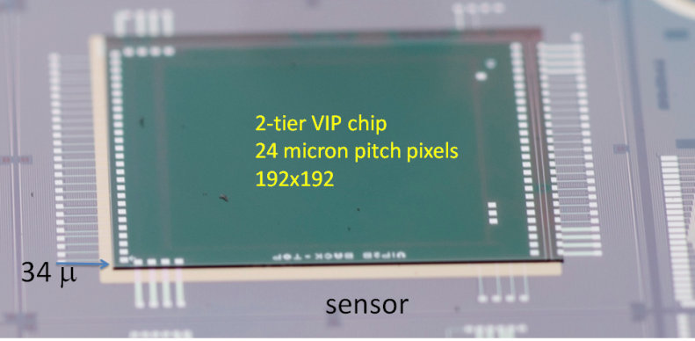
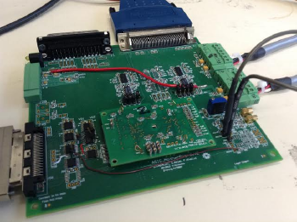
Technologies proposed for the SiD vertex detector
Vertical Integrated Pixel (VIP) :
Two layer 3D ASIC bonded to silicon wafer (500 μm thick)
ASIC is 34 μm thick
24x24 μm² pixel
192x192 array
Single pixel time stamping
Successfully read out all 192x192 = 36,864 pixels
Token passes through at 189ps/pixel
Sees source
Issues with test pulse masking,

Slide 14
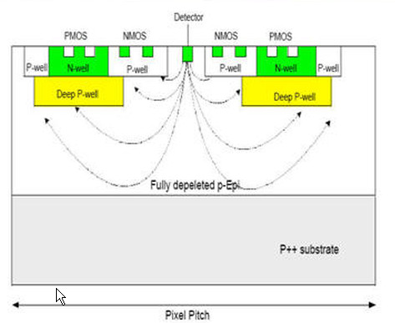
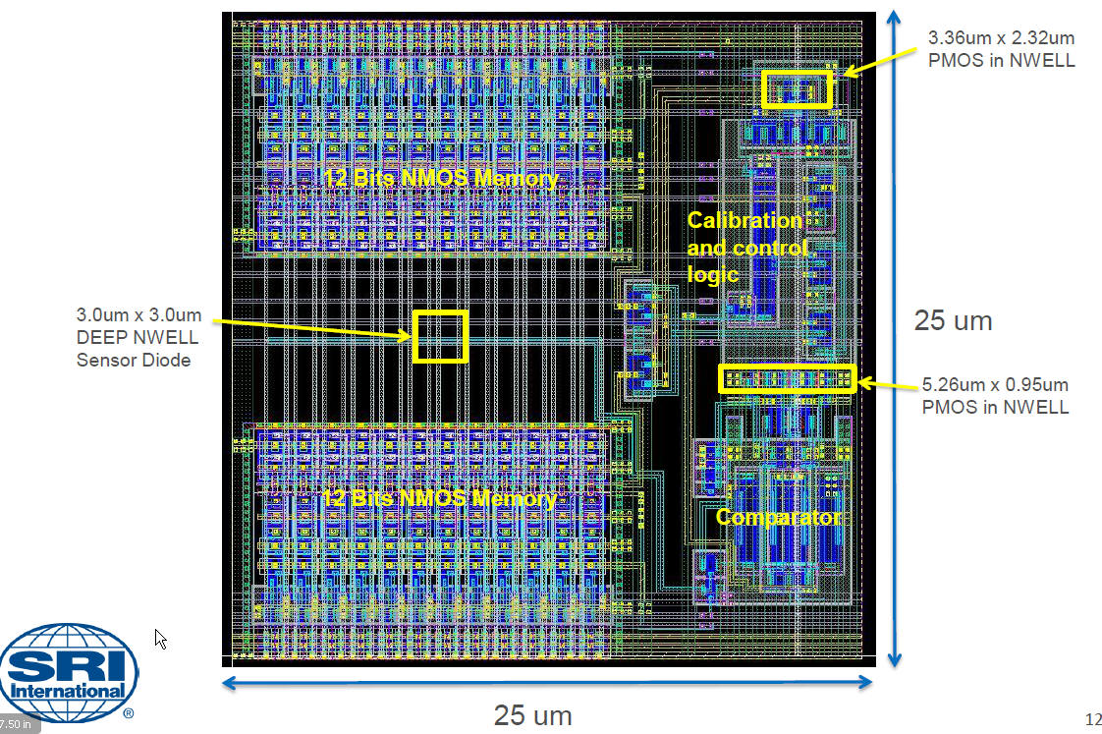
Technologies proposed for the SiD vertex detector
Chronopixel
Monolithic CMOS pixel sensor with integrated
electronics able to measure charge left by the particle
in the pixel and record the time of each hit
Based on using deep Pwell to prevent competing charge collection by PMOS transistors
Calibration process is ok
Readout is achievable during interval of bunch trains.
Timestamp recording speed is higher (7.23 MHz) than needed
Power-pulsing tested with no bad consequence on comparator performances.
Moderate power consumption could be obtained
with the NMOS electronics (without deep P-well techno.)
Issue with going to 90 nm technology (sensor capacitor)
which limits the signal/noise ratio but solution is there.
Prototype 3 intends to study 6 architectures
(deep, shallow NWELL, NTN,…

Slide 15
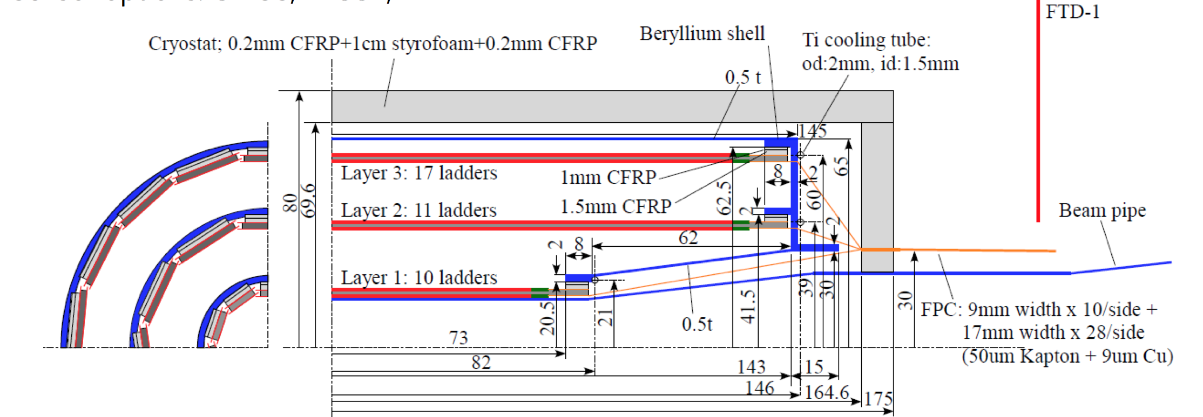
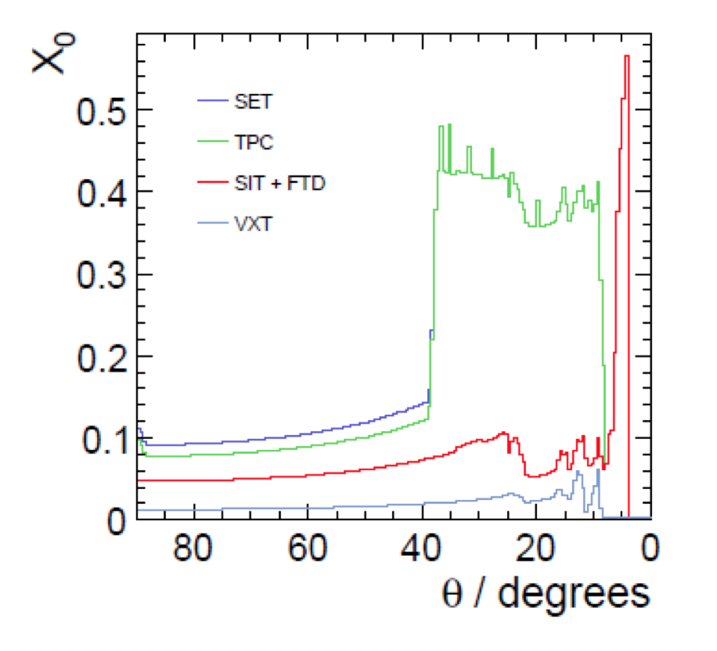
Tracker Silicon detectors : ILD
Central Si Tracker System (vertex detector)
3 ladders of double layers (6 pixel layers)
|cos(θ)| <.97 for inner layer, |cos(θ)| <.9 for outer layer
Inner radius ~1.6 cm, outer radius ~ 6 cm
3μm resolution in the inner layer
Material budget ~ 0.3%X₀/ladder layer : light support and genuine cooling system.
A pixel occupancy not exceeding a few %

Slide 16
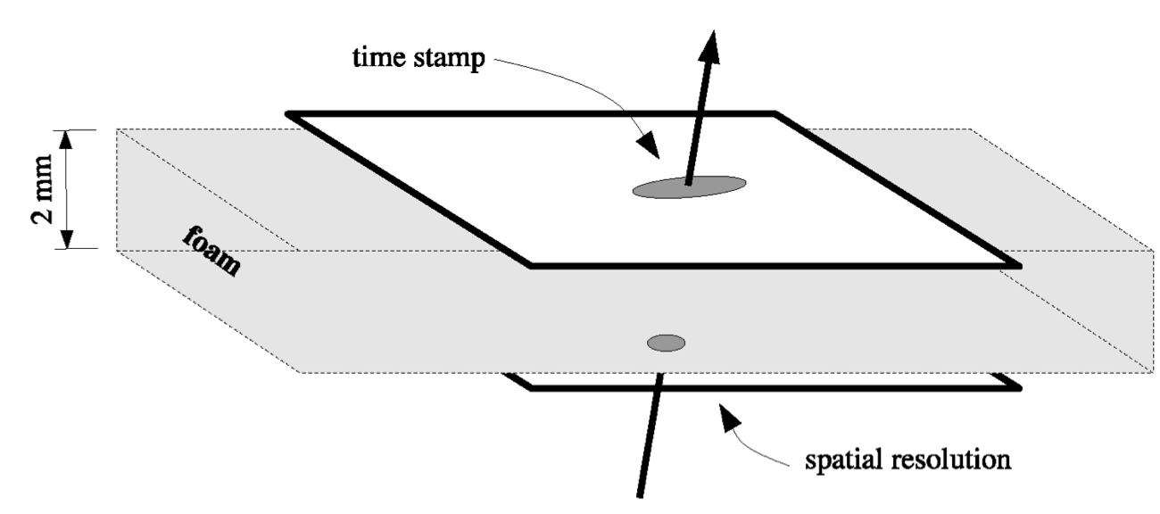
Tracker Silicon detectors : ILD
Central Si Tracker System (vertex detector)
3 ladders of double layers (6 pixel layers)
|cos(θ)| <.97 for inner layer, |cos(θ)| <.9 for outer layer
Inner radius ~1.6 cm, outer radius ~ 6 cm
3μm resolution in the inner layer
Material budget ~ 0.3%X₀/ladder layer : light support and genuine cooling system.
A pixel occupancy not exceeding a few %
Time stamping
Proposed technologies: CPS, FPCCD, DEPFET,MAPs

Slide 17
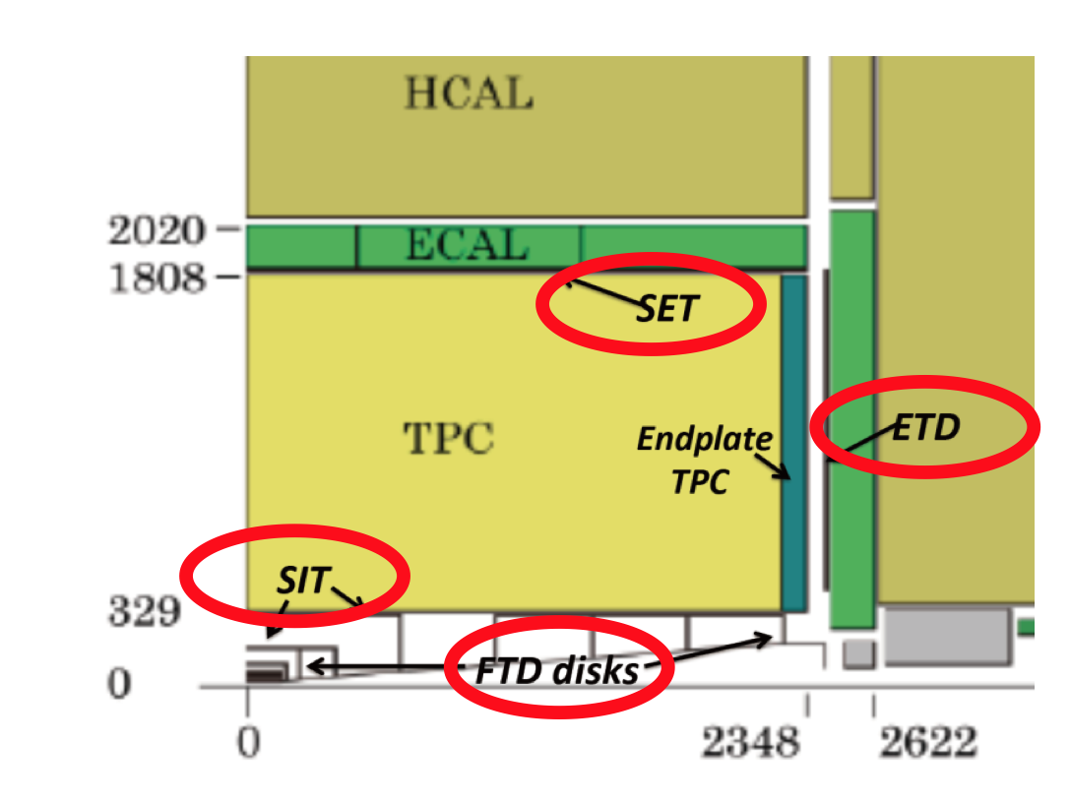
Tracker Silicon detectors : ILD
Forward Tracking Detector (vertex detector) FTD
2 pixel disks (0.25-0.5%X₀/Disk)
5 false double-sided layers of Si strips (0.65%X₀/Disk)
100 W/disk when power-pulsed
Same technologies proposed as for the pixel
detectors
Endcap Tracking System (ETS), Inner Tracker (SIT),
Si External Tracker (SET)
Additional precise measurements, forward tracking
improvement, time stamping
Pad size of 10x10 cm², 50μm pitch and 200 μm thickness.
Material budget ~ 0. 65%X₀/layer.
Resolution ~7μm

Slide 18
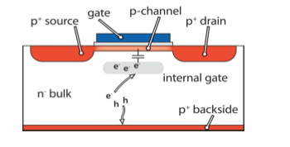
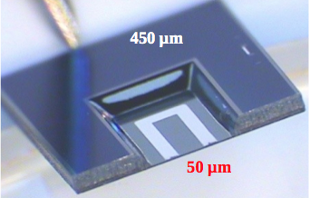
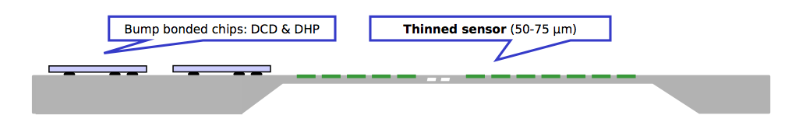
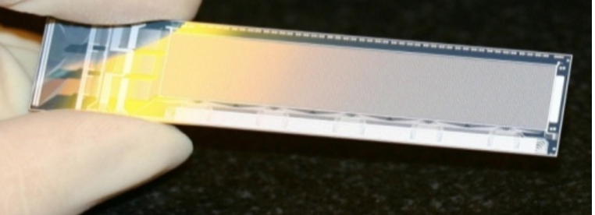
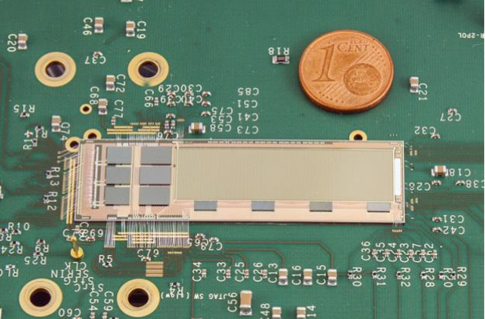
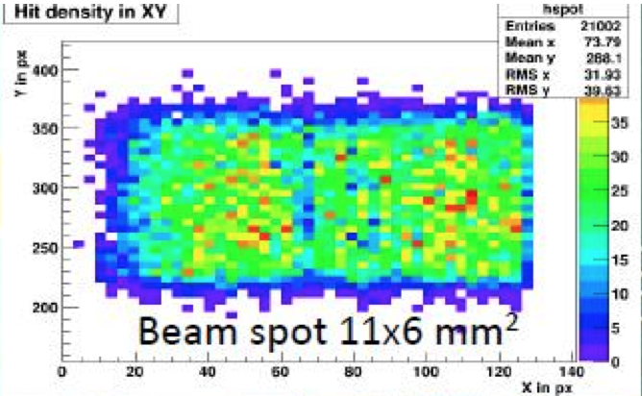
Technologies proposed for the ILD vertex detector
DEPFET: all-silicon vertex ladder:
Ultra-thin self-supporting Silicon sensor created from Si-Oxide-Si
sandwich made of a sensor and a handle wafer after grinding
and applying lithography process.
Signal and power lines are integrated on Silicon and ASICs directly bonded on top
Pixel size : 20x20μm²
Resolution (rφ) : 2.3 3.5 μm
Readout speed (25-100 μs)
Material budget : 0.15%X₀/s.layer
Occupancy :0.13 hit/mm²/s
Rolling shutter mode, R.O 50 ns/row
Rad. Hard
P.Pulsing, active cooling (EOS)
DCD (Drain Current Digitizer),
256 ch, 8-bit ADC/ch,
UMC 180 nm, rad hard
DHP (Digital Data Processor)
TSMC 65nm, zero suppression,
timing and trigger control
SwitcherB, Row control,
32X2 ch, Gate&Clear
AMS/IBM 180 nm
First large (512x192 pixels), thin (50 DEPFET μm) multi-chip ladder successfully tested at DESY in 2014
DEPFET technology is chosen for BELLEII.

Slide 19
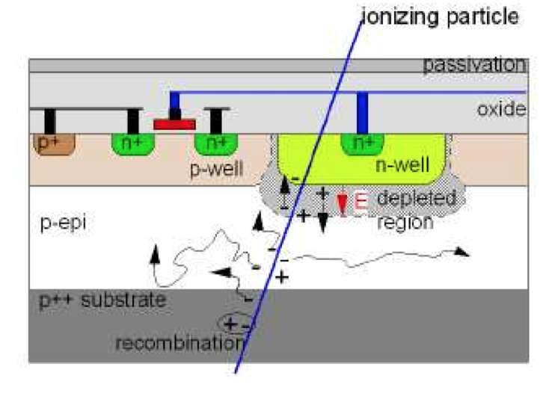
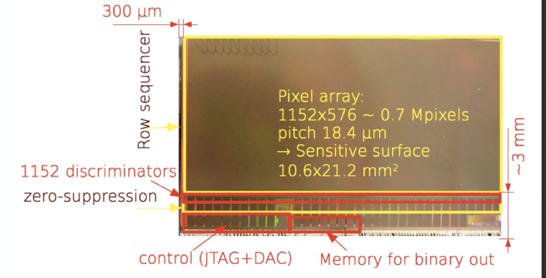
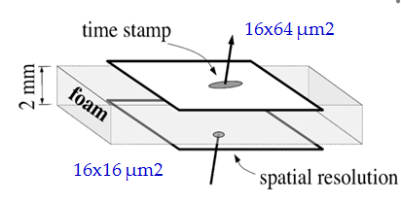
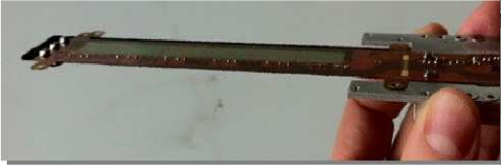
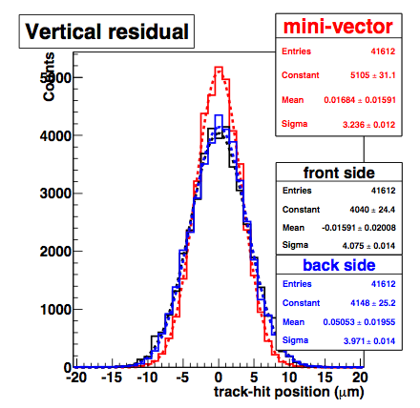
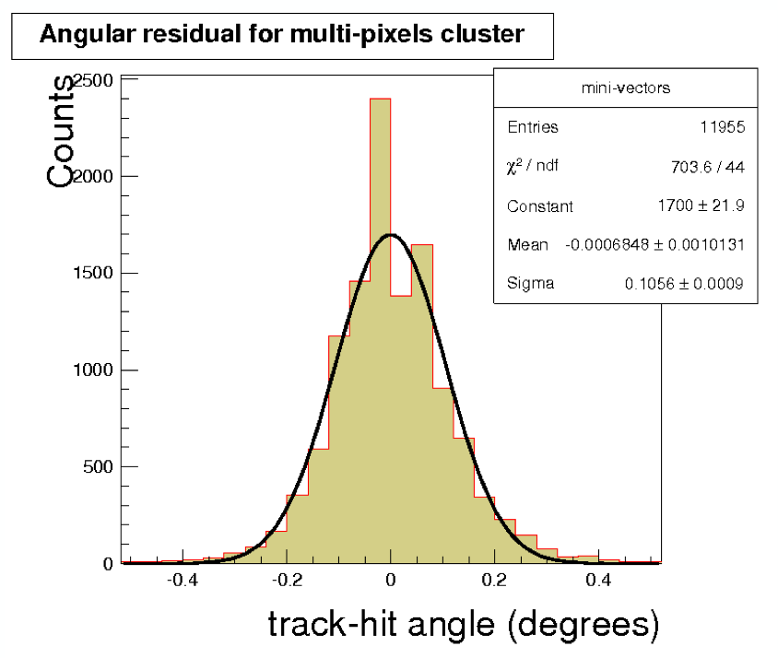
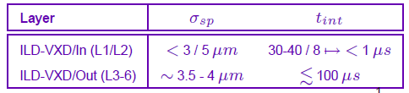
Technologies proposed for the ILD vertex detector
Eudet tel., STAR vertex detector
CMOS Pixel Sensor (CPS):
Developed in 0.35 nm, the Mimosa26 chip
fulfills ILC requirements
New chip in 180 nm is being developed
( 2-4 faster and 60% power cons. less)
Pixel size ~ 16x16-16-64 μm²
Readout speed (112 μs)
Material budget : 0.6%X₀/d.layer
(0.35%X₀ with a new version)
Occupancy :0.13 hit/mm²/s
Rolling shutter mode
Rad. Hard tested
Plume coll.
Future activities (using output of R&D for ALICE-ITS): Finalized pixel size for different layers, material budget, integration time, power-pulsing and integration issues
3-4 μm position resolution, 0.05-0.2° angular resolution obtained in 2012
TB at SPS. New versions of Mimosa have been successfully tested

Slide 20
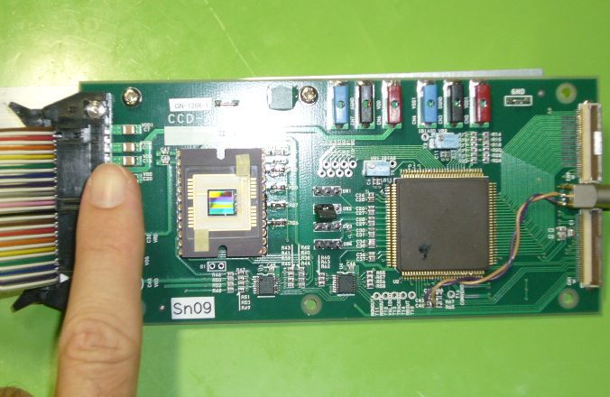
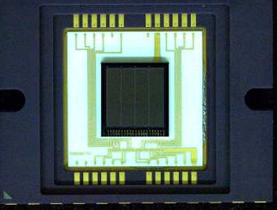
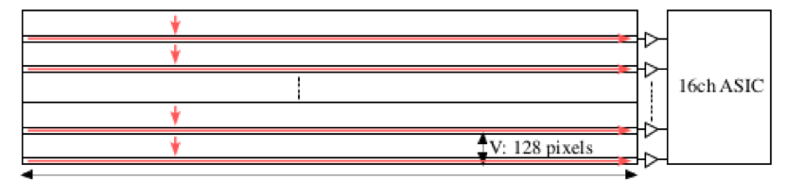
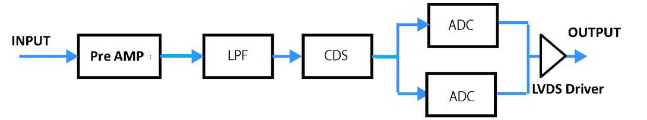
Technologies proposed for the ILD vertex detector
FPCCD:
CCD technology with tiny pixel to provide
excellent two-track separation and low
occupancy of beam-related background
Targeted pixel size (5x5 μm² for the inner layers,10x10 μm² for the external layers)
12 and 9.6 μm pixel size were successfully
tested
Fully depleted 15 μm thick epitaxial sensor
Low occupancy. No need to fast electronics. Readout between bunch trains (200 ms).
16ch-ASIC to read 16x128x2500 pixels
Active circuit localized on one edge
S/N>10
10 nW/pixel
Operated at -40°C
Two-phase CO₂ cooling (2 mm tube)
Low-pass filter
Double-correlated
Samplers

Slide 21
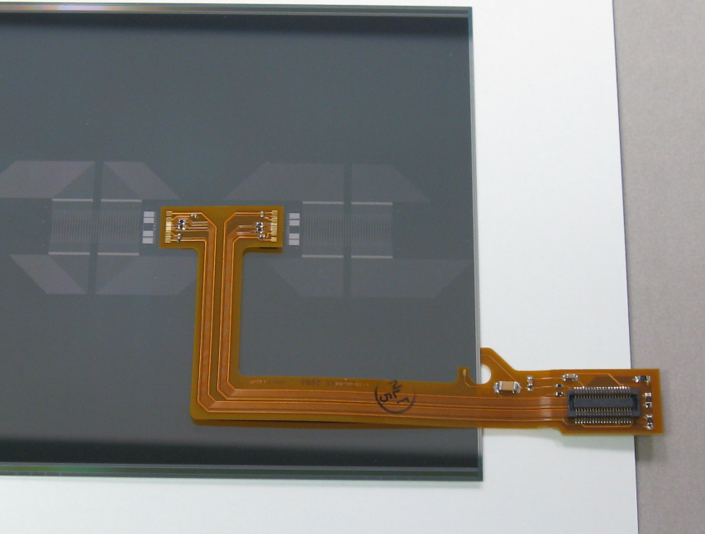
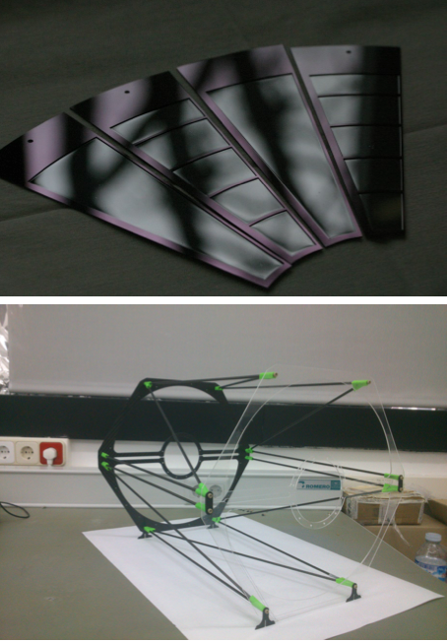
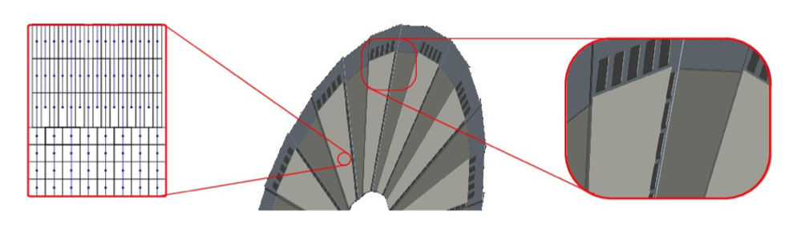
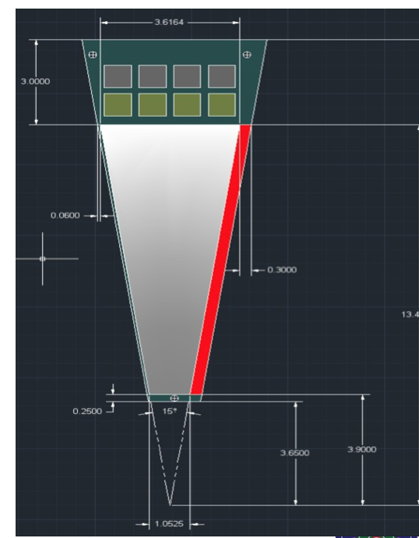
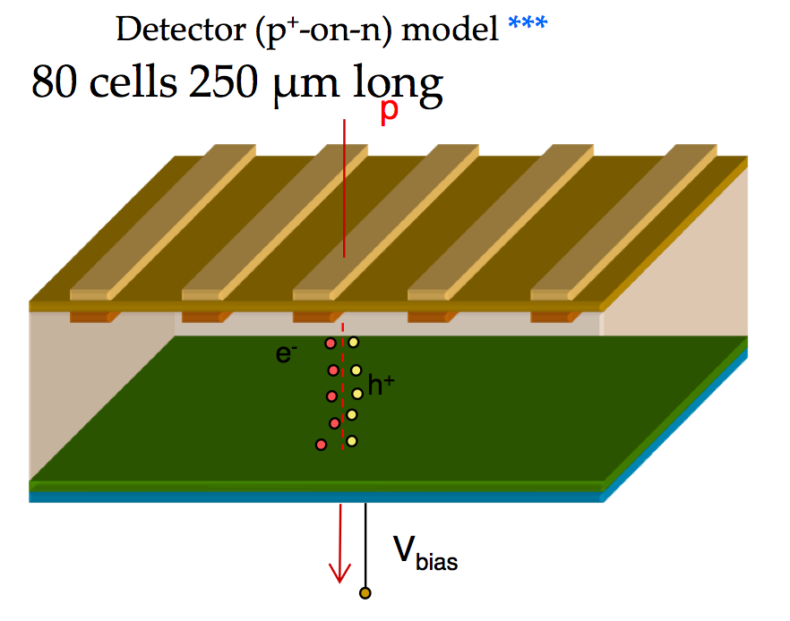
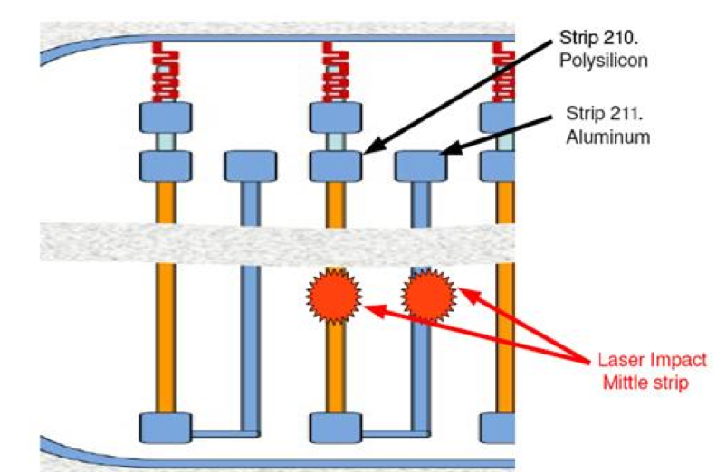
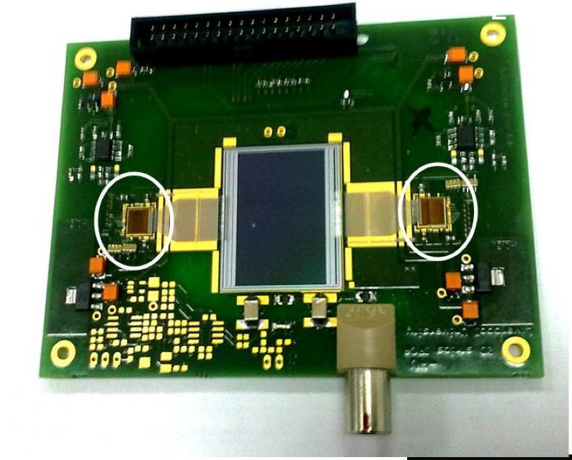
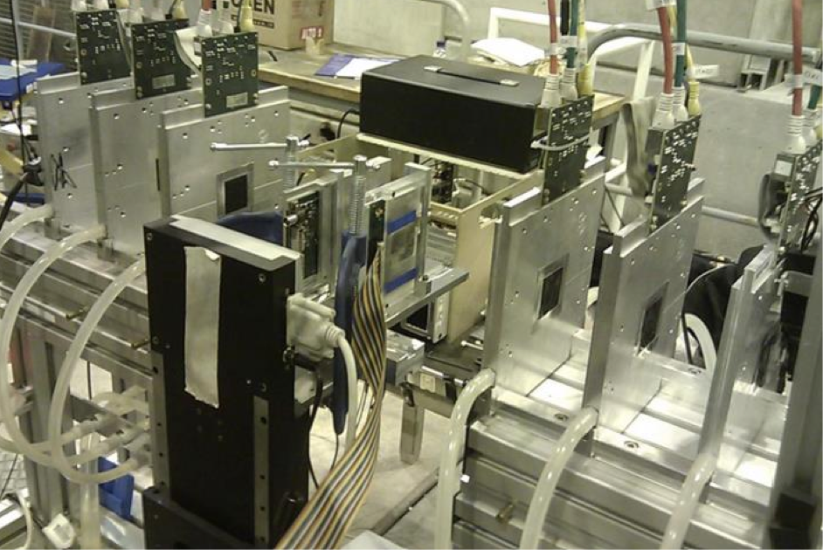
Technologies proposed for the ILD & SiD Disks
SiD :
Silicon strip model with hyprid-less design
Bump bonded FE to the sensor
kPix Connection
Bias Connection
ILD :
DEPFET petal
R&D on reducing the
material budget&cooling
2D position sensitive microstrip sensor

Slide 22
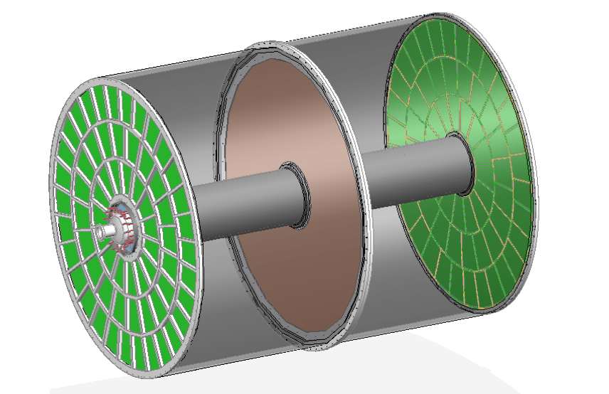

ILD TPC tracker
Time Projection Chamber (TPC) is chosen as the
central tracker of ILD
3D tracks (rφz) can be built thanks to many
hits (∼200/Track)
σ(rφ) of 100 μm (60 μm at z=0) is expected
σ(z) of 1400 μm (400 μm at z=0) is expected
σ(1/p_{t}) ∼10⁻⁴ GeV⁻¹
dE/dx information is provided (particle identification)
Readout pad size ∼ 1x6 mm² → 10⁶ pads/side
Material budget : 5%X₀ in central region and less
than 25%X₀ in the endplate region
Cooling is needed: two-phase CO₂ is a possibility.
Two main options for gas amplification are considered :
GEM, Micromegas
0.4m <R< 1.8m
|z|< 2.15 m

Slide 23






GEM proposals
Wet-etched Triple-GEM
Laser-etched Thick Double-GEM
GEM+Timepix
R&D to reduce the field deformation on the module edges
Wire ring is proposed.
R&D to reduce the field deformation due
to the presence of positive ions by using
a gate
With a wire ring
Micromegas proposals
Resistive Anode Micromegas
Ingrid (MM on Timepix)

Slide 24








Very active Test Beam measurements
using PCMAG@desy
= 72 cm, L = 58 cm, B=1T
A TPC prototype with:
Modular End Plate : Up to 7 modules
(similar in size to the ILC final ones)
HV, gas and slow control system
Cosmic&beam trigger
Laser calibration system
Cooling system TRACI 2PCO2
2 TimePix octoboards:
1 mounted on MM& 1 on GEM
3 modified GEM modules tested
7 MM modules tested
Similar results obtained with the different technologies
Ongoing R&D :
New electronics with Power-Pulsing to be tested
Mechanics and low budget material

Slide 25




Technologies proposed for ILD&SiD calorimeters
ECAL for SiD
TB scheme : 9 layers SiW
3-electron event
1024 KPiX ASIC
Power-pulsed
X-talk to be reduced by better shielding
New scheme to have rectangular sensor (modified cells on the edge)
Mechanical structure study needed

Slide 26






electron data (2006)
MOKKA (geant4) simulation
electron data (2006)
MOKKA (geant4) simulation
non-linearity<1%
non-linearity<1%
Ebeam
Ebeam
Technologies proposed for ILD&SiD calorimeters
HCAL for SiD
40 layers of 2 cm stainless steel interleaved with
planes made of Glass RPC and their embedded readout 1-bit electronics allowing a lateral segmentation of 1 cm²
An advanced physical (embedded electronics) prototype of 54 was built and successfully run.
Other options with GEM and micromegas detectors are also proposed as active layers for the SiD HCAL
Several layers of mm were built and tested using 2-bit readout electronics. Few GEM planes are also in preparation.
Scintillator tiles is also an option.
Dual readout is also an option for both ECAL&HCAL

Slide 27







electron data (2006)
MOKKA (geant4) simulation
electron data (2006)
MOKKA (geant4) simulation
non-linearity<1%
non-linearity<1%
Ebeam
Ebeam
Technologies proposed for ILD&SiD calorimeters
ECAL for ILD
Energy resolution =
16.5/sqrt(E)+1.1%
30 layers of tungsten (24X₀) interleaved with
-Pixellated Silicon of 5x5 mm²,
A physics prototype (1x1 mm² cell size) with a deported electronics was built and successfully tested.
A technological prototype fulfilling the ILD DBD requirement is being developed :
Self-supporting structure (alveolar)
Embedded power-pulsed electronics
Large surface detector
Linearity <1%
Several TB took place at DESY

Slide 28








electron data (2006)
MOKKA (geant4) simulation
electron data (2006)
MOKKA (geant4) simulation
non-linearity<1%
non-linearity<1%
Ebeam
Ebeam
Technologies proposed for ILD&SiD calorimeters
ECAL for ILD
Energy resolution
12.8%/√E ⊕ 1.0%
30 layers of tungsten (24X₀) interleaved with
of 5x45 mm² scintillator strip with alternating direction
layers (X&Y) → equivalent of 5x5 mm² (SSA)
Read out by SiPM
A physics prototype with a deported electronics was built and successfully tested
A technological prototype is being developed with
Scintillator shape that optimizes light collection and reduces dead zones : rectangular, wedge, tapered..
SiPM more compact with higher linearity range
and less noise (MPPC 10000 ch in 1x1mm²)
Electronic board to host ASIC on one side
and scintillator plane on the other.
A first plane with the new technology was tested
in 2014.
Linearity <1.5%

Slide 29








electron data (2006)
MOKKA (geant4) simulation
electron data (2006)
MOKKA (geant4) simulation
non-linearity<1%
non-linearity<1%
Ebeam
Ebeam
Technologies proposed for ILD&SiD calorimeters
HCAL for ILD
48 layers of 2 cm stainless steel interleaved with
planes made of 3x3 cm² tiles, read out directly by SiPM
and embedded electronics.
A physical prototype of 38 layers of 1 m², totalizing
(5.3 λ_{I}) accompanied by a tail catcher (6 λ_{I}) with
deported electronics was built and successfully tested
A technological prototype fulfilling the ILD requirements is being developed :
Optimized tile shape for direct readout
Embedded, power-pulsed readout electronics
Large plane with tiles assembled in a way to reduce
dead zones
Self-supporting mechanical structure
Several planes of different sizes were made and successfully tested in 2014

Slide 30




electron data (2006)
MOKKA (geant4) simulation
electron data (2006)
MOKKA (geant4) simulation
non-linearity<1%
non-linearity<1%
Ebeam
Ebeam
Technologies proposed for ILD&SiD calorimeters
HCAL for ILD
48 layers of 2 cm stainless steel interleaved with
planes made of Glass RPC and their embedded readout 2-bit electronics allowing a lateral segmentation of 1 cm²
A technological prototype of 48 fulfilling almost all the ILD requirements of compactness and power consumption was built with a self-supporting mechanical structure. It ws successfully tested with
Triggerless mode
Power-pulsing mode
Last step is to build very large GRPC and equip them with the last generation of the readout electronics
The GRPC was also successfully tested in a magnetic field of 3 T using the power-pulsing mode

Slide 31






electron data (2006)
MOKKA (geant4) simulation
electron data (2006)
MOKKA (geant4) simulation
non-linearity<1%
non-linearity<1%
Ebeam
Ebeam
Technologies proposed for ILD&SiD forward calorimeters
LumiCal: Precise luminosity measurement (10⁻³) at 500 GeV.
BeamCal : Instantaneous luminosity measurement, beam diagnostics
but very high radiation load (up to 1MGy/ year)
LHCaL: Extends the calorimeter measurements to small polar angles
LumiCal (31 -77 mrad)
Two Si-W sandwich EM calo at ~ 2.5 m from the IP (both sides).
30 tungsten disks of 3.5 mm thickness. Si sensor pitch of 1.8 mm
Two tracking layers in front are envisaged to improve angle
measurement and separate e/γ.
BeamCal (5 – 40 mrad)
similar W-absorber as for the LumiCal but radiation hard sensors
(GaAs, CV Diamond, Sapphire, Si).
Segmentation is being worked out,
new ideas on the sensor orientation

Slide 32






electron data (2006)
MOKKA (geant4) simulation
electron data (2006)
MOKKA (geant4) simulation
non-linearity<1%
non-linearity<1%
Ebeam
Ebeam
Technologies proposed for ILD&SiD forward calorimeters
LumiCal chip in 130 nm.
● 8 channel (preamp, shaper Tpeak ~ 60 ns,~9 mW channel);
● 8 channel pipeline ADC, ~1.2 mW/MHz;
● FPGA based data concentrator and further readout.
4 layers are realized and tested in TB
Mechanical structure studied and prototyped
BeamCal
Choice of the sensor will depend on the T-506 studies at SLAC
BeamCal is sensitive above 50 GeV. At 50 GeV the fake rate due to beamshtrahlung is 0.5% for R>7 cm,
energy resolution = 10%, at 200, 4% at 500
GeV 4%

Slide 33





Technologies proposed for ILD&SiD muon detectors
For ILD
14 (12) active layer for the barrel (endcap ) region, interleaved with iron slabs of return yoke.
Baseline adopts scintillator strips read out by SiPM through WLS fibers. RPC are an alternative (X&Y)
For SiD
Similar scenarios
More work is needed in this field

Slide 34


Cost estimate

Slide 35

Cost estimate

Slide 36
Conclusion
A tremendous amount of work on the ILC detectors has been achieved.
Many technologies have reached maturity.
Work on engineering prototypes is ongoing.
Common developments on the DAQ have been initiated.
Installation scenarios of the different sub-detectors are under study.
Many R&D within the ILC framework have been adopted in other experiments (upgrade LHC, BELLEII, STAR…)
R&D for ILC could benefit other future lepton colliders
CLIC, CPEC,FCC ee even if some features associated to
different duty cycles need to be carefully studied.

Slide 37
Acknowledgement
This presentation is a summary of many presentations by the different members of the ILD and SiD collaboration.
I apologize if information of some R&D are not be up-to-date

Slide 38
Back up

Slide 39



ILD PFA performance

Slide 40

Resolution
Tracking
Leakage
Confusion

Slide 41


Slide 42


Slide 43

ILD

Slide 44
ILD cost

Slide 45

Terraced View
Au pads
Metal 1 Shield Traces

