Slide 1


Physics and Experiments at the FCC
FCC-PHYSics-COordination-group
FCC-ee
Alain Blondel
John Ellis
Christophe Grojean
Patrick Janot
FCC-hh
Austin Ball
Fabiola Gianotti
Michelangelo Mangano
FCC-he
Max Klein
Monica d’Onofrio
Max will cover
e-h in his talk

Slide 2
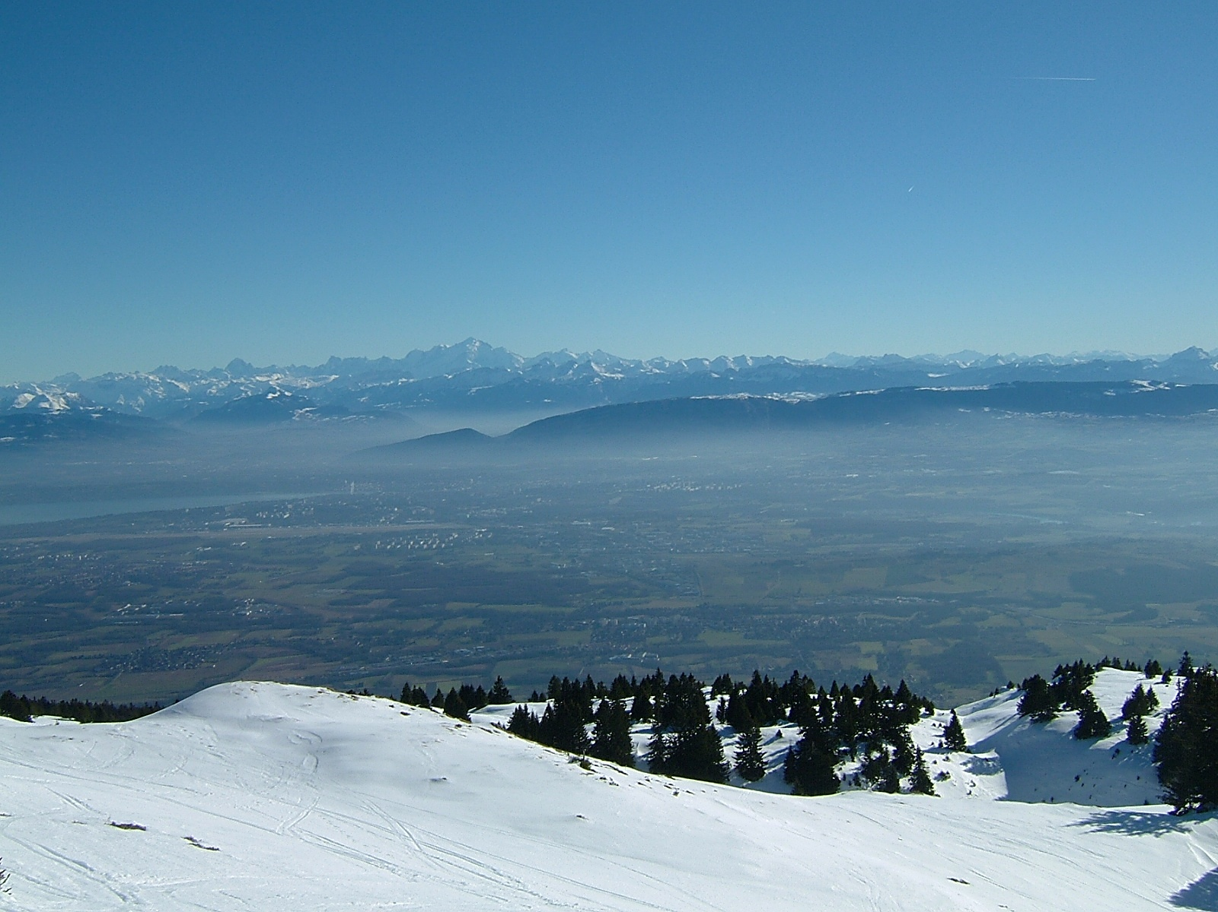

FCC
Design Study of Future Circular Colliders

Slide 3
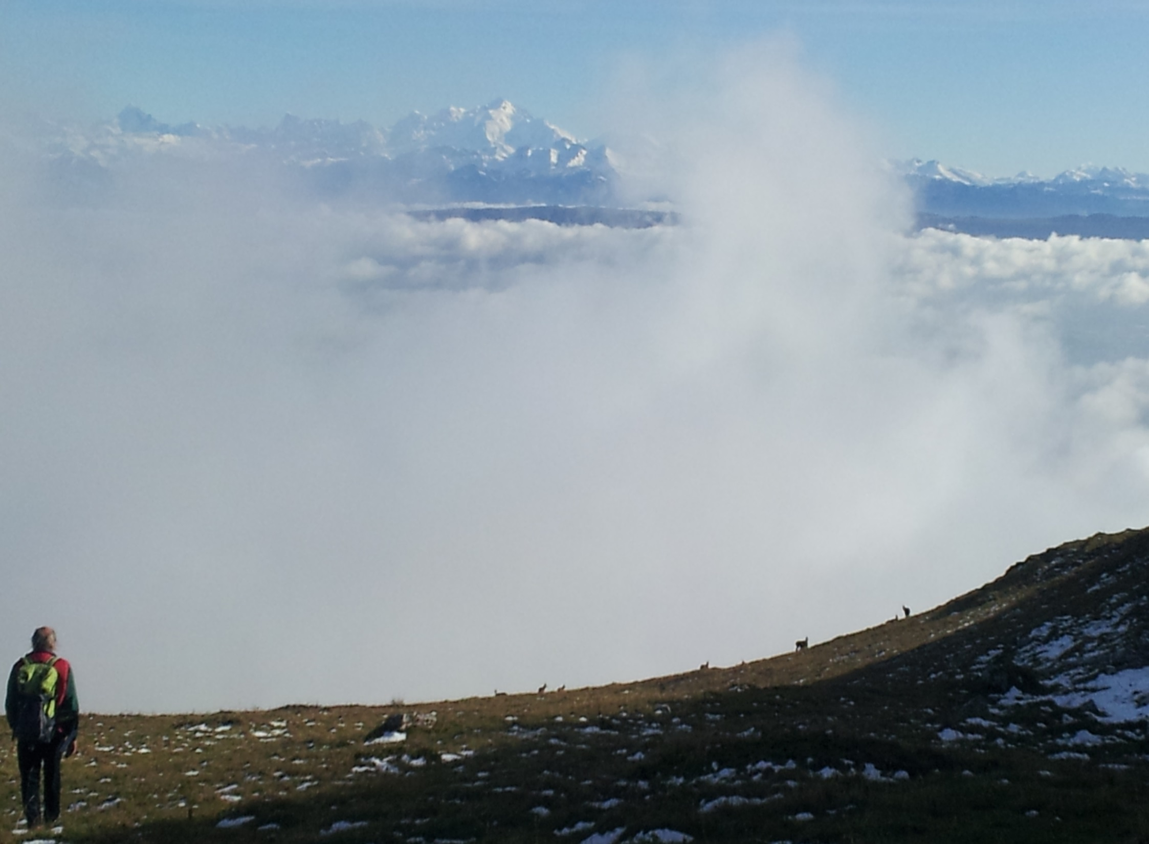
Where is Everybody?

Slide 4
Aims of the FCC «Physics and Experiments» design study:
-- to establish the physics capabilities of the FCC machines (- ee, hh, he)
and the complementarity and coverage of the complex.
-- scope the discovery sensitivities to a number of (new) physics scenarios by
-- direct observation of new particles
-- precision measurements of Higgs, Electroweak, Flavour etc observables
-- search for rare or forbidden phenomena
-- understand the experimental environment
-- establish the sensitivity of the physics performance of detectors to basic properties
and identify which ones:
-- are within reach of existing technologies and R&D
-- would most benefit from a new, dedicated, detector R&D program
-- define suitable layouts and requirements for infrastructure , study staging scenarios
-- identify which issues would require new theoretical calculations or
additional external or internal experimental input

Slide 5
First phase until March 2015:
SCOPING the physics panorama and the main technical issues
Establish collaboration and reach out to interested groups
Get things started.

Slide 6
Possible first step : FCC-ee
The Electroweak Factory

Slide 7
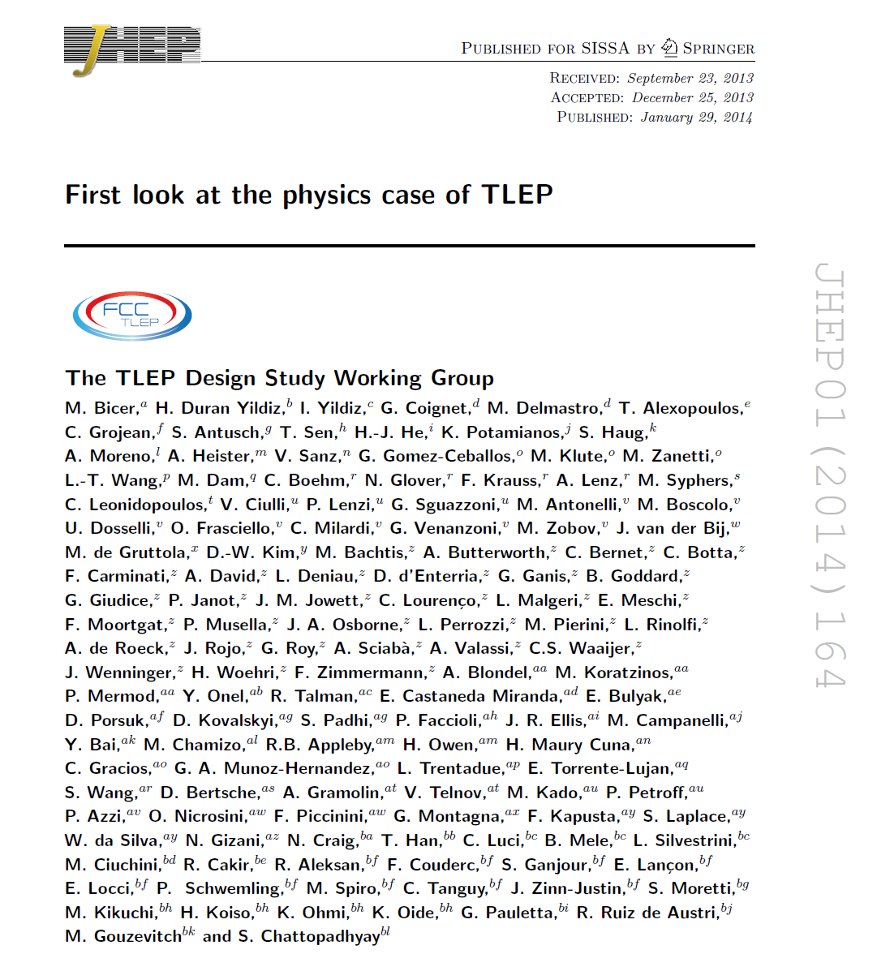
PUBLISHED

Slide 8
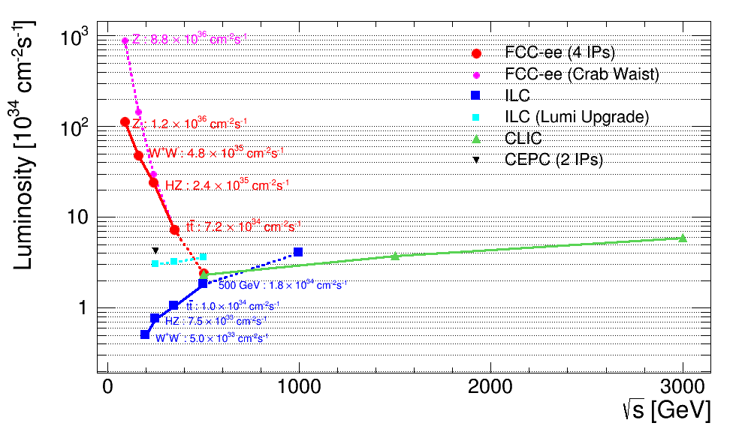
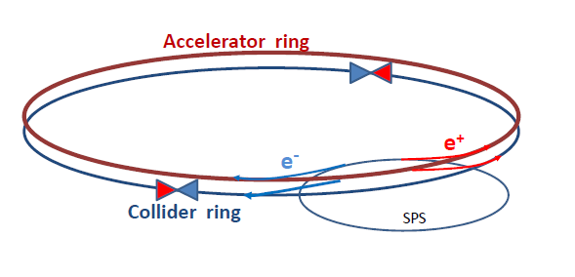
First look at the physics case of TLEP, arXiv:1308.6176v3 scoped the precision measurements:
-- Model independent Higgs couplings and invisible width
-- Z mass (0.1 MeV), W mass (0.5 MeV) top mass (~10 MeV), sin²_{W}^{eff} , R_{b ,} N_{ν} etc...
➔ powerful exploration of new physics with EW couplings up to very high masses
➔ importance of luminosity and E_{beam} calibration by beam depolarization up to W pair
So far: simulations with CMS detector (Higgs) -- or «just» paper studies.
Snapshot of novelties appeared in recent workshops
Higher luminosity prospects at W, Z with crab-waist
➔ sensitivity to right handed (sterile) neutrinos
➔ s-channel e+e- → H(125.2) production almost possible ( ➔ monochromators?)
➔ rare Higgs Z W and top decays, FCNCs etc...
➔ discovery potential for very small couplings and low mass Susy
➔ precision event generators (Jadach et al)
http://cern.ch/FCC-ee

Slide 9
A possible FCC-ee running scenario (07/2013)
1. ZH threshold scan and 240 GeV running (200 GeV to 250 GeV)
5+ years @2 10^35 /cm2/s => 210^6 ZH events
++ returns at Z peak with FCC-ee-H configuration
for detector and beam energy calibration
2. Top threshold scan and (350) GeV running
5+ years @2 10^35 /cm2/s ➔ 10^6 ttbar pairs ++Zpeak
will consider a somewhat higher energy (E_{CM} =380?) for couplings optimization
3. Z peak scan and peak running , TLEP-Z configuration ➔ 10¹² Z decays
→ transverse polarization of ‘single’ bunches for precise E_beam calibration
2 years
4. WW threshold scan for W mass measurement and W pair studies
1-2 years ➔ 10^8 W pairs ++Zpeak
---- possibly ----
5. Polarized beams (spin rotators) at Z peak 1 year at BBTS=0.01/IP => 10¹¹ Z decays.
Revisit physics case of longitudinally polarized beams
Higgs boson HZ studies
+ WW, ZZ etc..
Top quark mass
Hvv Higgs boson studies
Mz, Γ_{Z} R_{b} etc…
Precision tests and
rare decays
M_{W}, and W properties
etc…
A_{LR}, A_{FB}^{pol} etc

Slide 10
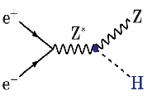
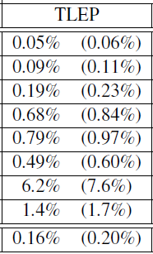
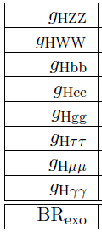
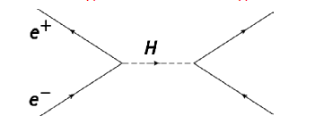
Higgs factory
(constrained fit
including ‘exotic’)
4 IPs
(2 IPs)
2 10⁶ ZH events in 5 years
«A tagged Higgs beam».
sensitive to new physics in loops
incl. invisible = (dark matter?)
A big challenge, but unique:
Higgs s-channel production at √s = m_{H}
10⁴ events per year.
Very difficult because huge background
and beam energy spread ~ 10 x Γ_{H}
limits or signal? monochromators?
Aleksan, D’Enterria, Woijcik
➔ total width
HHH (best at FCC-hh)
Htt (best at FCC-hh)
<1%
28%
13%
from HZ thresh
from tt thresh

Slide 11
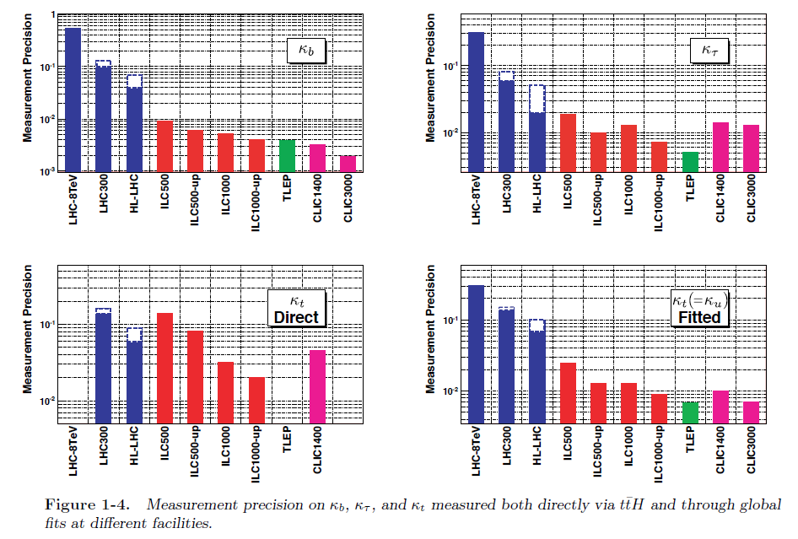

Slide 12
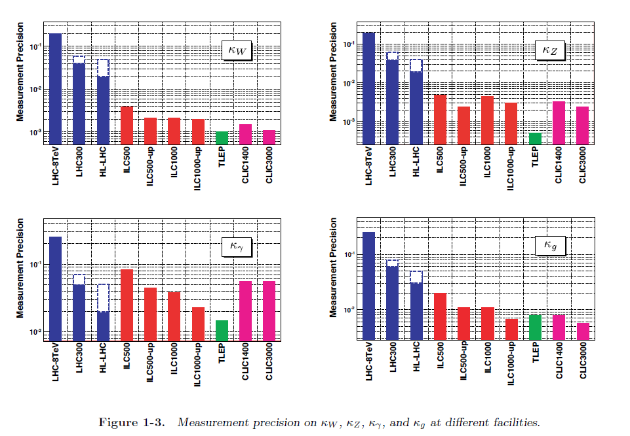

Slide 13
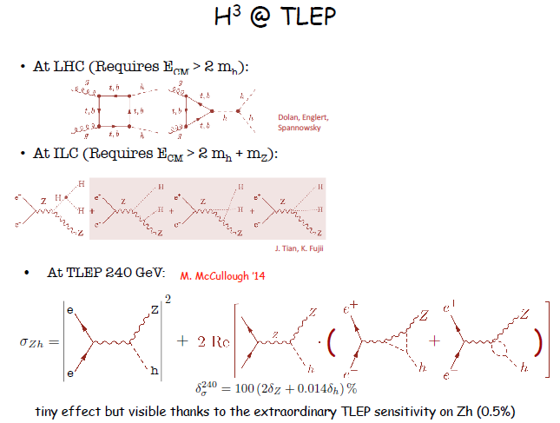
(0.05%)

Slide 14
(0.05%)

Slide 15
A Sample of Essential Quantities:
X | Physics | Present precision |  | TLEP stat Syst Precision | TLEP key | Challenge
M_{Z} MeV/c2 | Input | 91187.5 ±2.1 | Z Line shape scan | 0.005 MeV <±0.1 MeV | E_cal | QED corrections
Γ_{Z} MeV/c2 | Δρ (T) (no Δα!) | 2495.2 ±2.3 | Z Line shape scan | 0.008 MeV <±0.1 MeV | E_cal | QED corrections
R_{l} | α_{s ,} δ_{b} | 20.767 ± 0.025 | Z Peak | 0.0001 ± 0.002 - 0.0002 | Statistics | QED corrections
N_{ν} | Unitarity of PMNS, sterile ν’s | 2.984 ±0.008 | Z Peak Z+γ(161 GeV) | 0.00008 ±0.004 0.001 | ->lumi meast Statistics | QED corrections to Bhabha scat.
R_{b} | δ_{b} | 0.21629 ±0.00066 | Z Peak | 0.000003 ±0.000020 - 60 | Statistics, small IP | Hemisphere correlations
A_{LR} | Δρ, ε_{3 ,}Δα (T, S ) | 0.1514 ±0.0022 | Z peak, polarized | ±0.000015 | 4 bunch scheme | Design experiment
M_{W} MeV/c2 | Δρ, ε_{3 ,} ε_{2,} Δα (T, S, U) | 80385 ± 15 | Threshold (161 GeV) | 0.3 MeV <1 MeV | E_cal & Statistics | QED corections
m_{top} MeV/c2 | Input | 173200 ± 900 | Threshold scan | 10 MeV | E_cal & Statistics | Theory limit at 100 MeV?

Slide 16
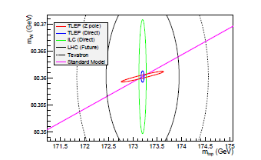
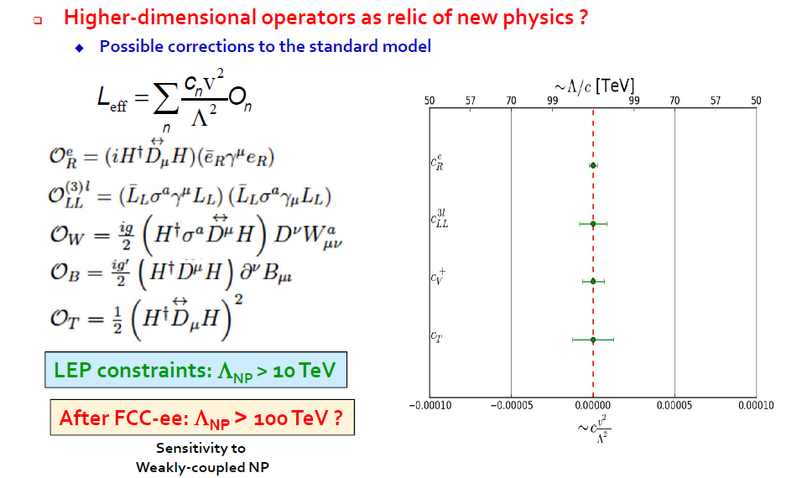
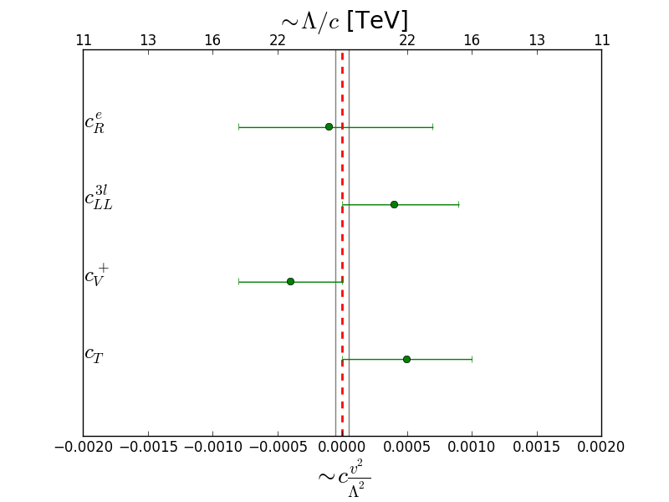
present
Precision measurements as tests of existence
of weakly coupled new physics
⬅ ‘classical’ precision measurements
+ flavour physics + Higgs precision measts
Thickness of SM line
is given by error on m_{Z}:
precise measurements of m_{Z} and m_{W}
➔ Energy calibration by resonnant depolarization

Slide 17

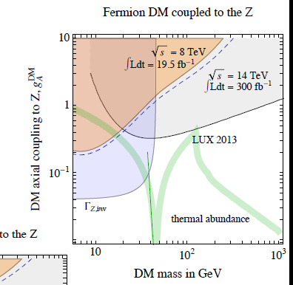
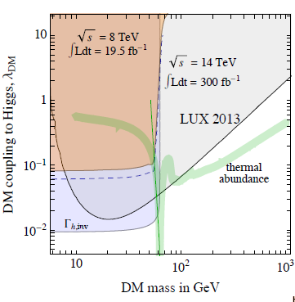
(Giudice)
Will improve these by large factors!
ΔN_{ν} = 0.0004?
from e+e-→Zγ
ΔΓ_{h,inv} /Γ_{tot} <0.19%

Slide 18
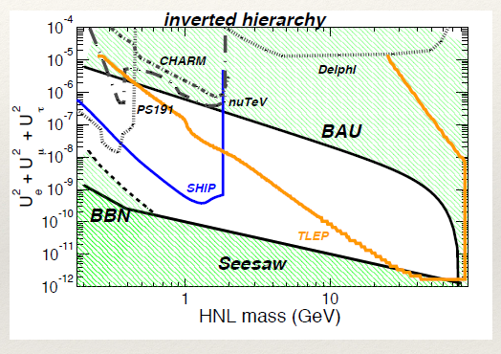
extremely rare process at the Z factory; an example:
see-saw:
|U|² ≅ m_{v}/m_{N}
Searching for Right-Handed neutrinos in Z decays Z → v N, N→ l⁺ W⁻
we thought it was impossible to reach mixing angle below 10⁻⁷ (backgrounds)
but realized that for small couplings the RH neutrinos are long lived
μ⁺
N
W⁻→qq
ν
accessible region for N decay between 100 μm and 5 m from IP
-- assuming 10¹³Z
AB, E. Graverini, N. Serra, M. Shaposhnikov

Slide 19
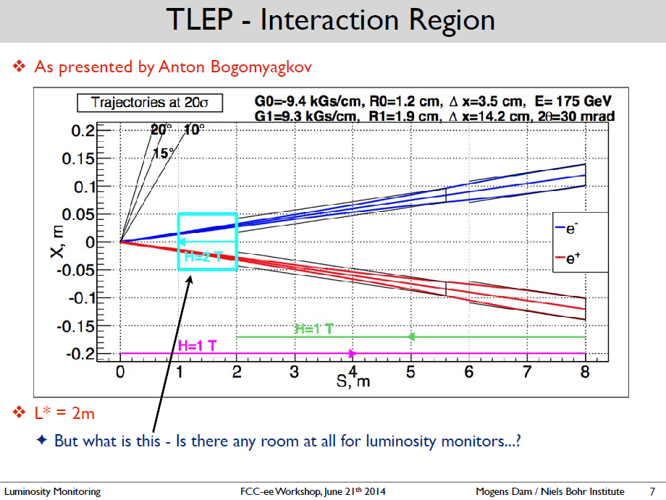
Machine Detector Interface (MDI) essential!
High Luminosity ➔ small β* and L*. ,
detail of small angle region in detector magnetic field.
Similar to ILC /CLIC but beam needs to circulate a few 10⁵ times!
FCC-ee MDI
+ synchrotron radiation
beamstrahlung

Slide 20
FCC-ee experiments
Experimental Studies: A. Blondel, P. Janot
  Discovery through precision measurements, rare, or invisible processes.
  Develop the necessary tools Understand the experimental conditions
  Set constraints (specifications) on possible detector designs to match statistical precision
Electroweak Physics at the Z pole
R. Tenchini
F. Piccinini
Di-boson Physics m_{W} measurement
R. Tenchini
H(126) Properties
M. Klute
K. Peters
Top Quark Physics
P. Azzi
QCD and γγ Physics
D. d’Enterria
P. Skands
Flavour Physics
S. Monteil
J. Kamenic
New Physics
M. Pierini
C. Rogan
Offline Software
B. Hegner
C. Bernet
Online Software
C. Leonidopoulos
Experimental Environment
N. Bacchetta
common across FCC
Detector Designs
A. Cattai
G. Rolandi
Synergy with linear collider detectors:
ILD proposed as benchmark, SID (CERN group)
both require L* modifications!
Several detectors possible:
lots of space for new ideas!
NB Conveners have mission for one year to assemble group and find co-conveners

Slide 21
FCC-ee Phenomenology Studies
Phenomenology Studies: J. Ellis, C. Grojean
  Match theory predictions to FCC-ee experimental precisions
  How to discover new physics in precision measurements, in rare decays (Z, W, t, H, b, c, τ, …) in rare or invisible processes (Right Handed neutrinos etc.. )
  Set up the framework for global fits and understand the complementarity with other colliders (LHC, FCC-hh, in particular)
QCD and γγ Physics
(Joint exp/th)
P. Skands
Precision EW calculations
S. Heinemeyer
Flavour Physics
(Joint exp/th)
Jernej Kamenik
Model Building and New Physics
Andreas Weiler
Synergy with
FCC-hh physics
Linear collider physics,
LEP physics
HF physics
:
Global Analysis, Combination, Complementarity
John Ellis

Slide 22
The ULTIMATE GOAL : FCC-hh

Slide 23
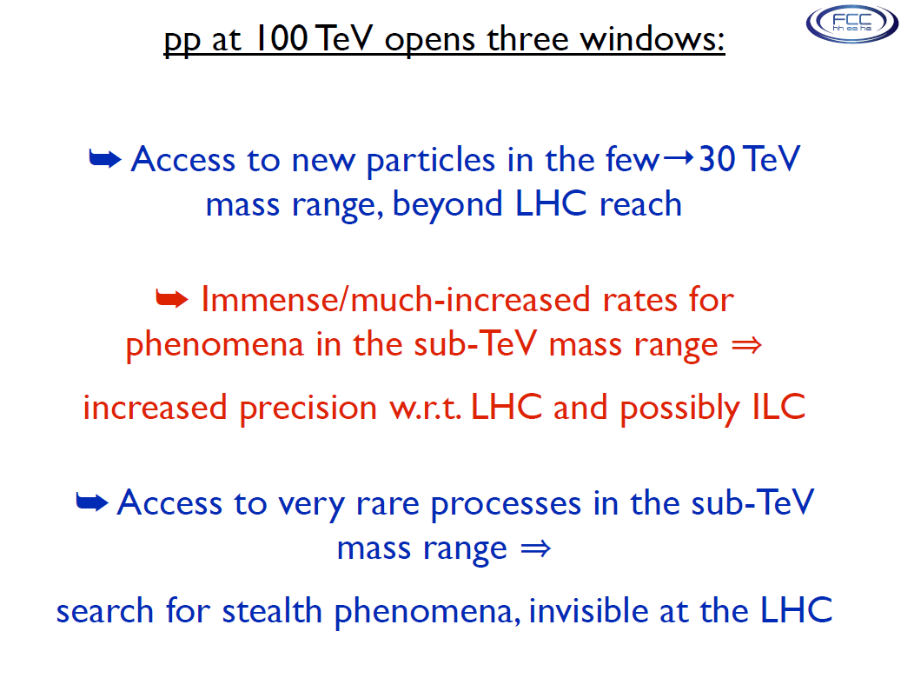

Slide 24
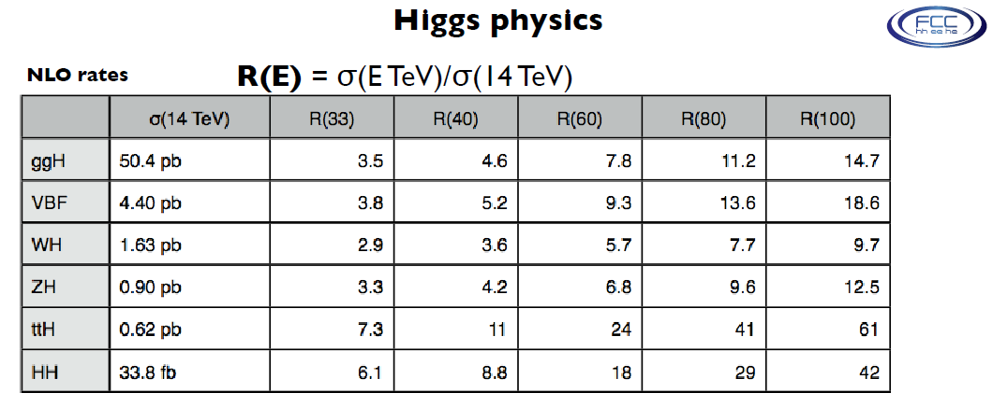
Expect complementarity with FCC-ee:
FCC completes the picture by providing ttH and HHH in great numbers

Slide 25
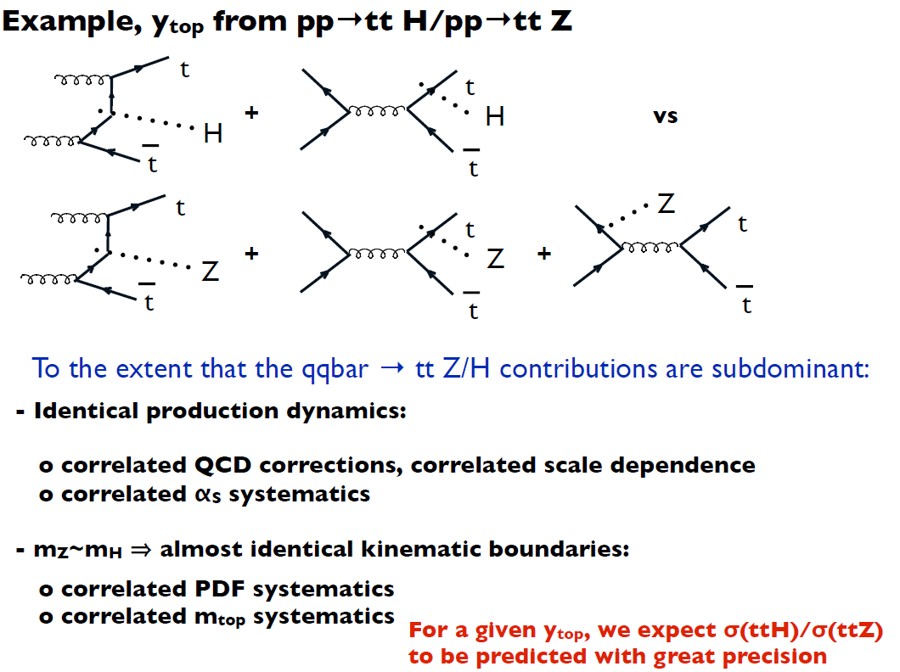
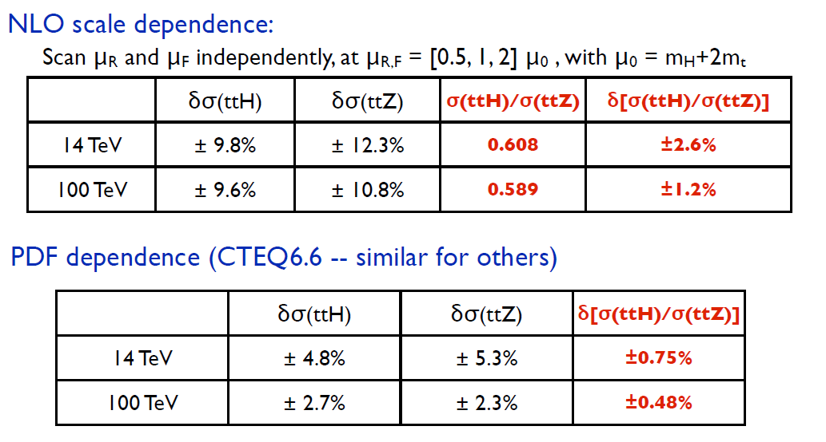

Slide 26
“….an ambitious post-LHC accelerator project at CERN”
Parameters - choices for initial machine relatively conservative
- a few more aggressive choices where cost savings balance the risks
--> establishing a credible baseline
- potential for evolution in performance
- as design process incl R & D proceeds
- as planned machine upgrade
important parameters for detectors baseline 2014 considered
Energy 100 TeV
Lumi 5 x 10³⁴ (p-p) up to 5 x 10³⁵ (p-p)
3 x 10²⁷ (Pb-Pb)
Bunch spacing 25ns 5 ns
Pile-up 170 34 - 340
Bunch-length 8 cm increased
% circumference filled 80 %
L * 46m 38m
β* 0.8m 0.3m
transverse beam size at ip 6.8mm 3mm
optimum run time 12 hrs

Slide 27
FCC-hh: Physics goals --> experiment design
Explore high energy frontier (E _{LHC} x 7)
requirements: high lumi at 2 points --> 2 x GP expts similar ATLAS/CMS
detectors tolerate rate, pile-up, radiation.
central measurement --> momentum res. ~10% for 20 TeV μ
Precision Higgs measurements, VBF
requirements: tracking, momentum resolution & electromag. resolution to η ~ 5
forward extensions to GP expts with dipole field
and/or dedicated forward experiments
also:
Standard Model studies (top, W, Z, flavour phenomena)
requirements : GP expts + dedicated smaller scale expts at lower lumi points?
Dedicated studies
requirements : eg HI & b-physics expts, similar ALICE/LHCb
at lower lumi points
Intensity frontier
requirements: “smaller” scale experiments using extracted beam from injectors

Slide 28
FCC-hh: General Purpose expts: overview so far
Studies so far: assume today’s tracking precision
achieve required momentum resolution by x 7 in BL² cf LHC expts
HCAL 10 λ → 12 λ for containment
10 Tm dipole in forward direction
Low angle calorimetry by moving detector further from i/p.
Simple extrapolation eg of CMs, can produce a hard-to-maintain monster!
opening & maintenance scenario horrible
and needs a lot of z : l* (hence β*) issues?
Yoke mass: 120,000 kg !!

Slide 29
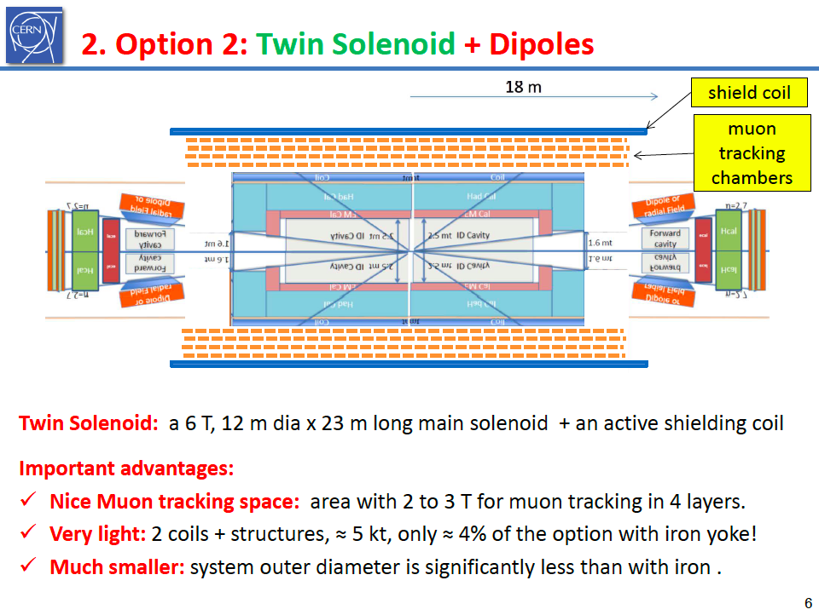
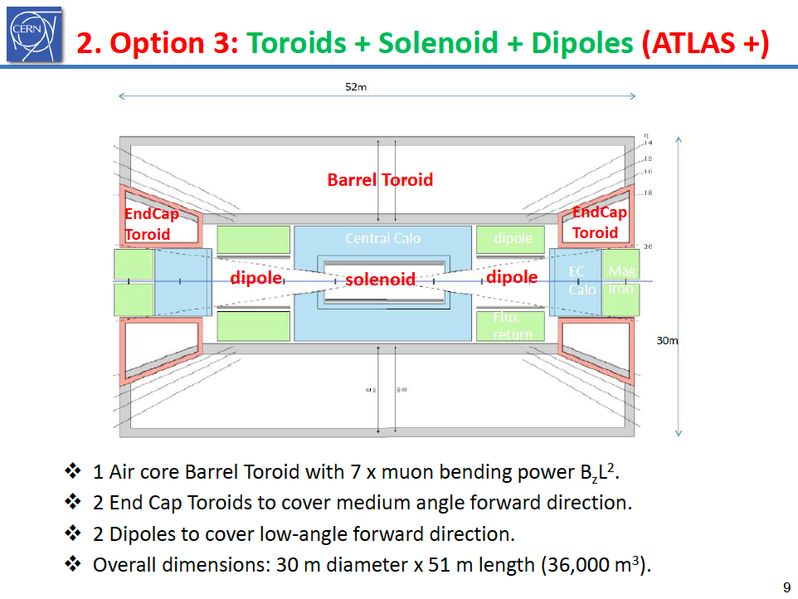
FCC-hh: GP expts: overview so far
Option 1
Option 2
Simulations of 2 magnetic designs (H. ten Kate et al) suggest these magnets could be built
Important now to : - decide on forward coverage of GP expts (or dedicated expts)
- study what could be achieved with future sensor resolution
+ more modest BL^{2.}

Slide 30
FCC-hh : particular needs
Tracking layout and performance for: i) existing sensor capabilities
ii) ambitious targets for point resolution & material
Focus on calorimetry: - granularity: channel count & consequences
- em & hadron calorimetry interplay
Trigger/DAQ: - develop from the bottom up (workshop needed)
Pileup mitigation: - software (recent workshop)
- detector & machine design: time resolution,
- lumi region shaping
Experiment interface to FCC: - Low β insertion: l* trade-offs, collimation,
shielding, backgrounds, radiation studies
beam pathology
- injector in FCC tunnel?
- construction/assembly/maintenance implications
- clustered or diametrically opposed collision points

Slide 31
At this point everybody needs SOFTWARE
→ turn paper studies into real simulations
including acceptance, resolution, PID, backgrounds & pile-up
→ study impact of detector properties on physics sensitivities
→ understand challenges and need for dedicated R&D.
Benedikt Hegner, Colin Bernet

Slide 32
FCC software for experimental studies: Goals
Software effort common to FCC-ee, FCC-hh and FCC-eh
  Conveners: Fabiola Gianotti, Patrick Janot until 5 September
    Now taken over by the experts: Benedikt Hegner (CERN) and Colin Bernet (IN2P3)
Goal is to find good solutions for
  Core framework
  Simulation
  Detector description
  Reconstruction
  Data Model
  Analysis
    Without starting a software effort from scratch
      i.e., pick up “existing” solutions / projects and choose pragmatically/wisely
        Gaudi
        Geant4, DELPHES, others
        DD4HEP, DDG4
        ?
        Inspired by LCIO
        C++ and python
A lot of synergies with
  PH-SFT, towards a turn-key universal framework
  ILC/CLIC (e.g., detector description, event data model)
  LHC (Gaudi & GaudiHive adapted from ATLAS, analysis framework adapted from CMS)
  AIDA2 (within which some of these efforts are carried out)

Slide 33
Complementarity
Proposed physics topics to be used in the study of synergy/complementarity among experiments at FCC-hh/ee/eh
Subject |  | ee | hh | he
Higgs Physics | precision studies higher dimension operators composite Higgs rare and exotic decays multiple Higgs production extra Higgs bosons
Interface with Cosmology | Dark matter baryogenesis right-handed/(almost) sterile neutrinos
Electroweak Sym. Breaking | WW scattering supersymmetry extra dimensions composite models
Flavour Changing | rare H,Z,W,top decays lepton flavor violation
Extensions of the SM | extra vector-like fermions SU(2)_{R} models leptoquarks
QCD | Perturbation theory, structure functions Modelling final states
EW/SM precision issues | precision measts (m_{Z},m_{W},m_{t},α,α_{s}(m_{Z}),sin²θ_{W}.R_{b}... higher-order EW corrections W,Z triple and quadruple couplings top (anomalous) couplings charm/bottom flavor studies

Slide 34
Where is Everybody?
At Higher Energies or at Very Small Couplings?

Slide 35
What we believe now and work to demonstrate in a few years:
The combination of the FCC machines offers outstanding discovery potential by exploration of new domains of
-- precision
and
-- direct search, both
-- at high energy and
-- at very small couplings

Slide 36
Extra slides

Slide 37
FCC Physics Coordination (Physco)
Meeting / activity | Present goals (as of April 2014) | who is present | Frequency
Physics Coordination Meeting (FCC-Physco) (Chair: A. Blondel until April 2015 Secretary: Mike Koratzinos) | • Ensure that all physics studies progress as one consistent endeavor • Define and align scope and milestones of physics studies • Propose physics topics to be used in the study of synergy/complementarity among experiments at FCC-hh/ee/eh • Track progress of individual physics study activities • Monitor/coordinate/promote talks on FCC physics at conferences and workshops • Identify technical and organizational questions which require further coordination Software platform theoretical calculations conference presentations repository of talks and papers, experimental R&D and infrastructures running scenarios and schedule general study management • Identify issues to be brought to attention to FCC coordination meeting | FCC Study leader and deputy; Hadron physics and experiments study leaders; Lepton physics and experiments study leaders; e-p physics and experiments study leader; others invited as required. ------------------------------ Accelerator: Benedikt Zimmermann FCC-hh: Gianotti Mangano Ball FCC-ee: Blondel Janot Ellis/Grojean FCC-eh: Klein/D’Onofrio | 1 / month or as needed (Thursdays 12:00-13:30) 5 February 20 March 10 April 8 May

Slide 38
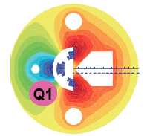
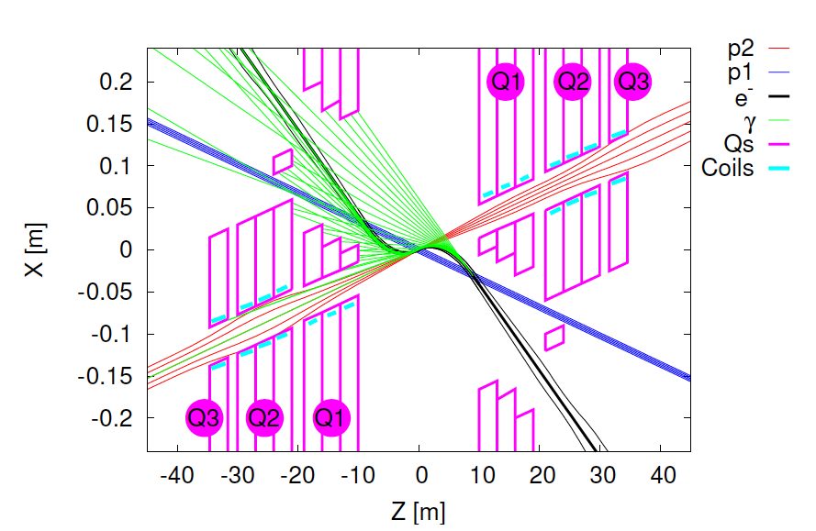
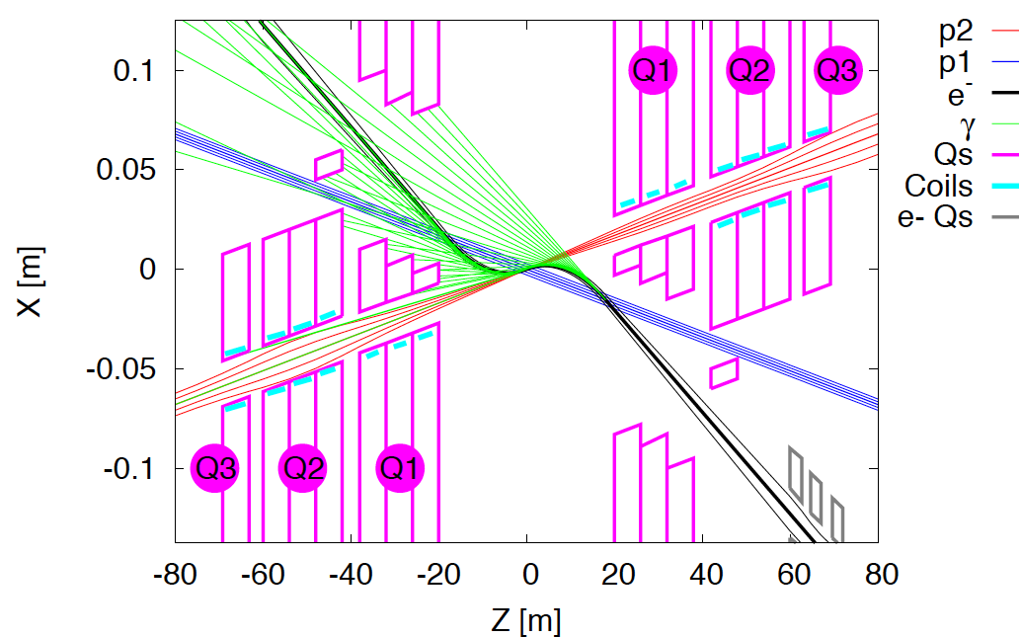
Interaction Regions for ep with Synchronous pp Operation
LHeC (CDR)
60 GeV * 7 TeV
Likely one IR.
Matching e and p beams
Limit synchrotron radiation
Design of inner magnets
Beam-beam effects ….
Non colliding p beam
Rogelio Tomas, Max Klein, ICHEP14
FCC-he (ERL)
60 GeV * 50 TeV
Tentative: ε_{p}=2μm, β*=20cm → σ_{p}=3μm ≈σ_{e} matched! ε_{e}=5μm ..

Slide 39
collider parameters | FCC ERL | FCC-ee ring |  | protons
species | e⁻ (e⁺?) | e± | e± | p
beam energy [GeV] | 60 | 60 | 120 | 50000
bunches / beam | - | 10600 | 1360 | 10600
bunch intensity [10¹¹] | 0.05 | 0.94 | 0.46 | 1.0
beam current [mA] | 25.6 | 480 | 30 | 500
rms bunch length [cm] | 0.02 | 0.15 | 0.12 | 8
rms emittance [nm] | 0.17 | 1.9 (x) | 0.94 (x) | 0.04 [0.02 y]
β_{x,y}*[mm] | 94 | 8, 4 | 17, 8.5 | 400 [200 y]
σ_{x,y}* [μm] | 4.0 | 4.0, 2.0 |  | equal
beam-b. parameter ξ | (D=2) | 0.13 | 0.13 | 0.022 (0.0002)
hourglass reduction | 0.92 (H_{D}=1.35) | ~0.21 | ~0.39
CM energy [TeV] | 3.5 | 3.5 | 4.9
luminosity[10³⁴cm⁻²s⁻¹] | 1.0 | 6.2 | 0.7
F.Zimmermann
ICHEP14, June
PRELIMINARY
L is 1000*HERA

Slide 40
FCC-hh physics studies: emphasis on new ideas and understanding implications of 100 TeV collisions for the exploration of BSM physics
Exploration of EW symmetry breaking (conv. R.Contino and H.Gray)
  High-mass WW and HH scattering
  Precision Higgs studies, rare production and decays
  BSM H dynamics, EW baryogenesis, etc
Exploration of BSM phenomena (conv. F.Moortgat, P.Schwaller)
  Discovery reach of various scenarios (SUSY, new interactions, contact interactions, …)
  DM searches
Continued exploration of SM particles (temp. conv. M.Mangano)
  Physics and precise measurements of top, W, Z
  Flavour phenomena (quarks and charged leptons, rare/forbidden decays, …)
Opportunities other than pp physics:
  Heavy Ions (conv. Dainese, Masciocchi, Wiedemann)
  Physics with the injectors (includes test beam) (conv. B.Goddard, G.Isidori, F.Teubert)
Theoretical tools for the study of 100 TeV collisions (conv. J.Rojo and G.Zanderighi)
  PDFs
  MC generators
  Higher order QCD adn EW corrections

Slide 41
FCC-hh detector (convener L.Pontecorvo)
Machine-Detector Interface (conveners B.Gorini and W.Riegler)
Detector performance
  Rapidity coverage (tracking, jets, b, lepts, MET)
  Calorimetry: dynamic range, granularity, for central and fwd regions
  Muon resolution at O(10 TeV)
  Bunch spacing optimization
Technical systems
  New detector technologies and R&D needs
  Radiation, shielding
  Calorimeters
  Muon systems
  Inner detectors, tracking
  Trigger, DAQ, controls and safety
Machine-Detector Interface (MDI)
  L*, TAS/TAN. Optics and impact on IR design
  Beam pipe and vacuum
  Radiation issues
  Physics and detector-protection instrumentation in the long straight sections

Slide 42
FCC software for experimental studies: Status
After three months of work
  Punctuated with 13 informal meetings (https://indico.cern.ch/category/5666/)
    Core framework infrastructure in active use
    First test setup for detector description in place (with bugs)
    Modest example workflow: histogram generated particles. We need much more!
    Simulation: DELPHES being integrated, but GEANT4 not yet integrated
    Data model needs to be worked on and integrated
    Nothing exists on reconstruction
    Analysis framework needs to be integrated
To come soon
  Documentation
  User training session (mid sept.)
Manpower is critical
  Less than one FTE for the time being
    Three students will start in Sept/Oct 2014
Parameterized
simulation
Fast
simulation

Slide 43
FCC software for experimental studies: Plans
More/faster progress require more participation from
  CERN
    Applied fellows, associates, invited scientists
  External institutes
    A number of projects / work-packages will be proposed momentarily
    ➔ Join the user training session
  CLIC / ILC software experts
    Towards the use / optimization of common and universal software
      (Geometry, data model, …)
  FCC detector groups (ee, hh, eh)
    Towards the parameterization / simulation of well-defined detectors
  FCC experimental study groups (ee, hh, eh)
    Generators to be interfaced
    Evaluation of simulation performance
    Benchmark analyses and analysis tools
For more information / organization / participation
  Contact Colin.Bernet@cern.ch and Benedikt.Hegner@cern.ch
    Subscribe to fcc-experiments-sw-dev@cern.ch

Slide 44
FCC-hh workshops and meetings
BSM at 100 TeV Workshop, Febr 10-11 2014, https://indico.cern.ch/event/284800/
1st Future Hadron Collider Workshop, May 26-28 2014, https://indico.cern.ch/event/304759/
Ions at the FCC, Workshop, https://indico.cern.ch/event/331669/
Experiments with the FCC injectors, https://indico.cern.ch/event/339178/
Periodic meetings:
  hh Indico (incl pp, HI and injectors): https://indico.cern.ch/category/5258/
  hh mailing lists:
    fcc-experiments-hadron@cern.ch (general)
    fcc-ions@cern.ch (heavy ions)
    fcc-experiments-physinj@cern.ch (physics with injectors)

Slide 45
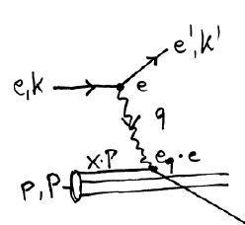
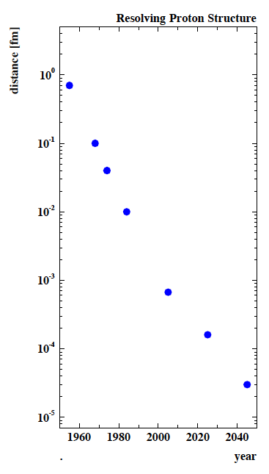
FCC-he: Deep Inelastic Scattering [eh → e’X]
e⁺e⁻
HERA-LHeC-FCC-eh: finest microscopes
with resolution varying like 1/√Q²
→
eh →
Finite p Radius
X
Stanford
→
Quarks
hh
SLAC
Deep inelastic ep and eA scattering complements pp and ee
From Hoftstatter to FCC-he: 100 years of eh scattering
CERN is the only place where new DIS experiments at the
energy frontier can be planned extending beyond HERA
(LHeC: ongoing study (CDR 2012) for ERL e beam + LHC)
FCC: options for 1 ep collision point :
ERL (of LHeC) on FCC-hh or FCC-hh on FCC-ee → FCC-he
FCC-he option Coordinated by Oliver Brüning and Max Klein
FNAL
Quark
Gluon
Dynamics
CERN
100 years of lp scattering
→ 5 orders of magnitude
deeper into matter
HERA
LHeC
?
FCC-he
electromagnetic radius

Slide 46
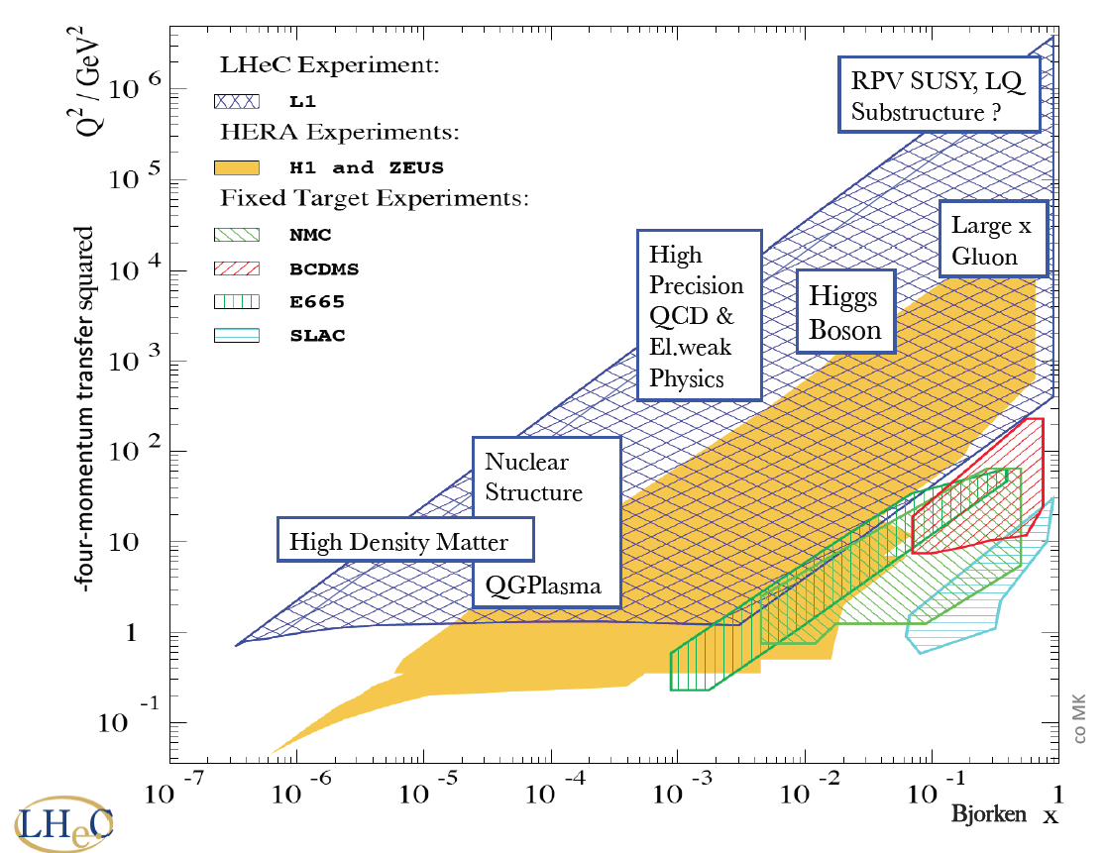
New dreieck
FCC_he

Slide 47
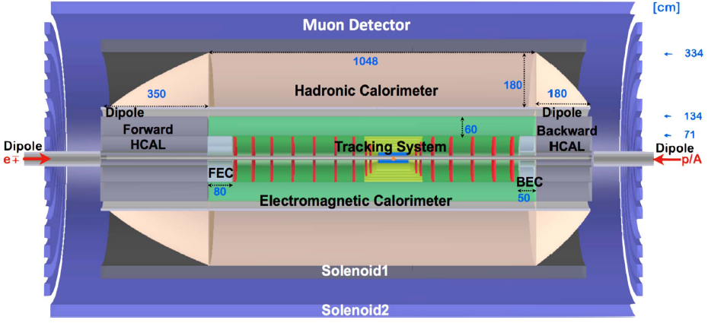
FCC-he Detector (B) – 0.1
Tentative design of detector for ep and eA physics with the FCC-he: 18m (l) x 9m (r)
High resolution of hadron energy and large forward acceptance for Higgs physics
High precision and full polar angle coverage for QCD, electroweak and BSM
Task: optimisation of design, full simulation, design of the interaction region
Goal: synchronous ep and pp operation from day 1 of p beam
P.Kostka, A.Pollini, M.Klein, H TenKate et al

Slide 48
