Slide 1
Superconducting magnet development for future high energy hadron colliders
Gijs de Rijk
10 January 2015
Epiphany conference
Krakow

Slide 2
Contents
The aim: 16 T, 20 T ( and beyond ?) for high energy colliders
Conductors for high field accelerator magnets: needs and availability
The challenge beyond 10 T
Earliest preparation for HL-LHC: LARP
US dipole R&D
High Field Magnet development in Europe
High Field Magnets for HILUMI-HL-LHC
Fresca2
HTS magnet development: EuCARD and EuCARD2 inserts
FCC first ideas

Slide 3
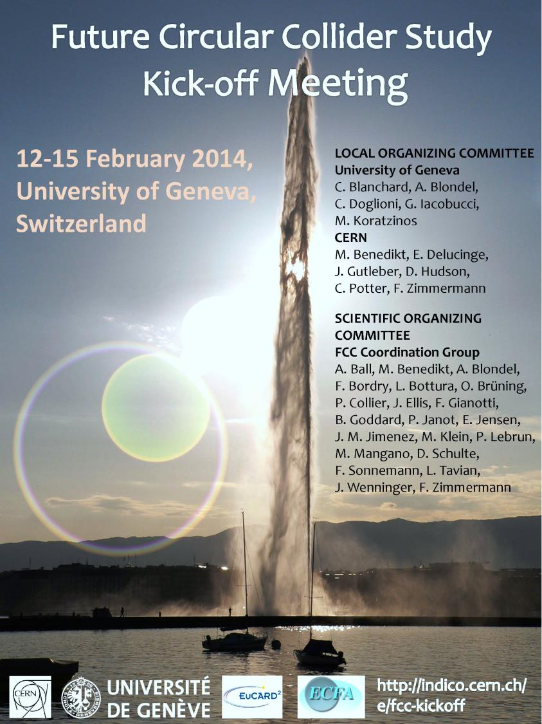
The aim: 16 T, 20 T (+ ?) for high energy colliders
Present studies for future high energy hadron colliders:
FCC-hh at CERN, two options under study
  100 TeV (com) in a 80 km ring with 20 T dipole magnets (baseline)
  100 TeV (com) in a 100 km ring with 16 T dipole magnets
  The FCC study was launched in February 2013
SppC Qinhuangdao China 50-90 TeV (com) in a 50-70 km ring (20T-16 T) but concentrating on the e⁺e⁻ option at the moment

Slide 4
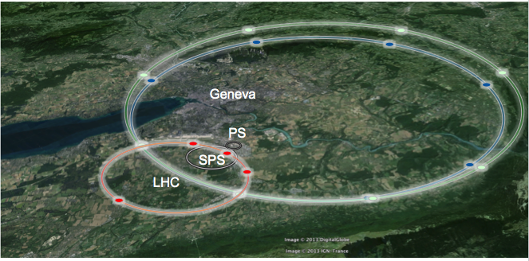
Some possible FCC-hh geometries
LHC
27 km, 8.33 T
14 TeV (c.o.m.)
HE-LHC
27 km, 20 T
33 TeV (c.o.m.)
FCC-hh
80 km, 20 T
100 TeV (c.o.m.)
FCC-hh
100 km, 16 T
100 TeV (c.o.m.)

Slide 5
FCC-hh main ring
For the FCC-hh main ring many new magnet types will be needed
Below are listed the very preliminary ideas for the 16 T option
 | B / G (T) / (T/m) | B_{peak} (T) | Bore (mm) | Length (units x m)
MB | 16 | 16.4 | 50 | 4500 x 14.3
MQ | 450 | 13 | 50 | 800 x 6
MQX | 225 | 13 | 100 | tbd
D1 | 12 | 13 | tbd | 4x2 x 12
D2 | 10 | 10.5 | tbd | 4x3 x 10

Slide 6
Conductors for high field accelerator magnets
The needs:
In order to attain high fields in a geometry that is practical in a tunnel:
J_{e} should be >400A/mm² (B prop. to width of coil and J_{e})
To have a good (<few units 10⁻⁴) ‘dynamic’ field quality the cable should be multi-filamentary to limit eddy currents
To keep the magnet “protectable” in case of a quench
J_{e} should be <600A/mm² (limiting the energy density per volume of coil)
I _{cable} should be >10kA (limiting the voltage at fast ramp-down and hence the inductance)

Slide 7
Conductors for FCC
16 T option
Nb₃Sn: (non-Cu part)
  J_{c} 2000 A/mm2 @ 15 T & 1.9 K
J_{c} 1400 A/mm2 @ 15 T & 4.2 K
20 T option
HTS:
  J_{e} 600 A/mm2 @ 20 T & 1.9 K (B perpendicular)
Nb₃Sn: (non-Cu part)
  2000 A/mm2 @ 15 T & 1.9 K
1400 A/mm2 @ 15 T & 4.2 K

Slide 8
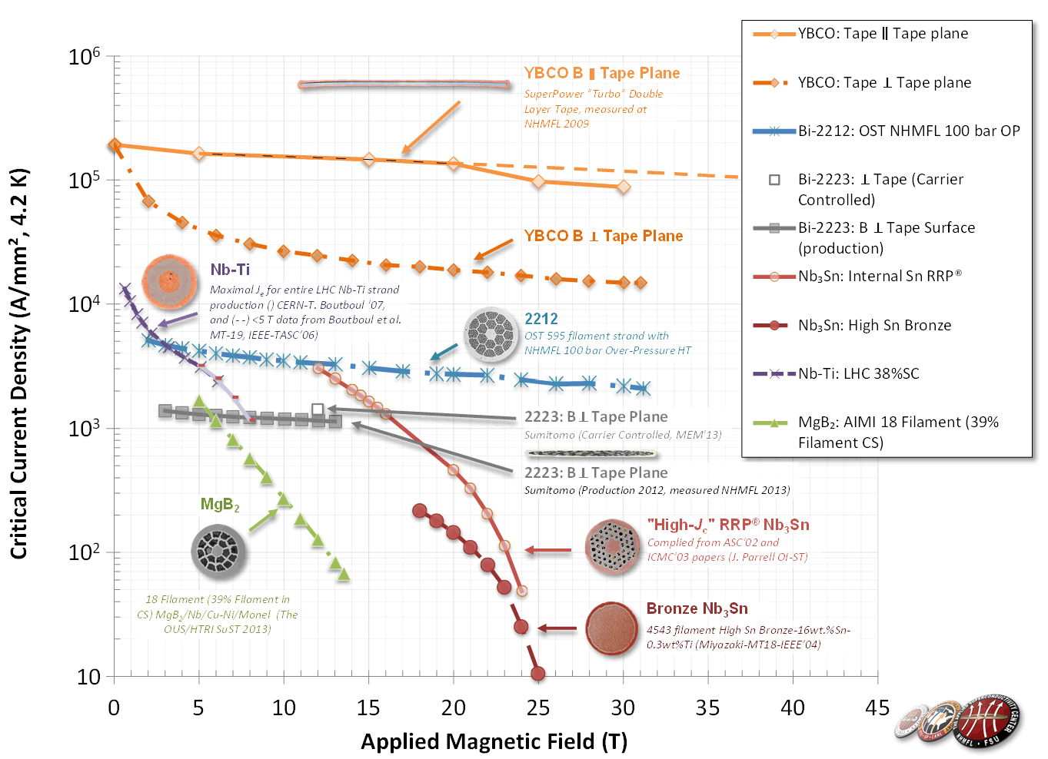
Available superconductors: J_{c}
(critical current density
in the superconductor J_{c})

Slide 9
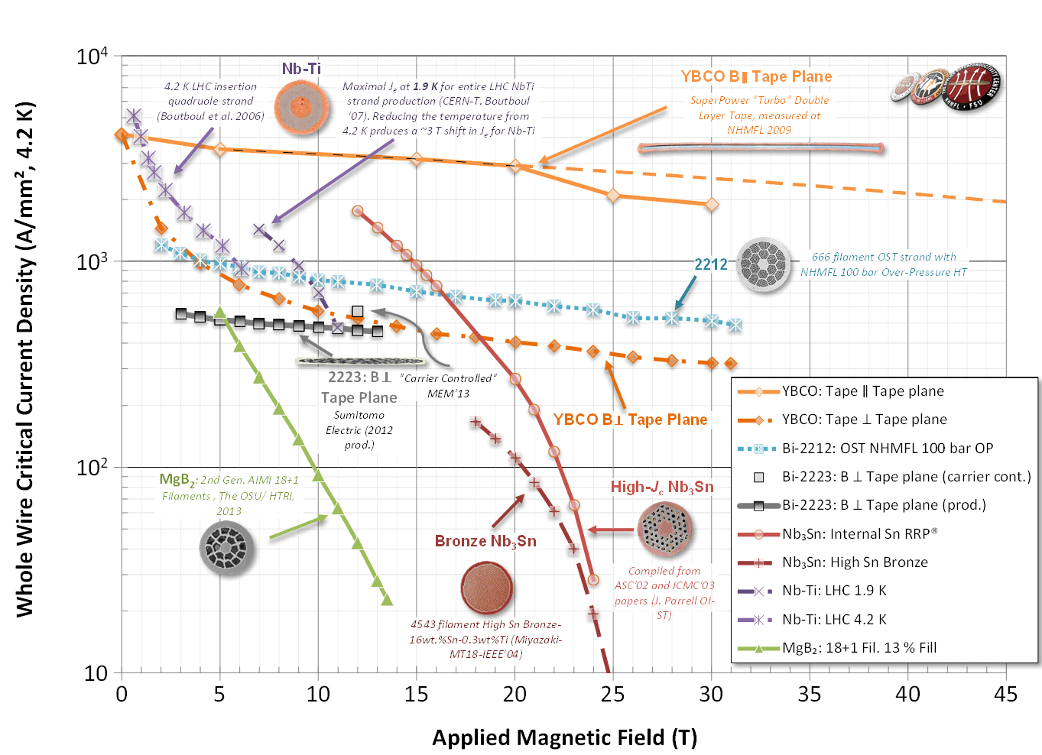
Available superconductors: J_{e}
(Engineering critical current density J_{e})

Slide 10
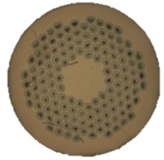
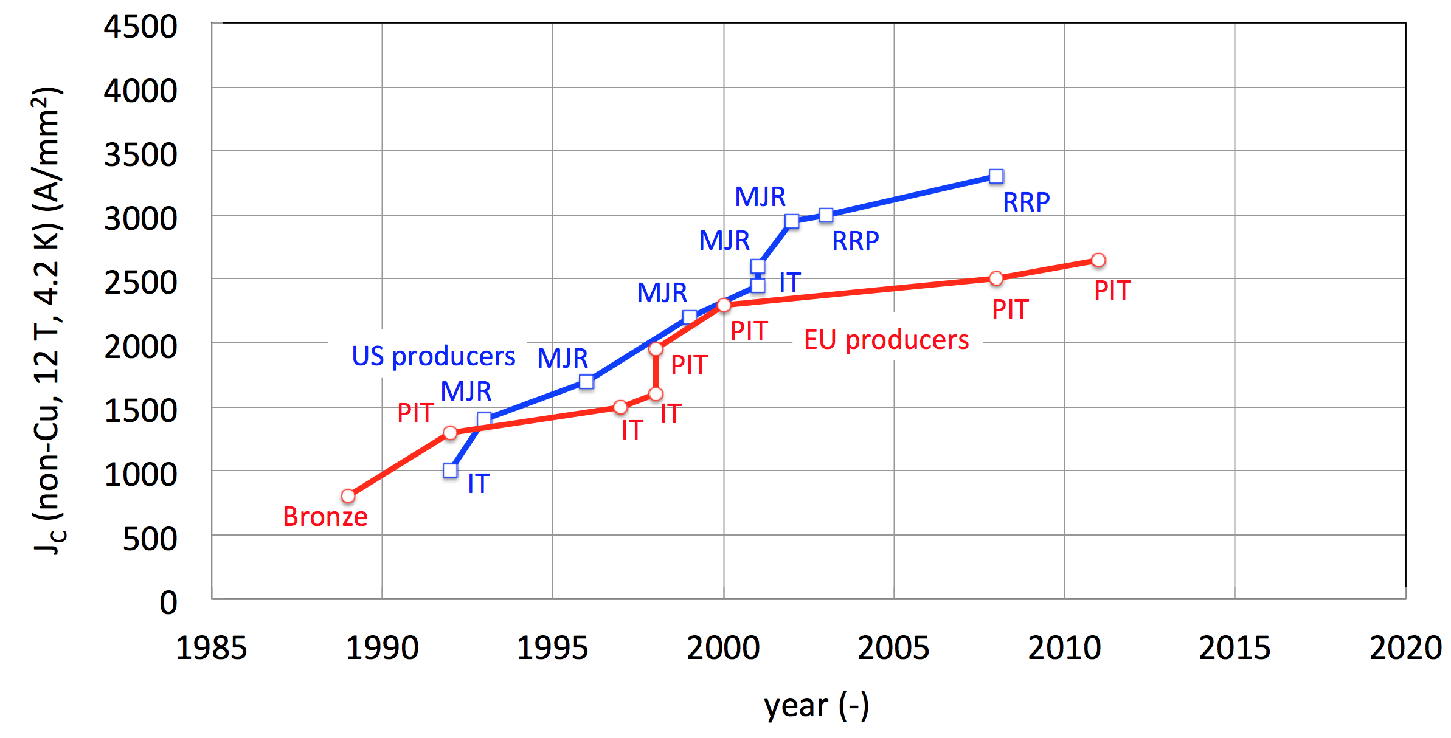
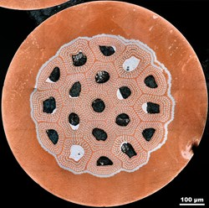
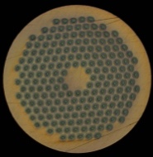
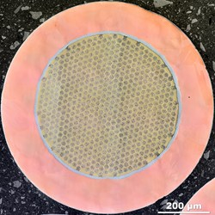



Nb₃Sn conductor Jc development
HL-LHC
ITER
FCC specs
HL-LHC specs
CARE-NED
EuCARD
US-CDP
FCC

Slide 11
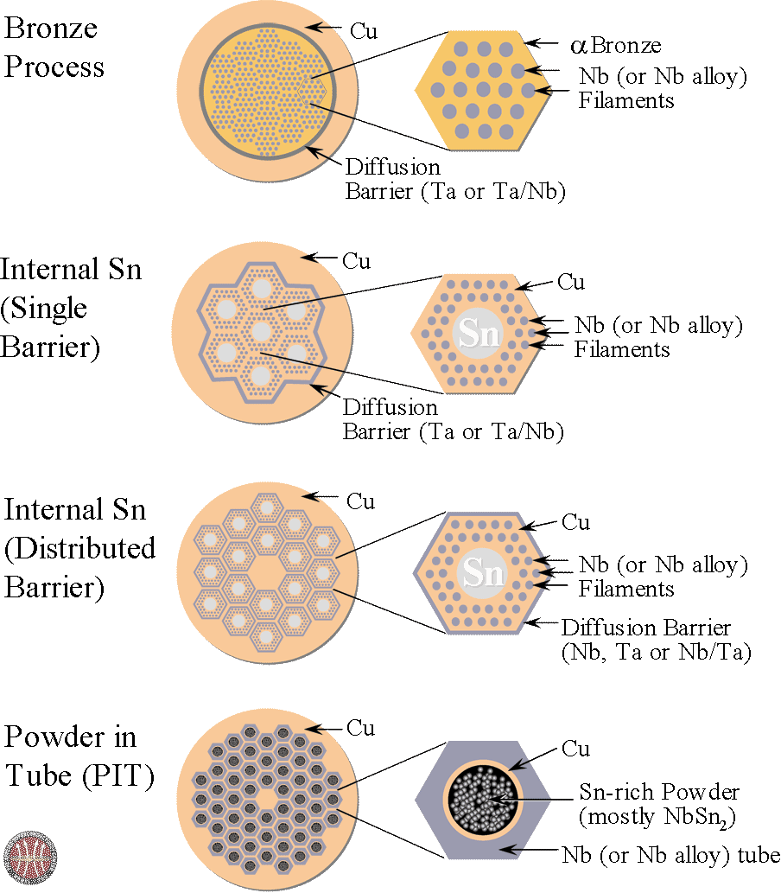
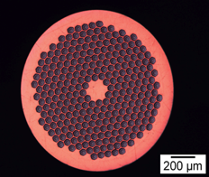
Nb₃Sn strands
Nb₃Sn for High Field Magnets
examples
OST (US)
  Restacked Rod Process (RRP) for High Energy Physics (r= 0.7 mm or 0.8 mm, J_{c} up to 3000 A/mm²@12T, 4.2 K, filaments~50 μm, Cu-nonCu=0.9)
EAS-Bruker (De)
  Powder in Tube (PIT) for HEP and others (r=1 mm, J_{c} up to 2400 A/mm²@12T , 4.2 K, filaments ~50 μm, Cu-nonCu=1.25)
To be reacted at 650°C for ~120 hr

Slide 12
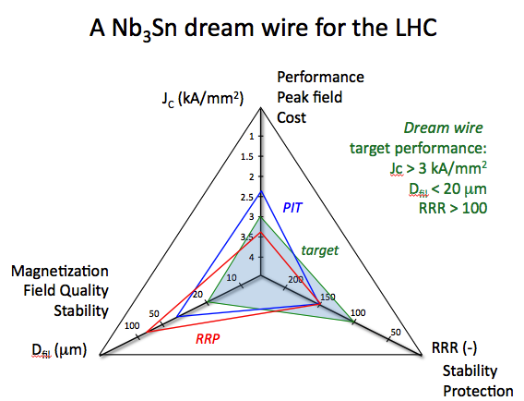
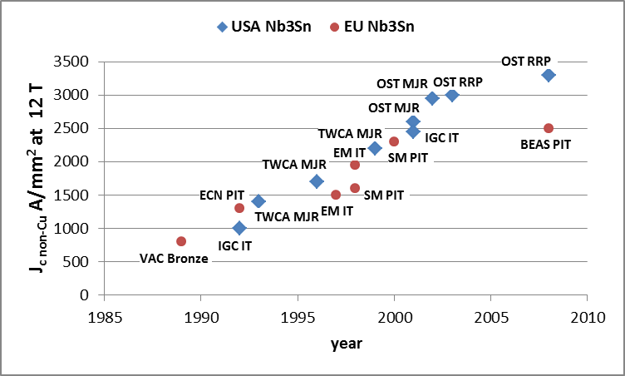
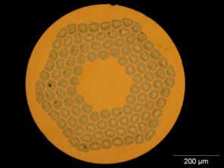
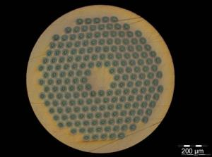
Nb₃Sn Conductor for HEP
Courtesy L. Bottura, B. Bordini
Between HL-LHC and FCC the Jc target shifts from 12 T to 16 T !
0.7 mm, 108/127 stack
RRP from Oxford OST
1 mm, 192 tubes
PIT from Bruker EAS

Slide 13
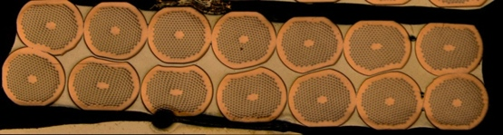
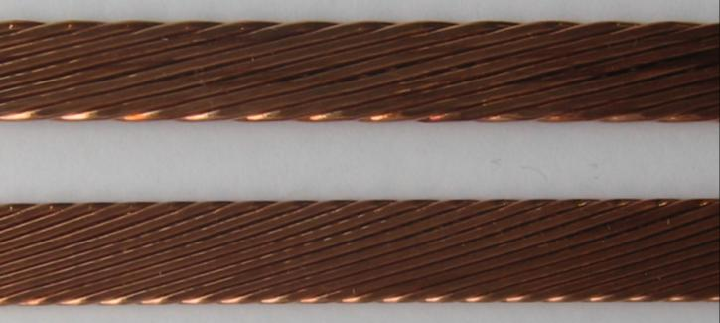
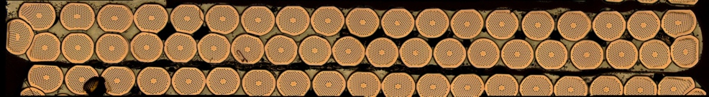
Nb₃Sn cables for the CERN HFM Program
Cabling tests were performed on several variants of strands/cable sizes to explore the space of parameters, and among others: dimensions, compaction, twist pitch, cabling angle and cabling force, …
Cabling degradation was reduced from 45 % (worst case) to negligible (within the scatter of measurements of extracted strands)
SMC Dipole cable – 14 strands (1.25 mm) and
18 Strands (1 mm), Width = 10 mm, Twist Pitch = 60 mm
Average I_{C} degradation 0 … 4 %
Cabling by L. Oberli and A. Bonasia (CERN)
Fresca 2 Dipole cable – 40 Strands (1 mm)
Width = 20.9 mm, Twist Pitch = 120 … 140 mm
Average I_{C} degradation < 15 %
DS Dipole cable – 40 Strands (0.7 mm)
Width = 14.7 … 15.1 mm, Twist Pitch = 100 mm, 0.8° keystone
Average I_{C} degradation < 3 %

Slide 14
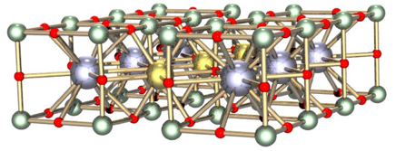
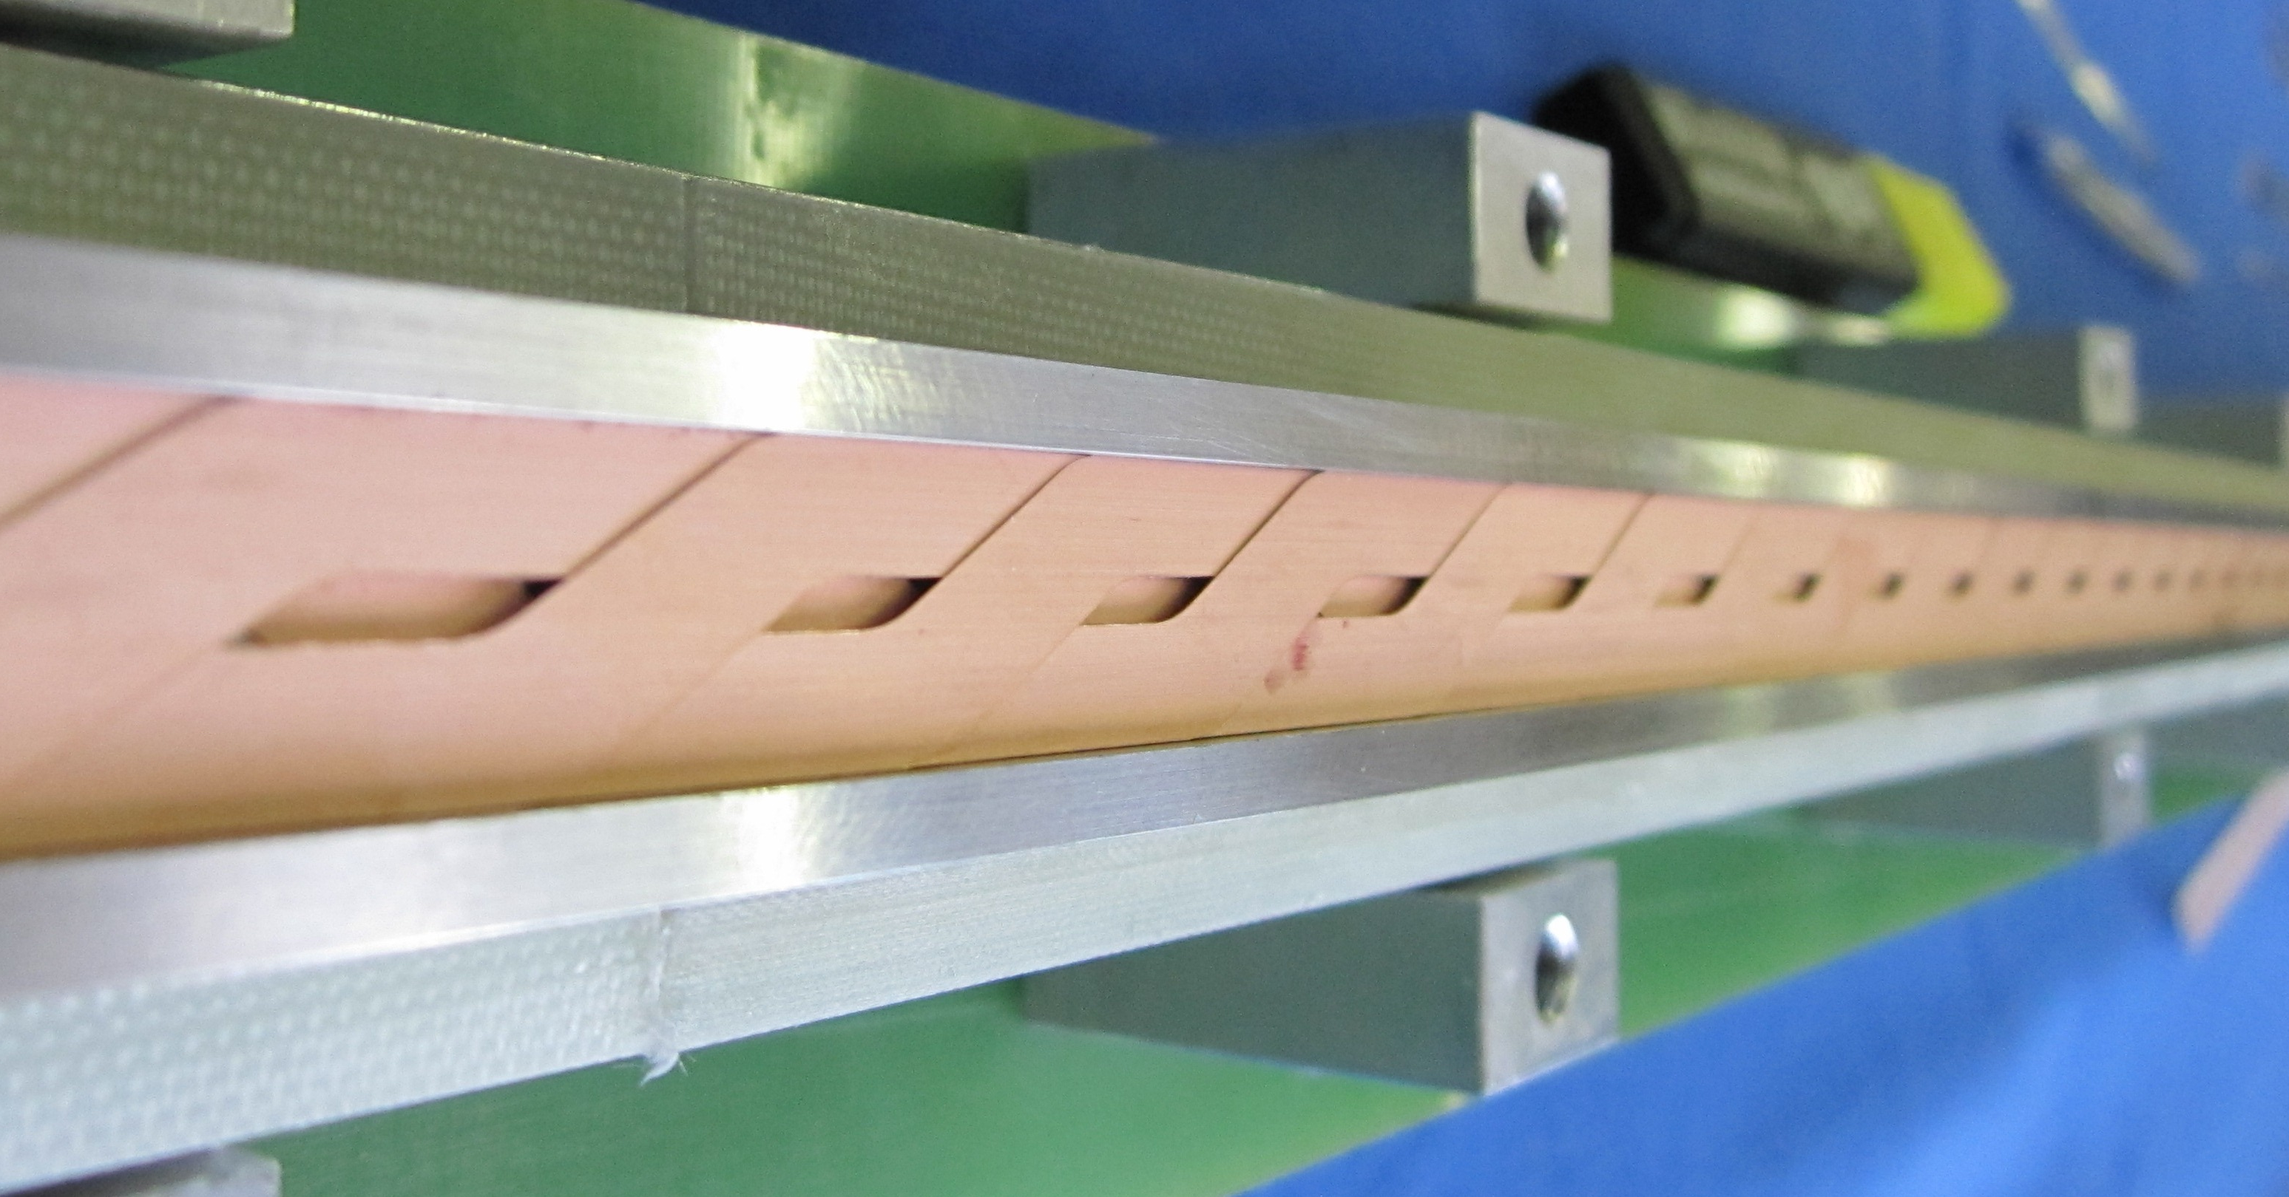
Superconducting tapes: YBCO
YBCO: Yttrium barium copper oxide
Available in tapes : YBCO deposited on a substrate to impose the texture (1-2 μm)
Can reach > 600 A/mm² (overall) but serious issue is the anisotropy
Is strong under axial stress and strain
Limited cabling possibilities:
Difficult technology but could be promising for high field magnets in >18 T region.
A

Slide 15
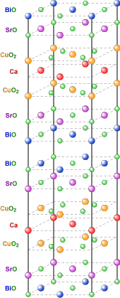
Superconducting strands and tapes: BSCO
BSCO: Bismuth strontium calcium copper oxide
Available in strands (OST)
Can reach 400 A/mm² (overall)
Is fragile under stress and strain
Powder in a silver tube
Has to be reacted at 850°C with a temperature precision of 1°C in an oxygen atmosphere
Can be cabled in high current Rutherford cables
Difficult technology but could be promising for high field magnets in >20 T region

Slide 16
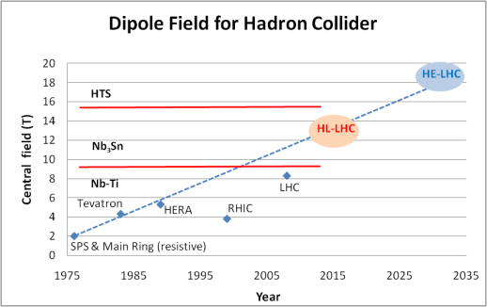
The magnet challenge beyond 10 T
HL-LHC will be a first for Nb3Sn magnets in accelerators and an intermediate step towards the future machines
FCC

Slide 17
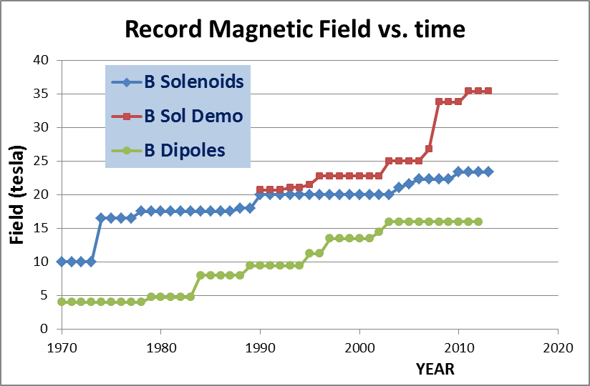
Comparison between dipoles and solenoids
We can see roughly a factor 2 due to Coil «efficiency» and to force-stress management

Slide 18
The magnet challenge beyond 10 T
Existing magnets for machines and test models
Nb-Ti : blue diamonds, nominal field
Nb₃Sn: red squares, maximum field
As a rule magnets are used with ~20% margin (nominal = 0.8 x maximum)

Slide 19
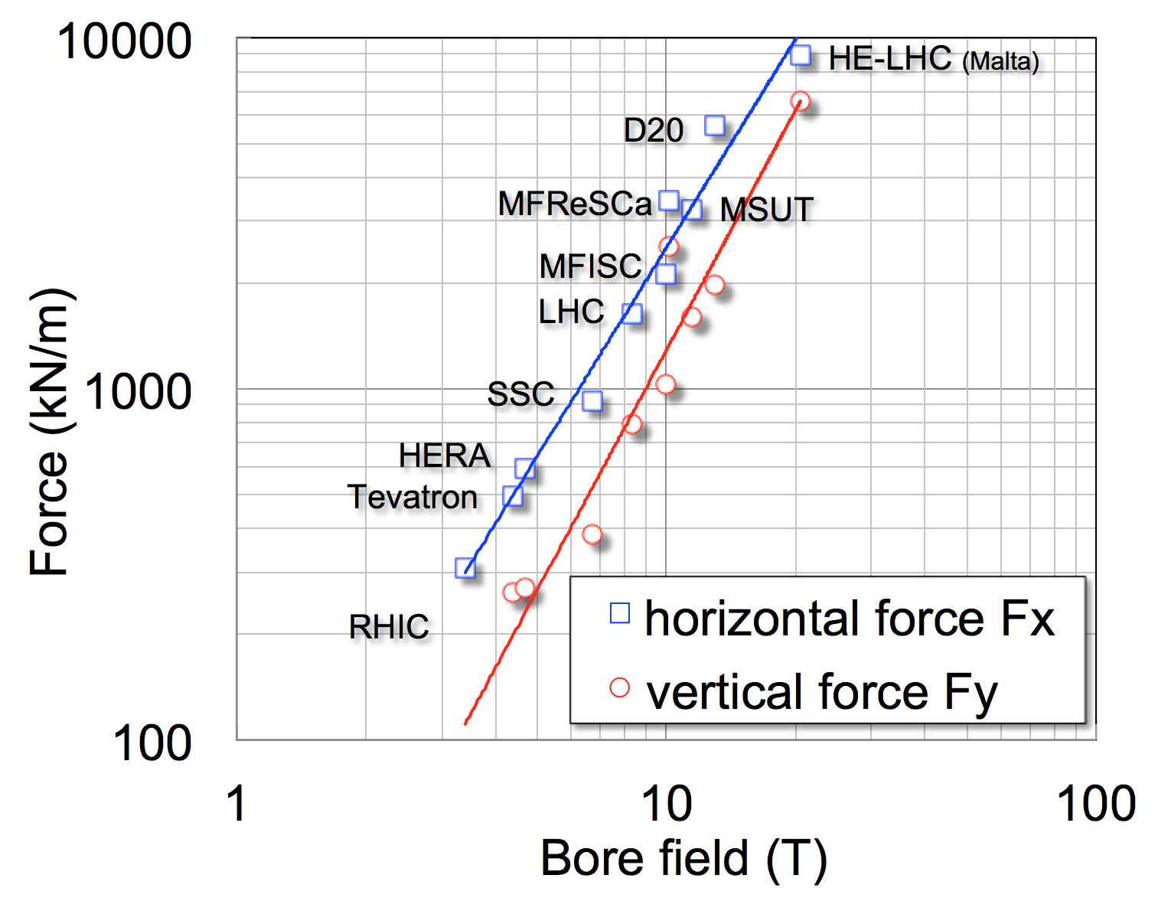
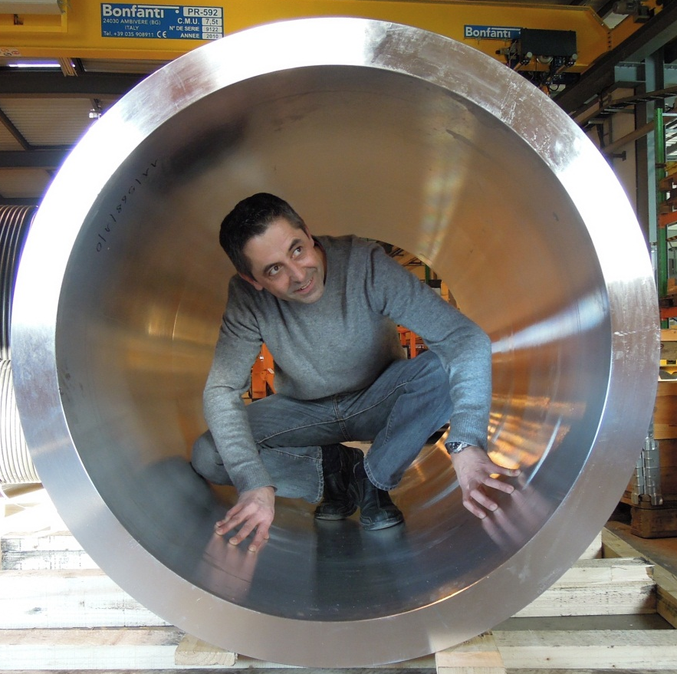
Forces (and mechanics)
The electromagnetic loads in a 20 T dipole would be a factor 5 to 8 larger than in the LHC dipole
Scaling of force on coil quadrant in recent production and R&D dipoles
x 5
The supporting shell for a 15T-class magnet, with apologies to J.-C. Perez, CERN

Slide 20
Around and beyond 10 T before 2004
Already for the LHC in 1986 Nb₃Sn was considered an option for the 10 T magnets which were then foreseen. The magnet by Asner-Perin 1987 went up to 9.5 T at 4.2 K. Many problems though remained in the manufacturing.
In 1995 Twente constructed the MSUT that was powered up to 11 T.
For the VLHC studies FNAL designed the HDFA magnet series that attained 9.4 T (@4.2 K)
The D20 magnet of LBNL (still) has the field record in a dipole aperture at 13.8 T. With the HD1 LBNL reached 16 T in a 8 mm aperture (much too small for an accelerator)
Texas A&M ( P. McIntyre) is working on a block coil dipoles with ‘stress management’

Slide 21


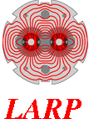


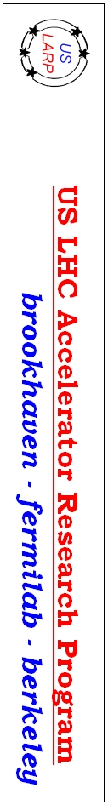
LHC IP Quadrupole design and technology evolution
Aperture (optics)
70
90
120
150
Courtesy L. Bottura

Slide 22
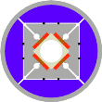
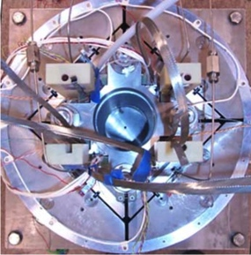


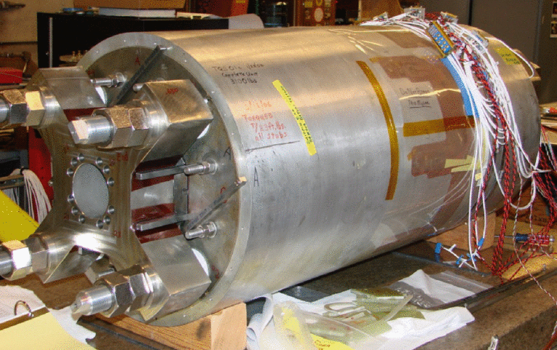
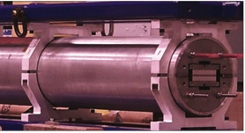
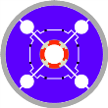

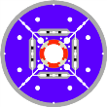
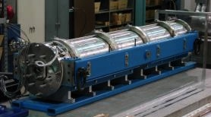
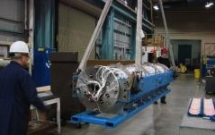
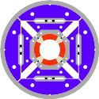
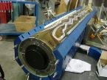
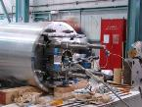
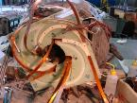
LARP: Ten years of intense R&D
Subscale Quadrupole
SQ
0.3 m long
110 mm bore
2004-2006
SQ02
TQS01
LRS01
Technology Quadrupole
TQS - TQC
1 m long
90 mm bore
2006-2010
Long Racetrack LRS
3.6 m long
No bore
2006-2008
LQS01
LQS03
Long Quadrupole LQS
3.7 m long
90 mm bore
2007-2012
HQ01b-c
HQ01d-e
HQ02
High Field Quadrupole HQ
1 m long
120 mm bore
2008-2014
Courtesy G. Sabbi & H. Felice

Slide 23
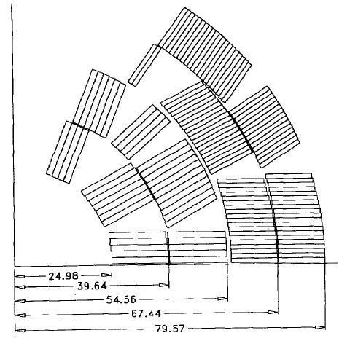
US dipole R&D, LBNL
Since 20 years LBNL is running a high field dipole development program
Some achievements:
D20, 50 mm aperture, cosΘ 4 layer dipole, reached 12.5 T
HD1, flat block coil, 8 mm aperture, reached 16 T
HD2, flared end block coil, 36 mm aperture, reached 13.8 T
These pose a clear breakthrough abode 10 T with a new coil layout (block coil) and a new mechanical structure (shell-bladder and keys) aimed at high fields
D20
Courtesy, P. Ferracin, LBNL

Slide 24
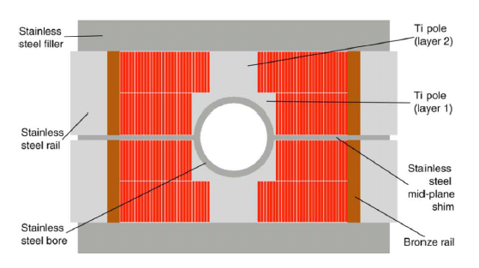
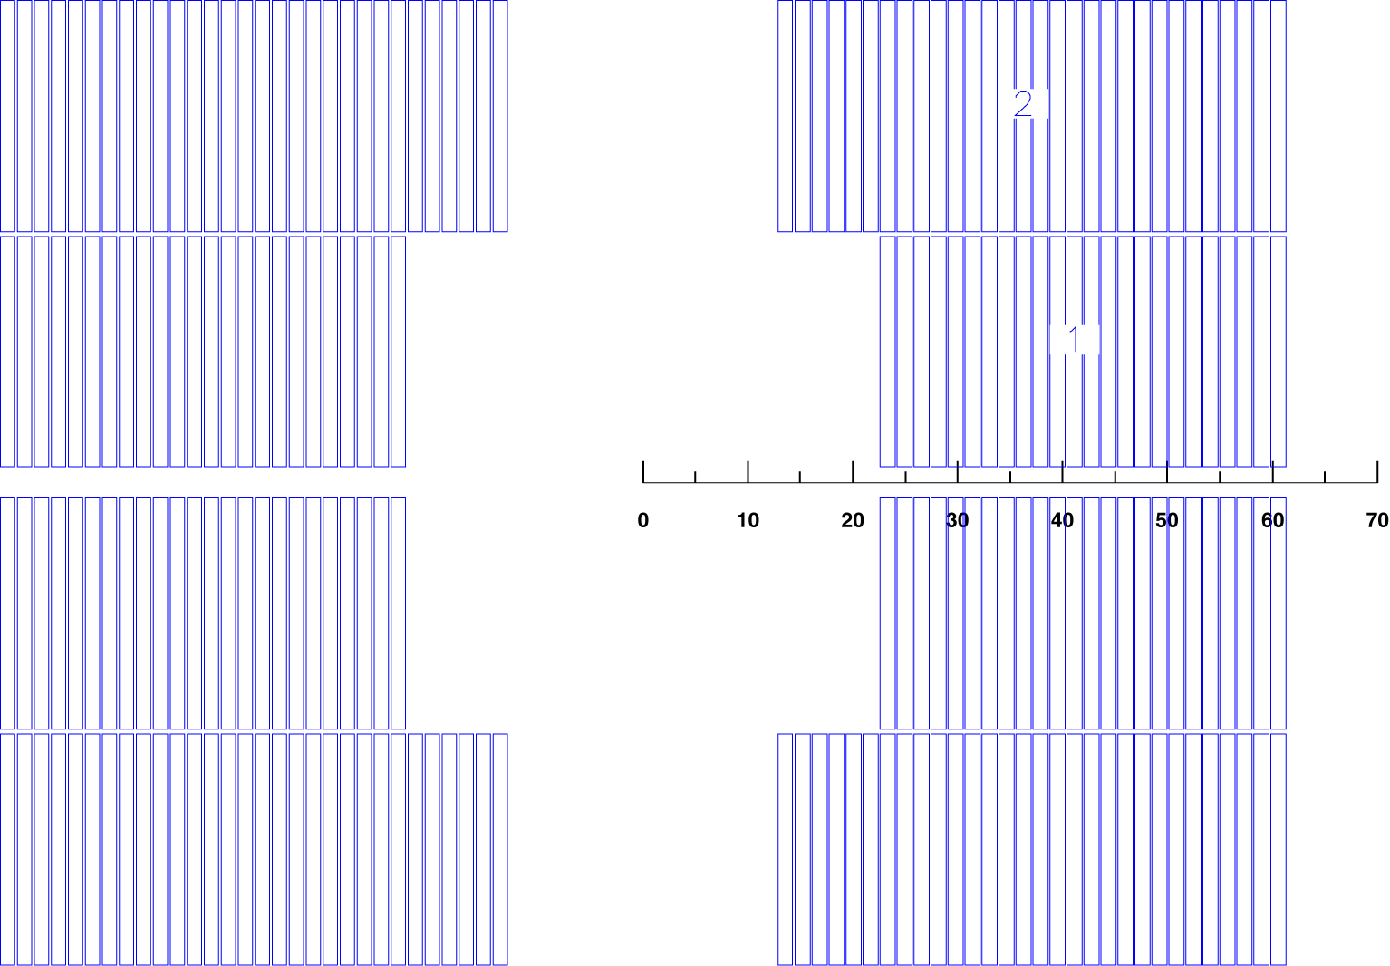
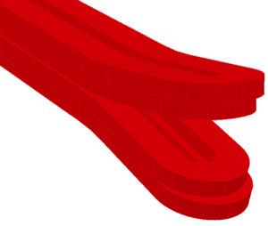
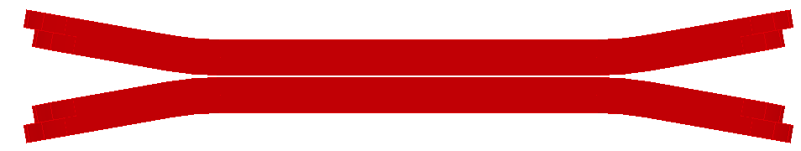
LBNL block coil designs
Block coil
  Used with thick coils the field quality is good
    Not yet used in accelerators
  Is less efficient (~10%) wrt to cos(Θ) for quantity of superconductor used
  The EM forces cause a stress buildup at the outside edge of the coil where the fields are lower
  The straight part is very easy : rectangular cable and wedges (field quality)
  ‘flared ends’ look easy but there is little experience exists to make them
HD2
Courtesy LBNL

Slide 25
High Field Magnet development program in Europe
Some history of HFM development in Europe
2004-2008 FP7-CARE-NED project (Next European dipole)
  Development of European accelerator grade Nb₃Sn conductor ➔ Powder In Tube (PIT) conductor now available from Brucker
  Various studies on design options and materials
2009-2013 PF7-EuCARD-HFM project (High Field Magnets)
  Development of a 100mm aperture 13 – 15 T Nb₃Sn dipole “Fresca2”
  Development of an HTS insert with ΔB = 6 T (inside Fresca2)
  Development of an HTS current link
  Development of a Nb₃Sn helical undulator
2008 – 2014 CERN High Field Magnet project
  Development of Nb₃Sn technology magnets for LHC upgrades and new projects (conductor, small models, materials, etc)

Slide 26
High Field Magnet development program at CERN
Present structure of the HFM development
Present – 2016 HL-LHC (HILUMI) HFM magnet development
  140 T/m 150 mm aperture low beta Nb₃Sn quadruple (QXF) (LARP-CERN collaboration)
  11T Nb₃Sn dipole for dispersion suppressor (FNAL-CERN collaboration)
2014 – 2017 FCC study
  Design study for 16 T dipole
  Design study for 20 T dipole
2013 – 2017 FP7- EuCARD2- MAG (Future Magnets)
  Development of 10kA HTS cable for accelerator magnets
  Development of an accelerator quality 5 T HTS dipole

Slide 27
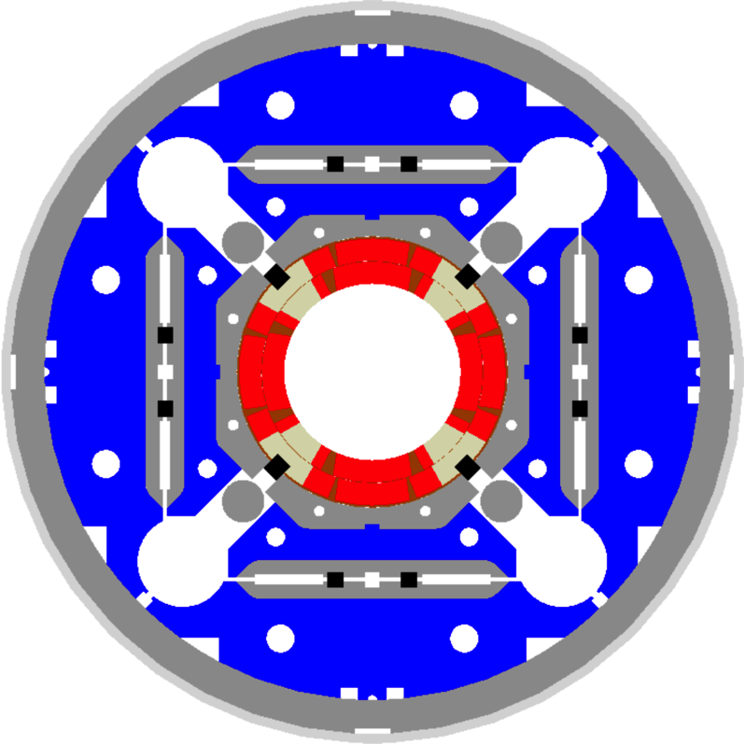
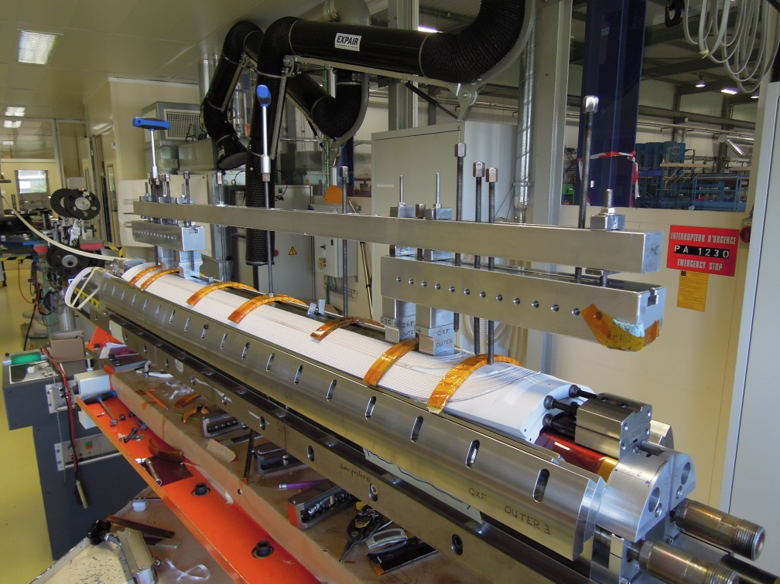
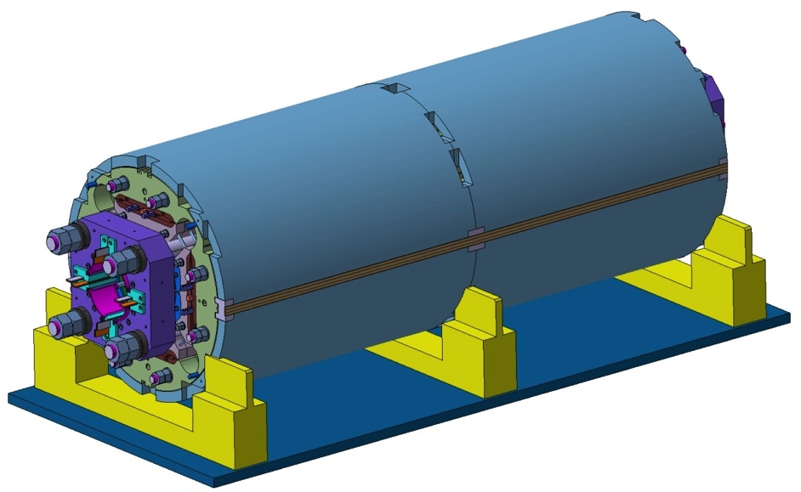
HL-LHC: MQXF low beta Nb₃Sn quadrupole magnet
A CERN LARP collaboration.
Nominal Gradient 140 T/m Aperture diameter 150 mm
Peak Field 12.1 T
Current 17.5 A
Loadline Margin 20% @ 1.9 K
Stored Energy 1.32 MJ/m

Slide 28
HL-LHC: MQXF low beta Nb₃Sn quadrupole magnet
Both in at US-LARP and CERN first coils are under construction:
First magnet test at FNAL with US and CERN coils in 2nd half 2015

Slide 29
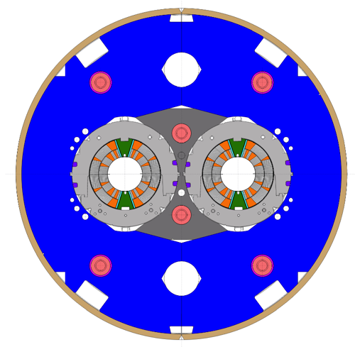
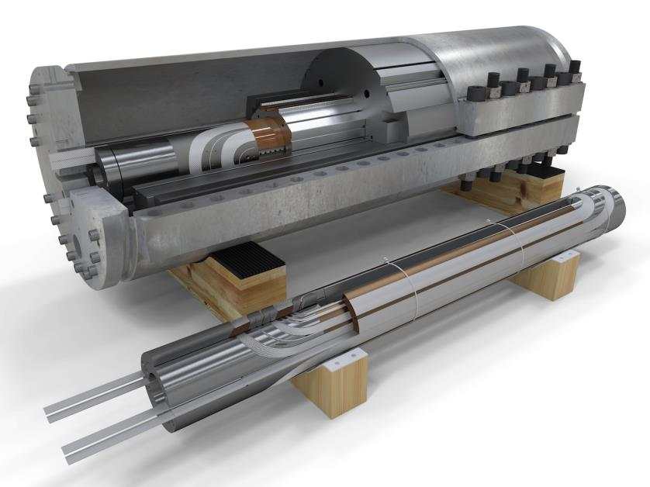
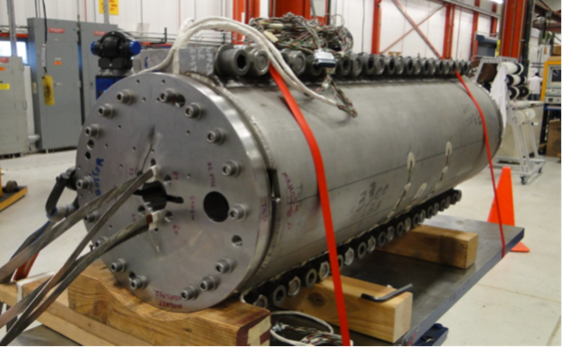
HL-LHC: 11 T Dispersion suppressor magnet
First Nb3Sn magnet to go into an accelerator (2018) !
Present model program (CERN and FNAL)
  demonstrating the required performance (11.25 T at 11850 A) and Achieve accelerator field quality
Nominal Field 11 T
Aperture diameter 60 mm
Peak Field 11.35 T
Current 11.85 kA
Loadline Margin 19.7% @ 1.9 K
Stored Energy 0.96 MJ/m
FNAL MBHSP02 ready for test
CERN coil
NOTE: virtual reality model
By courtesy of D. Mitchell, F. Nobrega (FNAL) and M. Karppinen (CERN)

Slide 30

HL-LHC: 11 T Dispersion suppressor magnet
Complete feasibility to be shown this year at CERN with 2m models (field, field quality,
Meanwhile long magnet construction being set up.
The first 2 units to be installed in LS2 in DSs of IP2
This will be the first Nb₃Sn magnet to be used in an accelerator: important prove of concept for the future
FNAL several models tested: attained 11T
CERN first model: attained 11T

Slide 31

EuCARD high field dipole FRESCA2: Nb₃Sn dipole magnet for cable test facility
Nominal Field 13 T
Aperture diameter 100 mm
Peak Field 13.2 T
Current 10.7 A
Loadline Margin 20% @ 4.2 K
Stored Energy 3.6 MJ/m

Slide 32





EuCARD high field dipole (Fresca2)
Fresca2 : CERN, CEA construction phase
First tests end 2015
156 turns per pole
Iron post
B_{center} = 13.0 T
I_{13T} = 10.7 kA
B_{peak} = 13.2 T
E_{mag} = 3.6 MJ/m
L = 47mH/m
Diameter Aperture = 100 mm
L coils = 1.5 m
L straight section = 700 mm
L yoke = 1.6 m
Diameter magnet = 1.03 m
42
42
36
36
Courtesy Attilio Milanese, Pierre Manil

Slide 33


FRESCA2: Nb₃Sn dipole magnet for cable test facility
Coil fabrication
Cu coil layer 1-2 reacted
Cu coil layer 3-4 impregn.

Slide 34



FRESCA2: Nb₃Sn dipole magnet for cable test facility
Support structure
Qualification with dummy coil completed after 3 pre-loads and cool-downs

Slide 35





SMC/RMC: race track development magnets
FReSCa2
Nb₃Sn Dipole
Short Model Coil
Race-track
Model Coil
RMC (Racetrack Model Coil)
SMC (Short Model Coil)
Horizontal Pad
Nb₃Sn Coil
Vertical Pad
Electrical connexion box
Laminated Yoke
Aluminium Shell
Longitudinal Rods

Slide 36





SMC/RMC: race track development magnets
RMC coil winding
RMC coil ready for reaction
RMC mechanical assembly
Test results SMC 11T #2
RMC finished coil

Slide 37


EuCARD, 6 T insert
Insert conductor is composed of three tapes
12 mm (nominal)
CuBe2 + polyester insulation (100 + 30 μm)
130 µm
Contact
Hastelloy + sc (65 μm)
460 μm
Cuopper 70 μm
200 μm
Contact
Hastelloy + sc (65 μm)
CuBe2 + polyester insulation (100 + 30 μm)
130 μm
B0 = 6 T
Je= 250 A/mm2
Bpeak= 5,87 T
Inom = 2400 A
Electron-beam welding
3 double layers coils
External pads, 316L
8/9 parts, Electron-beam
welded
After a long development phase the assembly is starting now
First stand alone test Q3 2015
Test in Fresca2 outsert end 2016
External tube, Nitronic 40
- 8 parts,
- Thermal shrinkage
- TIG welding
Iron pole
Compression plates, 316L

Slide 38








EuCARD2: 5T HTS dipole
YBCO HTS, 40 mm clear aperture, 5 T in stand alone & 17 T in Fresca2 dipole background field
Aligned coil block dipole
Short Sample in
different position
High Force Structure
Cable aligned with field
Roebel tape cable 10 kA
Angular dependent cable
Current distribution

Slide 39





Explotring new ideas: Aligned coil block dipole
PhD work Jeroen van Nugteren

Slide 40






Alternative EuCARD2 dipole designs
Block with stacked tapes YBCO cable
JE = 400 A/mm²
Courtesy: John Himbele (CNRS- Grenoble)
Cosine-Theta with YBCO cable
Courtesy: Clément Lorin (CEA)

Slide 41



FCC : Strawman coil design for 16 T and 20 T
From: E. Todesco, IEEE TAS, 24(3), 2014, 4004306
15 T “Snowmass” design
4578 units (+ 160 spares)
1000 tons of LHC-grade Nb-Ti
3500 tons of HEP-grade Nb₃Sn
16 T Nb3Sn block (2014)
20 T “Malta revised” design
3662 units (+ 120 spares)
1000 tons of LHC-grade Nb-Ti
3000 tons of HEP-grade Nb₃Sn
750 tons of HTS

Slide 42


Coil configuration for 20 T
Scan of possible configurations with YCBO-Nb₃Sn-Nb-Ti grading (Thesis J. van Nugteren)

Slide 43







New (old) design very suitable for Bi-2212 (LBNL, FNAL…)

Slide 44
Conclusions
There is an active High Field accelerator Magnet R&D program running in Europe and the US
The principle aim is to prepare for FCC, a 100 TeV hadron-hadron collider
Two main development road are being pursued for FCC
  16 T dipoles
  20 T dipoles
Development of HF quadrupoles is being defined at the moment
HL-LHC is also to be seen to show the feasibility for accelerator magnets >10T; ie. with Nb₃Sn instead of Nb-Ti conductor
Exciting times ahead !

