Slide 1



AWAKE: Advanced Proton Driven Plasma Wakefield Acceleration Experiment at CERN
Edda Gschwendtner
on behalf of the AWAKE Collaboration

Slide 2
Outline
Introduction
AWAKE at CERN
AWAKE: 1st Phase
AWAKE: 2nd Phase
The Experimental Facility at CERN
Planning and Next Steps
Summary

Slide 3
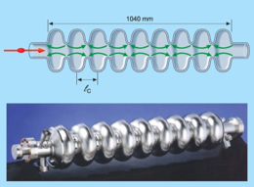
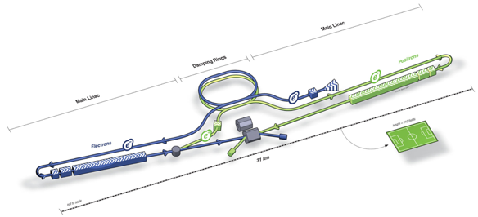
Main Driver for PWFA: Linear Collider
➔ Build a High energy collider at TeV range!
Linear collider based on RF cavities:
Accelerating field limited to <100 MV/m
  Several tens of kilometers for future linear colliders
  For example ILC:
    31km long
    500 GeV electrons
    16 superconducting accelerating cavities made of pure niobium
    Gradient of 35 MV/m
1000mm
ILC
Linear collider based on plasma wakefield acceleration:
Plasma can sustain up to three orders of magnitude higher gradient
  → Much shorter linear colliders!

Slide 4
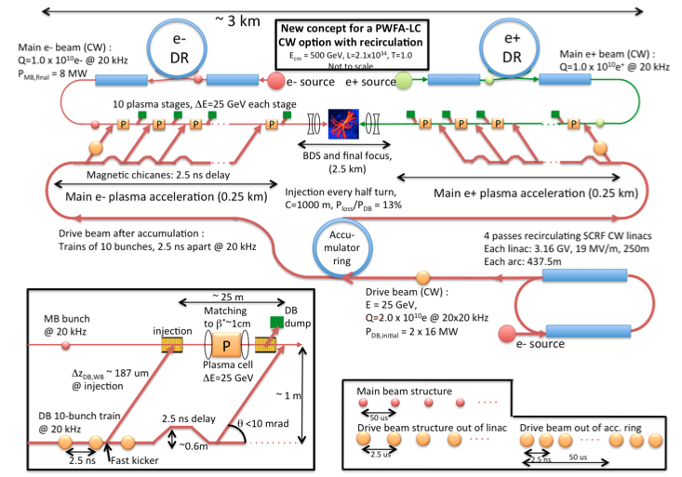
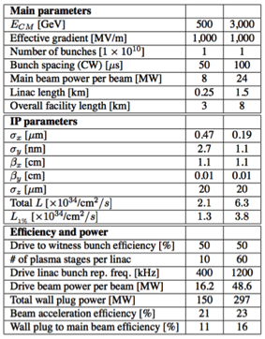
Main Driver for PWFA Research: Linear Collider
Aim to reach accelerators in the TeV range!
GeV
500
3000
km
3
8
* J.P.Delahaye, E. Adli et al., White Paper input to US Snowmass Process 2013

Slide 5
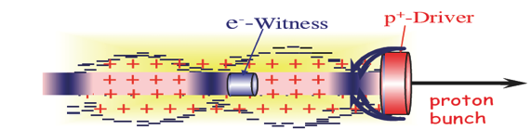

Plasma Wakefield Acceleration Principle
Ez
Plasma wave is excited by a relativistic particle bunch.
Space charge of drive beam displaces plasma electrons.
Plasma electrons attracted by plasma ions, and rush back on-axis.
→ deceleration
→ acceleration
Size of the accelerating structure is set by the plasma density:
plasma wavelength λ_{p} =1mm, (for typical plasma density of n_{p} = 10¹⁵cm⁻³ )
Produce ‘mini cavities’ inside the plasma cell
To excite large amplitude wakefields, proton bunch length σ_{z} ~ λ_{p} = 1mm

Slide 6
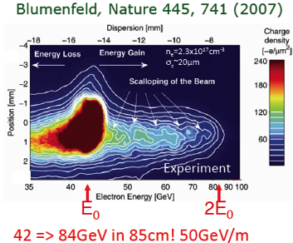
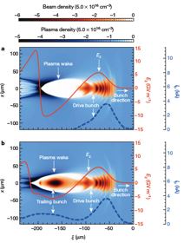
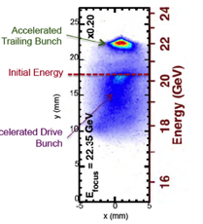
Some Experimental Results
Experimental results show success of PWFA and its research
High-Efficiency acceleration of an electron beam in a plasmas wakefield accelerator
M. Litos et al., doi, Nature, 6 Nov 2014, 10.1038/nature 13992
  SLAC beam: 42 GeV, 3nC @ 10 Hz, σx = 10µm, 50 fs
  Total efficiency is <29.1%> with a maximum of 50%.
  Final energy spread of 0.7 % (2% average)
Notes:
Test key performance parameters for the witness bunch acceleration:
Gradient
Efficiency
Energy spread
Emittance
Laser ionized Lithium vapour plasma cell:
36 cm long, Density: 5 10¹⁶ cm⁻³, λ_{π} = 200 µm
Drive and witness beam:
20.35 GeV, D and W separated by 160 µm
1.02nC (D), 0.78nC (W)

Slide 7
Electron Beam Driven PWA
There is a limit to the energy gain of a witness bunch in the plasma:
  Today’s electron beams usually < 100 J level.
To reach TeV scale with electron driven PWA: also need several stages, but need to have
  relative timing in 10’s of fs range
  many stages
  effective gradient reduced because of long sections between accelerating elements….
Plasma cell
Plasma cell
Plasma cell
Plasma cell
Plasma cell
Plasma cell
Witness beam
Drive beam: electron/laser

Slide 8
Proton Beam Driven PWA
Proton beams carry much higher energy:
19kJ for 3E11 protons at 400 GeV/c.
  Drives wakefields over much longer plasma length, only 1 plasma stage needed.
Simulations show that it is possible to gain 600 GeV in a single passage through a 450 m long plasma using a 1 TeV p+ bunch driver of 10e11 protons and an rms bunch length of 100 μm.
A. Caldwell, K. Lotov, Physics of Plasma, 18,103101 (2011)
Plasma cell
Witness beam
Drive beam: protons

Slide 9
Beam-Driven Wakefield Acceleration: Landscape
Facility | Where | Drive (D) beam | Witness (W) beam | Start | End | Goal
AWAKE | CERN, Geneva, Switzerland | 400 GeV protons | Externally injected electron beam (PHIN 15 MeV) | 2016 | 2020+ | Use for future high energy e-/e+ collider. Study Self-Modulation Instability (SMI). Accelerate externally injected electrons. Demonstrate scalability of acceleration scheme.
SLAC-FACET | SLAC, Stanford, USA | 20 GeV electrons and positrons | Two-bunch formed with mask (e⁻/e⁺ and e⁻-e⁺ bunches) | 2012 | Sept 2016 | Acceleration of witness bunch with high quality and efficiency Acceleration of positrons FACET II proposal for 2018 operation
DESY-Zeuthen | PITZ, DESY, Zeuthen, Germany | 20 MeV electron beam | No witness (W) beam, only D beam from RF-gun. | 2015 | ~2017 | Study Self-Modulation Instability (SMI)
DESY-FLASH Forward | DESY, Hamburg, Germany | X-ray FEL type electron beam 1 GeV | D + W in FEL bunch. Or independent W-bunch (LWFA). | 2016 | 2020+ | Application (mostly) for x-ray FEL Energy-doubling of Flash-beam energy Upgrade-stage: use 2 GeV FEL D beam
Brookhaven ATF | BNL, Brookhaven, USA | 60 MeV electrons | Several bunches, D+W formed with mask. | On going |  | Study quasi-nonlinear PWFA regime. Study PWFA driven by multiple bunches Visualisation with optical techniques

Slide 10
Outline
Introduction
AWAKE at CERN
AWAKE: 1st Phase
AWAKE: 2nd Phase
The Experimental Facility at CERN
Planning and Next Steps
Summary

Slide 11

AWAKE
AWAKE: Advanced Proton Driven Plasma Wakefield Acceleration Experiment
Proof-of-Principle Accelerator R&D experiment at CERN
  First proton driven wakefield experiment worldwide
  Demonstration of high-gradient acceleration of electrons
AWAKE Collaboration: 16 Institutes world-wide
Vancouver
Novosibirsk
Oslo
Glasgow
Manchester
Hamburg, Greifswald
London
Dusseldorf
Munich
CERN
Lisbon
11

Slide 12
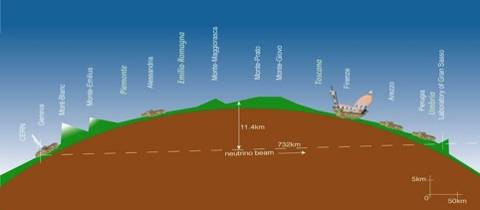
AWAKE at CERN
AWAKE in CNGS Facility (CERN Neutrinos to Gran Sasso)
CNGS physics program finished in 2012
  CNGS approved for 5 years: 2008 – 2012
  Expect ~8 tau-neutrinos, 4 published so far
CNGS
2006
Gran Sasso
CERN
produce
muon-neutrinos
732km
measure
tau-neutrinos

Slide 13
AWAKE at CERN
AWAKE
Approved in August 2013
First beam expected in 2016
Initial program for 3-4 years
Running underground facility
Desired beam parameters
➔ adequate site for AWAKE

Slide 14
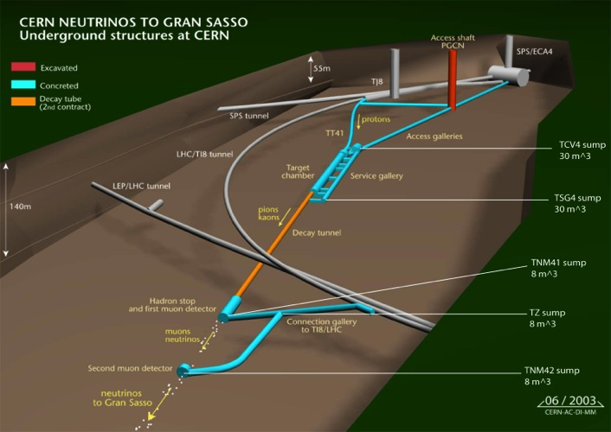
AWAKE at CERN
SPS
protons
AWAKE experiment
LHC
~1100m
dump
Running underground facility
Desired beam parameters
➔ adequate site for AWAKE

Slide 15
Outline
Introduction
AWAKE at CERN
AWAKE: 1st Phase
AWAKE: 2nd Phase
The Experimental Facility at CERN
Planning and Next Steps
Summary

Slide 16
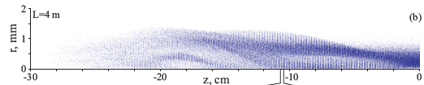
SPS Proton Beam: Drive Beam
Nominal SPS Proton Beam Parameters
Momentum | 400 GeV/c
Protons/bunch | 3 10¹¹
Bunch length | σ_{z} = 0.4 ns (12 cm)
Bunch size at plasma entrance | σ*_{x,y} = 200 μm
Normalized emittance (r.m.s.) | 3.5 mm mrad
Relative energy spread | Δp/p = 0.35%
Long proton beam σ_{z} = 12cm! ⬅➔Compare with plasma wavelength of λ = 1mm.
➔ Experiment based on Self-Modulation Instability!
  Modulate long bunch to produce a series of ‘micro-bunches’ in a plasma with a spacing of plasma wavelength λ_{p}.
    Strong self-modulation effect of proton beam due to transverse wakefield in plasma
    Starts from any perturbation and grows exponentially until fully modulated and saturated.
➔ Immediate use of the SPS beam!

Slide 17
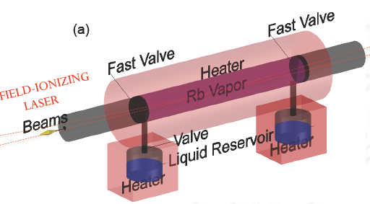
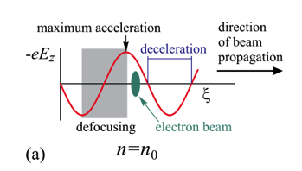
Plasma Source: Rubidium Vapor Source
Density adjustable from 10¹⁴ – 10¹⁵ cm⁻³
10 m long, 4 cm diameter
Plasma formed by field ionization of Rb
  Ionization potential Φ_{Rb} = 4.177eV
  above intensity threshold (I_{ioniz} = 1.7 x 10¹²W/cm²) 100% is ionized.
Plasma density = vapor density
System is oil-heated: 150˚ to 200˚ C
  keep temperature uniformity
  Keep density uniformity
Required:
Δn/n = ΔT/T ≤ 0.002

Slide 18
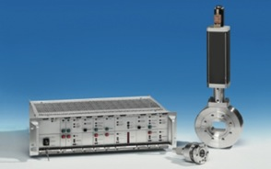
Plasma Source: Rubidium Vapor Source
3m prototype at MPI Munich
Ultra-fast (15 ms) valves
> 40 000 cycles!
Fast valves at both ends
→ separation of plasma from SPS beam vacuum.
→ Must be opened when laser/electron/proton passes through.

Slide 19
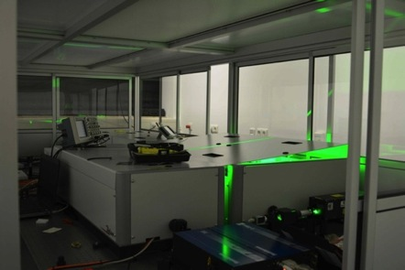
Laser Beam
Laser intensity must exceed ionization intensity at the plasma end (L=10m) over a plasma radius of r > 3σ = 600 µm.
Laser Beam
Laser type | Fiber Ti:Sapphire
Pulse wavelength | λ₀ = 780 nm
Pulse length | 100-120 fs
Pulse energy (after compr.) | 450 mJ
Laser power | 4.5 TW
Focused laser size | σ_{x,y} = 1 mm
Rayleigh length Z_{R} | 5 m
Energy stability | ±1.5% r.m.s.
Repetition rate | 10 Hz
Laser system in MPI, Munich

Slide 20
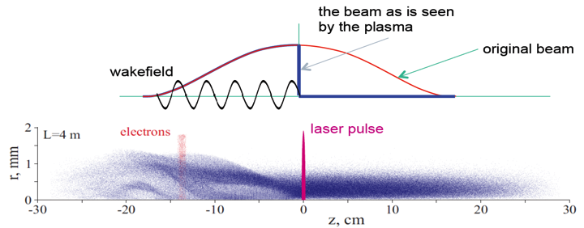

Combining Drive Beam, Plasma Source, Laser:
Proton Bunch Self-Modulation
Self-Modulation Instability (SMI):
Laser beam co-moving within the proton bunch effectively seeds the SMI
  Laser pulse creates the ionization front
  Ionization front acts as if long proton bunch is sharply cut
  Laser pulse excites wakes to directly seed the self-modulation instability
  grows exponentially until fully modulated and saturated.
plasma
gas
proton bunch
laser pulse
N. Kumar, A. Pukhov, K. Lotov, Phys. Rev. Letters (2010):
λ_{p} = 1.2 mm
Self-modulated proton bunch resonantly driving plasma wakefields.

Slide 21
AWAKE: 1st Experimental Phase
Perform benchmark experiments using proton bunches to drive wakefields for the first time ever.
Understand the physics of self-modulation instability processes in plasma.
Laser
Proton diagnostics
OTR, CTR, TCTR
p
10m plasma cell
Proton
beam
dump
Laser
dump
SPS
protons
plasma
gas
proton bunch
laser pulse
Self-modulated proton bunch resonantly driving plasma wakefields.
Plasma electron density ρ_{plasma}
Proton beam density ρ_{beam}
J. Vieira et al PoP 19063105 (2012)

Slide 22
AWAKE Experimental Layout: 1st Phase
plasma
gas
proton bunch
Laser
laser pulse
Proton diagnostics
OTR, CTR, TCTR
p
10m plasma cell
Proton
beam
dump
Laser
dump
SPS
protons
Laser and proton beam synchronized at the 100 ps level.
Laser and proton beam co-axial over the full length of the plasma cell:
  100 μm and 15 μrad pointing accuracy
  High resolution diagnostics to perform and monitor relative alignment
Plasma density uniformity better than 0.2%
Maximum amplitude of the accelerating field E_{z} as a function of position along the plasma.
Saturation of the SMI at ~4m.

Slide 23
AWAKE Experimental Layout: 1st Phase
➔ Measure self-modulated proton beam
plasma
gas
proton bunch
Laser
laser pulse
Proton diagnostics
OTR, CTR, TCTR
p
10m plasma cell
Proton
beam
dump
Laser
dump
SPS
protons
Laser and proton beam synchronized at the 100 ps level.
Laser and proton beam co-axial over the full length of the plasma cell:
  100 μm and 15 μrad pointing accuracy
  High resolution diagnostics to perform and monitor relative alignment
Plasma density uniformity better than 0.2%
Maximum amplitude of the accelerating field E_{z} as a function of position along the plasma.
Saturation of the SMI at ~4m.

Slide 24
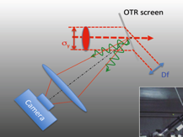
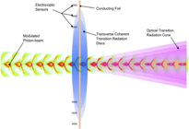
Self-Modulation Instability Diagnostics
Direct Measurement of self-modulation instability of the proton beam
  → results in radial modulation of the proton beam (micro-bunches)
  Measured by using the radiation emitted by the bunch when traversing a dielectric interface or by directly sampling the bunch space charge field. → streak-camera.
σ_{p} ~ 400 ps
CTR & TCTR
Optical Transition Radiation (OTR)
Coherent Transition Radiation (CTR)
Transverse Coherent Transition Radiation (TCTR)
4 ps
OTR
Indirect Measurement by observing the proton bunch defocusing downstream the plasma
  → Proton bunch: 1mrad divergence
Laser
10m
BTV
BTV
SPS
protons
p
Proton
beam
dump
Laser
dump
Laser
dump
SMI

Slide 25
Outline
Introduction
AWAKE at CERN
AWAKE: 1st Phase
AWAKE: 2nd Phase
The Experimental Facility at CERN
Planning and Next Steps
Summary

Slide 26
AWAKE Experimental Layout: 2nd Phase
Probe the accelerating wakefields with externally injected electrons, including energy spectrum measurements for different injection and plasma parameters.
e⁻ spectrometer
Laser
RF gun
e⁻
10m
p
Proton
beam
dump
SPS
protons
Proton diagnostics
OTR, CTR, TCTR
Laser
dump
SMI
Acceleration
plasma
gas
proton bunch
electron bunch
laser pulse

Slide 27
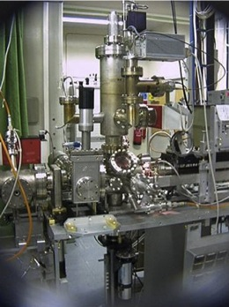
Witness Beam: Electron Source
Laser beam for electron source
Laser type | Ti:Sapphire Centaurus
Pulse wavelength | λ₀ = 260 nm
Pulse length | 10 ps
Pulse energy (after compr.) | 500 μJ
Electron source cathode | Copper
Quantum efficiency | 3.00 E-5
Energy stability | ±2.5% r.m.s.
PHIN Photo-injector for CTF3/CLIC:
  Charge/bunch: 2.3 nC
  Bunch length: 10 ps
  1800 bunches/train, 1.2µs train-length
  Program will stop end 2015
Fits to requirements of AWAKE
Photo-injector laser derived from low power level of plasma ionization laser system.
Klystron from CTF3
e-beam diagnostics
1m booster linac
(Cockcroft)
Incident, Reflected Power and phase
electron beam line
Laser +Diagnostics
Incident, Reflected, transmitted Power
Spectrometer
E, ΔE
Matching triplet
MTV
FCT
Emittance
MS
FC
BPR
BPR
BPR
RF GUN
Corrector
VPI
Accelerator
MTV,
Emittance
Length ~ 4 m

Slide 28
AWAKE Experimental Layout: 2nd Phase
Probe the accelerating wakefields with externally injected electrons, including energy spectrum measurements for different injection and plasma parameters.
e⁻ spectrometer
Laser
RF gun
e⁻
10m
p
Proton
beam
dump
SPS
protons
Proton diagnostics
OTR, CTR, TCTR
Laser
dump
plasma
SMI
Acceleration
gas
proton bunch
electron bunch
laser pulse
Electron beam
Momentum | 16 MeV/c
Electrons/bunch (bunch charge) | 1.2 E9 (0.2 nC)
Bunch length | σ_{z} =4ps (1.2mm)
Bunch size at focus | σ*_{x,y} = 250 μm
Normalized emittance (r.m.s.) | 2 mm mrad
Relative energy spread | Δp/p = 0.5%
Beta function | β*_{x} = β*_{y} = 0.4 m
Dispersion | D*_{x} = D*_{y} = 0

Slide 29
AWAKE Experimental Layout: 2nd Phase
plasma
gas
proton bunch
electron bunch
laser pulse
e⁻ spectrometer
Laser
RF gun
e⁻
10m
p
Proton
beam
dump
SPS
protons
Proton diagnostics
OTR, CTR, TCTR
Laser
dump
SMI
Acceleration
Laser and electron beam synchronized at the < 1 ps level.
Electron bunch is externally injected into the plasma cell, on-axis and collinearly with the proton and laser beam.
On-axis injection point is upstream the plasma cell.

Slide 30

AWAKE Experimental Layout: 2nd Phase
On-axis injection: animation of trapping and acceleration
black points – injected electrons, false colors – wakefield potential
K. Lotov, LCODE
2
r, mm
0
-17
ξ, cm
-16.4
  Electrons are trapped from the very beginning by the wakefield of seed perturbation
  Trapped electrons make several synchrotron oscillations in their potential wells
  After z=4 m the wakefield moves forward in the light velocity frame

Slide 31
AWAKE Experimental Layout: 2nd Phase
plasma
gas
proton bunch
electron bunch
laser pulse
e⁻ spectrometer
Laser
RF gun
e⁻
10m
p
Proton
beam
dump
SPS
protons
Proton diagnostics
OTR, CTR, TCTR
Laser
dump
SMI
Acceleration
Laser and electron beam synchronized at the < 1 ps level.
Electron bunch is externally injected into the plasma cell, on-axis and collinearly with the proton and laser beam.
On-axis injection point is upstream the plasma cell.
Energy of the electrons gained along the 10 m long plasma cell.

Slide 32
AWAKE Experimental Layout: 2nd Phase
plasma
gas
proton bunch
electron bunch
laser pulse
e⁻ spectrometer
Laser
RF gun
e⁻
10m
p
Proton
beam
dump
SPS
protons
Proton diagnostics
OTR, CTR, TCTR
Laser
dump
SMI
Acceleration
Laser and electron beam synchronized at the < 1 ps level.
Electron bunch is externally injected into the plasma cell, on-axis and collinearly with the proton and laser beam.
On-axis injection point is upstream the plasma cell.
Trapping efficiency: 10 – 15 %
Average energy gain: 1.3 GeV
Energy spread: ± 0.4 GeV
Angular spread up to ± 4 mrad
Large acceptance spectrometer (aperture and magnetic field)

Slide 33
AWAKE Experimental Layout: 2nd Phase
➔ Measure accelerated electrons
plasma
gas
proton bunch
electron bunch
laser pulse
e⁻ spectrometer
Laser
RF gun
e⁻
10m
p
Proton
beam
dump
SPS
protons
Proton diagnostics
OTR, CTR, TCTR
Laser
dump
SMI
Acceleration
Laser and electron beam synchronized at the < 1 ps level.
Electron bunch is externally injected into the plasma cell, on-axis and collinearly with the proton and laser beam.
On-axis injection point is upstream the plasma cell.
Trapping efficiency: 10 – 15 %
Average energy gain: 1.3 GeV
Energy spread: ± 0.4 GeV
Angular spread up to ± 4 mrad
Large acceptance spectrometer (aperture and magnetic field)

Slide 34
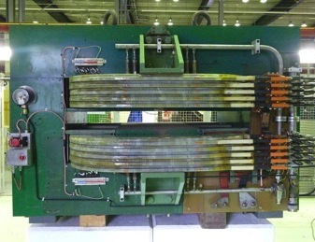
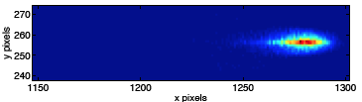
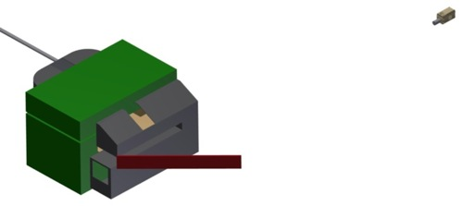
Witness Beam Acceleration Diagnostics
Probe the accelerating wakefields with externally injected electrons
→ Electron spectrometer
Measure peak energy and energy spread of electrons.
Spectrometer magnet separates electrons from proton beam-line.
Magnet: 15 ton, 1.84 T, 3.80 Tm, L=1670 mm, W=1740 mm
Camera
p
e⁻
Dispersed electron impact on scintillator screen.
Resulting light collected with intensified CCD camera.
Scintillator screen

Slide 35
Outline
Introduction
AWAKE at CERN
AWAKE: 1st Phase
AWAKE: 2nd Phase
The Experimental Facility at CERN
Planning and Next Steps
Summary

Slide 36

AWAKE Experimental Facility at CERN
Laser
e⁻ spectrometer
RF gun
e⁻
p
Proton
beam
dump
SPS
protons
SMI
Acceleration
Proton diagnostics
OTR, CTR, TCTR
Laser
dump
towards proton beam dump
protons
AWAKE experiment
protons

Slide 37
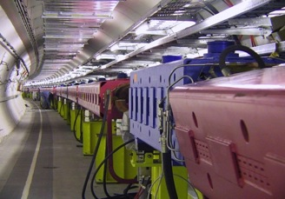
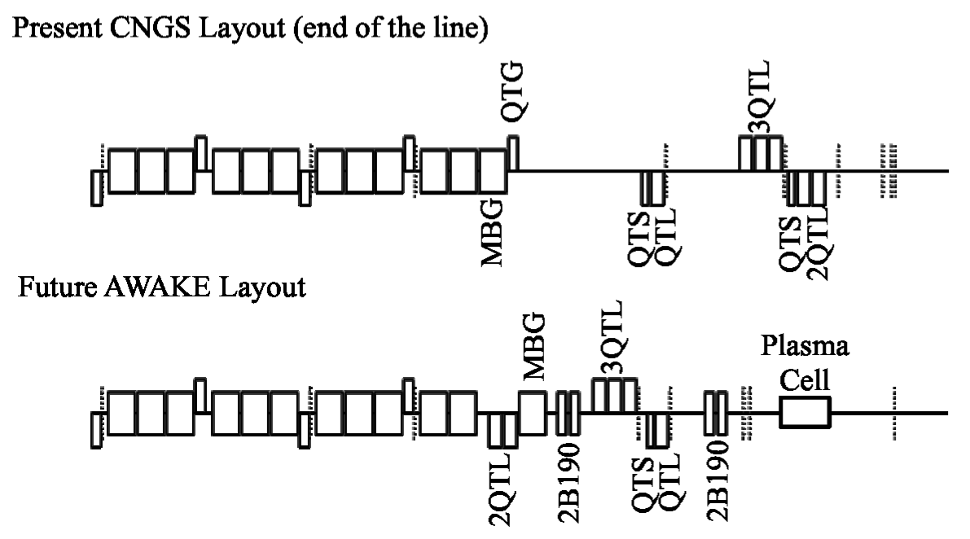
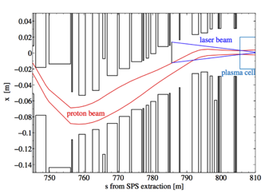
Proton Beam Line
Change of the proton beam line only in the downstream part (~80m)
→ Displace existing magnets of the final focusing to fulfill optics requirements at plasma cell
750m proton beam line
CNGS Layout
AWAKE Layout
→ Move existing dipole and 4 additional dipoles to create a chicane for the laser mirror integration.
Laser-proton merging 20m upstream the plasma cell

Slide 38
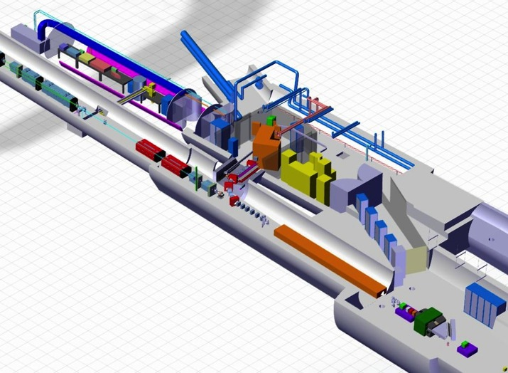
Laser System
New tunnel
laser
p⁺ beam
laser
e⁻ beam
Ti: Sapphire laser system:
Laser with 2 beams (for plasma and e-gun)
Delay line in either one of both beams
Focusing telescope (lenses, in air) before compressor
35 meter focusing
Optical compressor (in vacuum)
Optical in-air compressor and 3rd harmonics generator for electron gun
Complete UHV vacuum system up to 10⁻⁷ mbar starting from optical compressor

Slide 39
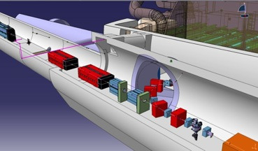
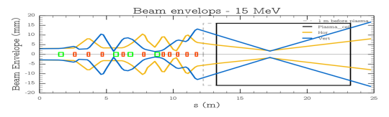
Electron Beam Line
Completely new beam line and tunnel:
  Horizontal angle of 60 deg,
  20% slope of the electron tunnel → 1m level difference
  7.2% slope of the plasma cell
  ~5 m common beam line between electron and proton
Common diagnostics for proton (high intensity, 3E11 p) and electron beam (low intensity, 1.2E9 e)
Flexible electron beam optics: focal point can be varied by up to 6 m inside the plasma cell
Plasma cell
Electron beam envelope (H, V)

Slide 40
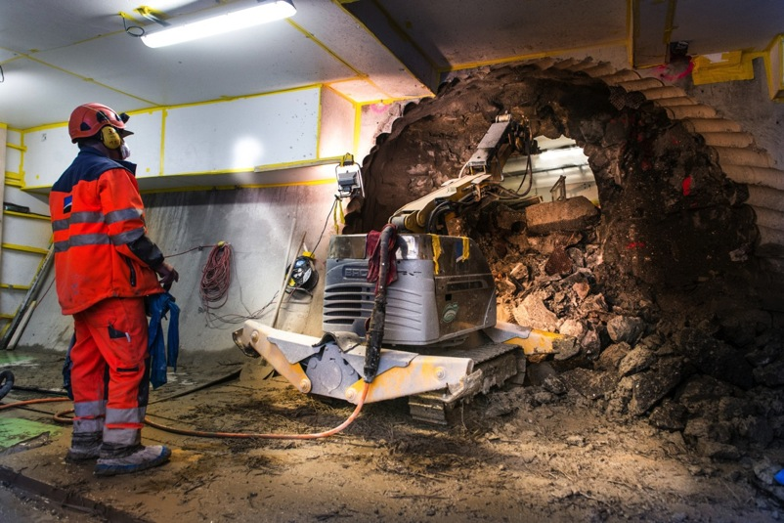
Electron Beam Line
Excavation June – October 2014

Slide 41
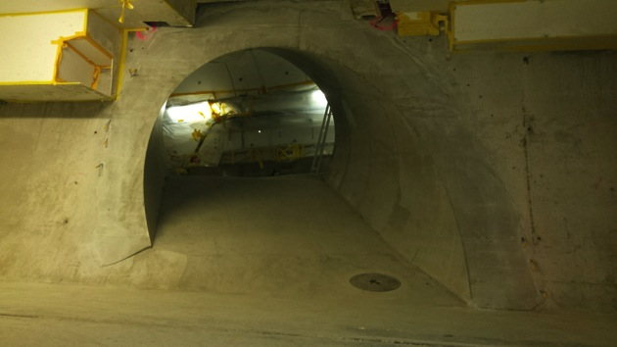
Electron Beam Line

Slide 42
Outline
Introduction
AWAKE at CERN
AWAKE: 1st Phase
AWAKE: 2nd Phase
The Experimental Facility at CERN
Planning and Next Steps
Summary

Slide 43
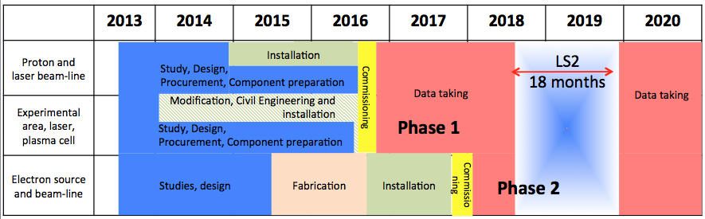
AWAKE Timeline
AWAKE was approved in August 2013
1st Phase: First proton and laser beam in 2016
2nd Phase: first electron beam in 2017
Physics program for 3 – 4 years
Run-scenario | Nominal
Number of run-periods/year | 4
Length of run-period | 2 weeks
Total number of beam shots/year (100% efficiency) | 162000
Total number of protons/year | 4.86×10¹⁶ p
Initial experimental program | 3 – 4 years

Slide 44
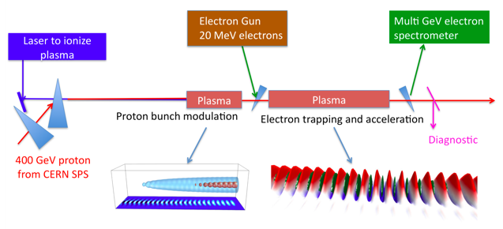
Next Steps
Split-cell mode: SMI in 1st plasma cell, acceleration in 2nd one.
New scalable uniform plasma cells (helicon or discharge plasma cell)
Step in the plasma density → maintains the peak gradient
Need ultra-short electron bunches (> 300fs) → bunch compression → Almost 100% capture efficiency
Plasma density profile
Maximum wakefield amplitude

Slide 45
Outline
Introduction
AWAKE at CERN
AWAKE: 1st Phase
AWAKE: 2nd Phase
The Experimental Facility at CERN
Planning and Next Steps
Summary

Slide 46



Summary
AWAKE is proof-of-principle accelerator R&D experiment currently being built at CERN
  First proton-driven wakefield acceleration experiment worldwide.
  The experiment opens a pathway towards plasma-based TeV lepton collider.
  → Final Goal: Design high quality & high energy electron accelerator based on acquired knowledge.
AWAKE using CERN infrastructure
  400 GeV SPS proton beam as drive beam
  10-20 MeV electrons as witness beam
  4.5 TW laser beam for plasma ionization and seeding of the SMI
AWAKE program
  Study the physics of self-modulation instability as a function of plasma and proton beam parameters (1st Phase, 2016)
  Probe the longitudinal accelerating wakefields with externally injected electrons (2nd Phase, 2017-2018)
  Develop long scalable and uniform plasma cells, production of shorter electron and proton bunches (2020)

Slide 47
Spare Slides

Slide 48
Proton/Electron/Laser Synchronization
Electron bunch (1σ~4ps)
Plasma
gas
proton bunch (1σ ~400ps)
laser pulse (100fs)
Synchronization between proton beam and laser pulse: ~ 100 ps (cf. proton bunch length 1σ~400ps).
  SPS beam must synchronize to the AWAKE reference just before extraction.
Synchronization between electron beam and laser pulse: ~ 100 fs (cf. plasma period ~4ps)
  For deterministic injection of e- bunch into plasma wakefields
  Achieved by driving the RF-gun of the electron source with a laser pulse derived from same laser system as used for plasma ionization.
Exchange of synchronization signals on ~3 km long fibres between the AWAKE facility and SPS RF Faraday Cage in the control room

