Slide 1
Searches for New Physics in rare decays and CP violating observables at LHCb
Bolek Pietrzyk
LAPP, Annecy, IN2P3, CNRS
EPIPHANY Conference
7-9 January 2013, Cracow

Slide 2
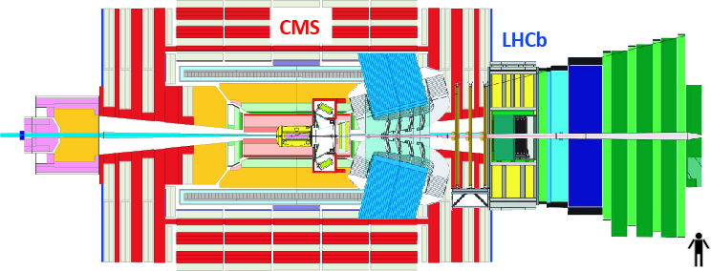
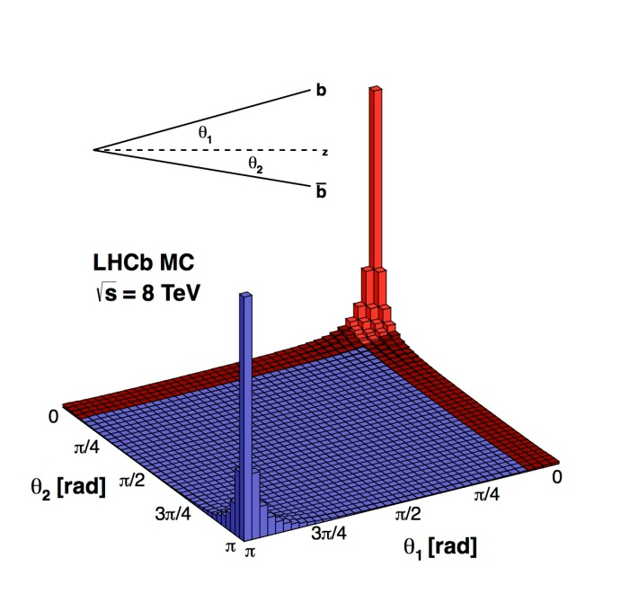
Intoduction to LHCb
CMS/ATLAS and LHCb are complementary
CMS/ATLAS: direct search for New Physics
LHCb: indirect search for New Physics

Slide 3
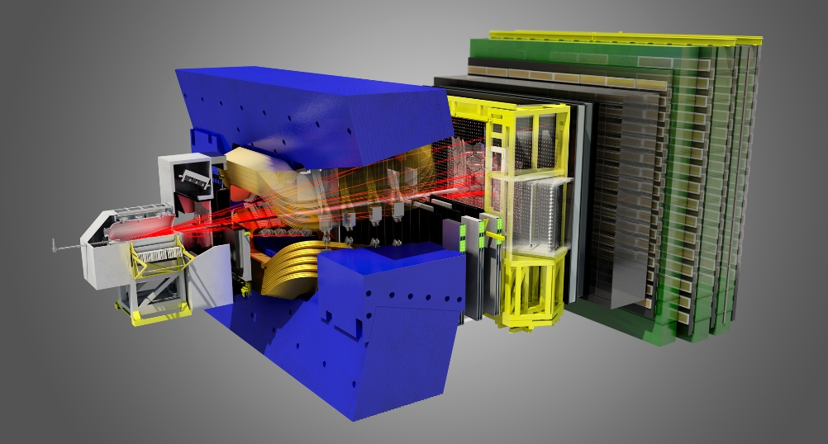
LHCb Detector

Slide 4
LHCb Detector
CALORIMETERS
RICH1
VELO
MAGNET
TT
RICH2
MUON
CHAMBERS
TRACKING
CHAMBERS

Slide 5
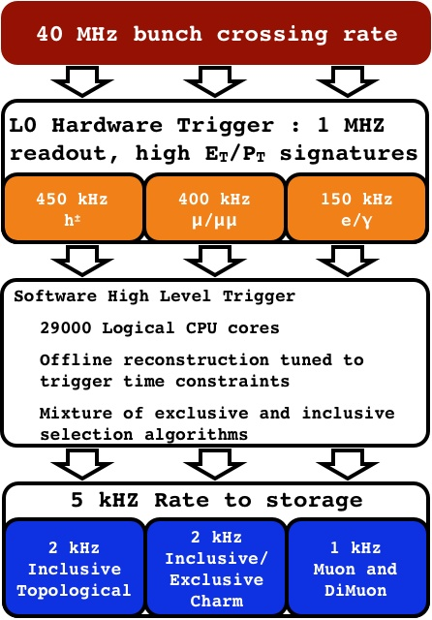
LHCb Trigger
# Dedicated heavy flavour trigger
L0: hardware trigger firing on high p_{T}
hadrons and muons(~few GeV/c)
HLT: software trigger exploiting,
in particular, tracking and vertexing,
outputs at 5 kHz
→ Efficient for hadronic B and D decays,
as well as leptonic channels

Slide 6
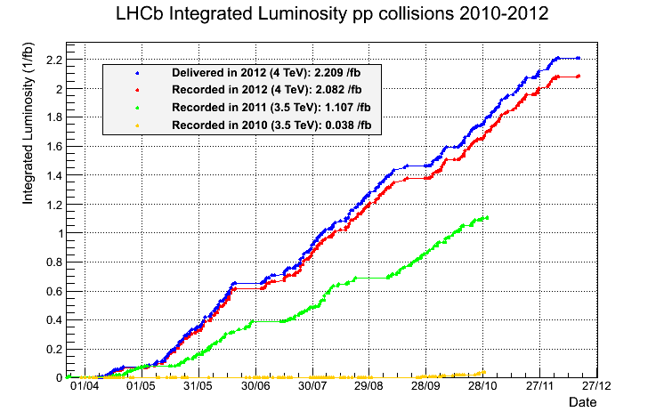
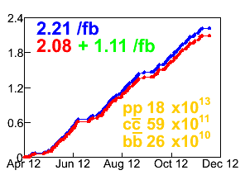
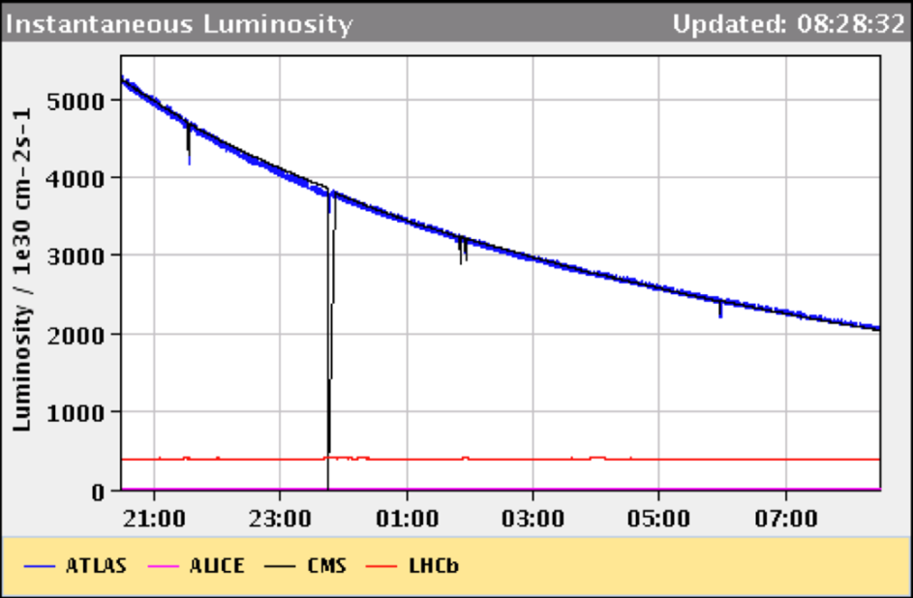
LHCb data taking
LHCb collected 37 pb⁻¹ in 2010, 1.1 fb⁻¹ in 2011 at 7 TeV,
and 2.1 fb⁻¹ in 2012 at 8 TeV.
Luminosity leveling delivers ~constant operation at 3.8x10³²cm⁻²s⁻¹
- above design luminosity of 2x10³²cm⁻²s⁻¹
efficiency 2012 94.3%
ATLAS & CMS lumi falls . off exponentially
Lumi of LHCb ‘levelled’ continually

Slide 7
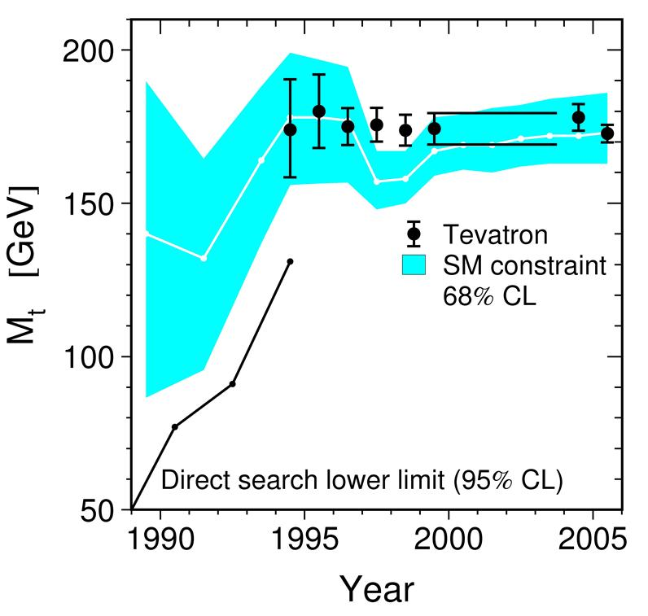
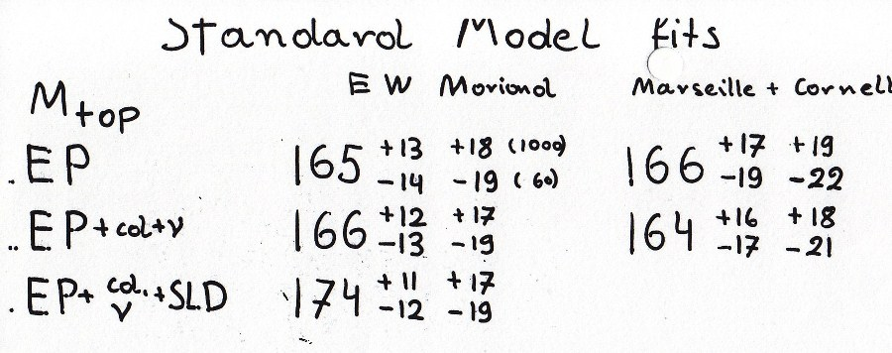
Indirect measurements
Indirect measurements are important:
L
L
L
BP at Moriond EW 1995
Tevatron combination (July 2012):
m_{t} = 173.18 ± 0.56 (𝑠𝑡𝑎) ± 0.75 (𝑠𝑦𝑠)

Slide 8
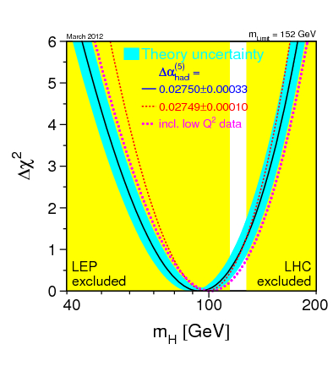
Indirect measurements
Indirect measurements are important:
LEPEWWG (2012):
m_{H} < 158 GeV
(one-sided 95 percent confidence
level upper limit, ΔX² = 2.7)
LHC (2012):
m_{H} ~ 126 GeV

Slide 9
Flavour Physics is Important
Flavour physics is a proven tool of discovery:
- CP violation → need for at least three generations
- BR(K⁰_{L}→μμ) & GIM→ prediction of charm
- B mixing → mass of top is very heavy
- SUSY parameter space already severely constrained by e.g. b→sγ
Precise studies of flavour observables are an excellent way to look for New Physics!

Slide 10
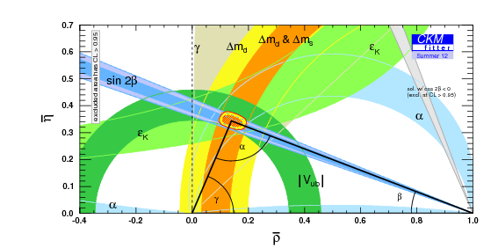
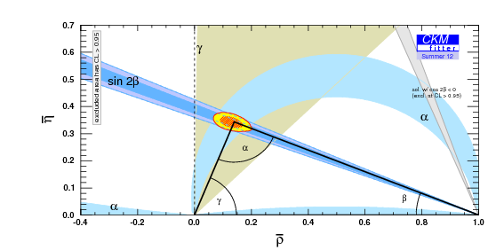
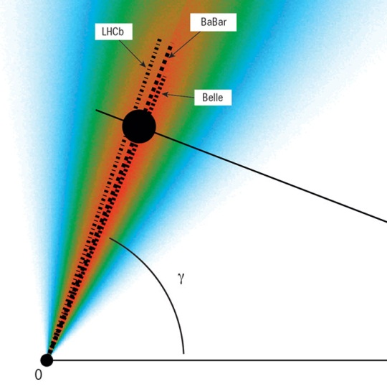
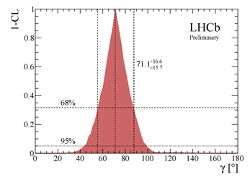
Measurement of the angle γ
5%
4%
Precision < 10 deg.
[LHCb-CONF-2012-032]
Cincinatti,October 2012
γ = (71.1^{+16.6}_{-15.7})°
(only B±→DK decays)
γ = 85.1°
uncertainty regions
[61.8,67.8]° and [77.9,92.4]° (at 68% CL) when the B±→Dπ decays are included in addition
Agnieszka Dziurda on Wednesday

Slide 11
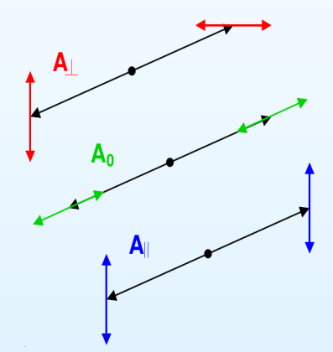
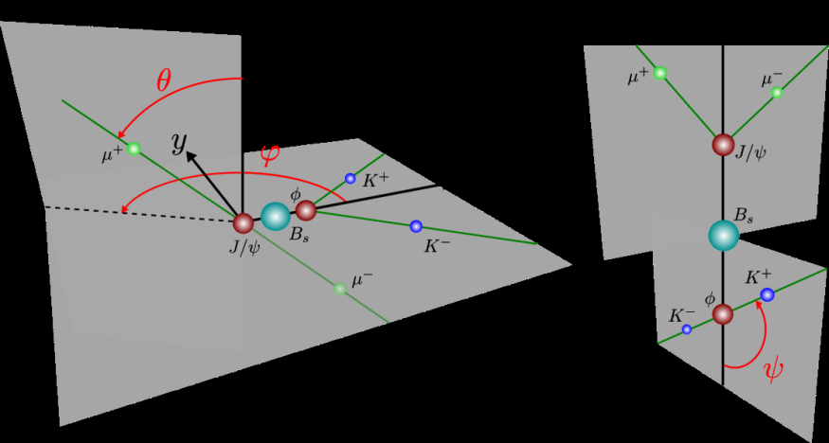
CP-violation in B_{s} mixing
Interference between mixing and decay
gives rise to CP violating phase
𝜙_{𝑠}=𝜙_{𝑀} −2 𝜙_{𝐷}
final state is mixture of CP even and
CP odd eigenstates (P—VV decay)
Described by three polarization
amplitudes: 𝐴⊥ (CP-odd) 𝐴0 ,𝐴∥ (CP-even)
Final states described by three angles:
Ω={𝜑,𝜃,𝜓}
𝜙_{𝐷}
[SM −0.0363 ± 0.0017 rad]
𝐵_{𝑠}
𝐽/Ψ Φ
𝜙_{𝑀}
−𝜙_{𝐷}
𝐵_{𝑠}

Slide 12
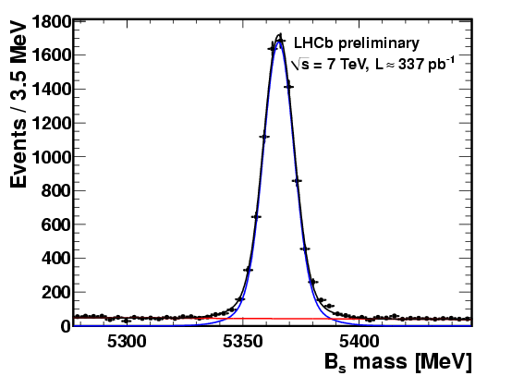
B_{s}→ J/ψφ
μ⁺
J/ψ
μ⁻
L = 0.3 fb⁻¹ (analysis August 2011)
1 fb⁻¹ (analysis March 2012,
2011 data)
Perform unbinned maximum
likelihood fit in mass, proper
time, transversity angles
OS tagger optimized and
calibrated on 2011 data using
𝐵⁺ → 𝐽/Ψ 𝐾⁺, 𝐵⁰ → 𝐽/Ψ 𝐾∗
and 𝐵⁰ → 𝐷^{∗-}𝜇⁺𝜈_{𝜇}
𝜖𝐷_{𝑒𝑓𝑓}² = 2.08 ± 0.17 ± 0.37%
B_{s}
φ
K⁺
K⁻

Slide 13
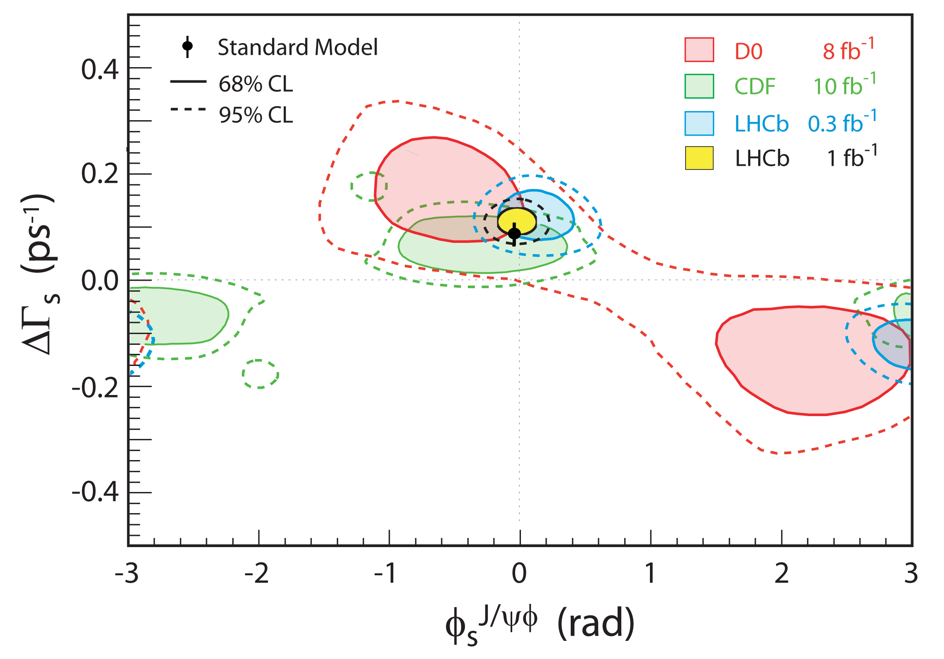
Heavier strange-beauty lives longer – improved Φ_{s}
Φ_{s} = 0.002
± 0.083 (𝑠𝑡𝑎)
± 0.027 (𝑠𝑦𝑠) rad
(J/ψφ and J/ψf₀ )
[LHCb-CONF-2012-002]
SM: Φ_{s} = −0.036
± 0.002
[CKMfitter,
Eur. Phys. J. C41 (2005)]

Slide 14
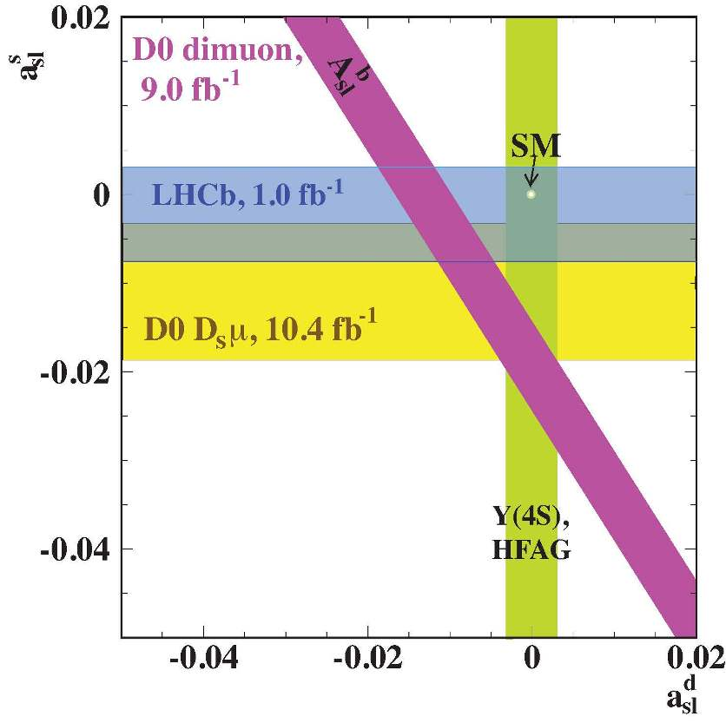
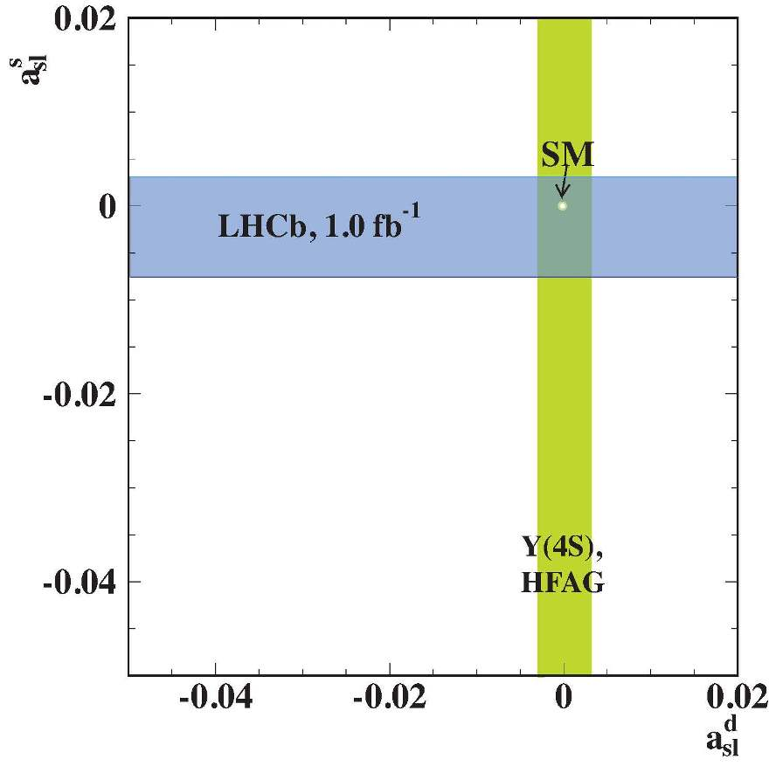
Flavour-specific matter antimatter asymmetry
D0: # μ⁺μ⁺ < # μ⁻μ⁻ ( 1% effect, 3.9σ from tiny SM prediction)
LHCb:
B⁰_{s} → D±_{s}μ∓
D±_{s} → φπ±
a^{s}_{sl} = (-0.24
± 0.54 ± 0.33)%
ICHEP 2012
[LHCb-CONF
-2012-022]
The LHCb result is consistent with the Standard Model prediction and does not confirm the deviation from the Standard Model reported by the D0 experiment.

Slide 15
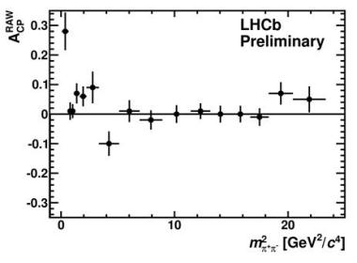
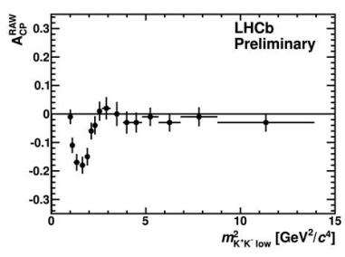
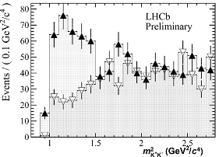
Three-body charmless B decays
[LHCb-CONF
-2012-018]
A_{CP}(B±→K±π⁺π⁻)
A_{CP}(B±→K±K⁺K⁻)
2.8σ
3.7σ
A_{CP}(B±→π±π⁺π⁻) = +0.120 ± 0.020 ± 0.019 ± 0.007
4.2σ
A_{CP}(B±→π±K⁺K⁻) = -0.153 ± 0.046 ± 0.019 ± 0.007
3.0σ
First evidence of global CPV in
charmless three-body B decays
B±→π±K⁺K⁻
[LHCb-CONF-2012-028]

Slide 16
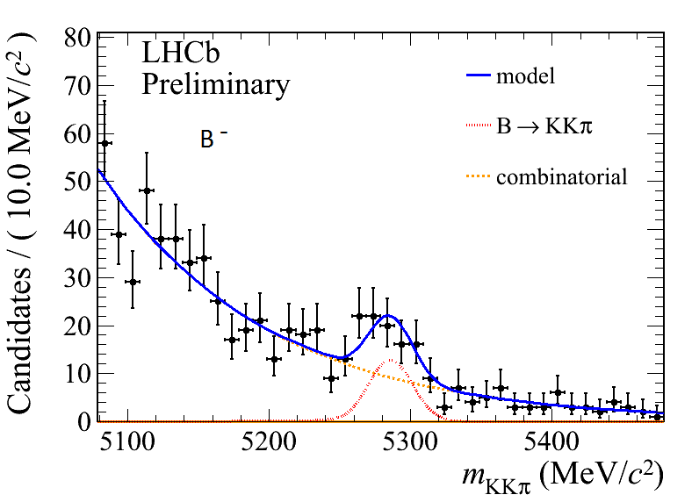
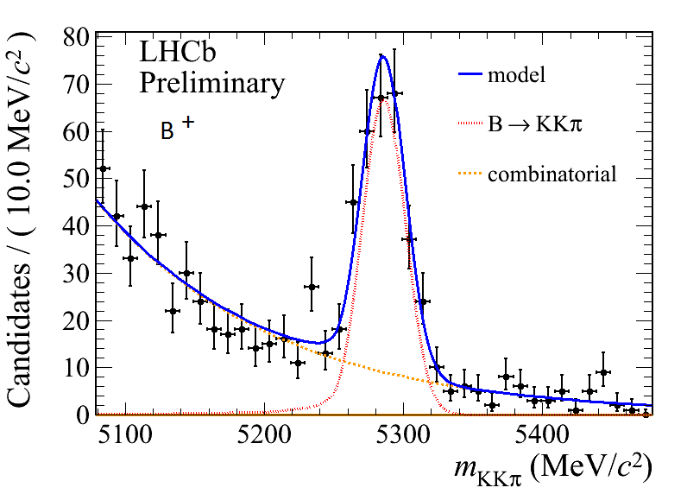
Three-body charmless B decays
A_{CP}(B±→π±K⁺K⁻) = -0.153 ± 0.046 ± 0.019 ± 0.007
[LHCb-CONF-2012-028]
B±→π±K⁺K⁻
m²_{K+K}⁻ < 1.5 GeV²/c⁴
9σ
Standard Model special feature? or New Physics?

Slide 17
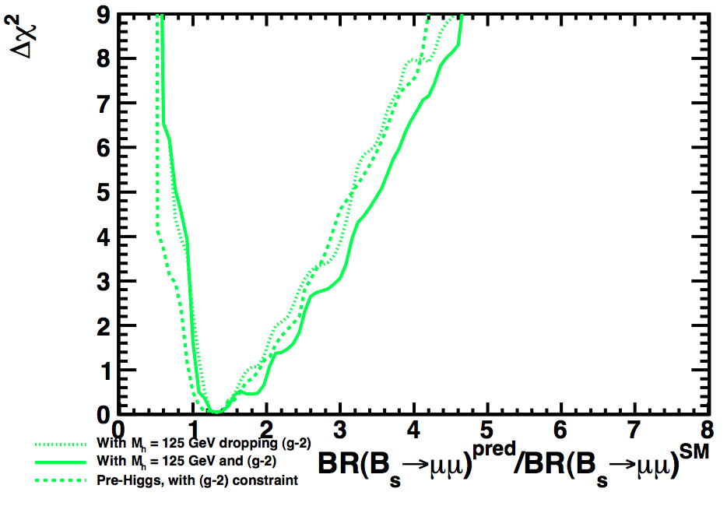
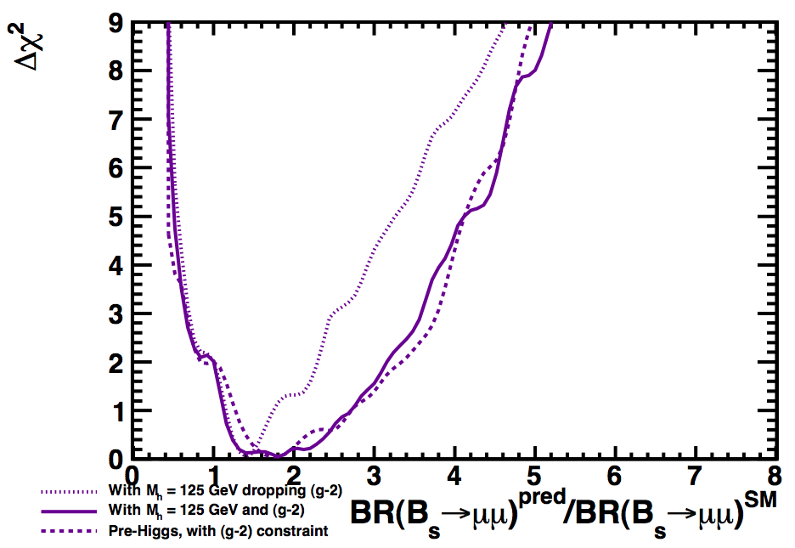
The golden mode: B_{s}→ μ⁺μ⁻
BR(B_{s}→μμ)_{SM} = (3.23 ± 0.27) x 10⁻⁹ (t=0)
[A.J.Buras, arXiv:1208.0934]
→ (3.54 ± 0.30) x 10⁻⁹ (time integrated)
[De Bruyn et al., PRL 109, 041801 (2012)]
- Very high sensitivity to New Physics, eg. CMSSM and NUHM1:
[O. Buchmuller et al, arXiv:1112.3564v2, May 2012]
CMSSM
NUHM1

Slide 18
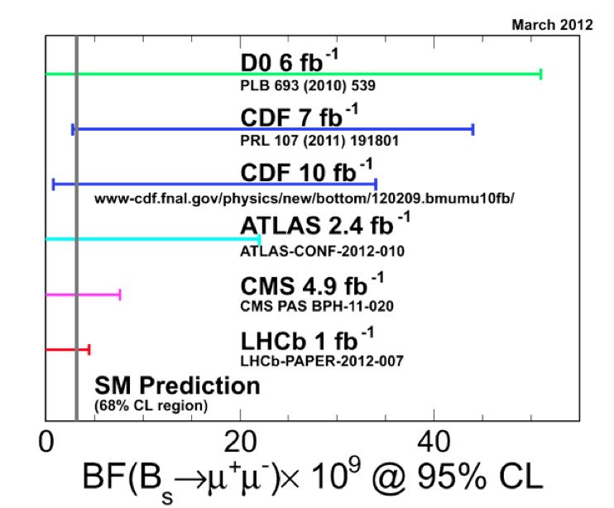
B_{s}→ μ⁺μ⁻ : experimental context
March 2012
LHCb and CMS getting very close to get sensitivity for observing a SM rate...
LHC combination (June 2012): B(B⁰s→μ⁺μ⁻)<4.2×10⁻⁹ at 95% CL
LHCb-CONF-2012-017, CMS-PAS-BPH-12-009 , ATLAS-CONF-2012-061

Slide 19
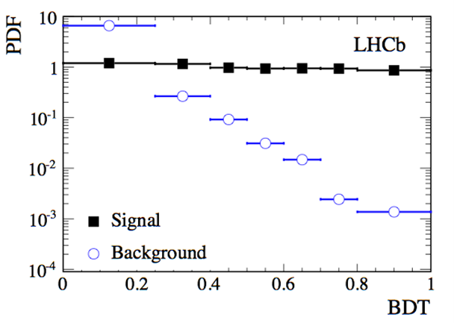
B_{s}→μ⁺μ⁻ search with LHCb
November 2012 (HCP)
Boosted Decision Tree out of
9 kinematical and topological variables
-Train BDT on MC and background
samples, but calibrate on data:
- BDT output: 8 bins for 7 TeV data,
7 bins for 8 TeV data,
flat for signal and peaked at zero for background
relative BR for signal use two normalization channels:
B⁺ → J/ΨK⁺, B⁰ → Kπ giving consistent results
see Marcin Chrząszcz, today

Slide 20
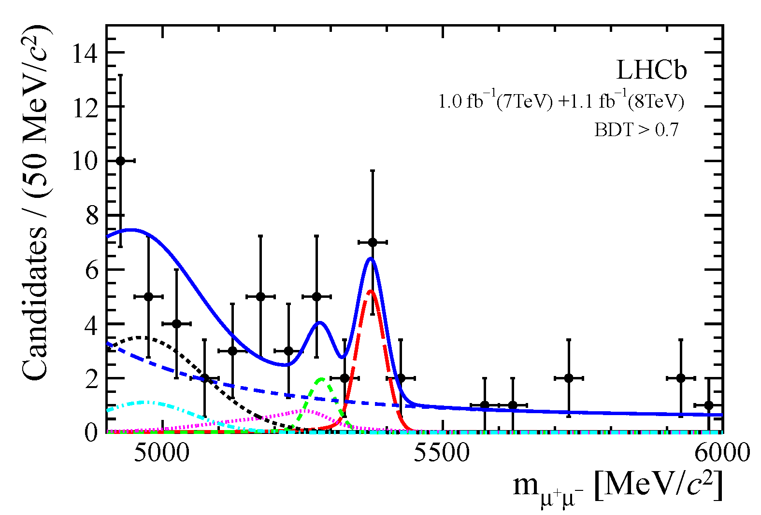
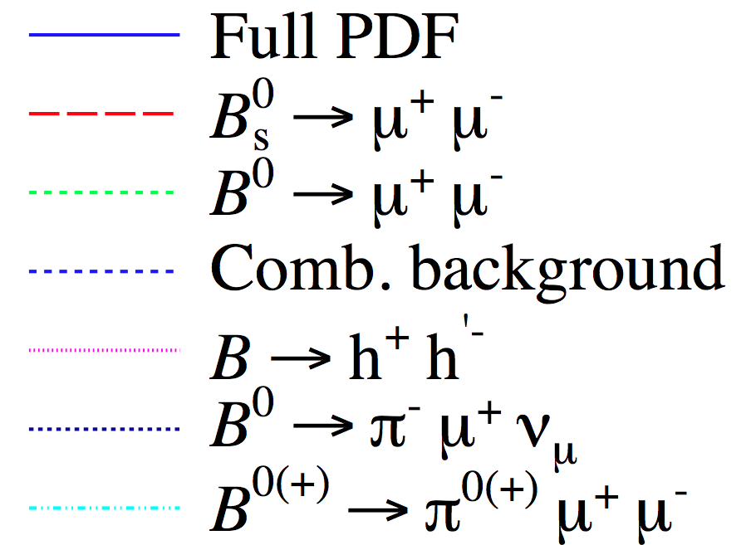
B_{s}→μ⁺μ⁻ search with LHCb
3.5 σ
7 TeV (1 fb⁻¹)
8 TeV (1.1 fb⁻¹)
B⁰
B⁰_{s}
[arXiv:1211.2674]
B(B⁰s→μ⁺μ⁻) = (3.2^{+1.5}−1.2)×10⁻⁹
The first evidence!
SM: (3.54±0.30)×10⁻⁹

Slide 21
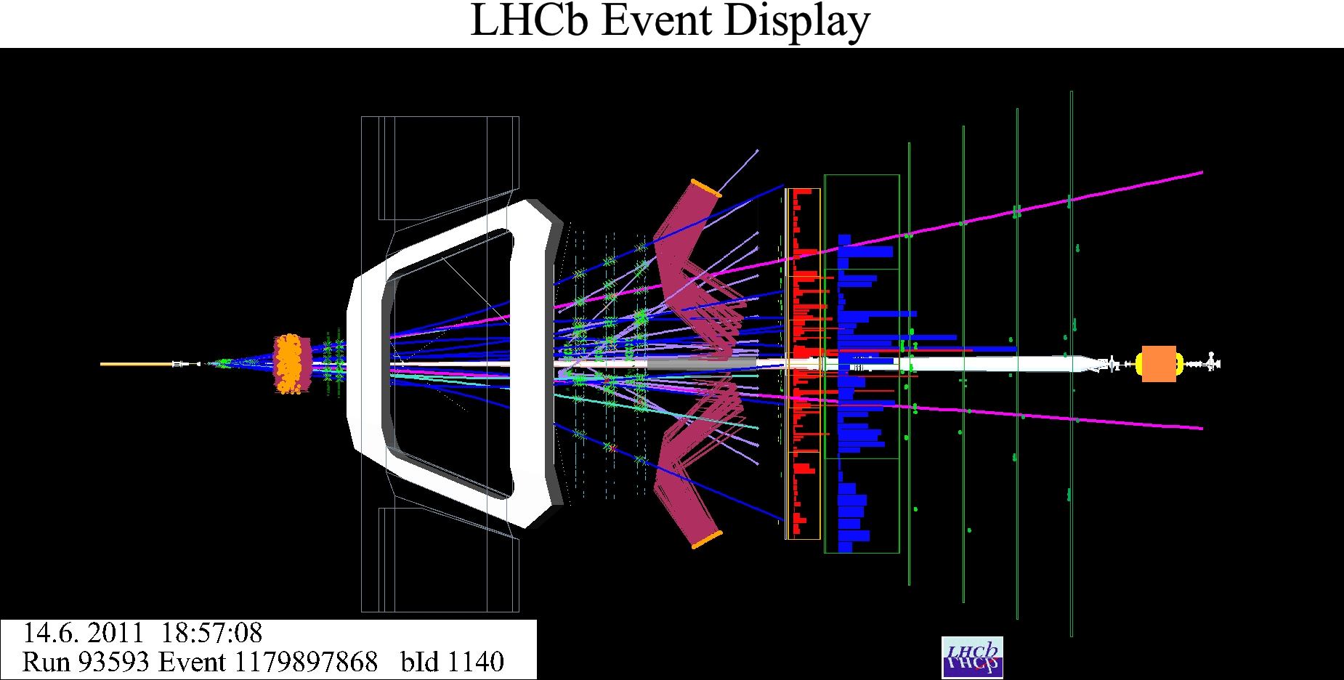
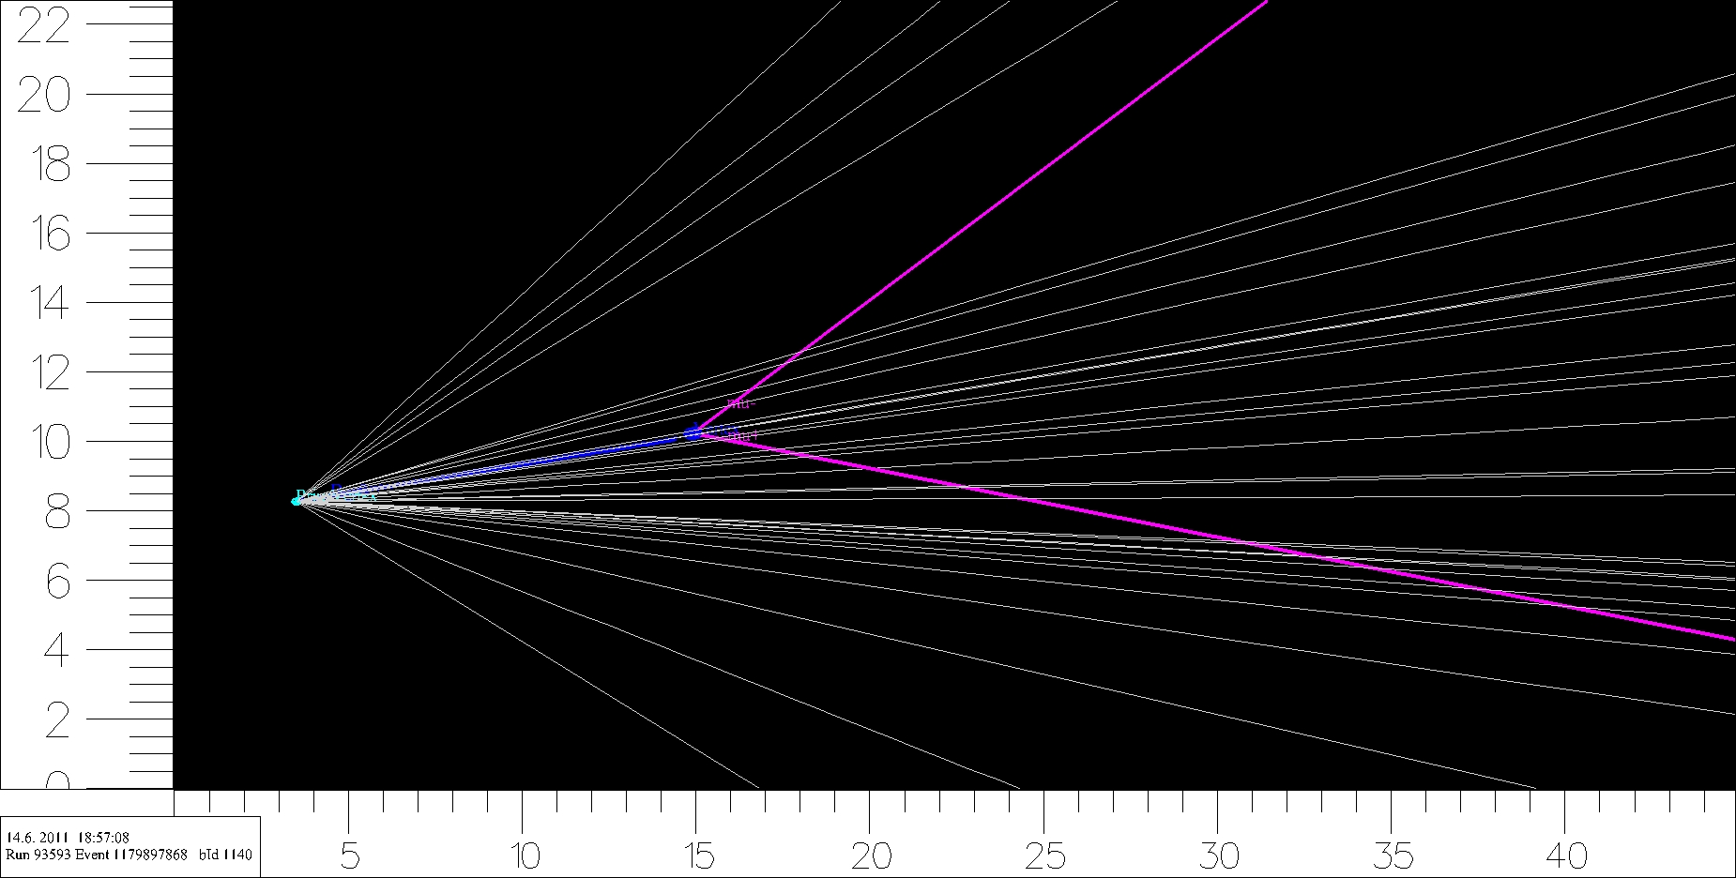
B_{s}→μ⁺μ⁻ search with LHCb
M_{μμ}=5.357 GeV, B mom. 58.16 GeV, transverse mom. 3.5 GeV,
lifetime 3.52 ps, flighting pass 1.15 cm

Slide 22
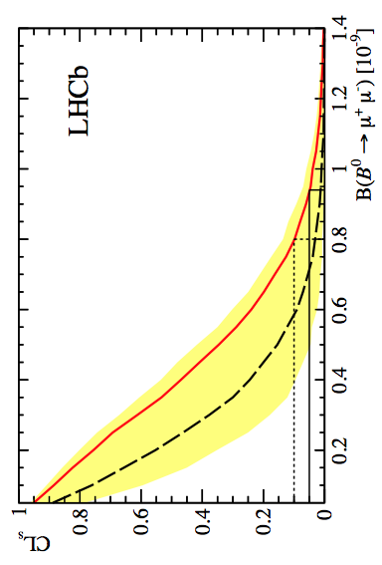
B⁰→μ⁺μ⁻ : upper limit
Use CLs method: evaluate compatibility with background only (CL_{b}) and signal + background hypotheses (CL_{s+b}); the 95%CL upper limit is defined at
CLs = CL_{s+b}/CL_{b}=0.05
observed upper limit:
B(B⁰→ μ⁺μ⁻) < 9.4 x 10⁻¹⁰
at 95% CL
observed
Expected:
< 7.1 x 10⁻¹⁰
expected
bkg+SM
Compatibility with background only hypothesis

Slide 23
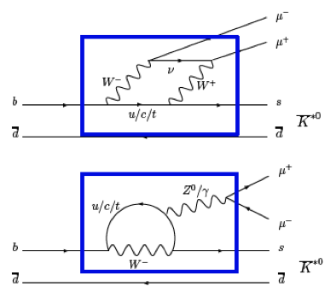
B⁰→K*l⁺l⁻
Many observables exist in B⁰→K*l⁺l⁻ to probe helicity structure of any New Physics...
...in particular,
forward-backward asymmetry
(A_{FB}) of lepton system
as a function of lepton
invariant mass (q²).

Slide 24
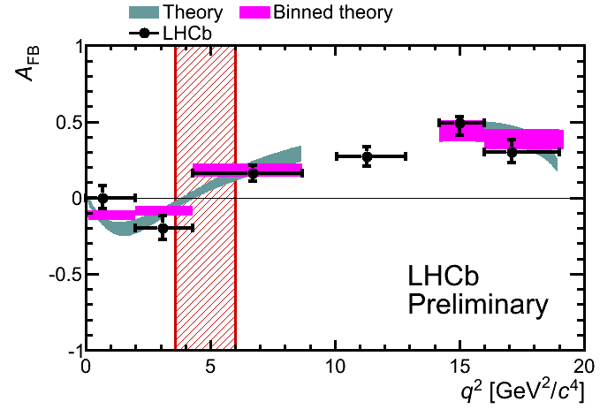
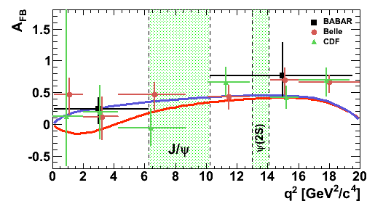
A_{FB} in B⁰→K*μ⁺μ⁻
Full 2011 data set,
1 fb⁻¹ at 7 TeV
[LHCb-CONF-2012-008]
Data are consistent with the SM predictions at present sensitivity, LHCb indicated for the first time that
the asymmetry is changing sign as predicted by the SM
and measured the zero crossing point: 4.9^{+1.1}_{-1.3} GeV².

Slide 25
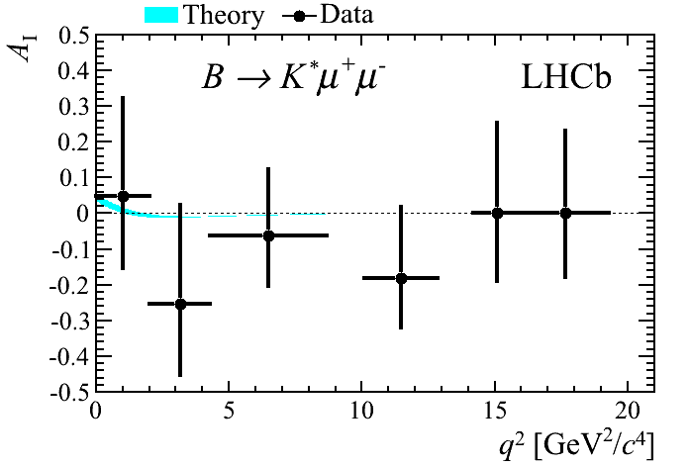
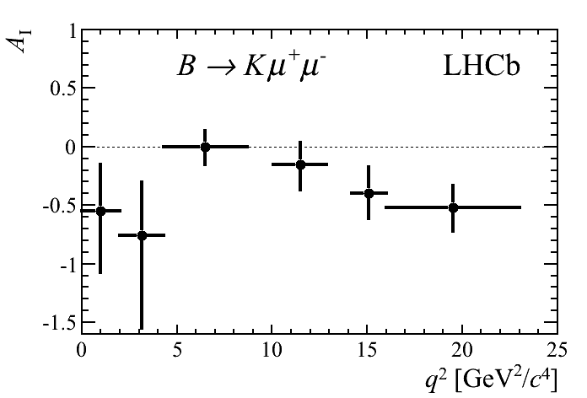
Puzzling isospin asymmetries
-
-
B⁰→K*μ⁺μ⁻
B⁺→K*⁺μ⁺μ⁻
B⁰→Kμ⁺μ⁻
B⁺→K⁺μ⁺μ⁻
Consistent with small asymmetry
4.4σ ≠ 0 (the whole q² region)
Standard Model special feature? or New Physics?
[JHEP07 (2012) 133]

Slide 26
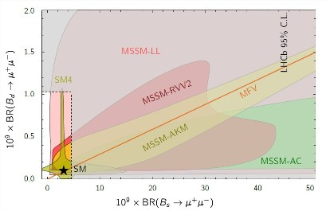
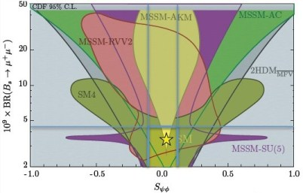
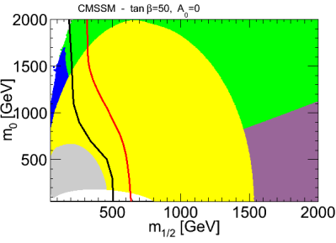
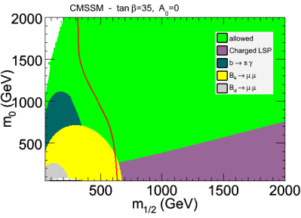
Theory implication
Rencontres de Moriond, March 2012 :
David Straub (1,2) and Nazila Mahmoudi (3,4)
LHCb strongly squeezes SUSY parameter space
allowed
CMS
CMS
allowed
LHCb
LHCb

Slide 27
Summary
- LHCb at LHC is making precise measurements
hints for strong signs of NP from other
experiments are not confirmed, LHCb results are in agreement with the SM prediction,
LHCb is an “anomaly killer”
- but … there are a few new interesting observations, interesting SM features?, signs for New Physics?
- all results presented here (except one) used 2011 data; LHCb data sample more than tripled.
excellent prospects for excellent results
at Moriond 2013

Slide 28
Backup slides

Slide 29
LHCb performance numbers
momentum resolution:
Δ p / p = 0.4 % at 5 GeV/c to 0.6 % at 100 GeV/c
ECAL resolution (nominal):
1 % + 10 % / √(E[GeV])
impact parameter resolution:
20 μm for high-pT tracks
invariant mass resolution:
~8 MeV/c² for B → J/ψ X decays with constraint on J/ψ mass
~22 MeV/c² for two-body B decays
~100 MeV/c² for B_{s} → φ γ, dominated by photon contribution
decay time resolution:
45 fs for B_{s} → J/ψ φ and for B_{s} → D_{s} π

Slide 30
B⁰s→μ⁺μ⁻ : 7 TeV vs 8 TeV
7 TeV (1 fb⁻¹):
B(B⁰s→μ⁺μ⁻) = (1.4^{+1.7}−1.3)×10⁻⁹
p-value: 0.11
8 TeV (1.1 fb⁻¹):
B(B⁰s→μ⁺μ⁻) = (5.1^{+2.4}−1.9)×10⁻⁹
p-value: 9x10⁻⁴
results from 7 TeV and 8 TeV are compatible at ~1.5σ

Slide 31
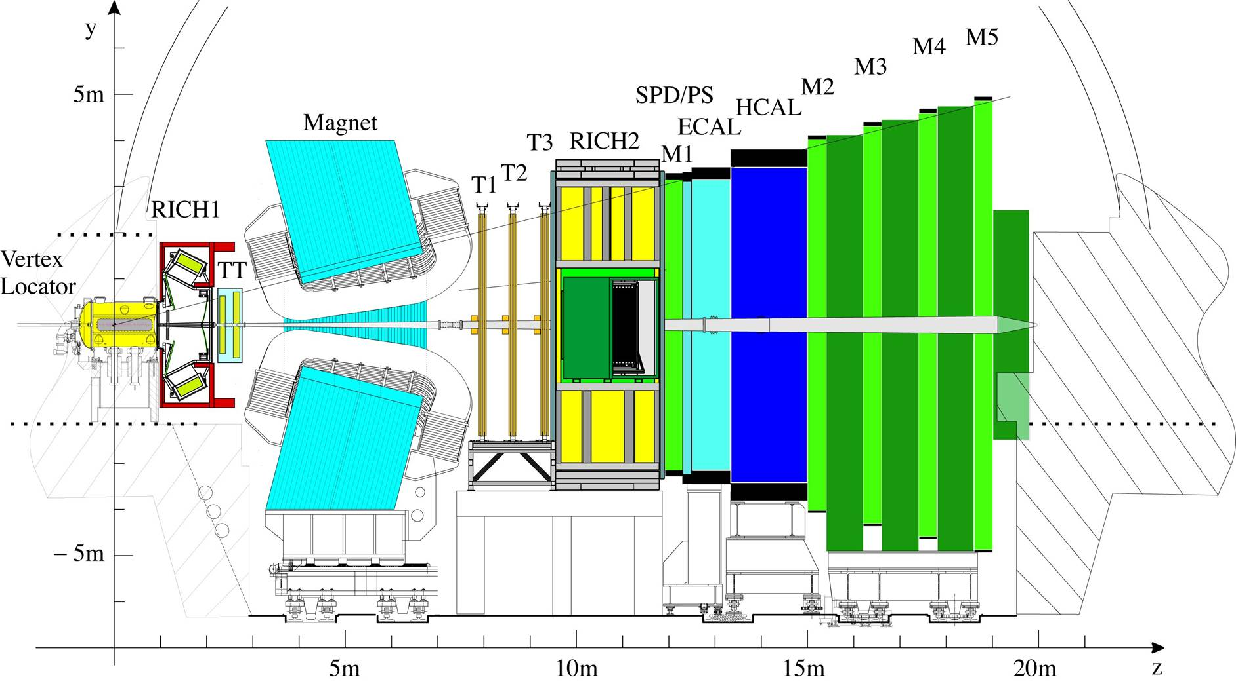
LHCb detector

Slide 32
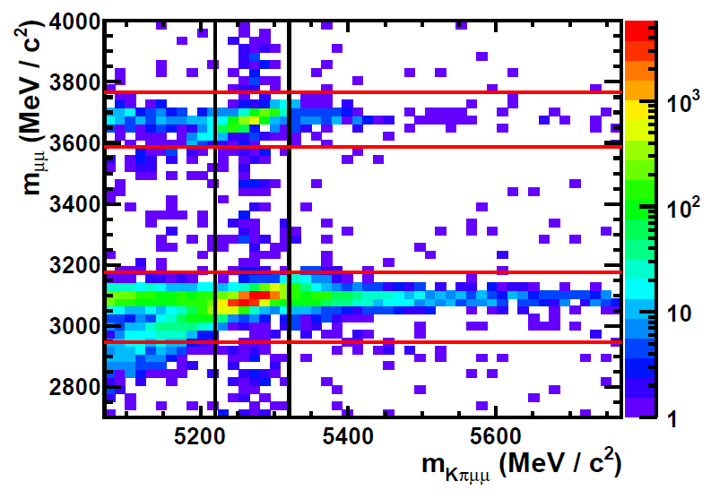
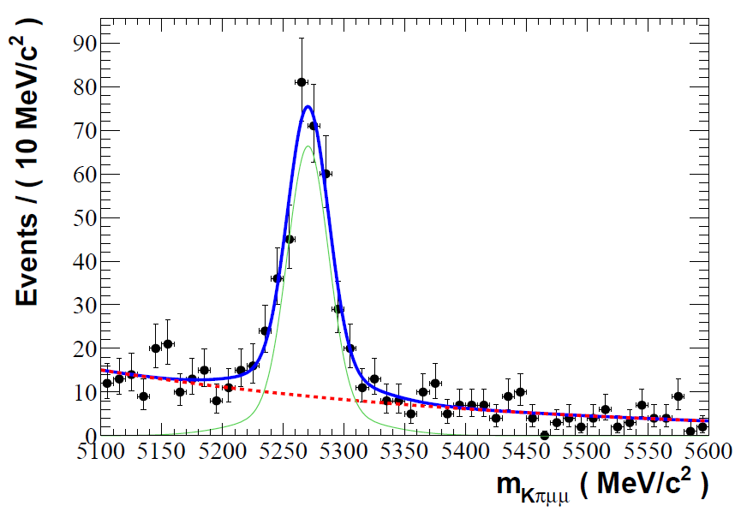
B⁰→K*μ⁺μ⁻ : event selection
Select events using Boosted Decision Tree from sample of 309 pb⁻¹
Veto decays in J/Ψ and Ψ(2S) resonance regions
303 signal events
after mass cut
Measure
in 6 q²
bins:
Simultaneous fit of 1D projections
of helicity angles of kaon & lepton
•differential branching
fraction, dΓ/dq²
}
Performance of fit validated on MC and B⁰→J/ΨK* decays
•longitudinal polarisation, F_{L}
•A_{FB}

Slide 33
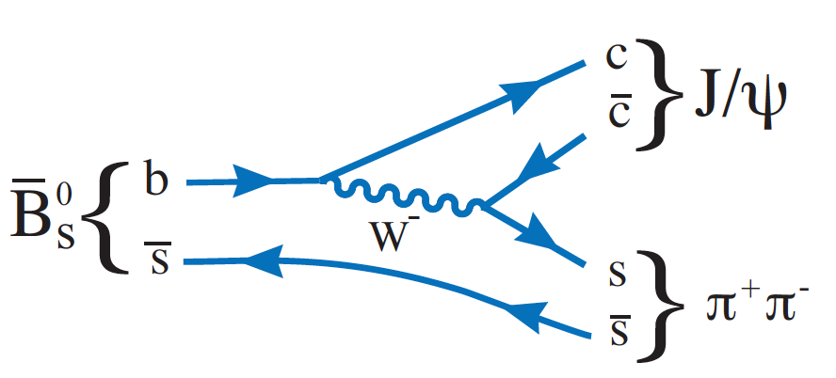
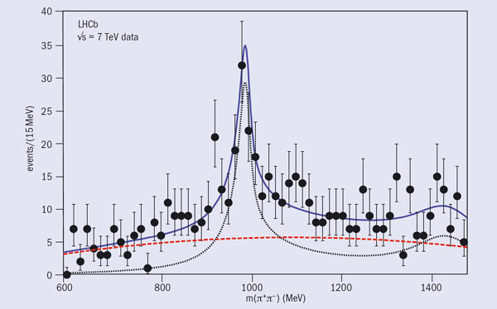
B_{s}→ J/ψf₀(980)
Feb. 1, 2011 – LHCb:
“1st observation of
B_{s}→ J/ψ f₀(980) decays“
[arXiv:1102.0206]
f₀ is a scalar
with an ss
component
but decays
predominatly
into π⁺π⁻

Slide 34
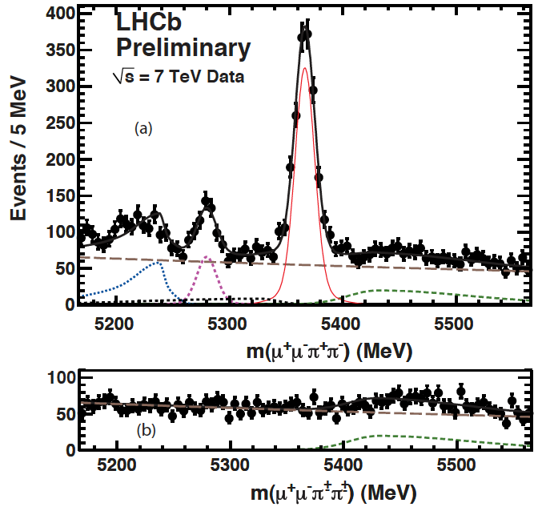
B_{s}→ J/ψf₀(980)
Bs→J/ψππ
2011 data
N_{sig} = 1428 ± 47 events
365 ± 22 after tagging
εD² = 2.13%
The f₀(980) signal region
looks pure scalar
purely CP odd
no angular analysis
required
B0→J/ψKπ
B0→J/ψππ
Bs→J/ψ η’,φ
B+→J/ψπ

