Slide 1
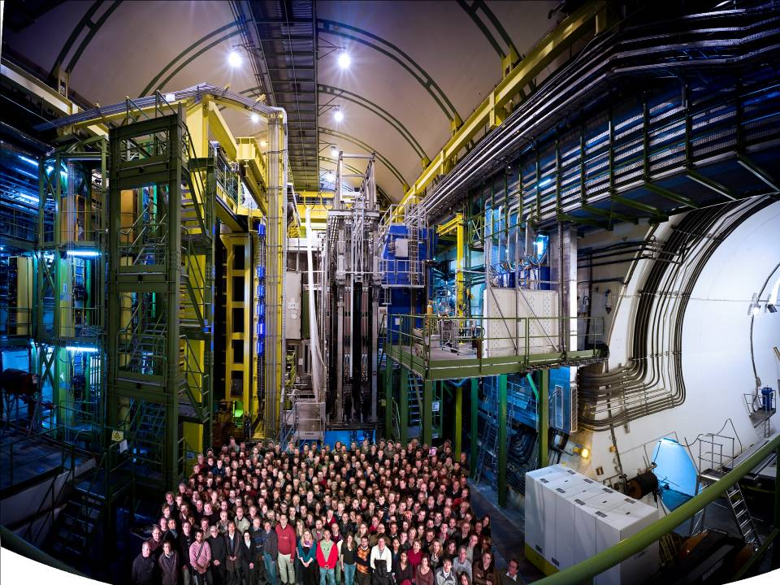



Muon System
RICH Detectors
Vertex Locator
Upgrade:
Beyond the Energy Frontier
Interaction
Point
Calorimeters
Tracking System
Chris Parkes, Epiphany Conference, Krakow, January 2012

Slide 2

Upgrade:
Beyond the Energy Frontier
LHCb
  recap: initial highlights
  Improving on LHCb - Key Challenges
Detector Upgrade
Physics Programme

Slide 3
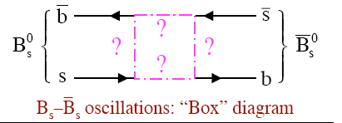
LHCb:A New Era in Flavour Physics
Discovering New Physics
through indirect effects:
sensitive far beyond
direct particle production reach
Precision Measurements
  Challenging forward region at hadron collider
  Need events !
  Need detailed understanding
  Of detector & systematics
Compelling results
from initial operation
  Key LHCb Attributes:
  Cross-section, Acceptance,
  Trigger,
  Vertex Resolution,
  Momentum Resol.,
  Particle ID
Chris Parkes

Slide 4
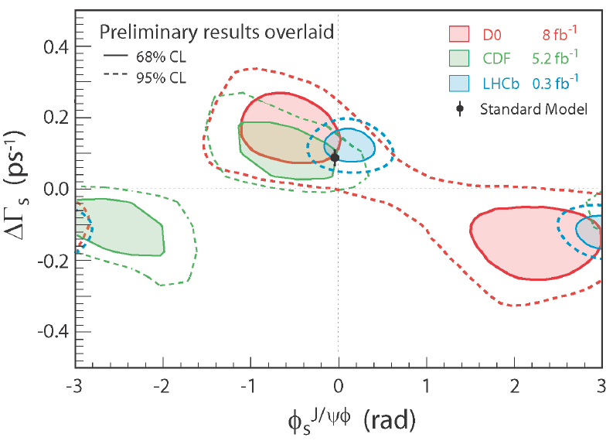

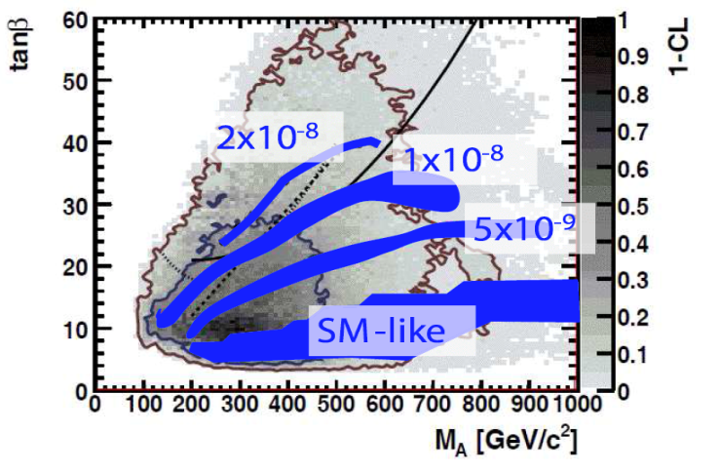
LHCb: Initial Highlights – Part 1
Φ_{s}: the B_{s} mixing phase
  Tagged, time dependent, angular analysis
  Tevatron SM discrepancy resolved
  ambiguity removed
World Best
B_{s}➔μ⁺μ⁻: constraining SUSY
  Strongly suppressed in SM
  Enhanced in MSSM
World Best

Slide 5
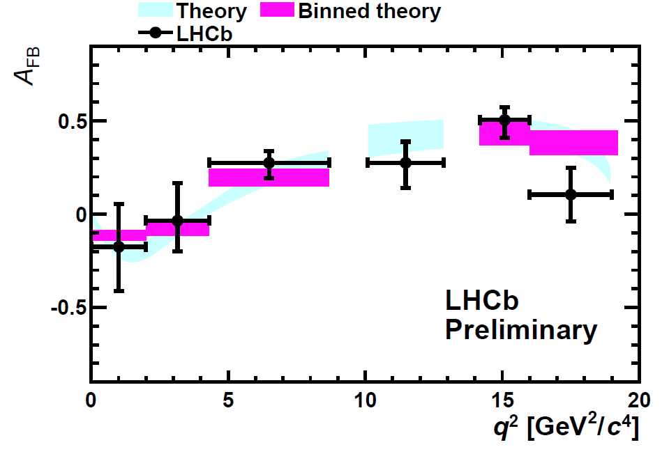
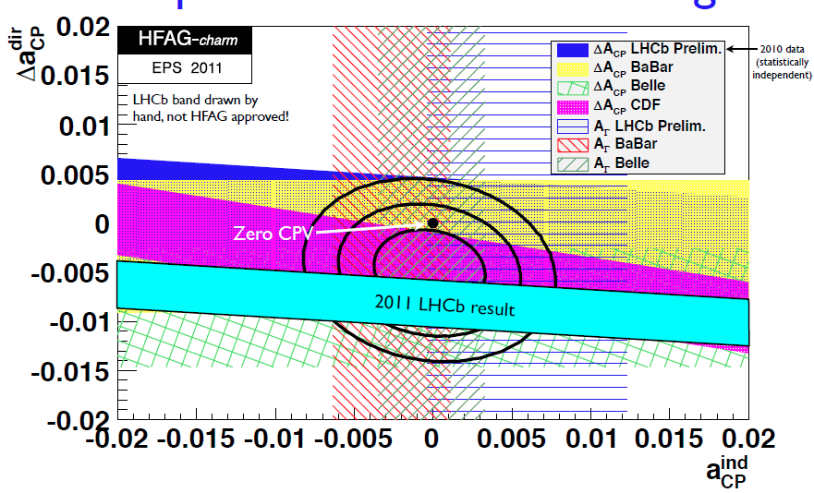
LHCb: Initial Highlights – Part 2
B⁰➔K*μ⁺μ⁻: NP in loops
  Rare decays are not so rare now !
  No sign of B-factory / CDF discrepancy
World Best
Charm CP Violation
  First evidence of CP violation in charm sector
  Direct CP Asymmetry
  Also measured y_{CP}, A_{Γ}
FIRST

Slide 6

LHCb Physics Programme
Limited by Detector
But NOT Limited by LHC
Upgrade to extend Physics reach
  Exploit advances in detector technology
      Displaced Vertex Trigger, 40MHZ readout
      Radiation Hard Vertex Detector
  Better utilise LHC capabilities
Timescale, 2018
Collect >50 fb⁻¹ data
Modest cost compared with
existing accelerator infrastructure
Independent of
LHC upgrade
HL-LHC not needed
But compatible
With HL-LHC phase
Chris Parkes

Slide 7

Upgrade:
Beyond the Energy Frontier
Detector Upgrade

Slide 8
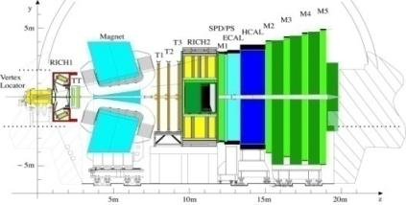
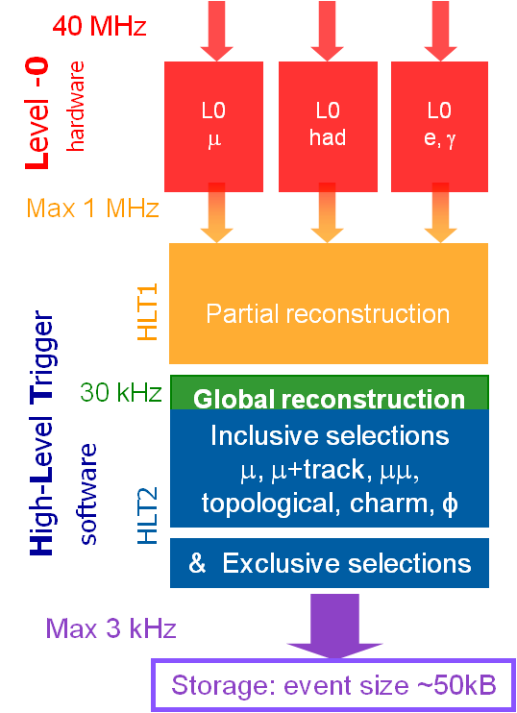
LHCb Trigger: the key to higher Lumi
Current First Trigger Level:
Hardware Muon/ECAL/HCAL
1.1 MHz readout
Performance:
Muon channels scale
Hadronic channels saturate bandwidth
Notes:
The current LHCb trigger allows to read out the full detector at 1.1 MHz. The purpose of L0 is reduce the event rate to that level .

Slide 9
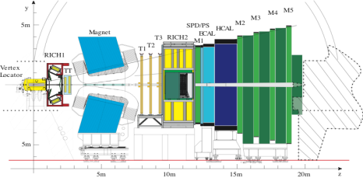
Solution: Upgrade detector to 40MHz readout
Upgrade Trigger fully software based
Runs in stageable Event Filter Farm
Up to 40 MHz input rate
20 kHz output rate
Trigger has access to all event information
Run at L > 10³³ cm⁻² s⁻¹
~ Gain of 2 in signal rates for hadronic
dependent on farm size
40 MHz
Optional
Low Level Trigger
throttle
1-40 MHz
HLT
Tracking and vertexing
Impact Parameter cuts
Inclusive/Exclusive selections
Efficiency | Farm Size = 5 x 2011 | Farm Size = 10 x 2011
B_{s} → φφ | 29% | 50%
B⁰ → K*μμ | 75% | 85%
B_{s} → φγ | 43% | 53%
20 kHz
Notes:
The FE electronics will be upgraded to readout at the LHC clock rate; in principle 40 MHz. The purpose of the tuneable Low Level Trigger are: 1) to allow a staged DAQ system which cannot handle the full rate 2) to deal with occupancy fluctuations preventing full readout 3)insuffieient CPU power in the event filter farm.
In the HLT not all tracks can be tracked in the downstream detector. IP requirement and number hits on track are used to select tracks. Keep HLT1 / HLT2 functionality

Slide 10

LHCb Upgrade to 40 MHz
VELO
Si strips
(replace all)
Silicon Tracker
Si strips
(replace all)
Outer Tracker
Straw tubes
(replace R/O)
Muon MWPC
(almost compatible)
RICH
HPDs
(replace HPD & R/O)
Calo
PMTs (reduce PMT gain, replace R/O)
Chris Parkes
Notes:
Spd, ps and m1 removed completely
Readout detector at 40MHz to run full software trigger
Replacement of all sub-detector Front-End electronics to 40 MHZ readout
Replacement of all silicon detectors attached to the current 1MHz electronics
VELO, IT, TT, RICH photo-detectors
Remove some detectors due to increased occupancies at higher luminosity
RICH1-aerogel, M1, possibly PS&SPD
Eventually improve PID at low momenta by introducing TORCH

Slide 11
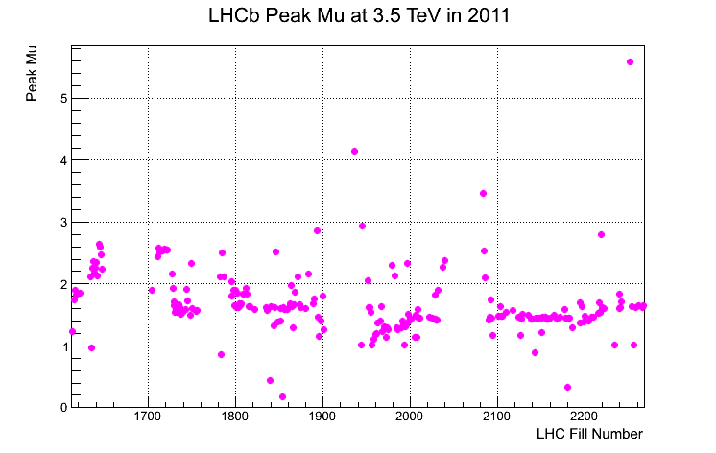
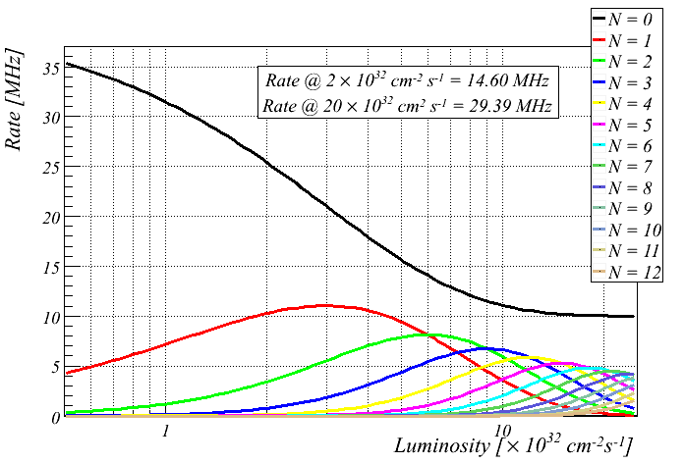
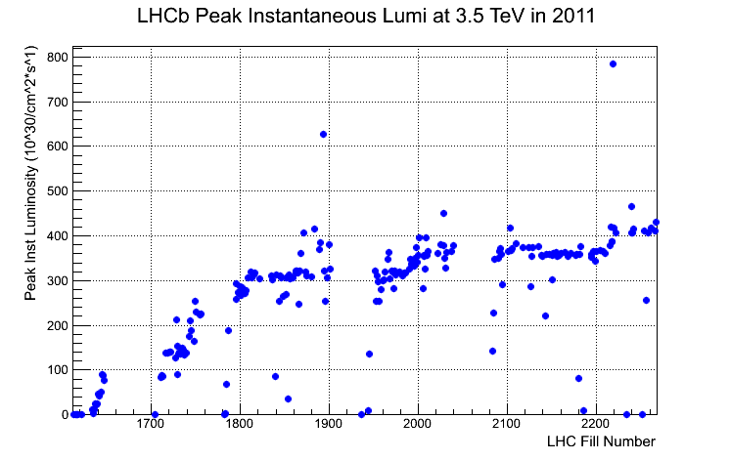
Luminosity and Pile-Up
LHCb design: L ~ 2x10³² cm⁻² s⁻¹ with 25 ns BX
→ interactions / beam crossing = 0.4
LHCb operations in 2011: L up to 4x10³² cm⁻² s⁻¹ with 50 ns BX
→ interactions / beam crossing = 2
LHCb Upgrade: L > 1x10³³ cm⁻² s⁻¹ with 25 ns BX
→interactions / beam crossing = 2
Chris Parkes

Slide 12
Luminosity and Pile-Up
LHCb design: L ~ 2x10³² cm⁻² s⁻¹ with 25 ns BX
→ interactions / beam crossing = 0.4
LHCb operations in 2011: L up to 4x10³² cm⁻² s⁻¹ with 50 ns BX
→ interactions / beam crossing = 2
LHCb Upgrade: L > 1x10³³ cm⁻² s⁻¹ with 25 ns BX
→interactions / beam crossing = 2
LHCb already running at twice design luminosity
Pile-up already at level expected at start of upgrade
Short 25ns test run also occurred in 2011
Can use current data to project future performance of upgrade
Chris Parkes

Slide 13
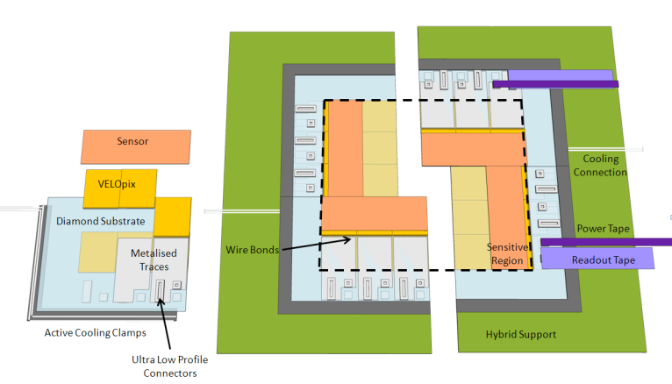
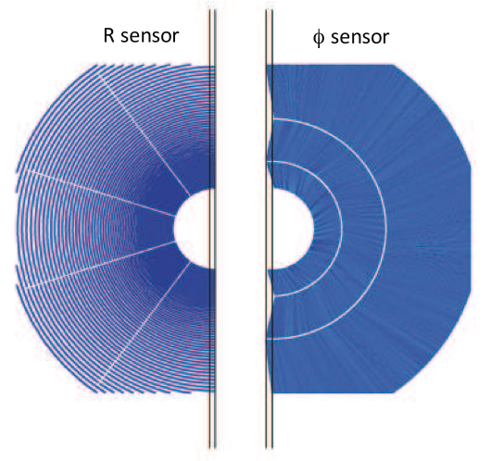
Velo Upgrade
New Velo @40 MHz readout
  Pixel detector: VELOPIX based on Timepix chip
    55 μm x 55 μm pixel size
  Strip detector
    New chip
R&D programme
  Module structure (X₀)
  Sensor options
    Planar Si, Diamond, 3D
  CO₂ cooling
  Electronics
  RF-foil of vacuum box
Chris Parkes
13

Slide 14
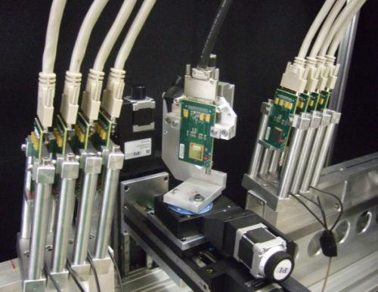
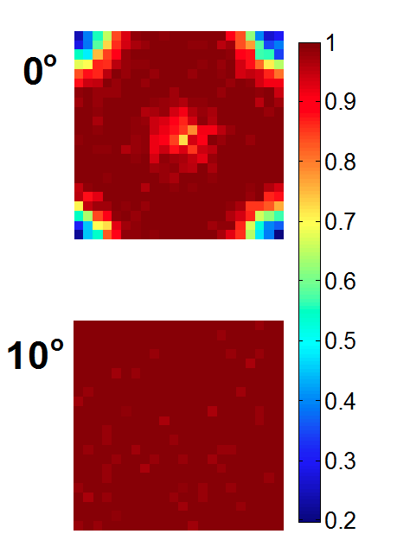
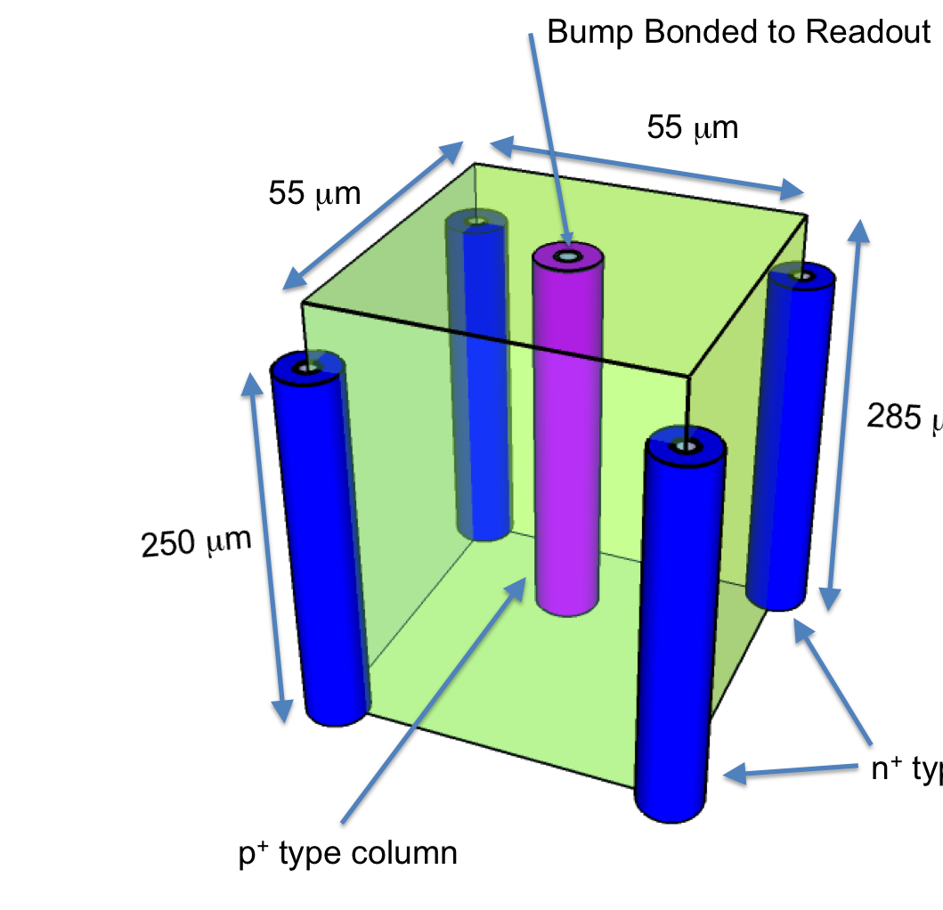
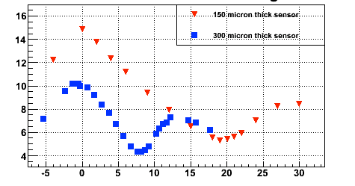
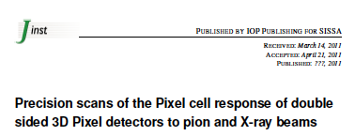
Velo R&D
Micron resolution, high rate
telescope based on TimePix
3D Sensor Studies
Nucl. Instrum. Meth. A Volume 661,
Issue 1, 1 January 2012, Pages 31-49
Planar Sensor Studies
Efficiency
σ(μm)
Sensor Angle (deg)
JINST 6 P05002 (2011)
Chris Parkes
14

Slide 15
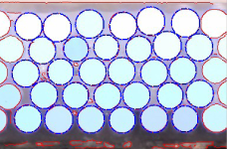
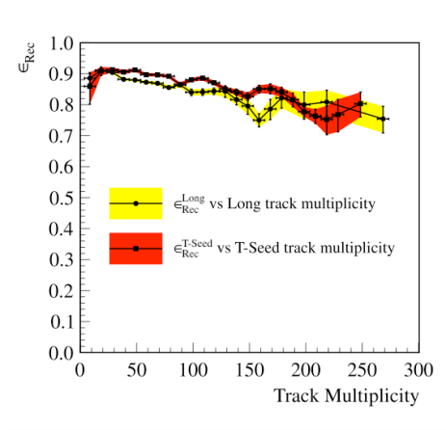
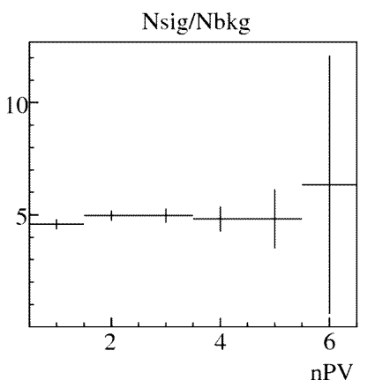
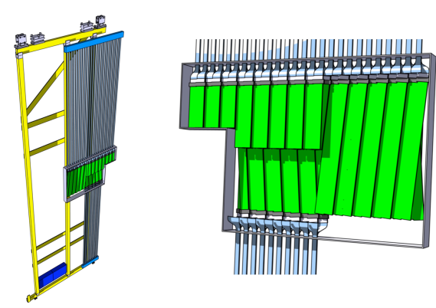
Main Tracker
IT fibres:
Outer Region
  Straw Tubes (current)
  1mm Scintillating Fibre Tracker
  Replace on-detector electronics by 40 MHz version (FPGA-TDCs)
Inner Region must be replaced (1 MHz electronics integrated)
  Silicon strips (replace current)
  0.25 mm Scintillating Fibre Tracker
Tracking efficiency
vs multiplicity
Nsig/Nbkg for B→J/ψK⁺
IT-fibre detectors:
Chris Parkes
15
Notes:
Readout of Sci Fi is Silicon Photomultipliers SiPM (20 p.e. per mip) – radiation protection. Alternative MAPMT a la RICH – same readout
Fibers by Kuraray
Nsig/Nbck = constant due to the fact that the primary vertices are well separated!

Slide 16
New Strip chip
AGH-Krakow
VELO, TT, IT silicon strip designs all require 40MHz readout chip
  Readout electronics identified as key area by LHCC
  May also share design elements with Sci. Fibres
On chip data processing and zero-suppression
  Outline specification produced
  Prototyping of key ADC stage underway

Slide 17
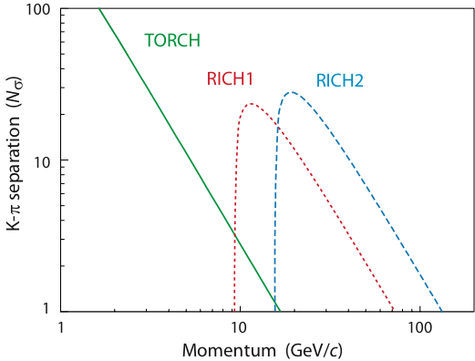
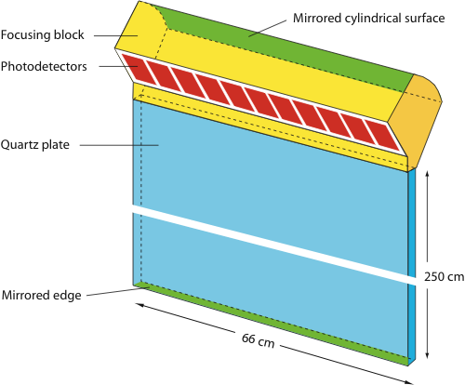
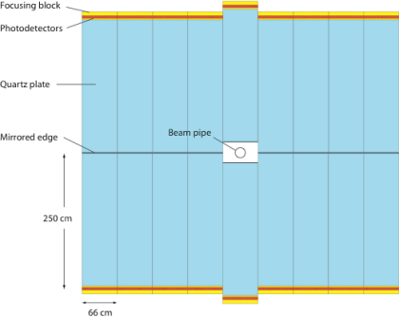
Particle ID
RICH-1 and RICH-2 detectors remain
  Readout baseline: replace pixel HPDs by MaPMTs & readout out by 40 MHz ASIC
  Alternative: new HPD with external readout
Low momentum tracks: replace Aerogel by Time-of-Flight detector “TORCH” (=Time Of internally Reflected CHerencov light)
  1 cm thick quarz plate combining technology of time-of-flight and DIRC
  Measure ToF of tracks with 10-15 ps (~70 ps per photon).
K-π separation vs p in upgrade:
TORCH detector:
17
Notes:
HPD electronics are limited to 1 MHz and is integrated within the vacuum envelope of the HPD tube. Therefore whole HPD must be replaced. Pixel HPD’s are custom made
The low photon yield of the aerogel leads to too much background in high trackmultiplicity environment.
TORCH time-of-flight and DIRC technology work coherently. Readout: Micro-Channel Plate photon detectors (MCP). TORCH is related to PID detectors TOP of Belle II and endcap DIRC of PANDA
The MaPMT option is baseline for RICH-1 and RIC-2. Magnetic field effects are being tested, shielding is required. Front end is 40 MHz ASIC, perhaps Maroc-3 readout chip.
Alternatives: HPD with external readout, MCP photon detector with Timepix readout

Slide 18
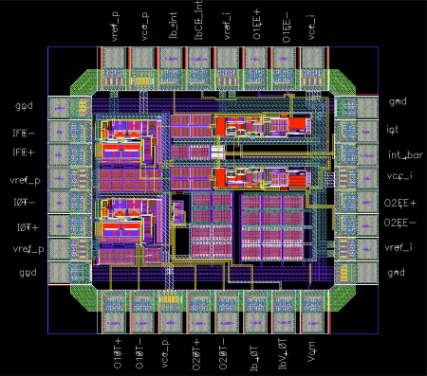
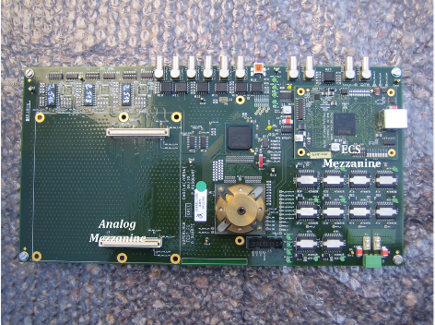
Calorimeters
ECAL and HCAL are maintained
  Keep all modules & photomultipliers (reduce gain in upgrade)
Initial stages (PS/SPD) used in 1st level trigger will be removed
  (e/γ separation provided by tracker)
Front End electronics modified for lower yield and to allow 40 MHz readout
ASIC prototype
New digital electronics prototype
18
Notes:
Reduce the photomulitplier gain by a factor 5 to keep the same current after lumi increase. New electronics: New FE card

Slide 19
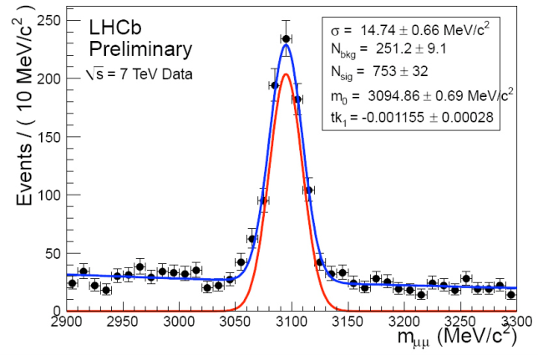
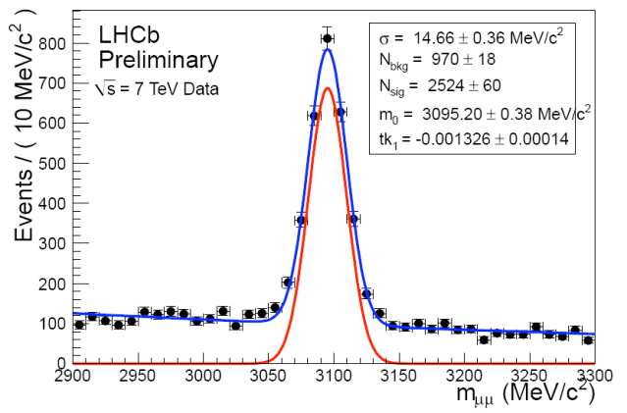
Muon Detectors
Muon detectors are already read out at 40 MHz in current L0 trigger
  Front end electronics can be kept
  Remove detector M1
Performance at higher occupancy
Investigations:
  MWPC aging : tested at CERN to 10³³ level and 50 fb⁻¹,
  Rate capability for FE of inner regions of station M2 at 2x10³³ luminosity
J/ψ → μ ⁺ μ – for single PV events
J/ψ → μ ⁺ μ – for events with <PV>=2.3
19
Notes:
M1 will be removed as the momentum measurement at the LLT will be done using the T stations
M_J/psi S/B reduction is 15%
Expect to replace 1-2% of the chambers per year

Slide 20
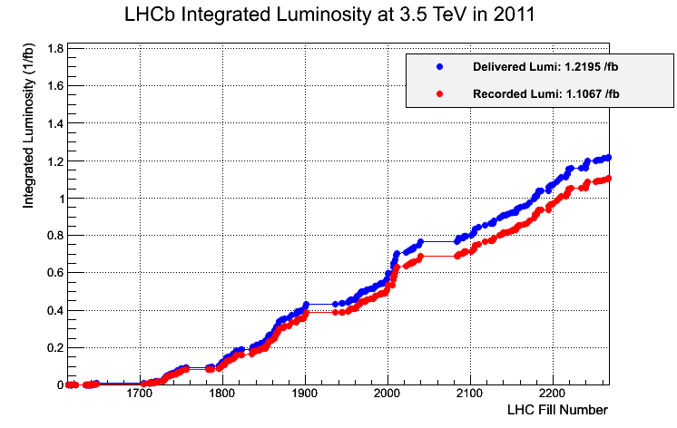
~Timescales: LHCb & Accelerator
2011: 1.2 fb⁻¹
Doubling time for statistics requires upgrade ~ 2018
2010 - 2012
Start of LHCb physics programme
7-8 TeV
Long shutdown
Splice repairs
2015-2017
14 TeV
LHCb > 5 fb⁻¹
LHCb upgrade installed
Injector and LHC
Phase I GPD upgrades
2018-2022
Start of LHCb upgrade physics programme
Towards High
Luminosity LHC

Slide 21

Upgrade:
Beyond the Energy Frontier
Physics Programme
Complementary to ATLAS / CMS direct searches
New particles are discovered
  LHCb measure flavour couplings through loop diagrams
No new particles are found
  LHCb probe NP at multi-TeV
  energy scale

Slide 22



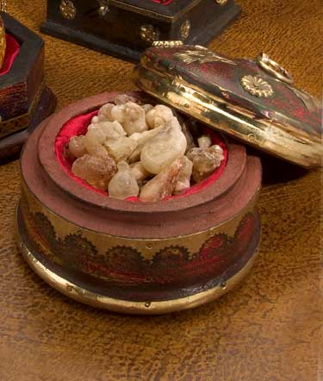



LHCb Upgrade Physics Programme
is the dedicated experiment at the LHC for:
B physics
CP violation, rare decays
Electroweak
in forward
Charm physics
CP violation, spectroscopy
QCD
Central exclusive production
Frankinscense
Lepton Flavour
Violation
Exotics
long lived

Slide 23

LHCb Upgrade Physics Programme
is the dedicated experiment at the LHC for:
Electroweak
in forward
B physics
General Purpose experiment
for the forward region
Charm physics
QCD
Central exclusive production
Frankinscence
Lepton Flavour
Violation
Exotics
long lived

Slide 24
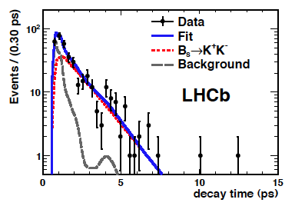
CP Violation: Upgrade Examples
Core familiar physics – two examples:
ϕ_{s} : Mixing induced CPV in B_{s}
  Phase I: Observe NP in ϕ_{s} if larger than 3xSM
    arXiv:1112.3183; arXiv:1112.3056
  Upgrade: Beyond SM precision measurement: σ≈0.006
Rare penguin decay topologies sensitive to NP: Charmless hadronic B-decays
  Phase I: Direct CP violation in B_{s} and Λ_{b,}
    Time dependent CPV in B_{s}→K⁺K⁻ (arXiv:1111.0521)
  Upgrade: Precision time dependent CPV in penguin dominated B_{s}→K*⁰K*⁰ (arXiv:1111.4183), B_{s}→ϕϕ : σ ~ 0.02
A_{fs}- probing D0 result soon; CKM angle γ….

Slide 25
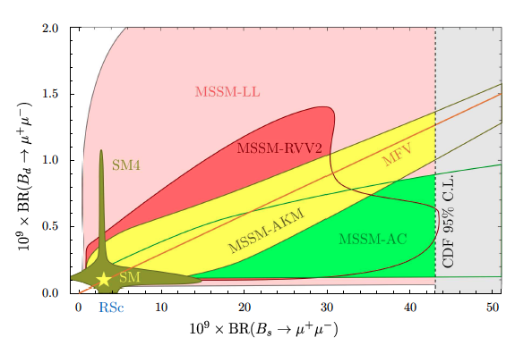
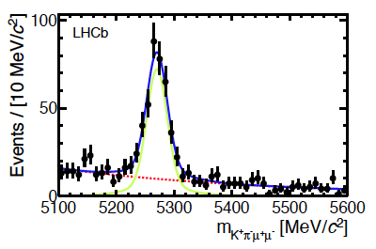
Rare Decays
B_{s,d}→μ⁺μ⁻
  Phase I: Search for NP in B_{s}→μ⁺μ⁻ (arXiv:1112.1600, arXiv:1103.2465)
  Upgrade: Correlation B_{s}→μ⁺μ⁻ vs B_{d}→μ⁺μ⁻
B⁰→K*⁰μ⁺μ⁻
  Phase I: measure AFB and other observables
  (arXiv:1112.3515)
  Upgrade: precision full angular analysis
Radiative decays: b→s γ : B_{s}→ϕ γ, photon polarisation (flexible trigger)
Probing MFV Scenarios

Slide 26
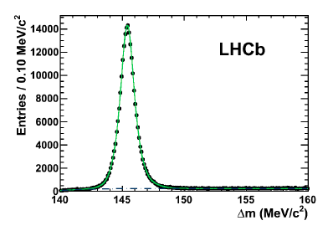
Charm
LHCb is world’s foremost charm factory
  Evidence direct CP violation (arXiv:1112.0938)
  Probing oscillations (y_{CP})
  CP violation in mixing* (A_{Γ}) (arXiv:1112.4698)
    Upgrade D sample approx 1000 X B factories and time dependent measurements benefit from excellent resolution
  Rare decay measurements e.g.
    where limit currently 10⁶ X larger than SM
  Dalitz Analyses e.g.
  Time dep. CP violation in
* mostly, see arXiv:1111.6515

Slide 27
Sensitivities to key flavour channels
Unique potential B_{s} / b baryon sector
Charged particle final states far in excess of other facilities

Slide 28

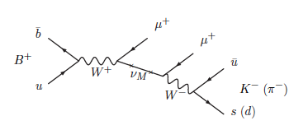
Lepton Flavour Violation
Neutrino oscillations established
  but low neutrino mass scale to be understood
  Heavy Majorana neutrinos in many NP models
    e.g. νMSM (dark matter, baryon asymmetry)
  Direct Search: long lived from B& D decays
  Indirect: lepton violating e.g.
.
    (arXiv:1110.0730)
Lepton Flavour violating τ-decays
  Vanishingly small in SM with mixing
LHC mainly produces τ’s from B and D_{s} decays
  LHCb : τ→3μ
    Phase-1: aim to match B-factories with few years
    Upgrade: 10⁻⁹ level

Slide 29
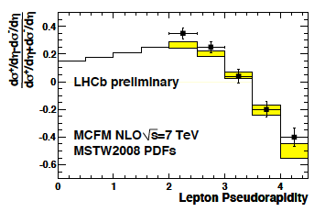
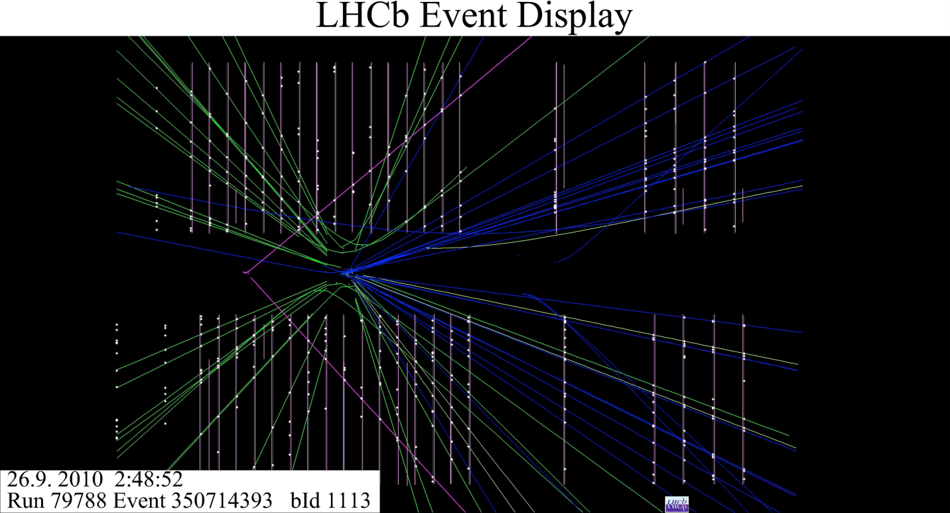
Electroweak & QCD
Boson follows quark direction in forward
  Hence asymmetry measurements at LHCb
  sin² θ_{eff}^{lept :} measure A_{FB} of leptons in Z-decays
    raw A_{FB} asymmetry factor 5 larger than @ LEP
  Top quark forward-backward asymmetry
Constraining pdfs, e.g. W Charge Asymmetry
  changes sign in LHCb region: constraints on the low x quark content of the protons at high q²
Central Exclusive Production
GPDs
pp → p + X + p with rapidity gap:
  Photon or pomeron exchange

Slide 30
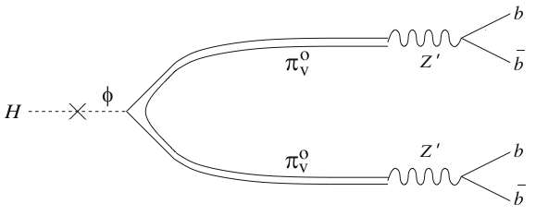
Exotics
Hierarchy problem: why is Higgs mass not at Planck scale?
  Many models (Susy, Xtra dimensions, Technicolour, Little Higgs) predict new states at TeV scale: Z’, 4th generation, leptoquarks, Hidden Valley particles
Hidden Valley particles carry “v” quantum number and can be low mass
  Lightest v-particle is a dark matter candidate
  V-neutral particles might have long lifetime and decay, e.g. to b bbar
  V flavoured particles could be produced by Higgs
M.J. Strasser and K.M. Zurek, Phys. Lett. B 661 (2008) 263
Notes:
Hidden valley motivated by string theory

Slide 31
LHCb Upgrade Summary
40 MHz Readout of all subdetectors
  Flexible Trigger
  Retain key LHCb advantages:
  Vertex Resolution
  Momentum resolution
  Particle ID
Installation 2018
General Purpose Experiment for Forward region:
  Beauty, Charm, LFV, Electroweak, QCD, Exotica
Particular thanks to:
Paula Collins, Marcel Merk, Burkhard Schmidt, Andreas Schopper

Slide 32
Introducing LHCb
LHCb is a dedicated experiment to study flavour physics at the LHC
  Search for New Physics in quantum loop processes
  CP violation and rare decays allowing to probe
  beyond the LHC energy frontier
B decay vertices:
a few tracks
Primary vertex:
many tracks ~50
10 mm
π⁺
Detector requirements
Efficient trigger for both leptonic and
hadronic final states
Excellent vertex finding and tracking efficiency
Outstanding particle identification
B⁰
π⁻
B⁻
µ⁻
D⁰
υ_{µ}
K/π separation

Slide 33
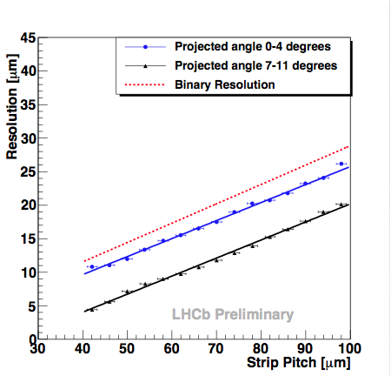
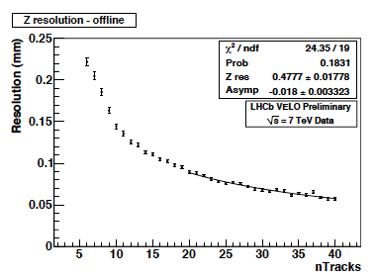
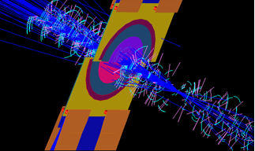
Vertex Resolution
VELO - Highest Resolution Vertex Detector at LHC
Identification of beauty and charm
from displaced vertices critical to LHCb physics

Slide 34
Particle Identification
RICH PID close to MC expectations across full momentum range
Clean reconstruction of hadronic decays critical to many of following physics results
φ → K⁺ K⁻

