Slide 1
The first year of operating the LHC accelerator
Andrzej SIEMKO
CERN, European Organization for Nuclear Research
Geneva, Switzerland
On behalf of the LHC commissioning team

Slide 2
OUTLINE
Early beam operations and main parameters for the first LHC proton run
Strategy and progress during 2010
Observations, encountered limitations
First heavy ion run
Prospects for 2011
Summary and conclusions

Slide 3
OUTLINE
Early beam operations and main parameters for the first LHC proton run
  Reduced energy
  Instantaneous luminosity
Strategy and progress during 2010
Observations, encountered limitations
First heavy ion run
Prospects for 2011
Summary and conclusions

Slide 4
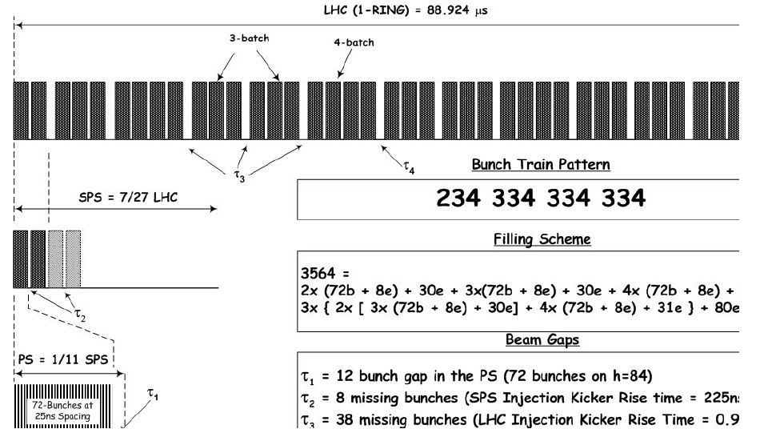
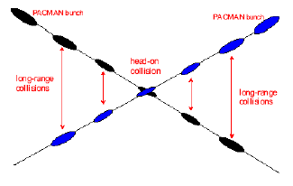
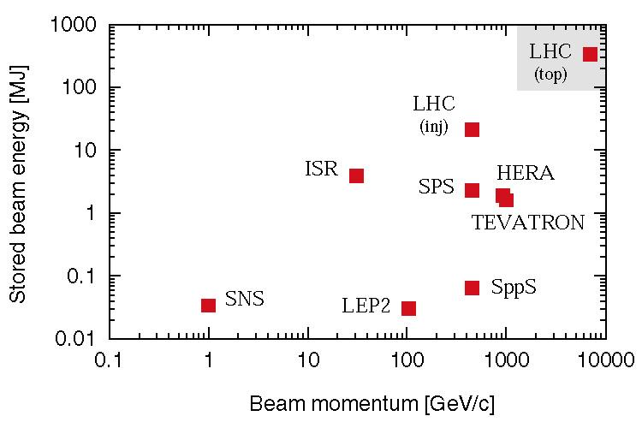
LHC nominal performance
Nominal settings
Beam energy (TeV) | 7.0
Number of particles per bunch | 1.15 10¹¹
Number of bunches per beam | 2808
Crossing angle (μrad) | 285
Norm transverse emittance (μm rad) | 3.75
Bunch length (cm) | 7.55
Beta function at IP 1, 2, 5, 8 (m) | 0.55,10,0.55,10
Derived parameters
Luminosity in IP 1 & 5 (cm⁻² s⁻¹) | 10³⁴
Luminosity in IP 2 & 8 (cm⁻² s⁻¹)* | ~5 10³²
Transverse beam size at IP 1 & 5 (μm) | 16.7
Transverse beam size at IP 2 & 8 (μm) | 70.9
Stored energy per beam (MJ) | 362
* Luminosity in IP 2 and 8 optimized as needed

Slide 5
Reduced energy in 2010 – the origin
Defective joints between superconducting magnets
New Quench Protection System for online monitoring and protection of all joints implemented during 2009 and commissioned early 2010
New QPS cannot protect the joints with lacking bonding between the bus Cu stabilizers (fuse like configuration)

Slide 6
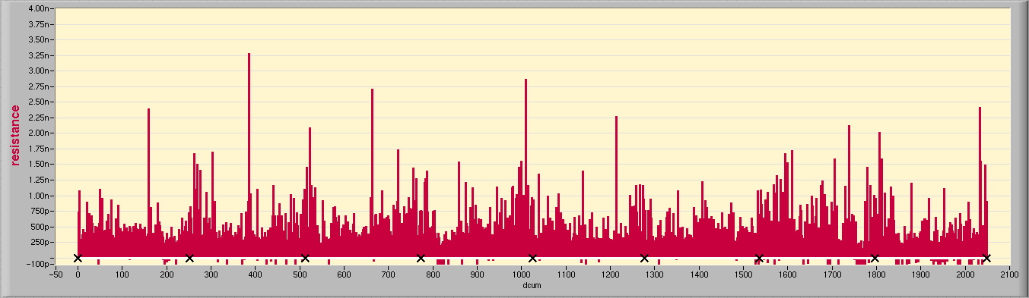
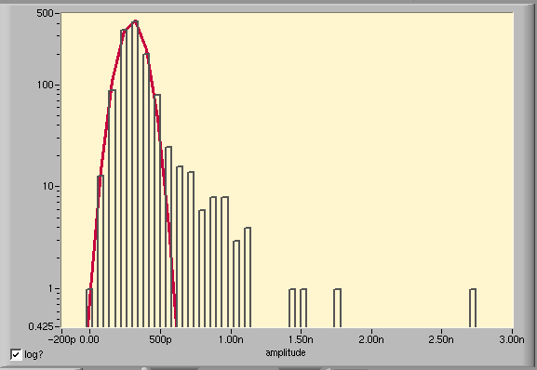
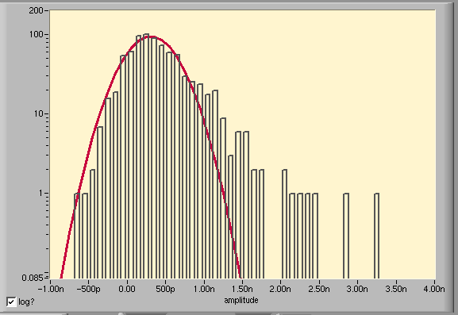
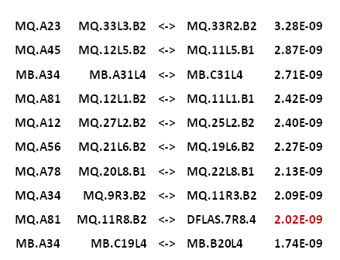
LHC main interconnect joints today (S.C.)
Main Dipoles & Quads Bus, sorted by position, 2048 segments
All HWC pyramids and plus ~150 ramps to 3.5TeV analyzed
2nΩ
12 23 34 45 56 67 78 81
Dipole Buses
Quad Buses
Top 10 Splice Resistances
306** ± 313pΩ
301 ± 85pΩ
R_{max} = 3.3nΩ
R_{max} = 2.7nΩ
From Z. Charifoulline
Notes:
1/9/11
6

Slide 7
Reduced energy – the history
Decision at Chamonix meeting in January 2010
  Safe to run at 6 kA in the main dipoles = 3.5 TeV/beam
  Run at 3.5 TeV/beam up to an integrated luminosity of around 1fb⁻¹.
  Then consolidate the whole machine for 7TeV/beam (will require a long shutdown in 2013?)

Slide 8
Evolution of target energy during commissioning
When
Why
7 TeV
2002-2007
Design
12 kA
5 TeV
Summer 2008
Symmetric quench
9 kA
Late 2008
Splice problem
3.5 TeV
3.5 TeV
Summer 2009
Stabilizers
6 kA
Fix nQPS
Test 6kA
Winter
2010
1.18 TeV
October 2009
nQPS
2 kA
450 GeV

Slide 9
Instantaneous luminosity
Nearly all the parameters are variable (and not independent)
  Number of bunches per beam k_{b}
  Number of particles per bunch Ν
  Normalised emittance ε_{n}
  Relativistic factor (E/m₀)
  Beta function at the IP β *
  Crossing angle factor F
    Full crossing angle θ_{c}
    Bunch length σ_{z}
    Transverse beam size at the IP σ*
Total Intensity
Beam Brightness
Energy, γ
Interaction Region
“To achieve high luminosity, all one has to do is make (lots of) high population bunches of low emittance to collide at high frequency at locations where the beam optics provides as low values of the amplitude functions as possible.” (PDG 2005, chapter 25)

Slide 10
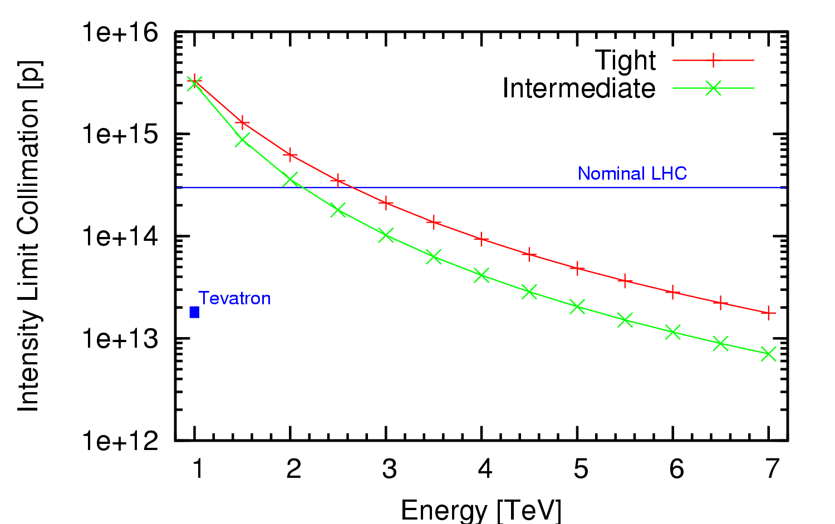
LHC - present intensity limit
Collimation system conceived as a staged system
First stage to allow 40% of nominal intensity at 7TeV
  Under certain assumptions
    LHC lifetimes and loss rates
    0.1%/s assumed (0.2h lifetime)
    Ideal cleaning
  Imperfections bring this down
    Deformed jaws
    Tilt & offset & gap errors
    Machine alignment
  Machine stability
    Tight settings are challenging
    Intermediate settings make use of aperture to relax tolerances
Fix I_{max} to 6×10¹³ protons per beam at 3.5TeV
(about 20% nominal intensity)
30MJ stored beam energy

Slide 11
β* and F in 2010
Lower energy means bigger beams
  Less aperture margin around the IP
  Higher β* helps in this
> 50 bunches requires crossing angle
  Requires more aperture
  Higher β* again helps
Targets for 3.5TeV
  2m no crossing angle
  3m with crossing angle

Slide 12
OUTLINE
Early beam operations and main parameters for the first LHC proton run
Strategy and progress during 2010
Observations, encountered limitations
First heavy ion run
Prospects for 2011
Summary and conclusions

Slide 13
2009 re-commissioning after partial repair of 13 kA joints
November 20th 2009
  First LHC beams around again
November 29th 2009
  Both beams accelerated to 1.18 TeV simultaneously
December 8th 2009
  2x2 bunches accelerated to 1.18 TeV
  First collisions at 2.36 TeV cm!
December 14th 2009
  Stable 2x2 bunches at 1.18 TeV
  Collisions in all four experiments
LHC - highest
energy collider
Limited to 2 kA in main superconducting magnet circuits (1.18 TeV) during deployment and testing of new Quench Protection System

Slide 14
The operational cycle
Squeeze
Collisions
Ramp
Rampdown
Injection
Injection | Ramp | Squeeze | Collisions | Rampdown
Many schemes Injection channel | Dynamic effects Feedbacks | Optics Collimators | Beam steering Beam-beam | Ramp rates Reproducibility
← All through the cycle →
Beam dump Collimations system Protection devices

Slide 15
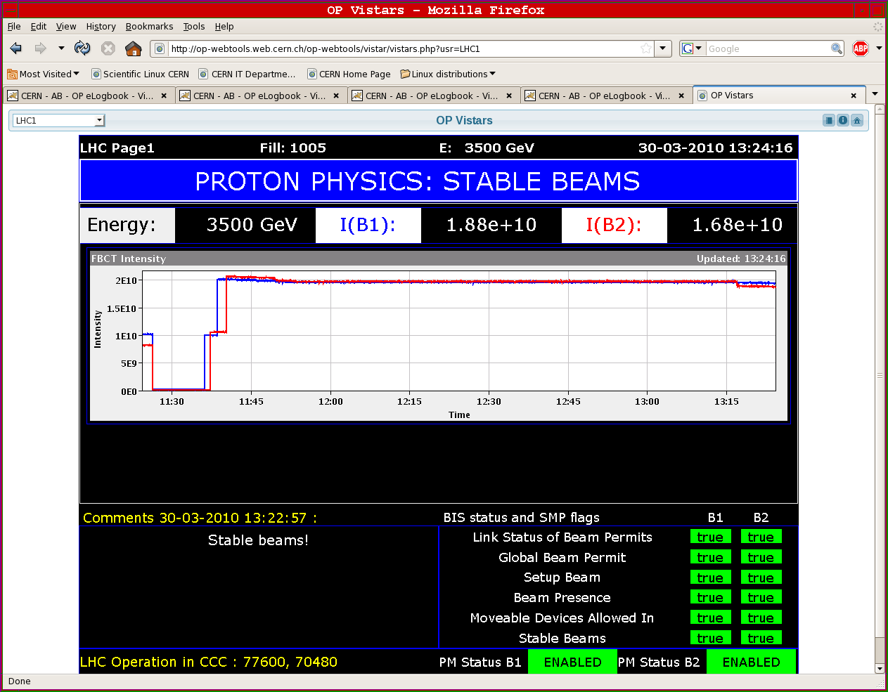
First Collisions at 3.5TeV/beam

Slide 16
After the first collisions
Steady progress but carefully
  Increase the number of bunches slowly
Prepare for future progress
  Decided to go to nominal bunch intensities of 1.1·10¹¹
  Squeeze = β* at the IP back to 3.5 m to prepare for crossing angle and have some protection margin
Why slowly:
  Don’t want to break the machine
  It is more complicated with more bunches

Slide 17
Commissioning strategy
Some numbers
What | Limit |  | Comment
Pilot | Single bunch of 5 10⁹ protons |  | Quench limit
Safe beam | 10¹² protons at 450 GeV |  | Damage limit
 | Energy | Safe beam | Scales with 1/E^{1.7}
 | 0.45 | 1.00E+12
 | 1.18 | 1.94E+11
 | 3.5 | 3.06E+10
 | 7 | 9.41E+09

Slide 18
Commissioning strategy
At whatever energy
  Correct everything with safe beams
  Then establish references
  Then set up protection devices
  Then increase intensity incrementally
    Low bunch currents, increase k_{b}
    Increase bunch current
      High bunch current, low k_{b}, same total current
      Nominal bunch currents, increase k_{b}
    Once k_{b} > 50 or so, need bunch trains
At each stage, re-qualify machine protection systems

Slide 19
Milestones reached during 2010
Early beam operations - physics running with low intensity widely spaced bunches
Date | Day | Achieved
Feb 28 | 1 | Restart with beam
Mar 12 | 13 | Ramp to 1.18 TeV
Mar 19 | 20 | Ramp to 3.5 TeV
Mar 30 | 31 | First collisions at 7 TeV centre of mass | Luminosity ~ 2×10²⁷ cm⁻² s⁻¹
Apr 01 | 33 | Start squeeze commissioning | Regular physics runs 2 on 2 bunches of 10¹⁰ Un-squeezed 1 colliding pairs per experiment Rates around 100Hz
Apr 07 | 39 | Squeeze to 2 m in points 1 and 5
Apr 09 | 41 | Single nominal bunch of 1.1×1011 stable at 450GeV
Apr 13 | 45 | Squeeze to 2 m in point 8
Apr 16 | 48 | Squeeze to 2m in point 2
April 24 | 54 | First stable beams at 7 TeV, 3 on 3, squeeze to 2m | Luminosity ~ 2×10²⁸ cm⁻² s⁻¹
May |  | Increase bunch intensity to 2×10¹⁰ ,Increase k_{b} | Regular physics runs
May 24 |  | 13 on 13, 2m, 8 colliding pairs per experiment | Luminosity ~ 3×10²⁹ cm⁻² s⁻¹
Physics running with low intensity widely spaced bunches

Slide 20
Milestones reached during 2010
Physics running with nominal intensity widely spaced bunches
Physics running with nominal intensity 150ns bunch trains
Date | Day | Achieved
June |  | Increase bunch intensity to nominal, squeeze to 3.5m | No physics for 3 weeks!
June 25 |  | First stable beams at 7 TeV, 3 on 3 nominal bunch | Luminosity ~ 5×10²⁹ cm⁻² s⁻¹
July 15 |  | 13 on 13, 8 colliding pairs per experiment, 9 10¹⁰ / bunch | Luminosity ~ 1.5×10³⁰ cm⁻² s⁻¹
July 30 |  | 25 on 25, 16 colliding pairs per experiment, 9 10¹⁰ / bunch | Luminosity ~ 3×10³⁰ cm⁻² s⁻¹
Early Aug |  | Stable running period to consolidate operation and MP | ~1.3 MJ per beam
Aug 19 |  | 48 on 48, 36 colliding pairs 1 5 and 8 (< in 2), 9 10¹⁰ / bunch | Luminosity ~ 6×10³⁰ cm⁻² s⁻¹
Aug 24 |  | 50 on 50, 35 colliding pairs 1 5 and 8 (< in 2), 10¹¹ / bunch, lower ε | Luminosity ~ 10³¹ cm⁻² s⁻¹
Sept |  | Setting up bunch trains on crossing angles | No physics for 3 weeks!
Sept 22 |  | First stable beams at 7 TeV with bunch trains, 24/16 nominal bunches | Luminosity ~ 4×10³⁰ cm⁻² s⁻¹
 |  | Increase number of trains, 10¹¹ / bunch
Oct 08 |  | 248 on 248, 150ns bunch trains, 233 colliding pairs in 1, 5 and 8 | Luminosity ~ 9×10³¹ cm⁻² s⁻¹
Nov 08 |  | 368 on 368, 150ns bunch trains, 348 colliding pairs in 1, 5 and 8 | Luminosity ~ 2×10³² cm⁻² s⁻¹
Physics running with nominal intensity widely spaced bunches
Physics running with nominal intensity 150ns bunch trains

Slide 21
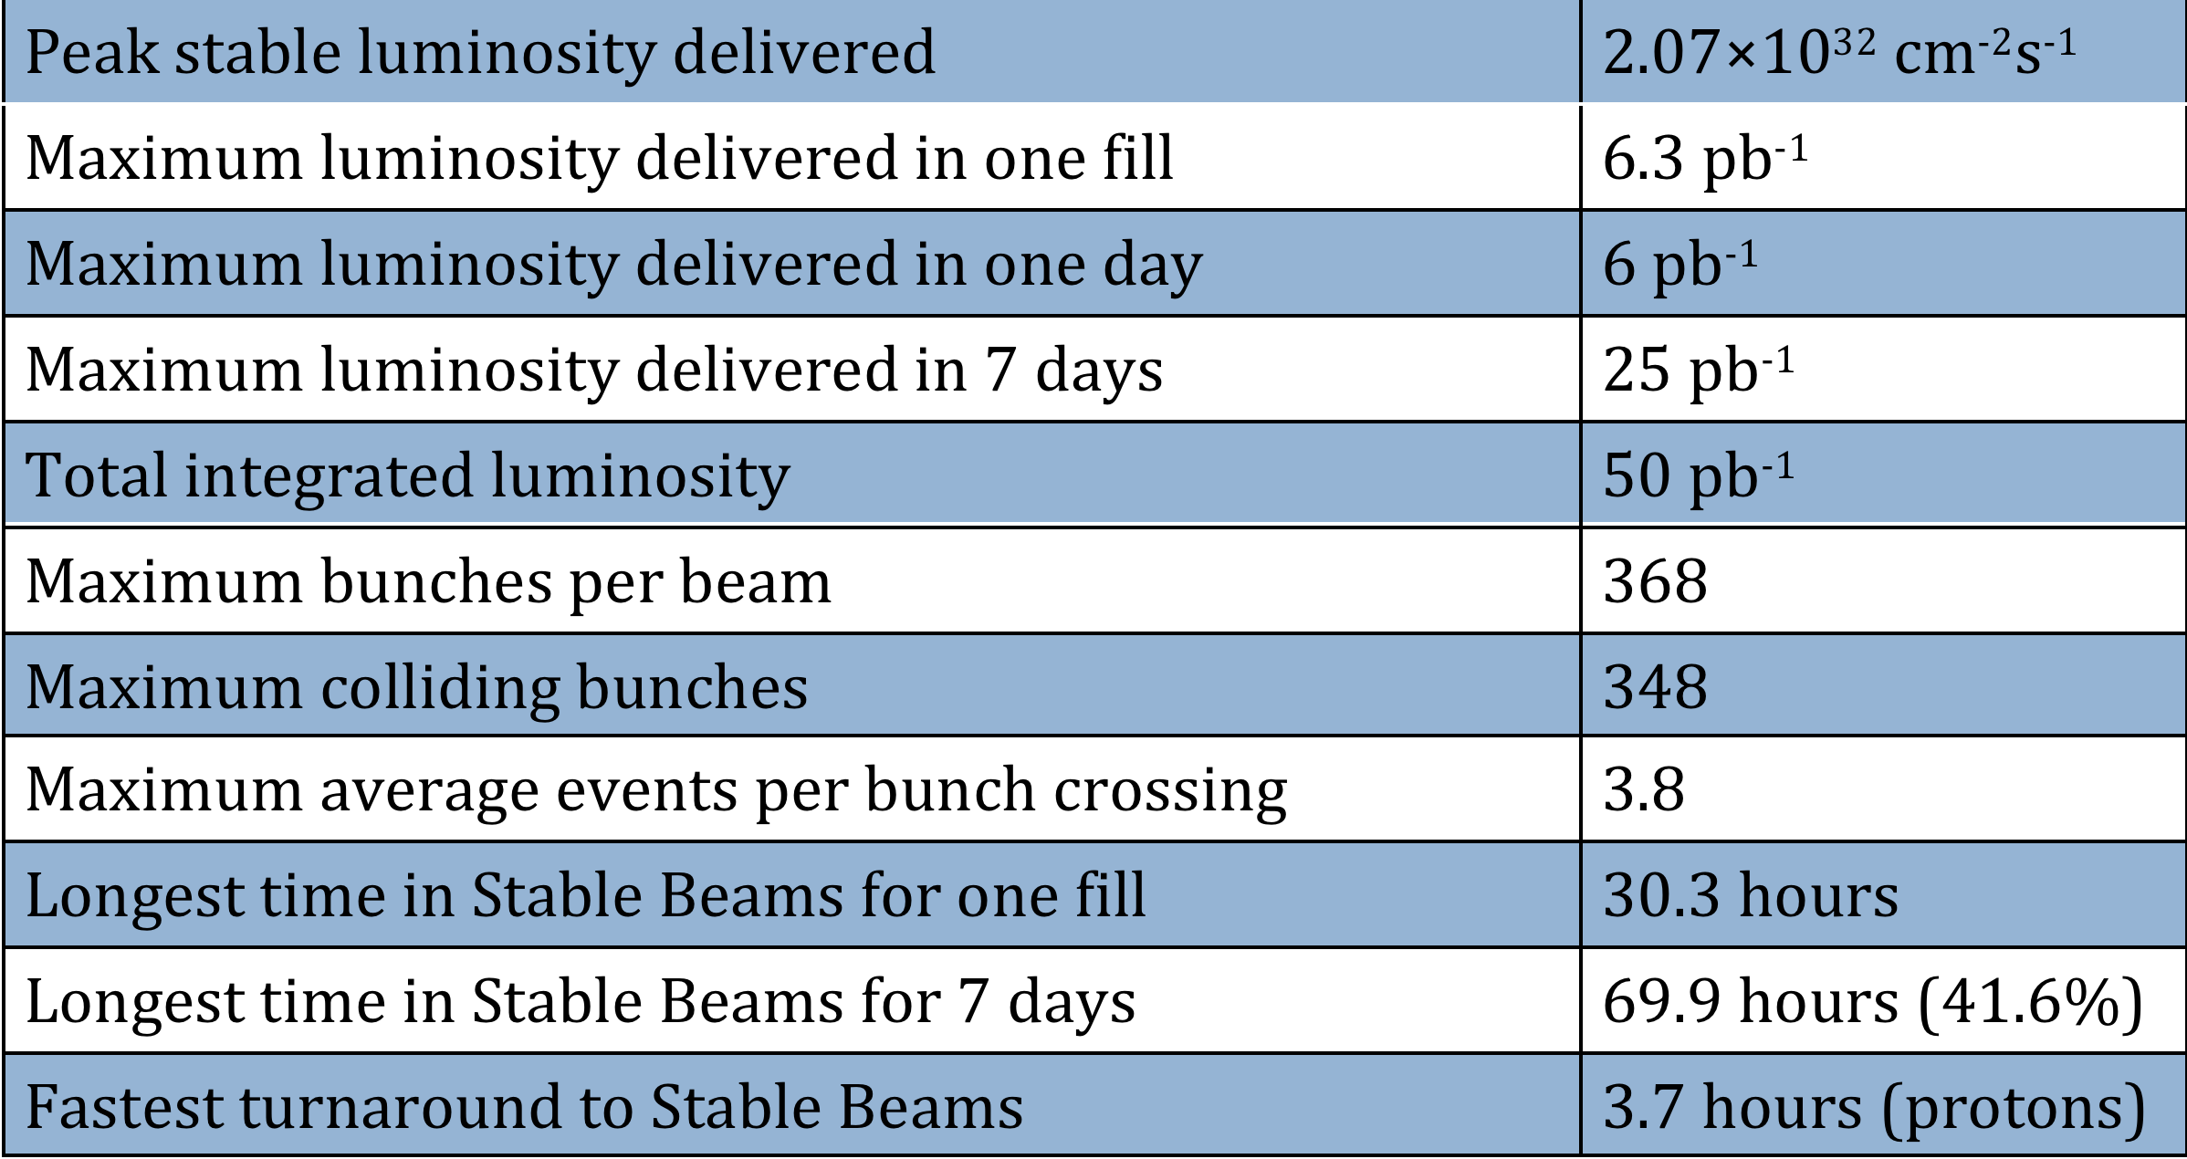
2010 Proton Run - Performance Highlights

Slide 22
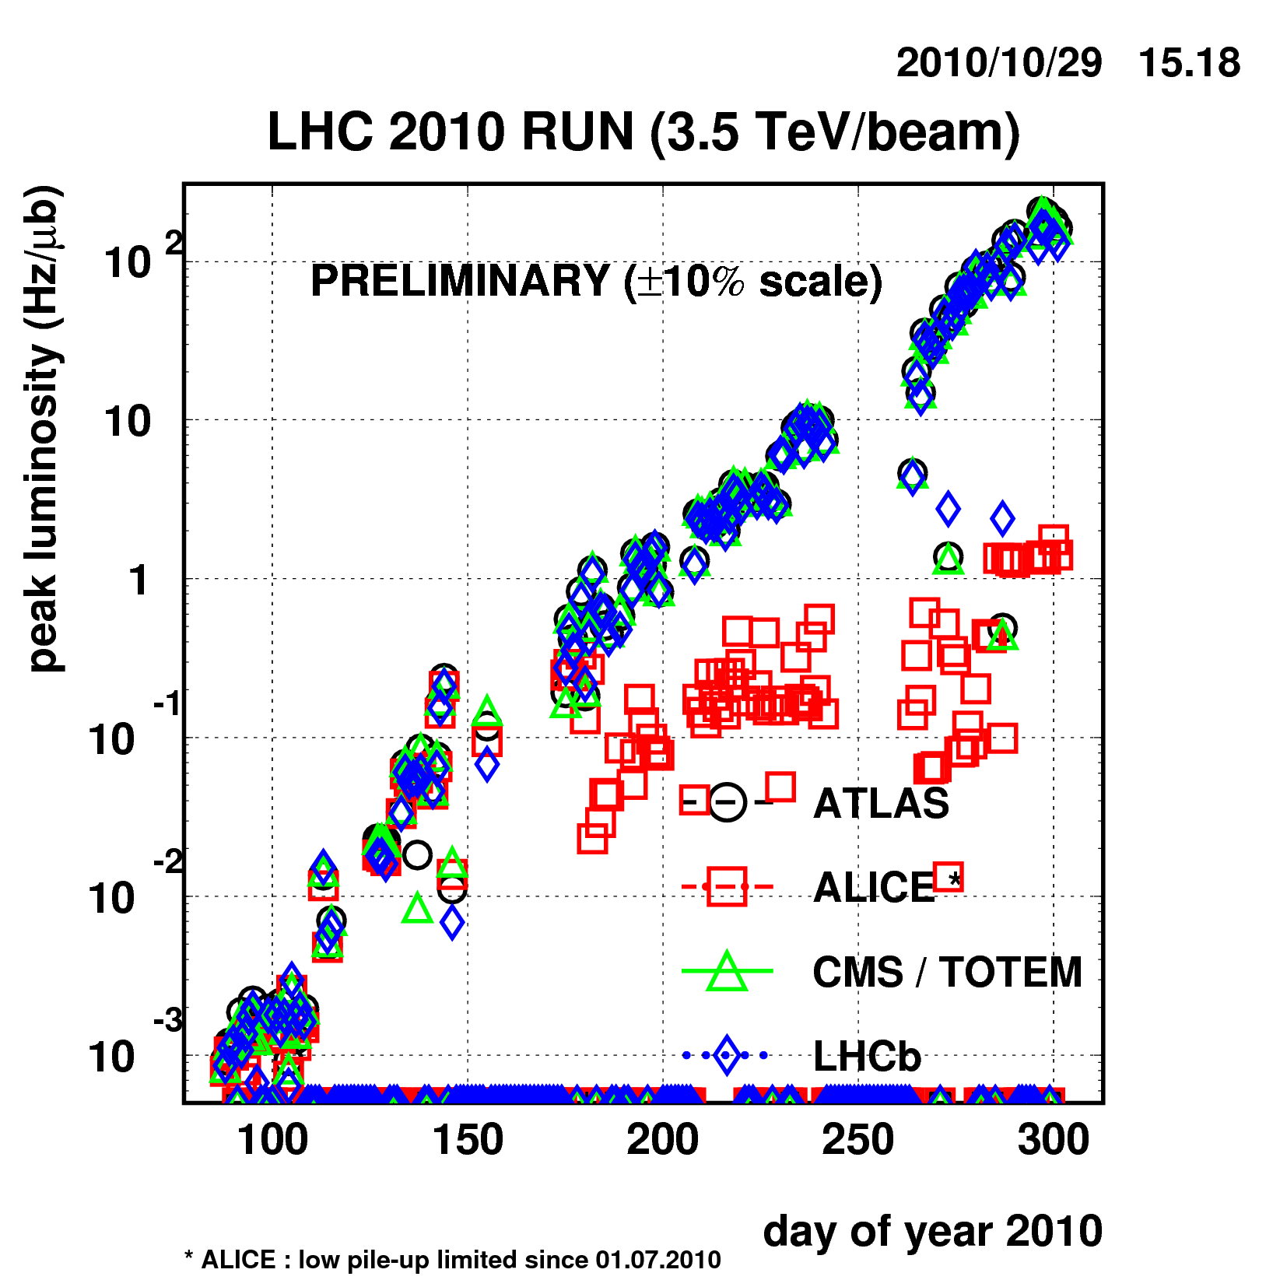
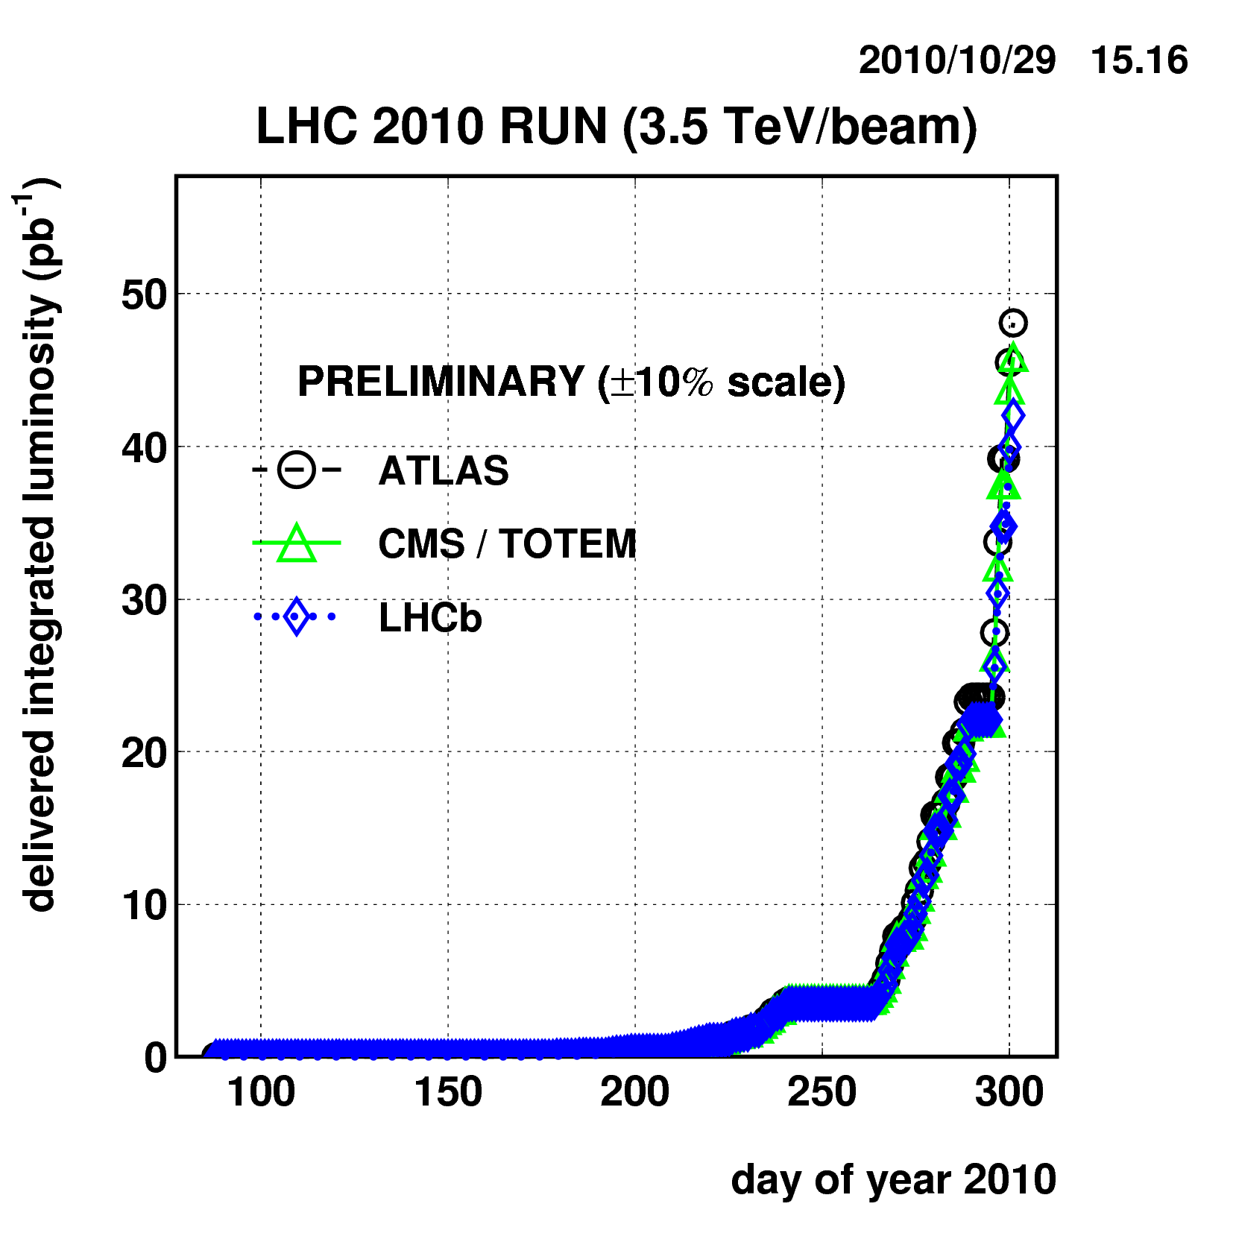
Luminosity evolution
5 orders of magnitude in ~200 days
~50 pb⁻¹ delivered, half of it in the last week !
10³⁰ cm⁻² s⁻¹
Bunch train commissioning

Slide 23
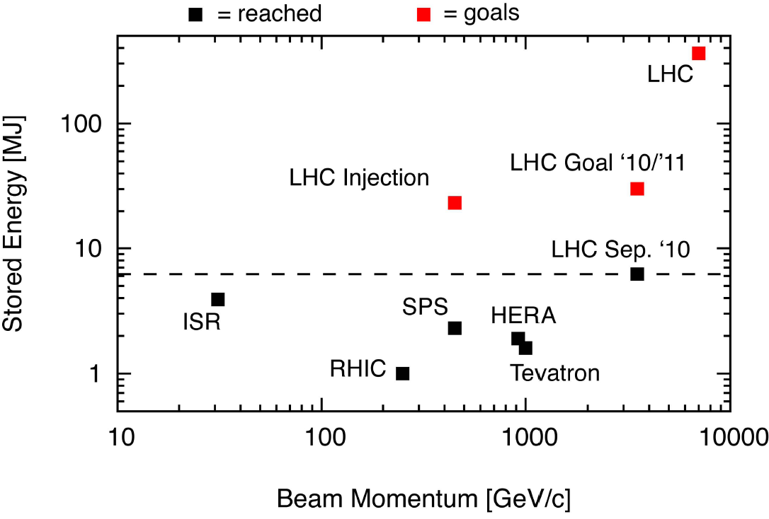
LHC on its own in terms of stored energy

Slide 24
OUTLINE
Early beam operations and main parameters for the first LHC proton run
Strategy and progress during 2010
Observations, encountered limitations
First heavy ion run
Prospects for 2011
Summary and conclusions

Slide 25
Measured 450 GeV Aperture
On-momentum, as relevant for collimation and protection
Predicted aperture bottlenecks in triplets do not exist !
Excellent news… aperture larger than expected
Beam / plane | Limiting element | Aperture [σ]
Beam 1 H | Q6.R2 | 12.5
Beam 1 V | Q4.L6 | 13.5
Beam 2 H | Q5.R6 | 14.0
Beam 2 V | Q4.R6 | 13.0

Slide 26
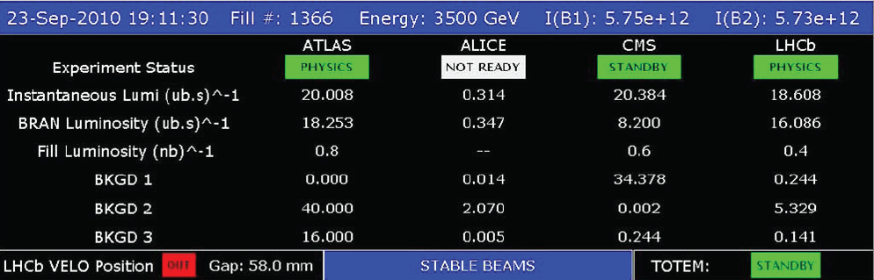
Bunch intensity and beam-beam effects
Easy to get to 1e11, could go higher
Surprise when we (accidentally) had low emittance
  Thursday September 23
    Physics fill 1366 (Scheme 50ns_56b_47_16_47_8bpi)
    Initial luminosities ~ 2 10³¹ cm⁻² s⁻¹
    For these intensities ε ~ 2.2 µm.rad
    Beam-Beam tune shift ~ 0.016
wirescan @ start ramp
B2 H 2.14
B2 V 2.33
B1 H 1.88
B1 V 1.86

Slide 27
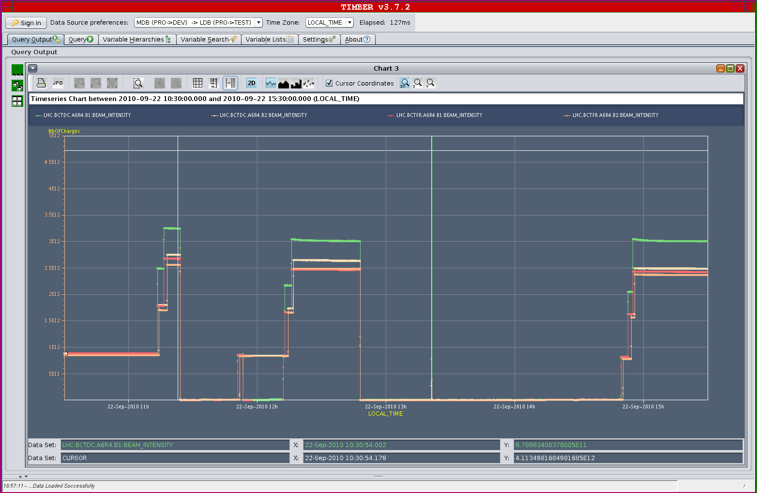
Open Issue - BCT
Problem with DC-BCT depending on the injection pattern.
DC BCT data not reliable
Impact on the SMP System
Impact on luminosity evaluation

Slide 28
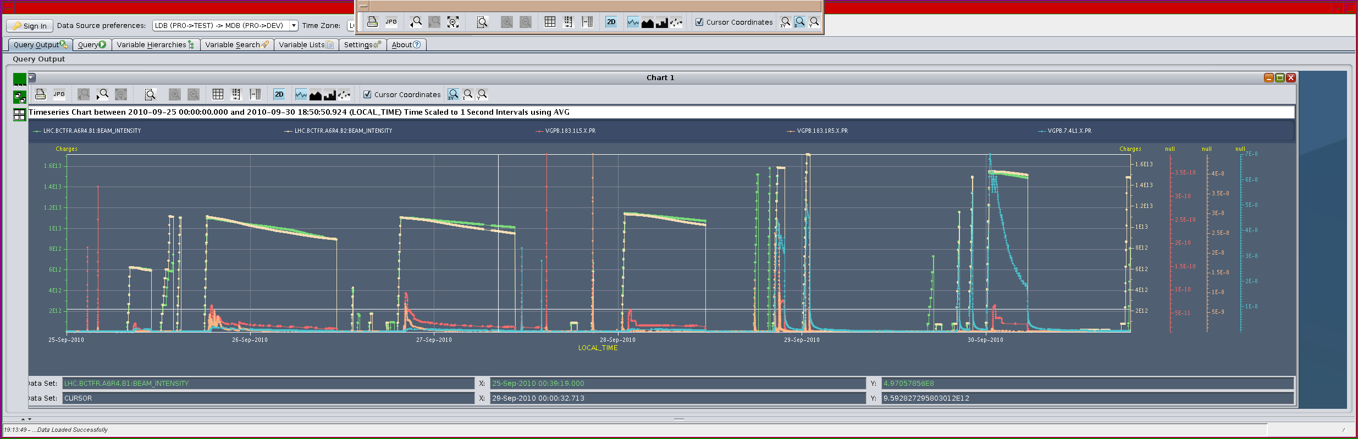
Issue - bunch trains and vacuum degradation
104
104
104
152 attempt
#1381
Gradual degradation seen, in particular with 50 ns bunch spacing

Slide 29
Vacuum - summary of observations
  In the LSS (Long Straight Sections)
    Pressure rises in the pipes with 1 circulating beam explained by Synchrotron Radiation. Dependant only from the energy and total intensity
    Pressure rises in the pipes with 2 circulating beams cumulates different effects:
      SR induced by D1 or D2 bending magnets
      HOM effects linked to the bunch length variations during the ramp
      Electron stimulated desorption (Electron cloud) – Threshold effect
  Bigger effects observed in the Cold/Warm transitions of the inner triplets: Q3/DFBX side for ATLAS and D1 side for Alice and LHCb
    Nothing in CMS, could be explained by the wake fields from the CMS solenoid
  Vacuum cleaning (scrubbing) demonstrated to be effective to reduce the pressure rises
    Except in case of important water coverage – case of cold/warm transitions

Slide 30
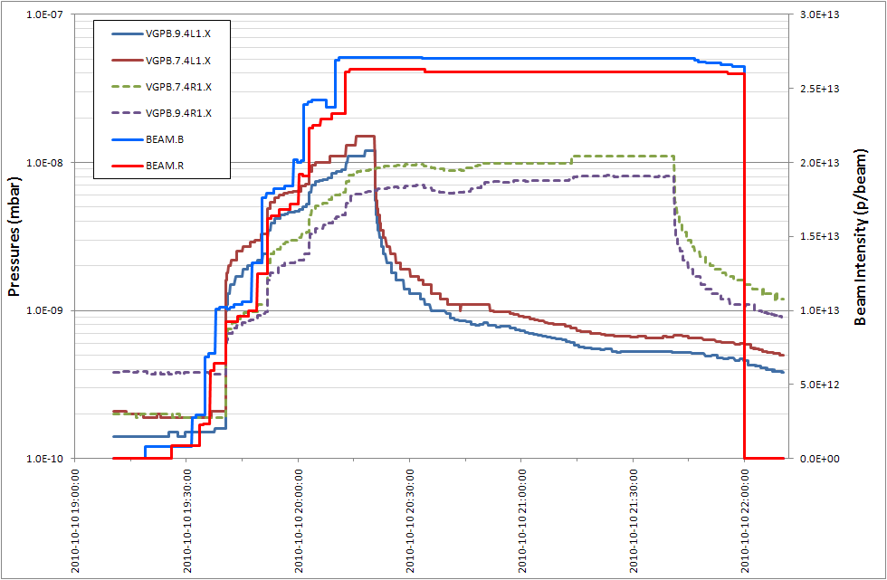
Vacuum - effect of solenoids on pressure IR1
Solenoid A4L1 - ON
Solenoid A4R1 - ON

Slide 31
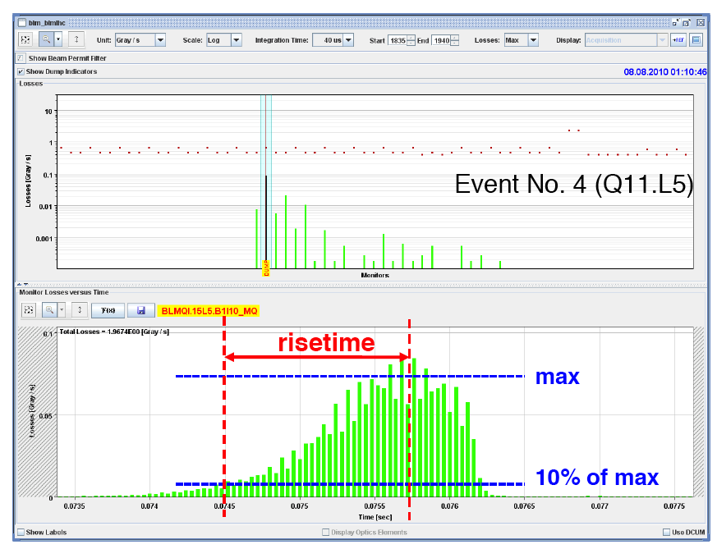
Issue - UFOs: Unidentified Falling Object (fast local loss)
Sudden local losses
No quench, but preventive beam dump
Rise time on the ms scale
Working explanation: dust particles falling into beam creating scatter losses and showers propagating downstream

Slide 32
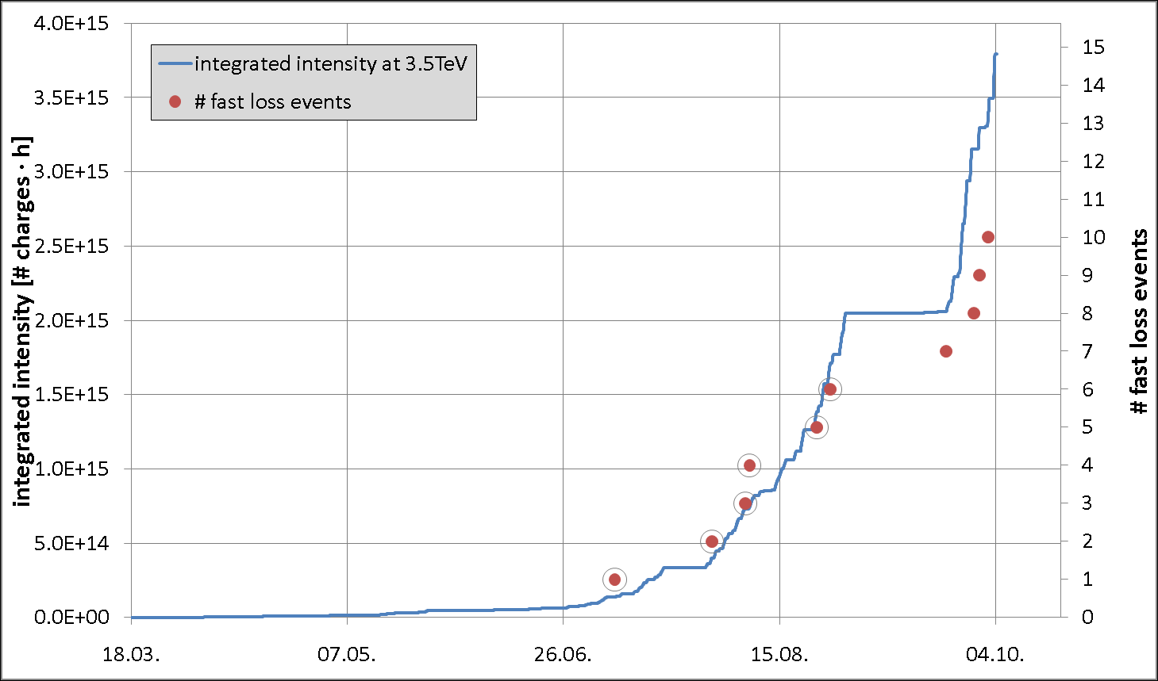
UFOs - Worrying trend through the summer

Slide 33
Mitigated by change of BLM threshold
UFO dump rate has gone down significantly since we increased the thresholds at SC elements (except triplets) by a factor 3.
  12 UFOs before change of threshold.
  But there are still coming at a steady rate.
  No quench with UFOs.
2 UFOs since threshold change:
  UFO near LHCb leading to dump by LHCb – not the LHC BLMs.
  Ultra-fast and somehow non-standard UFO at BSRT.
Even though the UFO rate seems to be under control now, UFOs will become a problem if we ever increase the energy since the quench and BLM thresholds will come down again (factor 2-3 !).
To be looked at and understood
  UFO mechanism
  Possible cleaning by beam
  Actions for 2012 stop

Slide 34
LHC Systems – Operational Efficiency
All faults downtime distribution
Equipment type | Faults | Qty. | Availability^{[1]} [%] | MTBF [hours]
Quench heater power supplies | 26 | 6076 | 99.998 | 1145760
Quench detection systems | 19 | 10438 | 99.999 | 3362135
DAQ caused by radiation (SEU) | 12 | 1624 | 99.997 | 828240
DAQ other causes than radiation | 8 | 2532 | 99.999 | 1936980
DAQ all faults combined | 20 | 2532 | 99.997 | 774792
EE600 | 6 | 202 | 99.988 | 206040
EE13 kA | 5 | 32 | 99.939 | 39168
R. Denz
QPS wins in 2010 by a neck…

Slide 35
OUTLINE
Early beam operations and main parameters for the first LHC proton run
Strategy and progress during 2010
Observations, encountered limitations
First heavy ion run
Prospects for 2011
Summary and conclusions

Slide 36
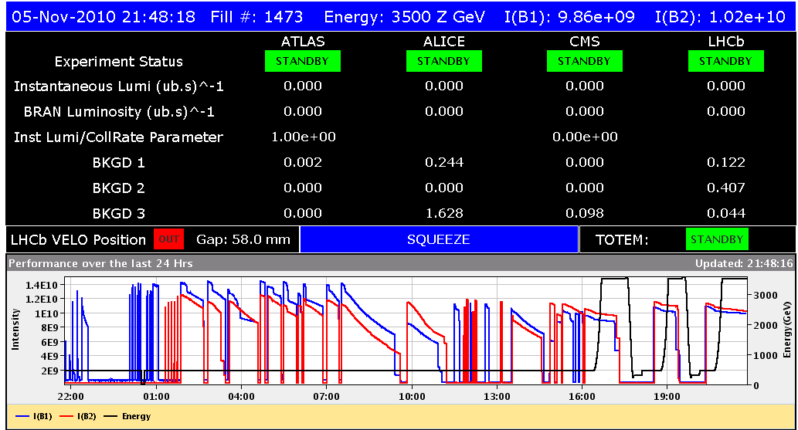
Heavy Ion Commissioning
First 24h from Nov 4th !
Beam 1 Inj., Circ.
& Capture
Beam 2 Inj., Circ.
& Capture
Optics Checks
BI Checks
Collimation Checks
First Ramp
Collimation Checks
Squeeze

Slide 37
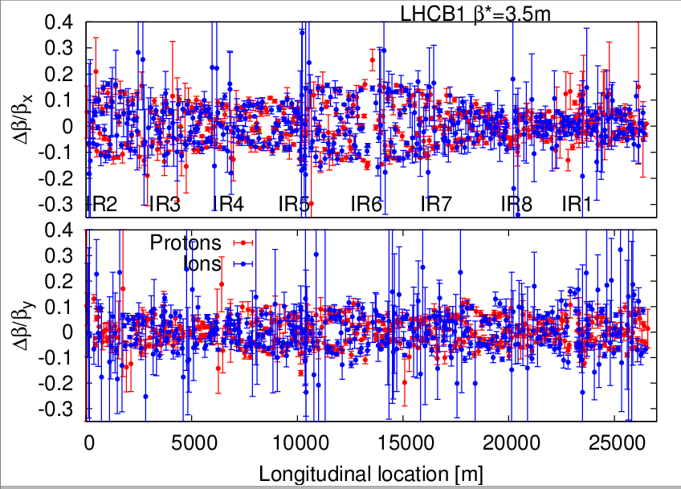
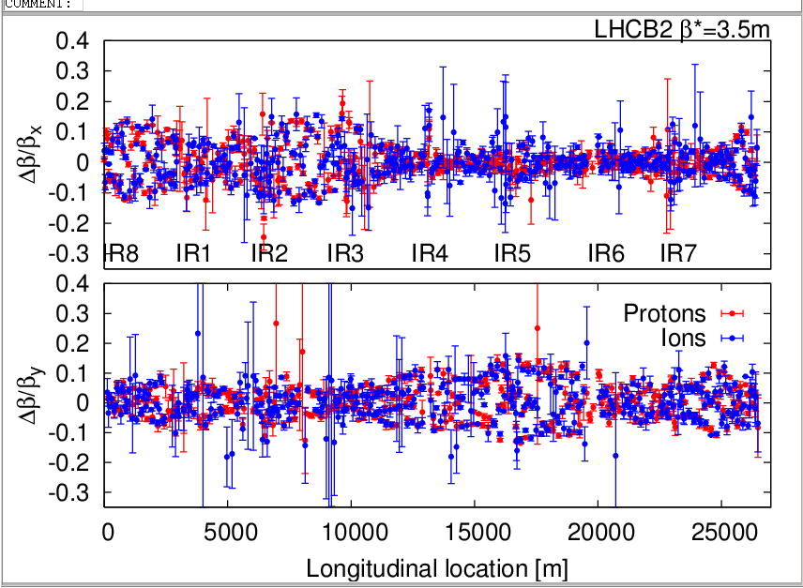
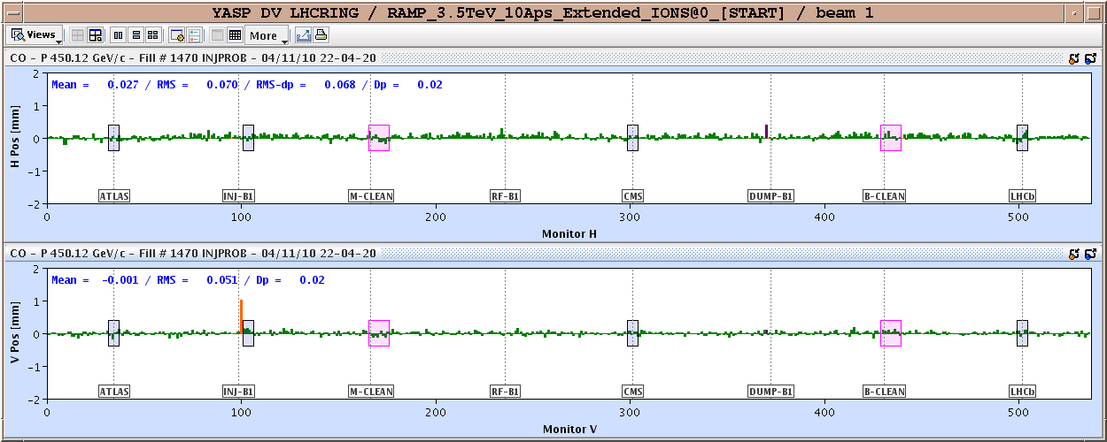
Pb vs p: Orbit and optics comparison

Slide 38
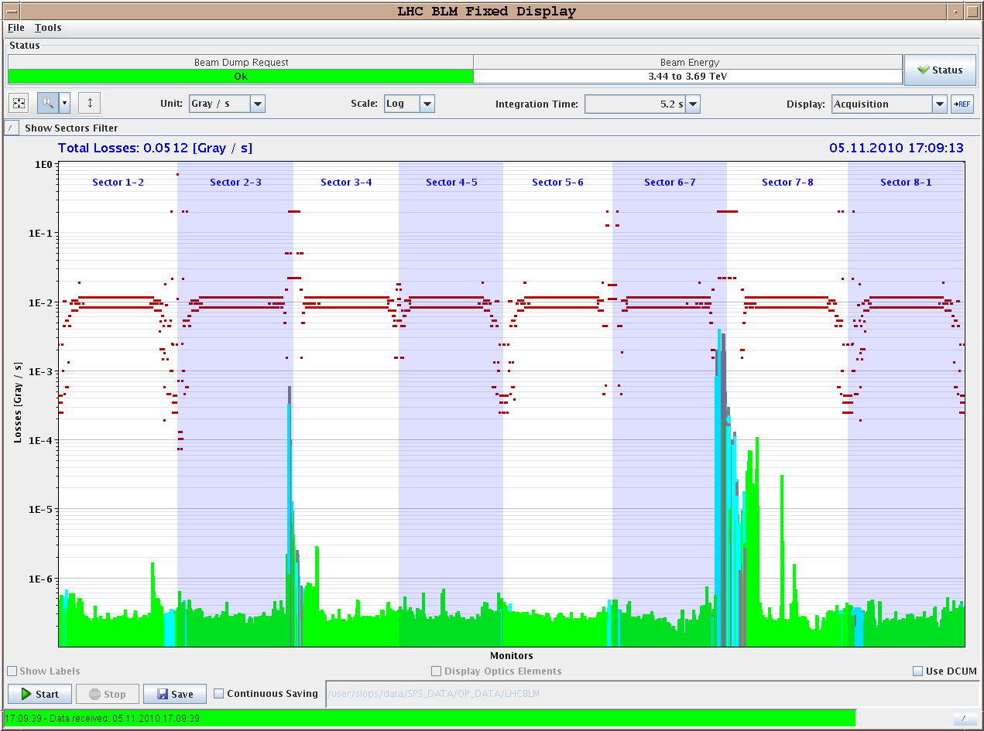
Collimation checks (loss maps)
Leakage to DS
Lose about a factor 50-100 in cleaning efficiency for ions cf protons
  Expected (ion fragmentation and dissociation)
Main losses in predicted locations, namely the dispersion suppressors

Slide 39
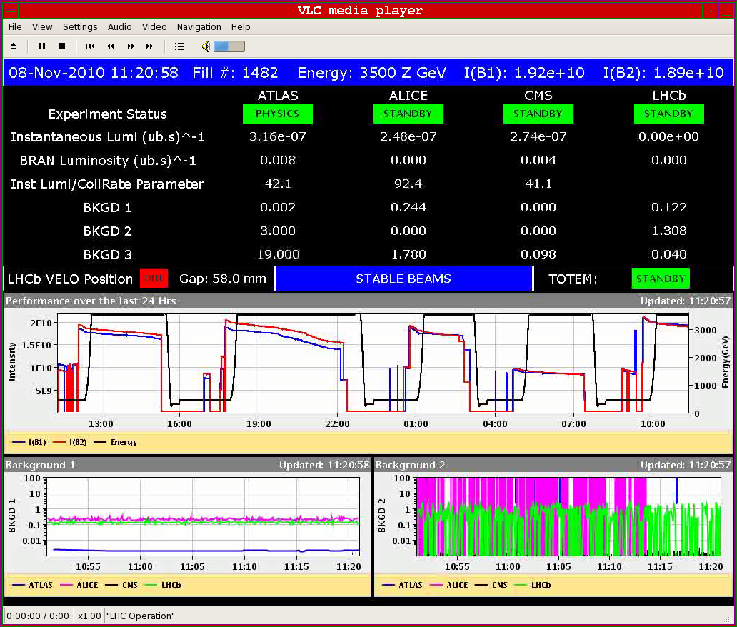
First stable beams (2 bunches per beam)

Slide 40
Characteristics and Evolution
Injectors are giving us 70% beyond design single-bunch intensity of 7×10⁷ ions/bunch, which is wonderful, but has consequences…
  Significant IBS growth and debunching at injection, seems to be in reasonable agreement with theory
Emittances at injection around 1-2 μm (with Pb gamma!).
Emittances on flat top 1.5-3 μm
Emittance blow-up in physics is not too bad, but mostly not IBS
Date | Bunches | Colliding IR2 | Luminosity
November 8 | 2 | 1 | 3 10²³
November 9 | 5 | 4 | 5 10²³
November 9 | 17 | 16 | 3.5 10²⁴
November 13 | 69 | 66 | 9 10²⁴
November 14 | 121 | 114 | 2 10²⁵
November 15 | 121 | 114 | 2.8 10²⁵

Slide 41
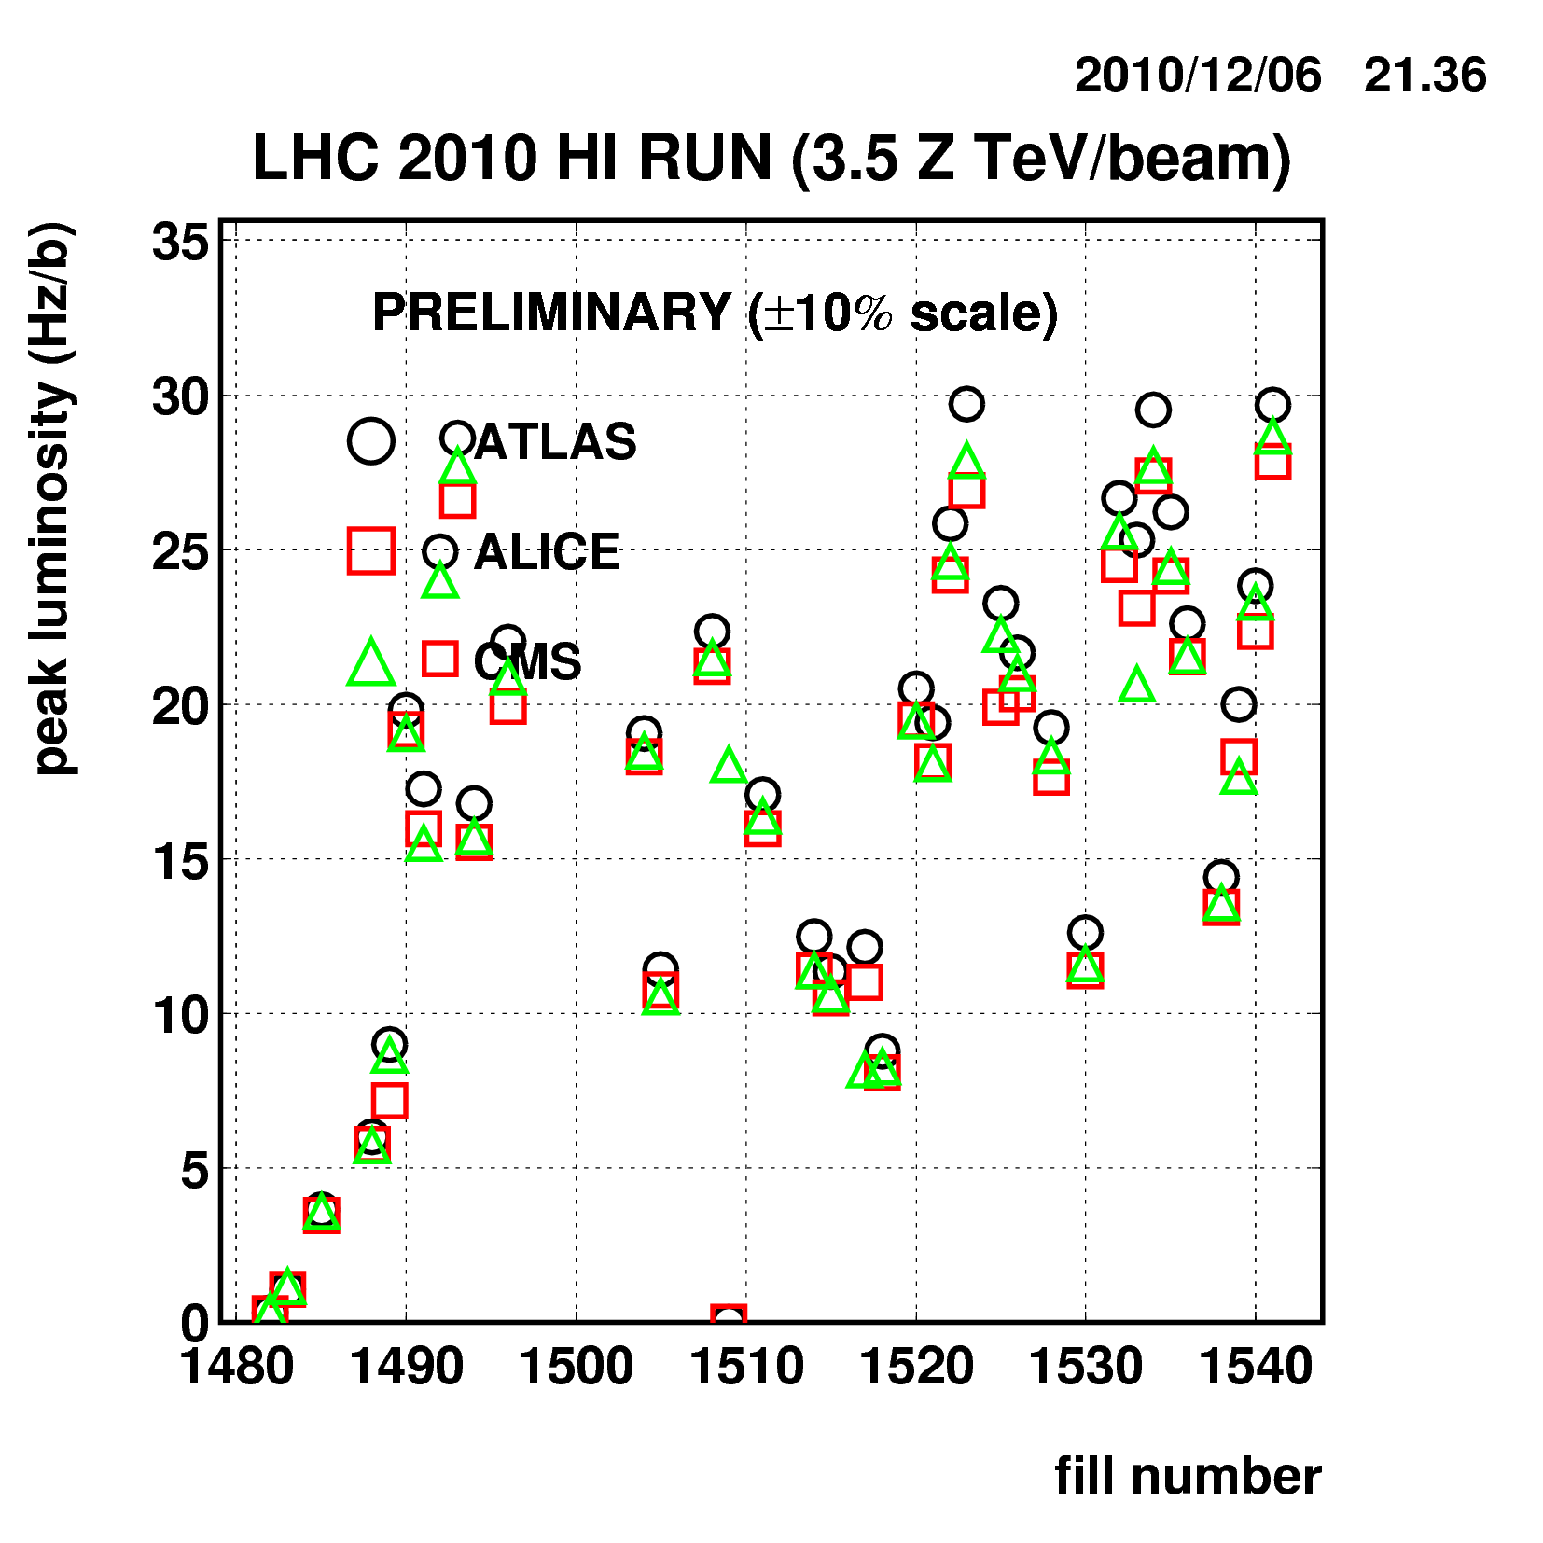
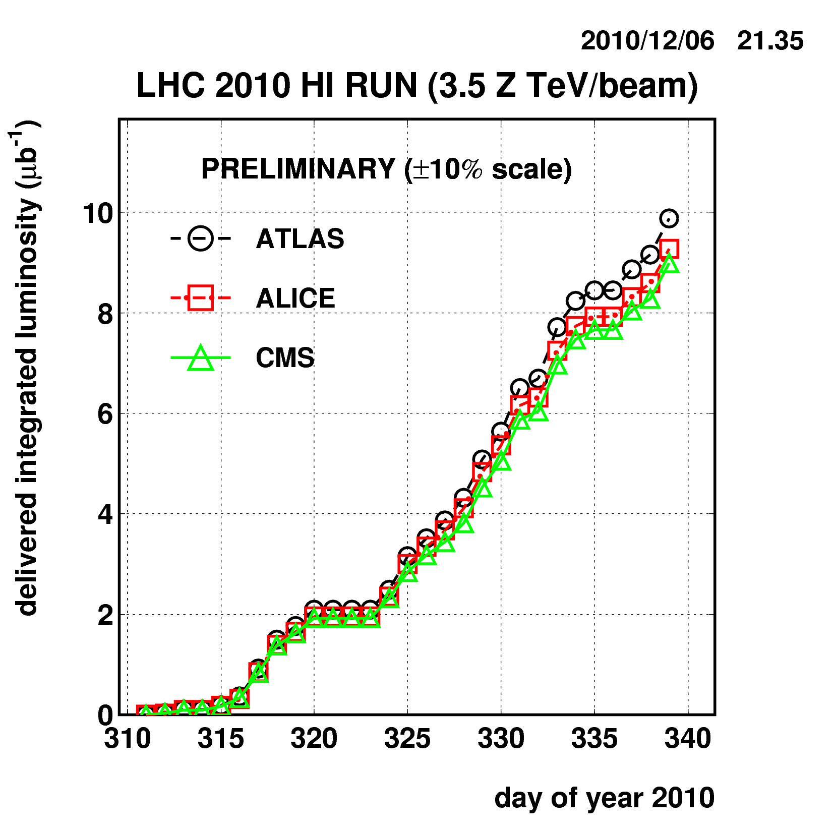
Heavy Ion Run 2010 - luminosity
pp
Prediction !

Slide 42
Heavy Ion Issues - Single Event Upset
Primary ion beam losses are intercepted at the collimators
Several features contribute to more severe ion loss
  Ion dissociation and fragmentation reduce cleaning efficiency by factor ~100 when compared to protons.
    Collimation upgrade (DS collimators) will solve this.
  Ion beam lifetimes factor ~3-6 lower than for proton beams
    Not yet understood
Effects are clearly seen in Radmon monitors
And in the equipment!
  QPS and PC

Slide 43
OUTLINE
Early beam operations and main parameters for the first LHC proton run
Strategy and progress during 2010
Observations, encountered limitations
First heavy ion run
Prospects for 2011
Summary and conclusions

Slide 44

2011 LHC Draft Schedule
Beam back around 21st February
2 weeks re-commissioning with beam (at least)
4 day technical stop every 6 weeks
Count 1 day to recover from TS (optimistic)
2 days machine development every 2 weeks or so
4 days ions set-up
4 weeks ion run
End of run – 12th December
~200 days proton physics

Slide 45
2011: “reasonable” numbers
3.5 TeV (to be discussed at Chamonix)
936 bunches (75 ns)
3 micron emittance
1.2 x 10¹¹ protons/bunch
beta* = 2.5 m, nominal crossing angle
Peak luminosity | 6.4 x 10³²
Integrated per day | 11 pb⁻¹
200 days | 2.2 fb⁻¹
Stored energy | 72 MJ
Usual warnings apply – see problems above

Slide 46
Ultimate reach
4 TeV
1400 bunches (50 ns)
2.5 micron emittance
1.5 x 10¹¹ protons/bunch
beta* = 2.0 m, nominal crossing angle
Peak luminosity | 2.2 x 10³³
Integrated per day | 38 pb⁻¹
200 days | 7.6 fb⁻¹
Stored energy | 134 MJ
Usual warnings particularly apply – see problems above

Slide 47
Summary
LHC beam parameters were limited in 2010 to
    3.5 TeV per beam
    20% intensity
    β* > 2 m
Operation started with safe beams
  Qualified machine protection systems
First collisions at 7 TeV cm end March 30
Three phases for physics thereafter
  Low bunch current, increase k_{b}
  Nominal bunch current, increase k_{b} up to limit without Xing angle
  Nominal bunch current, 150ns trains, increase k_{b} to limit of ring (~400)

Slide 48
Summary
Very successful first year of LHC operations
  Bunch intensity ~ nominal
  Normalised emittance ε_{n} in collision ~ 2.5 µm
  Maximum bunches/colliding 1 & 5 368/348
  Peak luminosity ~ 2.07×10³² cm⁻² s⁻¹
  Delivered luminosity ~ 50 pb⁻¹
  Plenty of interesting data a few interesting (intensity-related) effects
50ns run
  Very useful few days, should allow definition of strategy for 2011
Ion run
  Very fast switch from p to Pb
  Quickly up to nominal performance for 2010
Full debriefing and more at forthcoming Chamonix workshop

Slide 49
Conclusions
We come a phenomenally long way in 2010
All key systems performing remarkably well
Performance with beam (losses, lifetimes, luminosity, emittance growth etc.) is very encouraging
Possible improvements, consolidation are detailed for all systems
2011 aims to leverage off of what’s been learnt in 2010
Some interesting ‘challenges’ to be faced in 2011:
  UFOs, hump, electron cloud, SEU-R2E…

Slide 50
Acknowledgements
This talk sketched some aspects of the work of many people, over many years.
Particular thanks for material to:
  R. Bailey, R. Schmidt, F. Bertinelli, J. Wenninger, J. Jowett, M. Lamont, A. Verweij and J. Uythoven.

Slide 51
Solution - new joint design, in practice ready
All interconnects need to be opened and repaired
The size of this task compares to series interconnection during LHC installation (ca. 16 month)

