Slide 1
CMS overall performance and physics results in 2010
Epiphany 2011: Cracow Epiphany Conference
on the First Year of the LHC, 10-12 Jan 2011,
Institute of Nuclear Physics PAN , Kraków (Poland)
Marcin Konecki
Faculty of Physics, University of Warsaw, Poland
(marcin.konecki@fuw.edu.pl)
on behalf of the CMS collaboration

Slide 2
Outline
CMS in 2010,
Detector performance and physics objects (selection),
Main physics measurements,
Discovery searches (link to other talks),
Summary.

Slide 3

LHC and CMS
LHC = Large Hadron Collider
CMS = Compact Muon Solenoid
European Laboratory for
Particle Physics CERN
Founded in 1954 r.,
Poland joined in 1991.
LHC (pp, Pb-Pb coll.) opened in 2008 after 25 y. of design /construction.
CMS is a general purpose experiment optimized for Higgs searches, wide range of New Physics, SM studies and HI program (LOI‘92)
LHC

Slide 4
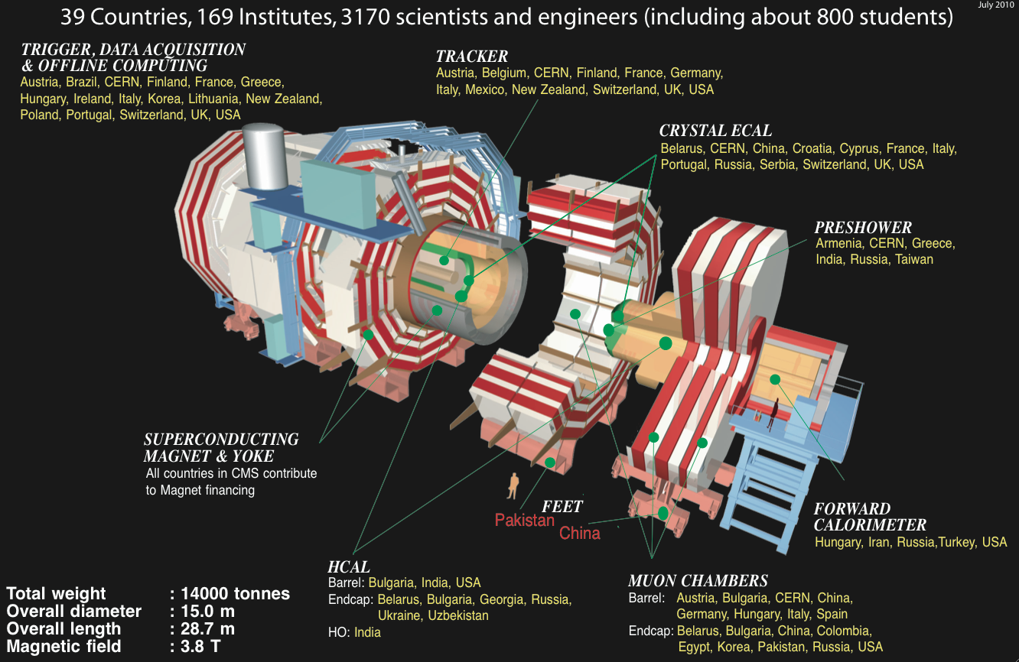
CMS

Slide 5
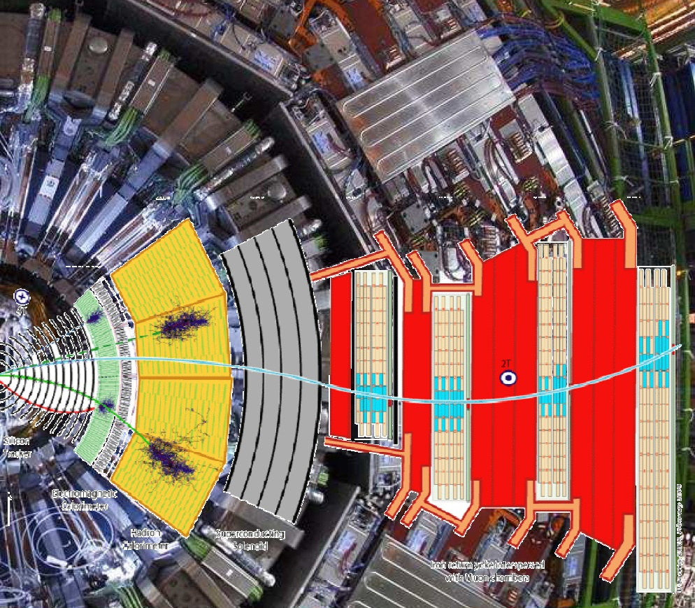
Challenge: CMS
Compact Muon Solenoid
The design goals of CMS:
A very good and redundant muon system
The best possible ECAL consistent with 1)
A high quality central tracking to achieve 1) and 2)
A financially affordable detector
3.8T solenoid 13m long, 6m diameter
high eta HCAL coverage
Silicon based inner tracking system supplementing all types of reconstr.
Powerful reconstruction of:
µ, e/γ, τ-jets, jets, MET
(+tracks, vertices)

Slide 6
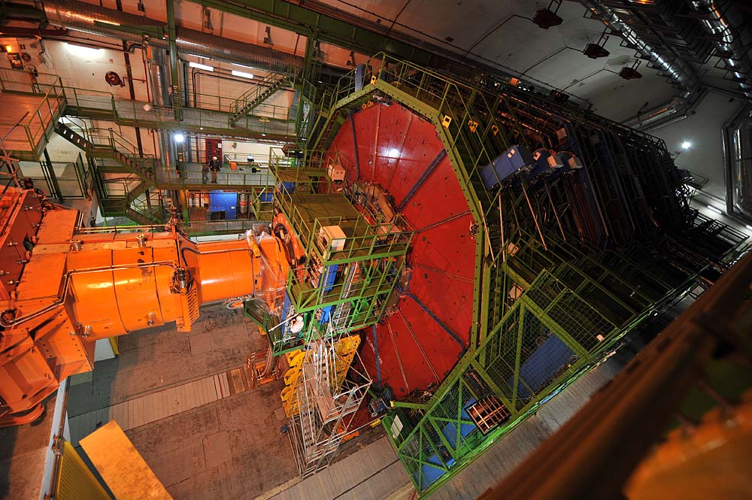
CMS preparation to LHC physics
Sept. 2008

Slide 7
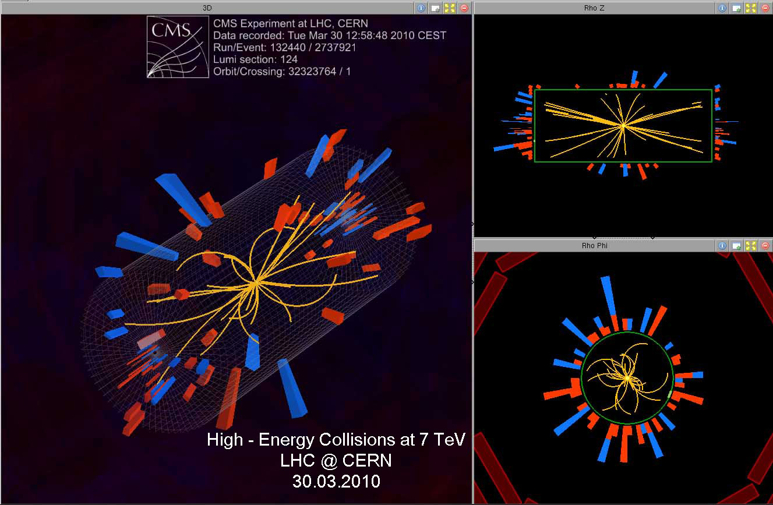
30.03.2010: 3.5 TeV/beam

Slide 8
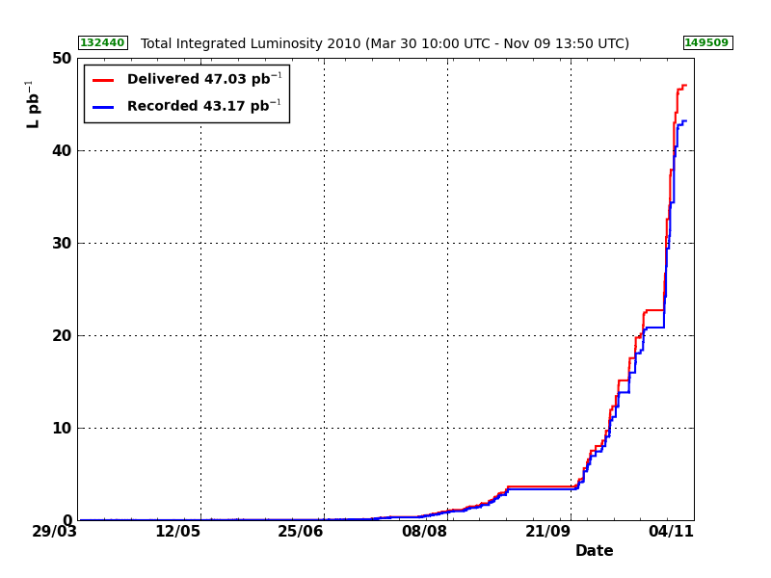
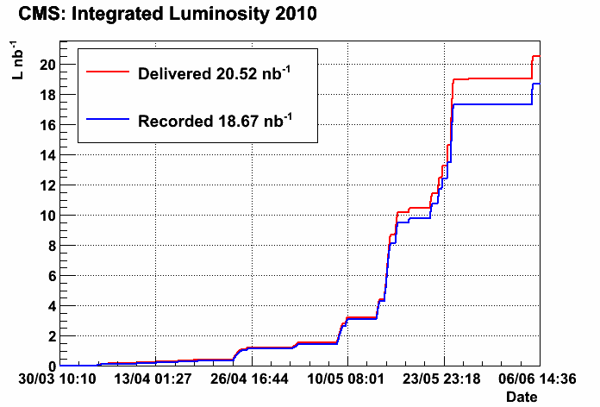
LHC in 2010: √s = 7 TeV and L increase
Luminosity increase by 5 orders of magnitude within ~200 days. Since 30.03 about ~50 pb⁻¹ delivered in pp runs till 4.11.2010 to CMS.
L≈ 2∙10³²cm⁻²s⁻¹
10³⁰ cm⁻² s⁻¹
L≈ 10²⁹cm⁻²s⁻¹
We are greatful for
the excellent
performance of LHC in 2010.
Bunch train commissioning
L≈ 10²⁸cm⁻²s⁻¹
L≈ 10²⁷cm⁻²s⁻¹

Slide 9
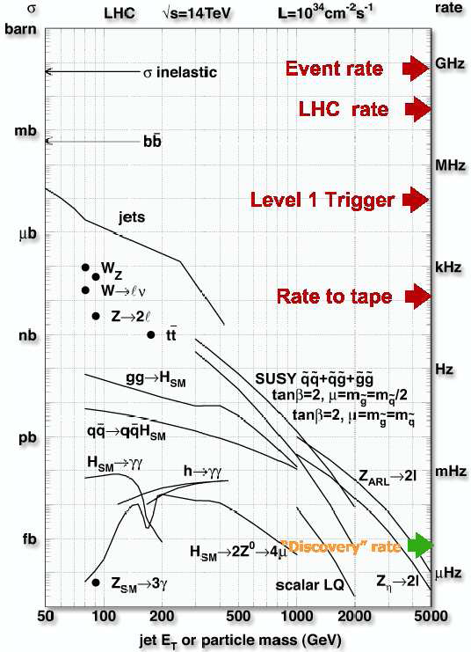
CMS data taking efficiency (pp)
Max HLT in: 100kHz
Max HLT out: O(100Hz)
See M. Kazana talk
„CMS trigger and data taking in 2010”

Slide 10
Detector performance and physics objects results (selection)

Slide 11
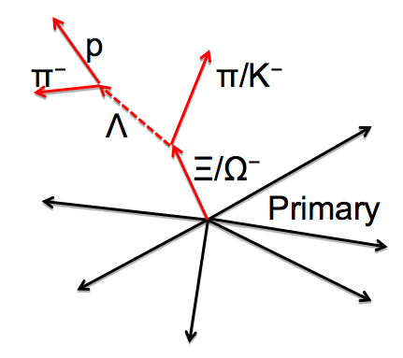
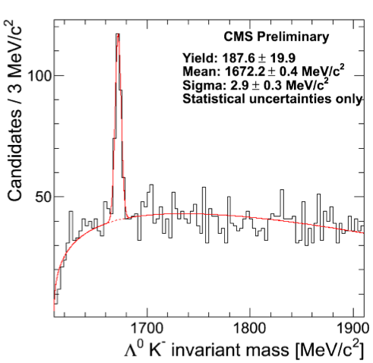
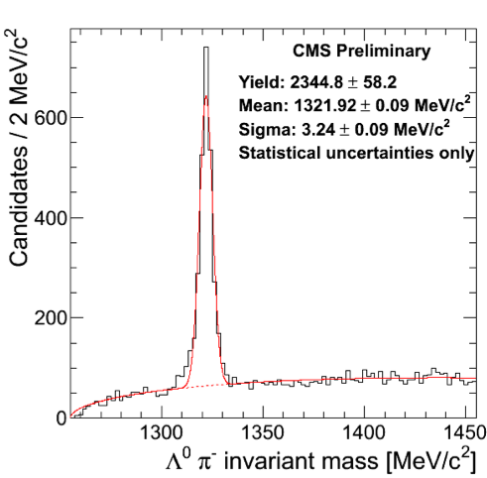
Tracker: Low mass resonances
Invariant masses for various particle hypothesis (Ω± → ΛK± or Ξ± → Λπ± ) – fit to a common vertex
tracks displaced from PV (d_{3D} > 3σ)
CMS DPS-2010/013
CMS DPS-2010/013
PDG Mass:
1672.43 ± 0.29
PDG Mass:
1321.71 ± 0.07
Ξ⁻ → Λπ⁻
Ω⁻ → ΛK⁻

Slide 12
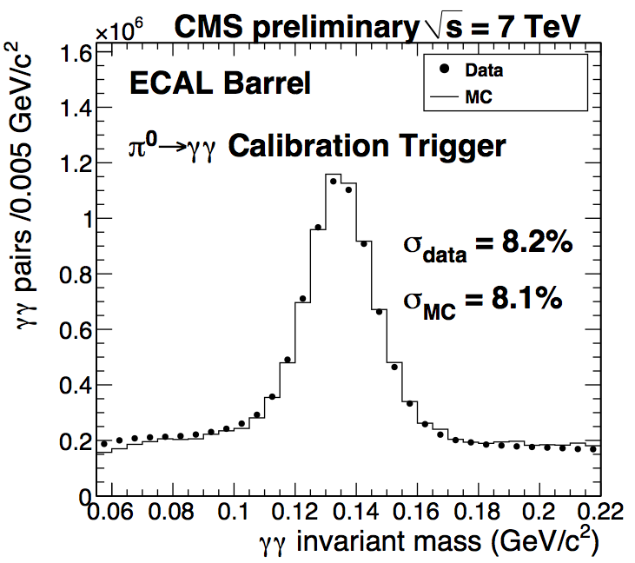
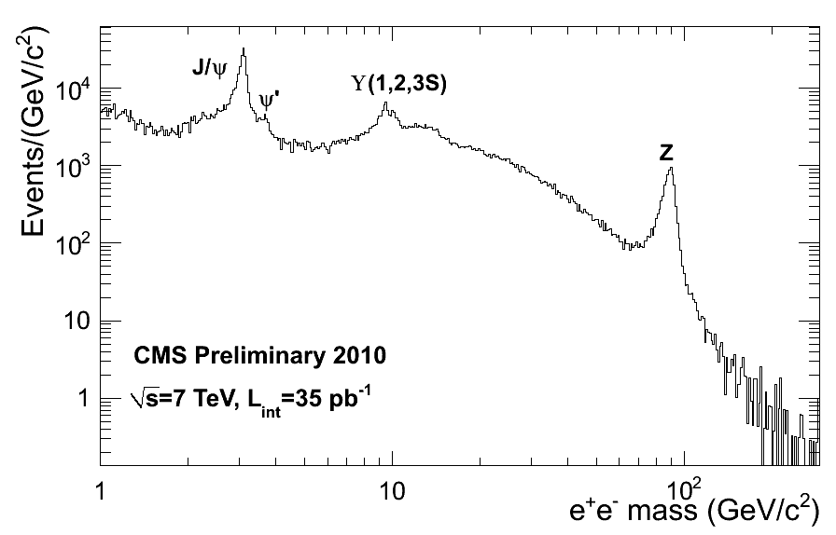
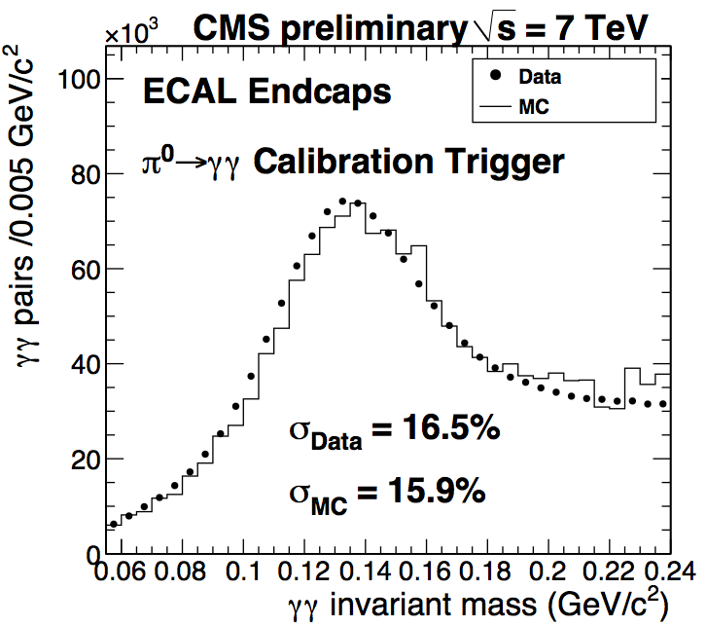
e/gamma
CMS calibration strategy :
- φ symmetry inter-calibration (at η slice)
- π⁰,η →γγ, used initially for energy scale impr.
- W,Z electron decays (with support from Tk).
Expected to become main channel-by-channel calibration tool after fb⁻¹
- di-electron J/ψ, Z decays. To monitor and correct energy scale.
EGM-10-003
σ(J/Ψ)=52 MeV/c²
σ( Y ) = 149 MeV/c²
EGM-10-003

Slide 13
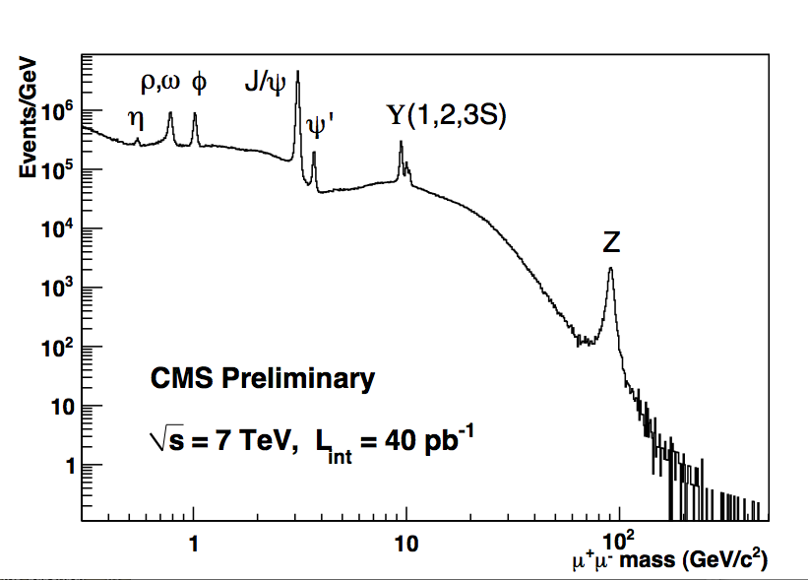
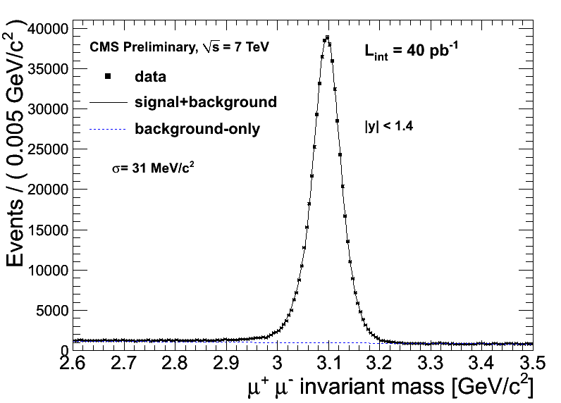
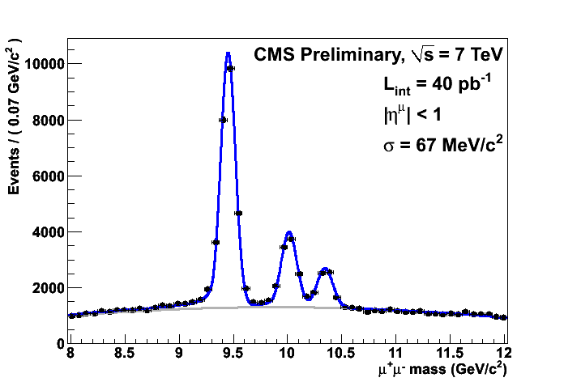
Muons
Initial focus: local reconstruction of segments and hits, synchronisation, alignment, validation of µ reconstruction, efficiency (tag and probe meth. based on J/ψ).
In a few months performance well
compatible with design values reached

Slide 14
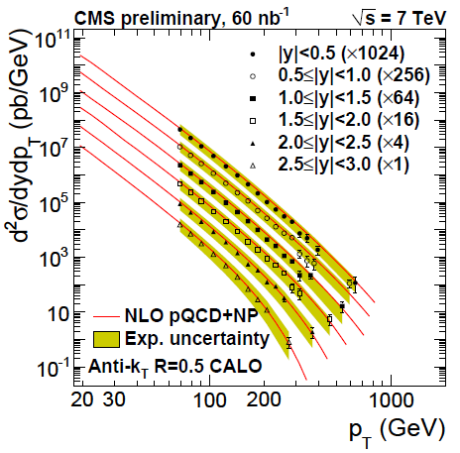
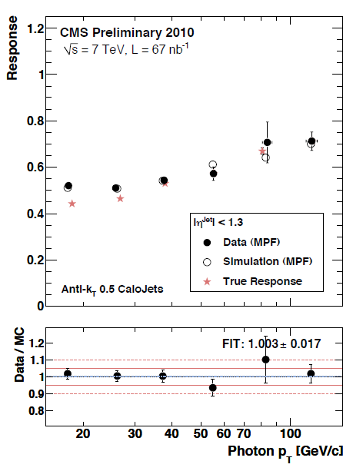
Jet/MET
Three methods of jet /met reconstruction
  CALO: calorimeter
  JPT: calorimeter + tracker
  PF jets: particle flow (current default)
Initial goal: jet energy scale and resolution
Corrections: - offset, relative in η, absolute p_{T}
Corrections made by MC and validated
with data using:di-jet balancing, γ+Jet events
JME-10-003
QCD-10-011
extended (3pb⁻¹) JME-10-010
Jets in situ calibrations
(using γ+jet events)
MPF=MET projection fraction
wrt GenJets
Also:
„Jet Transverse Structure...” CMS PAS QCD-10-014
„Measurements of the 3-jet to 2-jet...” CMS PAS QCD-10-014

Slide 15
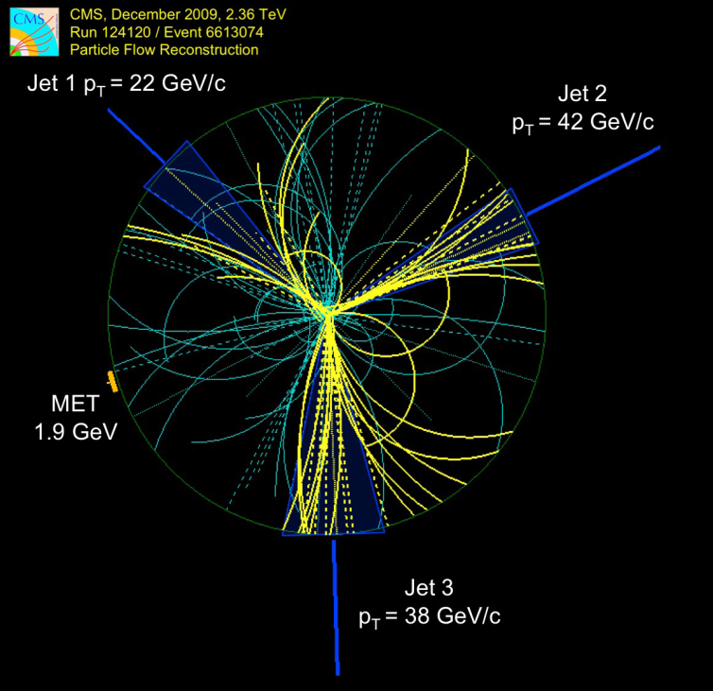
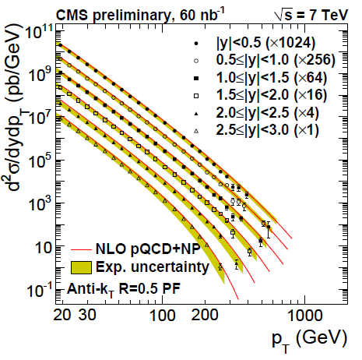
particle flow
QCD-10-011
Particle Flow attempts to reconstruct individually each particle in the event, prior to the jet clustering, based on information from relevant sub-detectors. → better reconstruction of the jets, E_{T}, MET, tau
Also: „Commissioning of the particle-flow...” CMS PAS PFT-10-003

Slide 16
Measurements

Slide 17
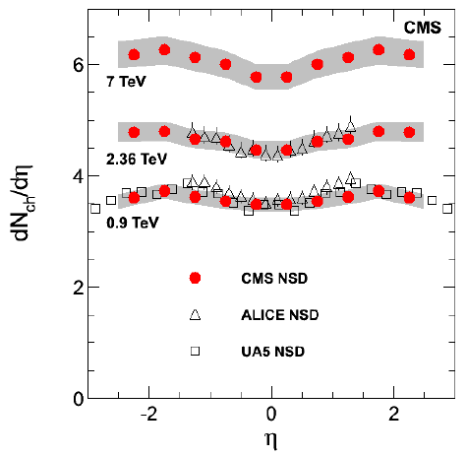
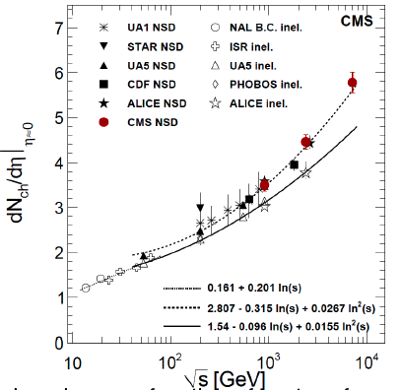
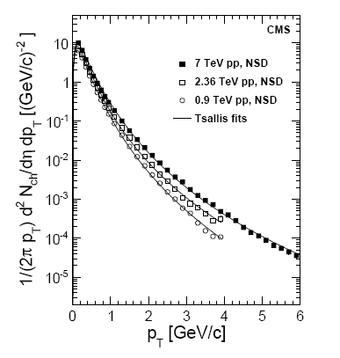
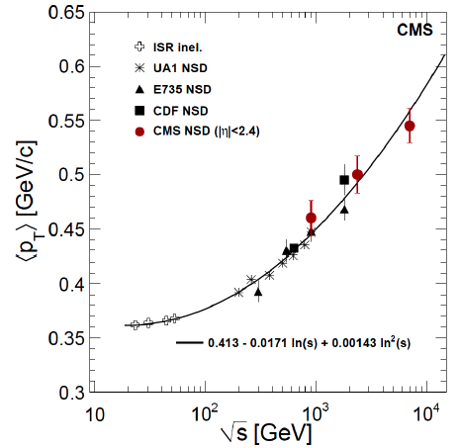
Charged particles multiplicities and p_{T} distributions
A lower rise was expected from MC (Pythia)
η=-ln(tg(Θ/2))
“Transverse Momentum
and Pseudorapidity
Distributions of Charged
Hadrons in pp
Collisions at √s=7TeV”
Phys. Rev. Lett. 105, 2010.

Slide 18
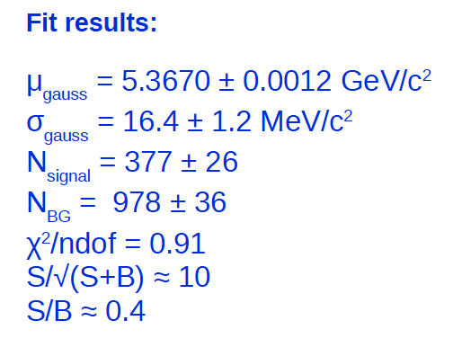
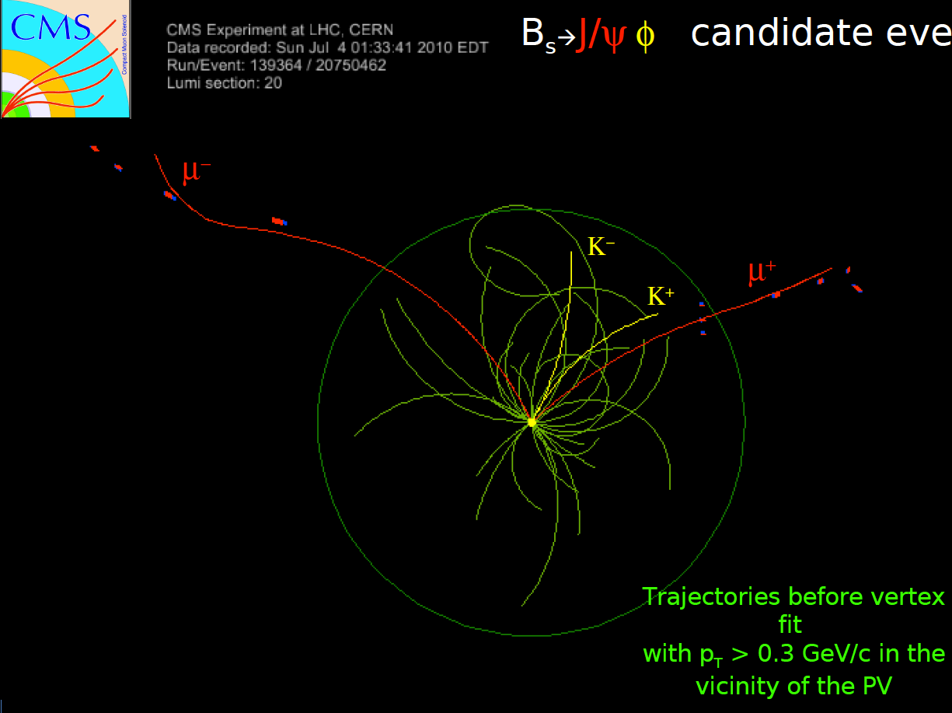
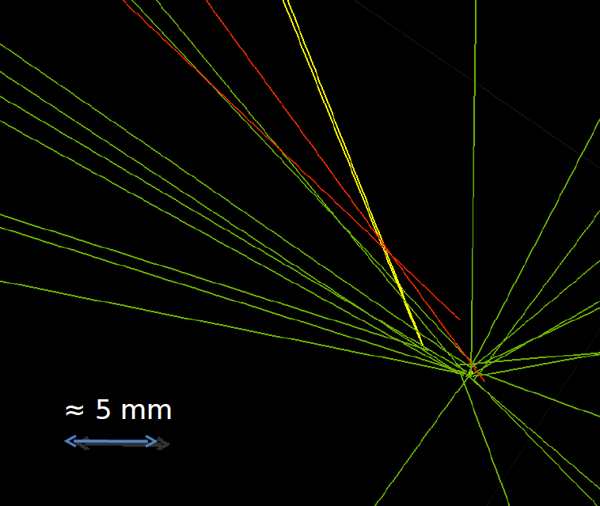
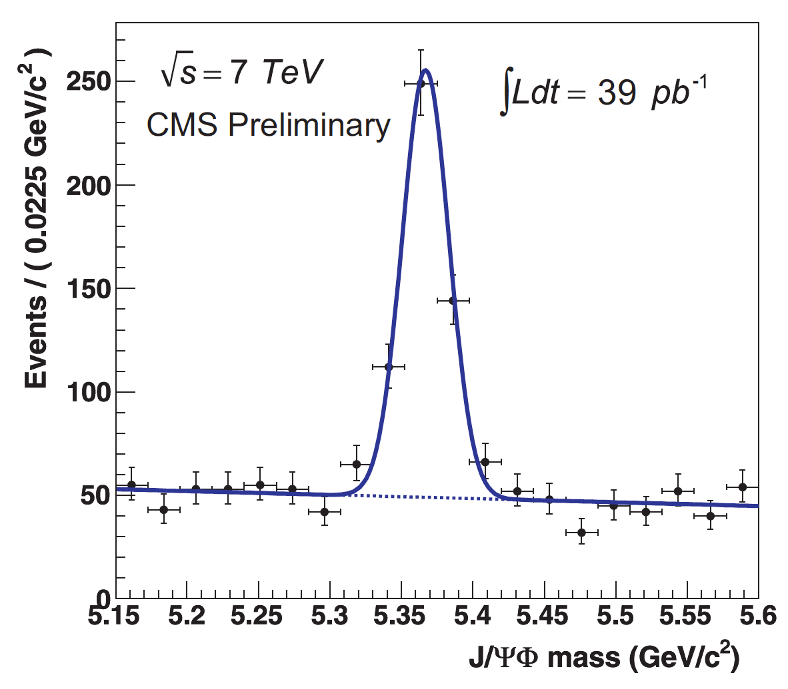
b-physics (example B_{s}→J/ψΦ)
CMS DPS-2010/024
CMS DPS-2010/040
Also: „Inclusive b-jet production...” CMS PAS BPH-10-009
„Open beauty production...” CMS PAS BPH- 10-007

Slide 19
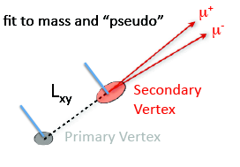
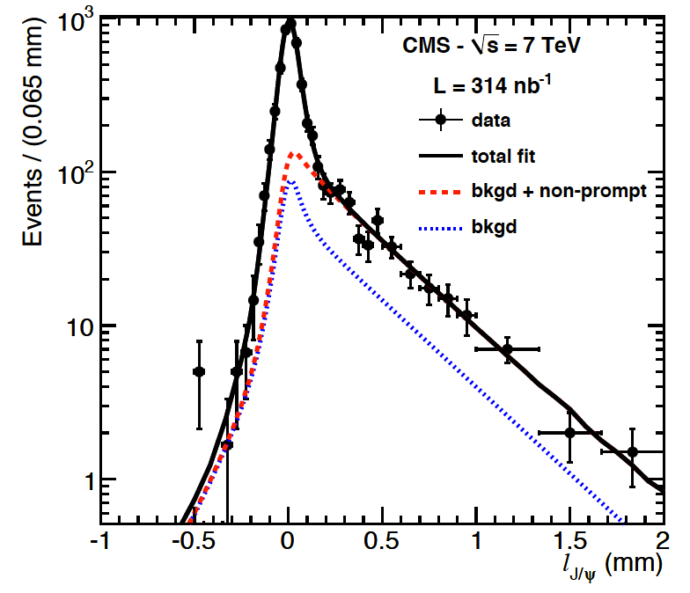
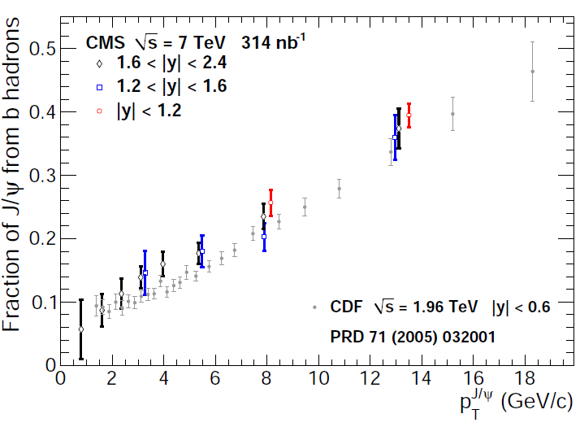
production of J/ψ
arXiv:1011.4193 [hep-ex]
mass/transverse decay length fit
allow us to separate
prompt/non-prompt
components
stat sys lumi

Slide 20
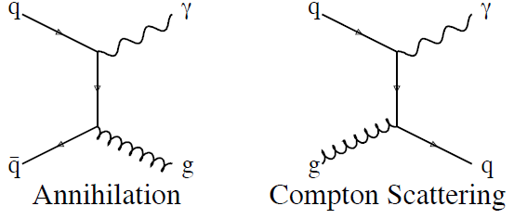
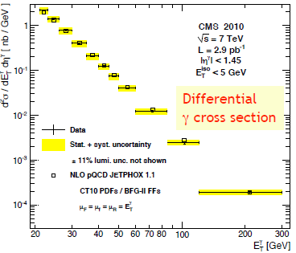
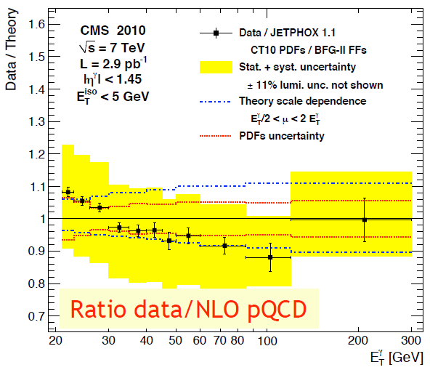
Isolated prompt γ production
A test of perturbative QCD
Constraints PDF function of proton
Background for NP
hep-ex1012.0799
hep-ex 1012.0799

Slide 21
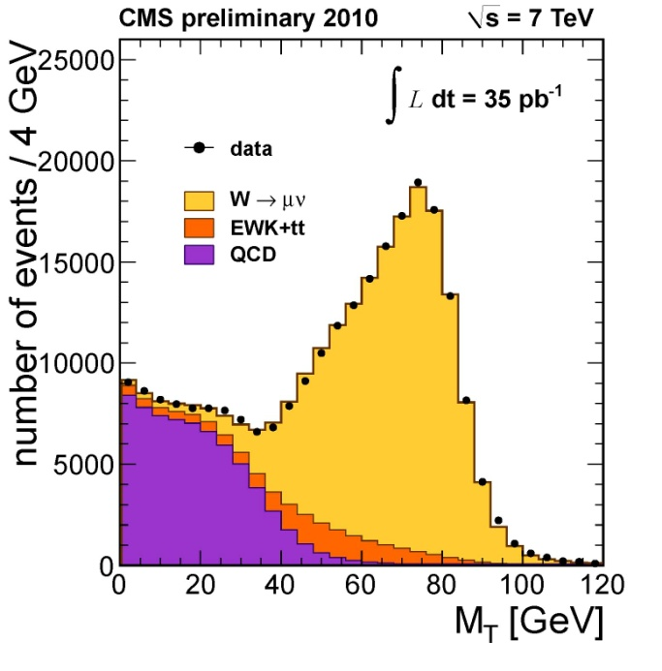
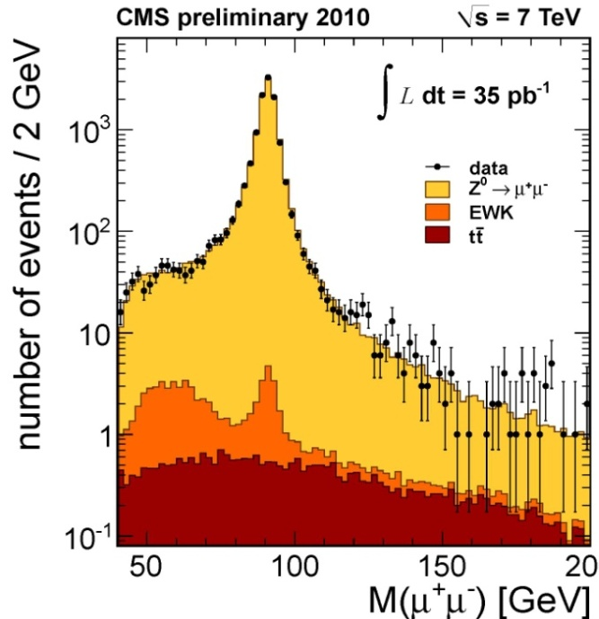
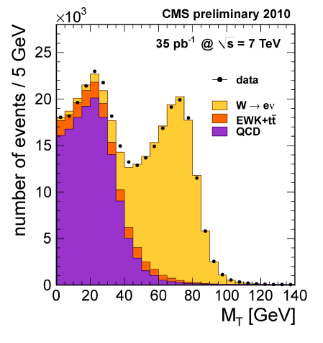
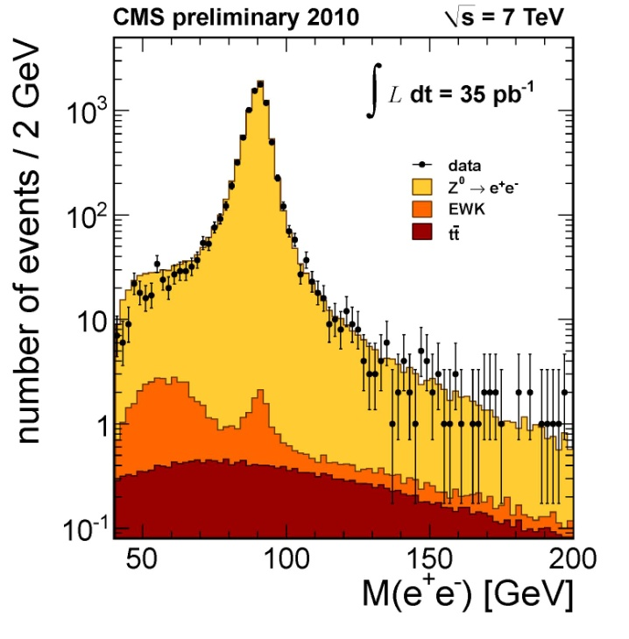

W and Z decaying in e/µ channels
W → μν
Z → μμ
first electroweak process to
be observed at LHC
benchmark for lepton
reconstruction,
accurate σ prediction
precision tests of pQCD,
tests of proton PDF,
possible estimator of ∫Ldt,
important for background
determination in NP searches
Z → ee
W → eν

Slide 22
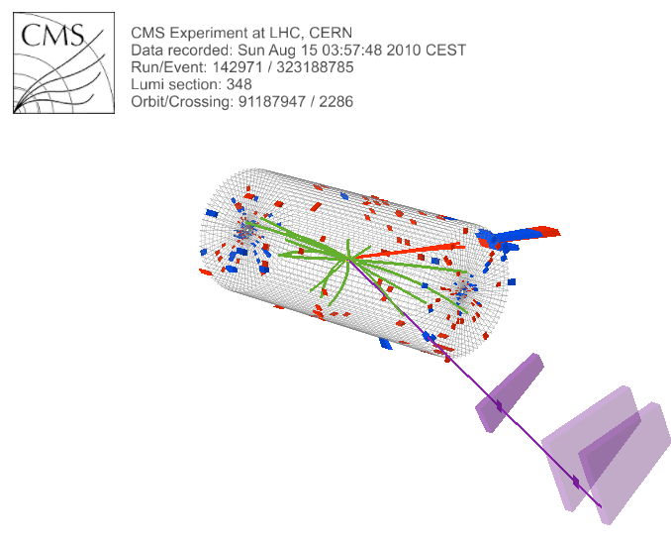
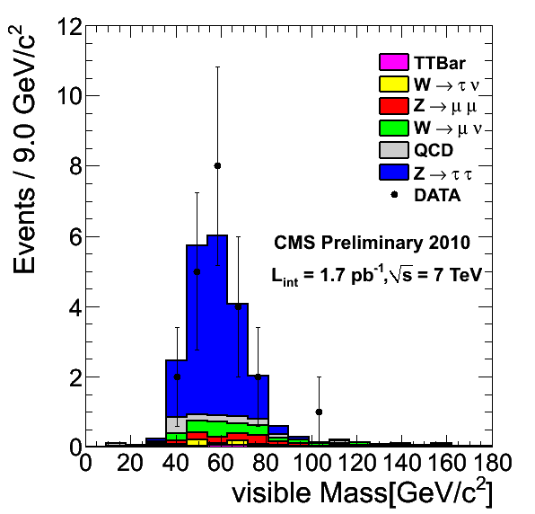
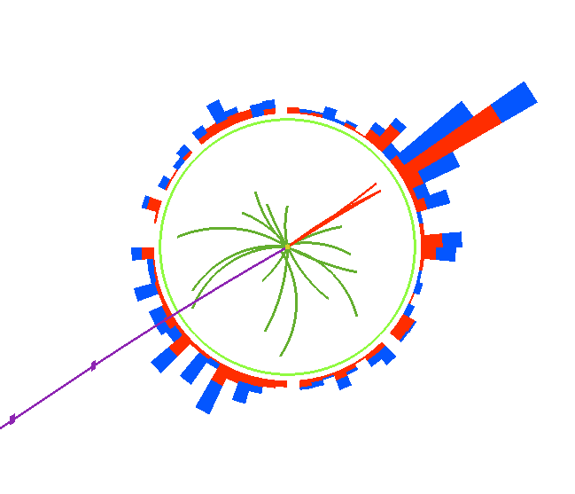
Z→ττ→τ-jet µ
See also: „Study of tau reconstruction..,” CMS PAS PFT-10-004

Slide 23
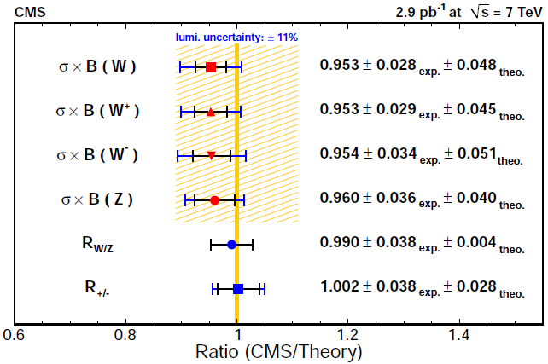
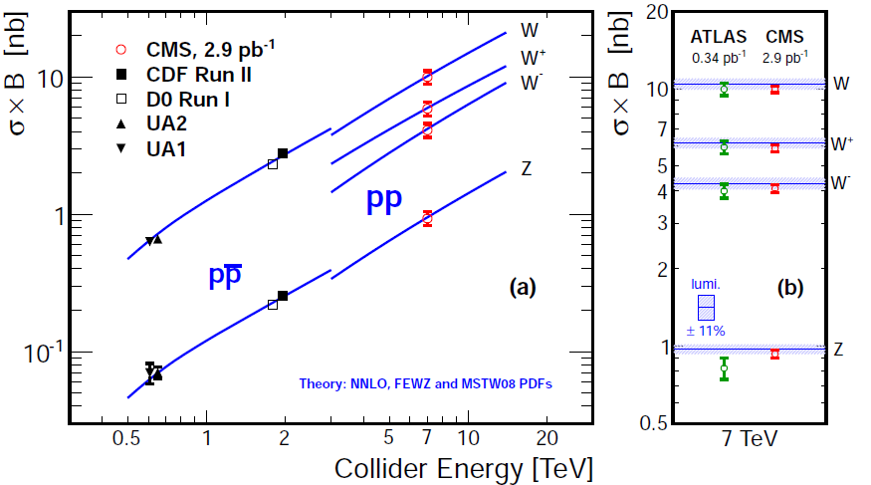
W/Z cross-sections
first electroweak process measured by CMS
tests of perturbative QCD and PDF
detector calibration and lumi. measurements
hep-ex 1012.2466
hep-ex 1012.2466

Slide 24
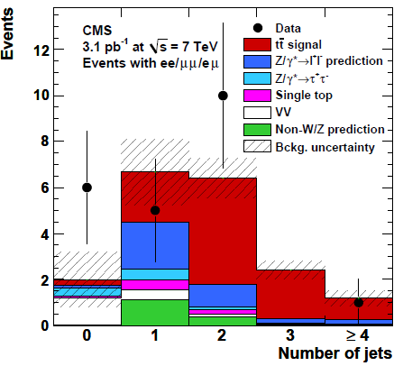
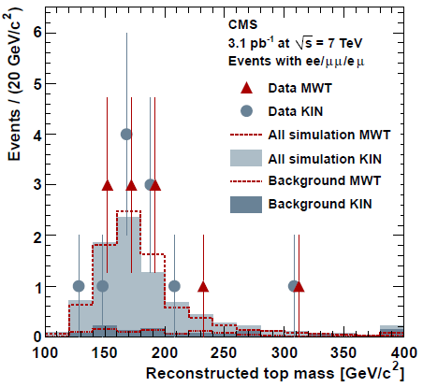
top: observations and first measurements
  Selection: Z-Veto, |M(ll)-M(Z)|>15 GeV, MET >30 (20) GeV in ee,μμ, (eμ); N(jets)≥2
Phys.Lett B695 (2011) 424-443, arXiv:1010.5994
σ(pp → t t) = 194 ± 72(stat.) ± 24(syst.) ± 21(lumi.) pb
¯
ee/eμ/μμ

Slide 25
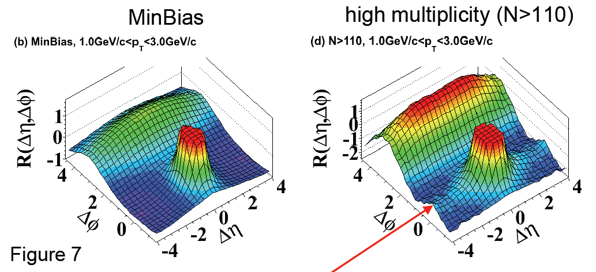
correlations in distributions of particles
Observation of Long-Range, Near-Side Angular Correlations in Proton-Proton Collisions at the LHC, JHEP 09 (2010) 091
Similar effect was observed by PHOBOS at RHIC in Au-Au collisions.
It is interpreted as an effect of forming of hot dense matter in HI collisions.
Effect was not foreseen by MC generators at this size in p-p events.
Signal grows with event multiplicity (not seen at low mult.); effect maximal for 1<p_{T}<3 GeV/c

Slide 26
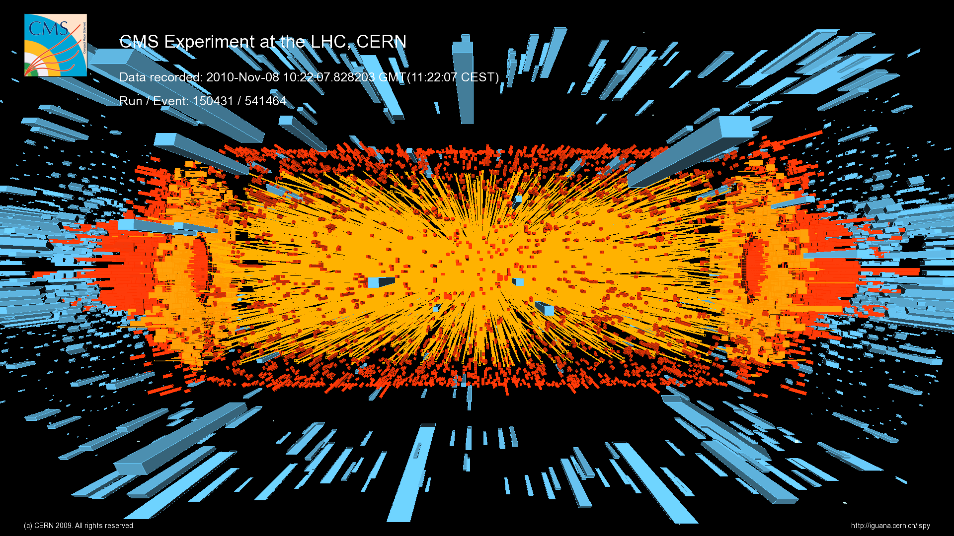
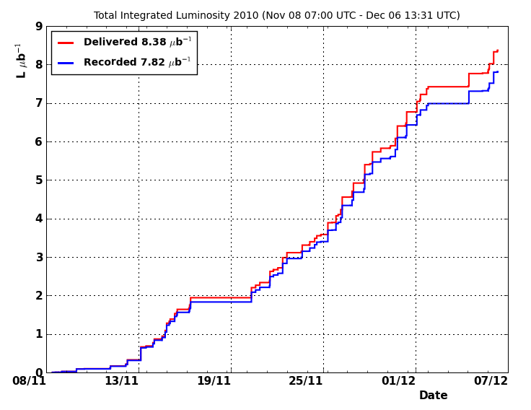
Heavy Ions at CMS (Nov./Dec.)

Slide 27
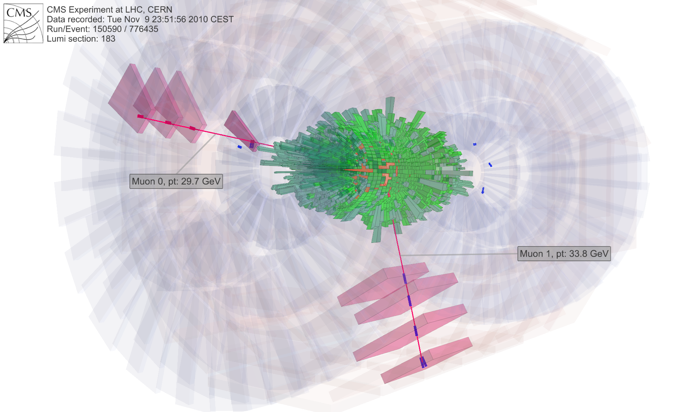
Our first Z⁰ →μ⁺μ⁻ candidate

Slide 28
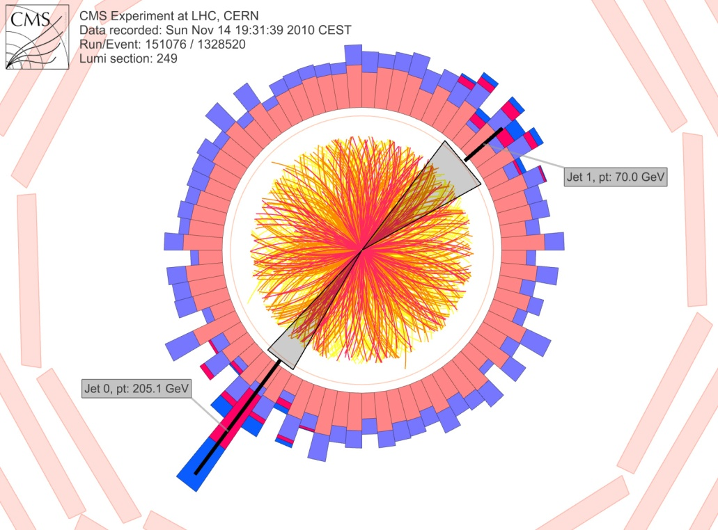

Jet quenching in HI events
While in pp events jets in pairs have balanced energies in HI events one may expect jet-quenching effect, as previously observed at RHIC in
Au-Au@200GeV.

Slide 29

Discovery searches (links)
CMS is starting to provide a new limits in NP searches, especially in heavy object regime. Expected luminosity and an increase in energy will push up to fronts of SM Higgs searches next year.
See P. Zalewski talk
„CMS searches in 2010”
See A. Kalinowski talk
„CMS potential for the Higgs boson searches with 1 fb⁻¹”

Slide 30
Summary
During 2010 LHC provided almost 50pb⁻¹ p-p events at 7TeV. Last period of operations (November/December) was dedicated to heavy ions (Pb-Pb) physics.
CMS experiment is working very well.
First LHC data allow us to better understand detector, tune MC generators parameters,
optimise reconstruction algorithms
and measure expected processes.
This year should deliver many interesting data for physics analyses and searches.

