Slide 1
Status of the LHCb experiment
Outline
Introduction to the LHCb experiment
The LHCb detector
Calibration of the VELO detector
Performance with the first collision data
Summary
On behalf of the LHCb collaboration

Slide 2
Introduction to LHCb

Slide 3
Why the LHCb detector was built?
LHCb is a dedicated experiment to study B physics at the LHC
  search for New Physics (indirect)
  rare decays
  complementary to ATLAS/CMS experiments (direct searches)
B decay vertices:
a few tracks
Primary vertex:
many tracks ~50
100 µm to 10 mm
π⁺
Main detector requirements
Efficient trigger for both hadronic and
Leptonic final states
Excellent vertex finding and tracking efficiency
Outstanding Particle Identification
B⁰
π⁻
B⁻
µ⁻
D⁰
υ_{µ}

Slide 4
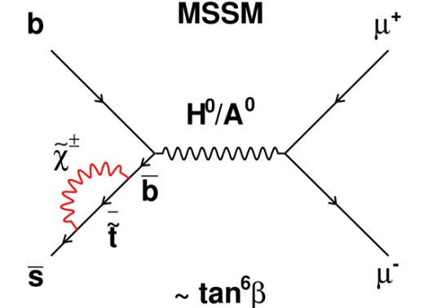
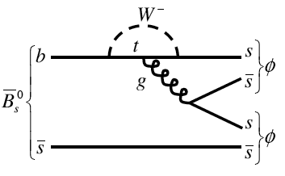
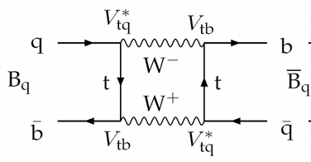
Physics prospects
b → s transitions: far from having full picture, space for NP effects
Flavour physics observables have sensitivity to new particles at high mass scales via their virtual effects in loop diagrams:
+ NP?
+ NP?
Loop diagrams are sensitive to New Physics effects (heavy particles)
Limits come from both experiment (measurement precision) and theoretical uncertainties (not CM energy)
Heavy flavour physics can provide reliable hints before direct observation of new particles is made

Slide 5
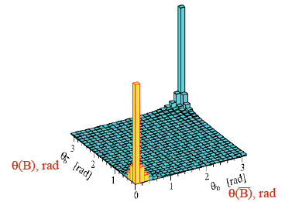
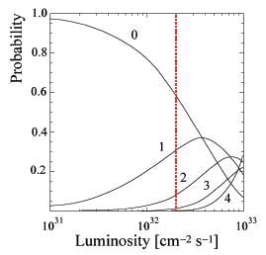
B physics at LHCb
The LHCb is a forward spectrometer, angular acceptance 15 – 300 (250) mrad or in other ‘pseudo-rapidity language’ η = 1.9 - 4.9
A forward spectrometer is sufficient for the physics since produced bb pairs are strongly correlated and forward peaked
For the designed LHC machine energy of 14 TeV extrapolated cross-section (PYTHIA) is about 500 μb this is equivalent to 10¹² pairs per year (access to all b-hadrons)
But…, σ_{bb}/σ_{Tot}≈10⁻², in addition the most interesting events have tiny BR
Luminosity limited to ~2x10³² cm⁻² s⁻¹ (to maximise the prob. of single int. per x-ing), 2fb⁻¹ per nominal year (10⁷ s)
bb
LHCb acceptance
B - B
B - B

Slide 6
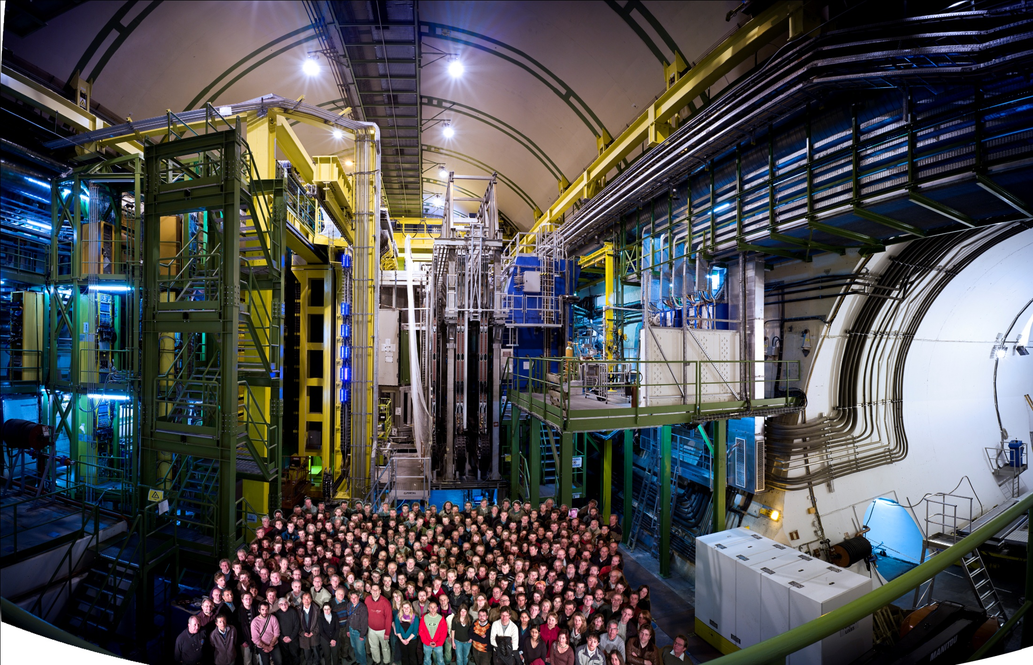

The LHCb collaboration
~700 members
15 countries
52 institutes
6

Slide 7
The LHCb detector

Slide 8
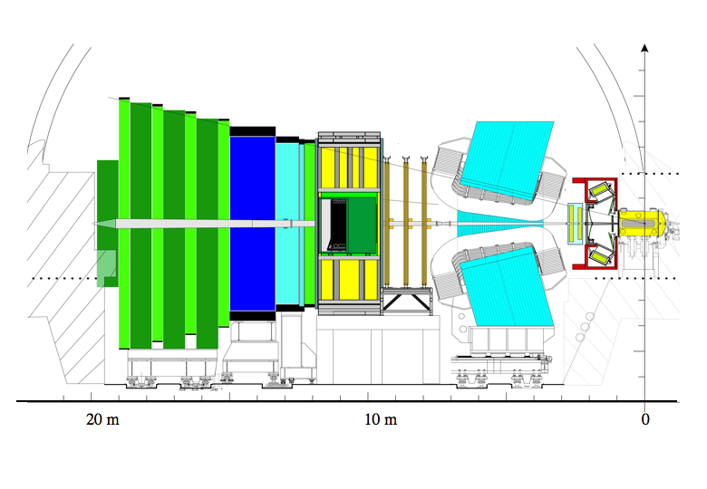
The LHCb detector
Muon system
TT+IT (Silicon Tracker)
300/250 mrad
OT
Calorimeters
Dipole magnet
Vertex
Locator
15mrad
Conductor: Aluminium
Integrated field: 4 Tm (10m)‏
Peak field 1.1 T
Weight 1600 tons
Power 4.2 MW
RICH detectors

Slide 9
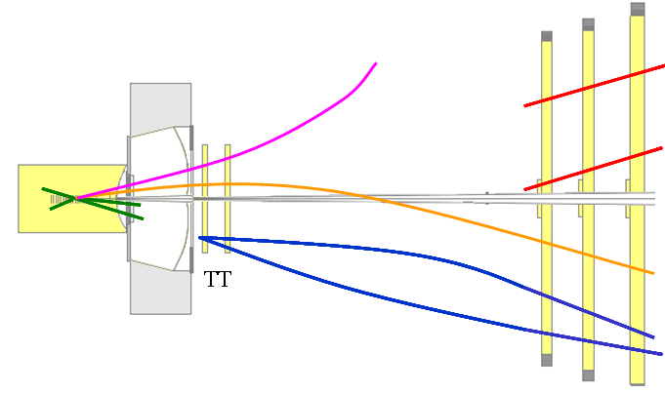
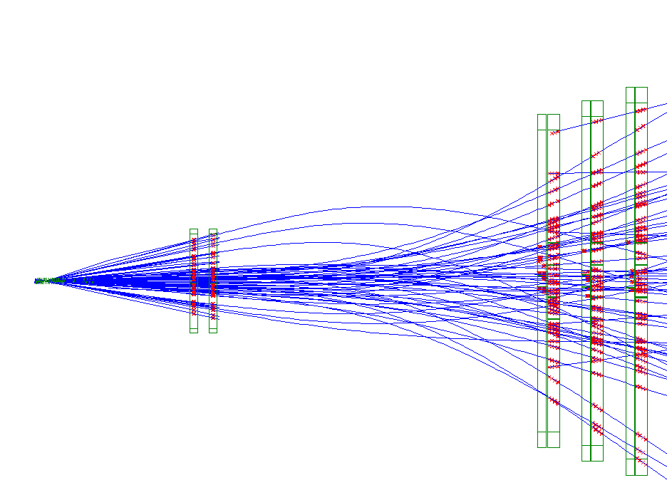
The LHCb tracking
Upstream Tracks
RICH1
T Tracks
20-50 hits assigned to each long track.
98.7% assigned correctly.
VELO
Magnetic field region
Long Tracks
VELO Tracks
Long Tracks (matched)
Downstream Tracks
T1
T2
T3
Velo tracks: → Used to find primary vertex.
Long tracks: → Used for most physics studies: B decay products.
T tracks: → Improve RICH2 performance.
Upstream tracks: → Improve RICH1 performance, moderate p estimate.
Downstream tracks: → Enhance K_{S} finding.

Slide 10
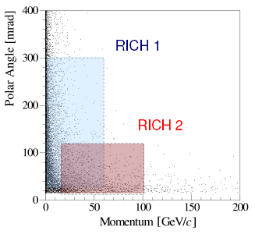
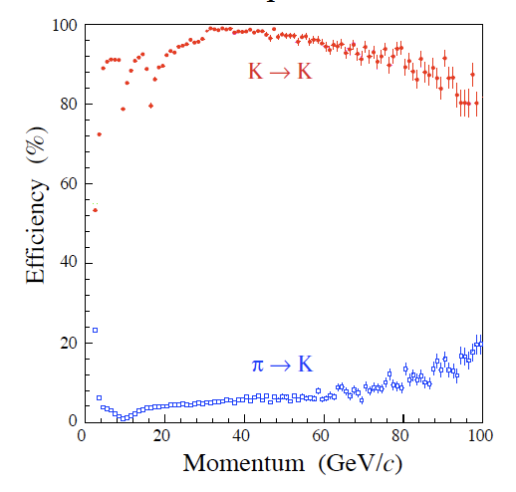
RICH detectors
Two RICH detectors are needed to cover angular and momentum acceptance
The RICH detectors allow (π – K) Identification from ~2 to 100 GeV
RICH1
Good π–K separation
in 2-100 GeV/c range
Low momentum:
  Tagging kaons
High momentum
  Clean separation of B_{d,s} → hh modes
All tracks
from B
RICH2
Power of
PID

Slide 11
LHCb Trigger System
Trigger | had | μ | μμ | e± | γ | π⁰
p_{T}> (GeV) | 3.5 | 1.3 | Σ>1.5 | 2.6 | 2.3 | 4.5
Hardware Trigger
Level -0
High Level Trigger (C++ application)
Event Filter Farm with up to 1000 16-core nodes
HLT1: Check L0 candidate with more complete info (tracking), adding impact parameter
HLT2: global event reconstruction + selections.
L0
e, γ
L0
had
L0
μ
1 MHz
HLT1
ECAL
Alley
Had.
Alley
Muon
Alley
 | ε(L0) | ε(HLT) | ε(total)
Hadronic | 50% | 80% | 40%
Electromagnetic | 70 % | 60% | 40%
Muon | 90% | 80% | 70%
30 kHz
Global reconstruction
High-Level Trigger
Inclusive selections
μ, μ+track, μμ
HLT2
Exclusive selections
Trigger is crucial as σ_{bb} is less
than 1% of total inelastic cross
section and B decays of interest
typically have BR < 10⁻⁵
2 kHz
2 kHz
Storage: Event size ~40kB

Slide 12
Calibration of the VELO detector

Slide 13
Detector calibration
Involved procedure
Critical for the physics performance of the experiment
Will try to explain it using VELO detector as an example
Only selected topics – not enough time for too many details

Slide 14
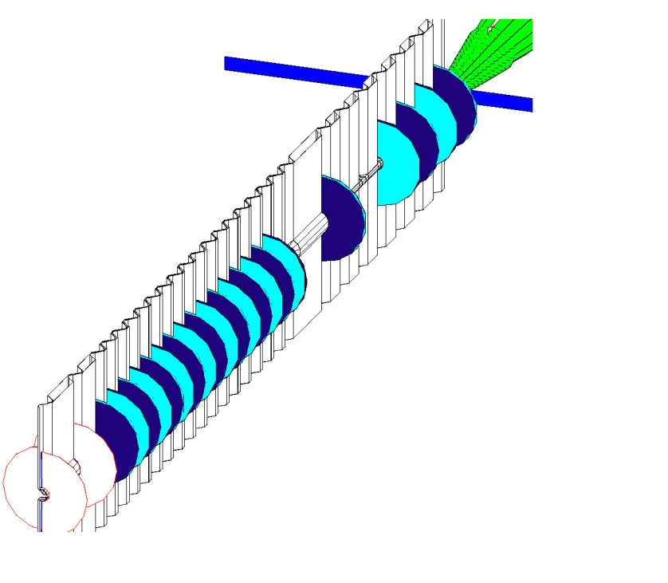
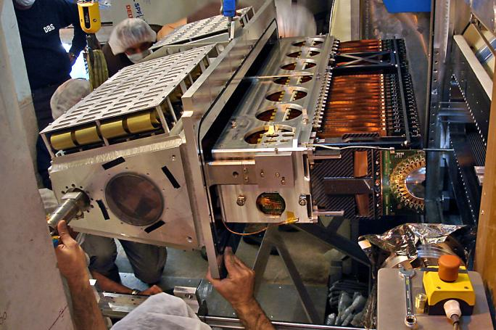

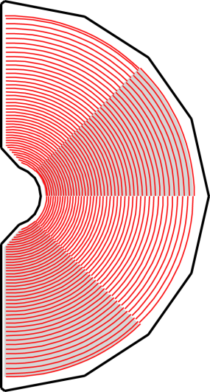
VELO – VErtex LOcator
Detector halves retractable (by 30mm) from interaction region before LHC is filled (to allow for beam excursions before injection and ramping)
21 tracking stations
Unique R-Φ geometry, 40–100μm pitch, 300µm thick
Optimized for
  tracking of particles originating from beam-beam interactions
  fast online 2D (R-z) tracking
  fast offline 3D tracking in two steps (R-z then Φ)
~ 1 m
RF foil
3cm separation
interaction point
pile-up veto (R-sensors)
r = 42 mm
r = 8 mm
2048
strips

Slide 15
VELO – VErtex LOcator
Before physics analysis we need to understand our detector
Learning how to use VELO is a good example of what needs to be done
I will introduce briefly the following topics:
  Processing parameters setting and verification
  Clusterisation (zero-suppression)
  Time alignment
  Resolution

Slide 16
Data processing
Non Zero Suppressed data
Calibration Data stream
needed to optimize processing
  Non-zero suppressed data taken in so called round-robin scheme during physics
Run emulation of TELL1 board processing off-line to
optimise algorithm performance
  6 algorithms
  ~ 10⁶ parameters
  Bit perfect emulation of FPGA performance
Parameters used for readout board fixed in emulation
Emulation
Pedestal Subtraction
Cross-talk Removal
Common Mode Subtraction
Reorderering
Common Mode Subtraction
Clusterization
Emulated RawEvent

Slide 17
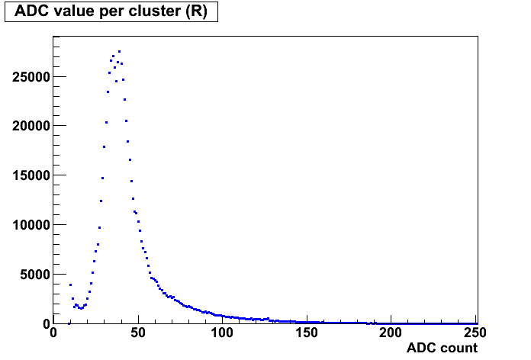
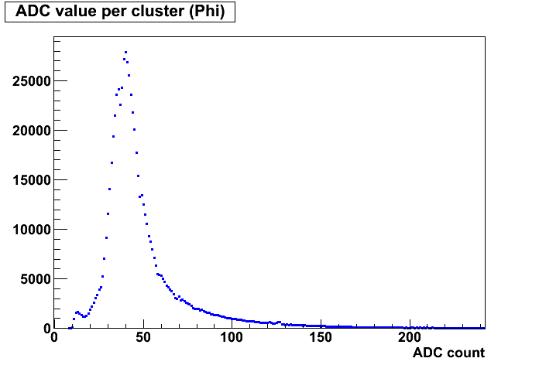
Clusterisation
Clusterisation (hit reconstruction) has profound impact on the quality of the physics – depends completely on the Tell1 processing parameters
Noise hits considerably suppressed.

Slide 18
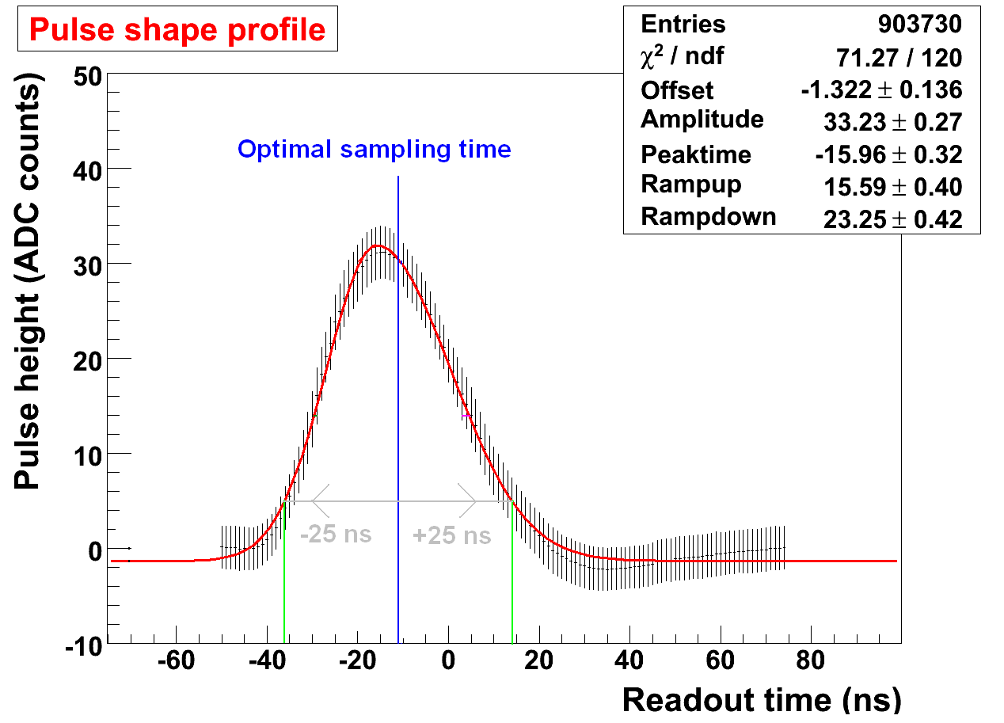
Time alignment
Time alignment affects directly the quality of the data (S/N, Spillover)
Tuning the front-end sampling time
(time when the charge is stored in the front-end pipeline)
Collision data must be used (need to have particles crossing the detector)
Each sensor needs to be adjusted separately:
- time of flight
- cable length

Slide 19
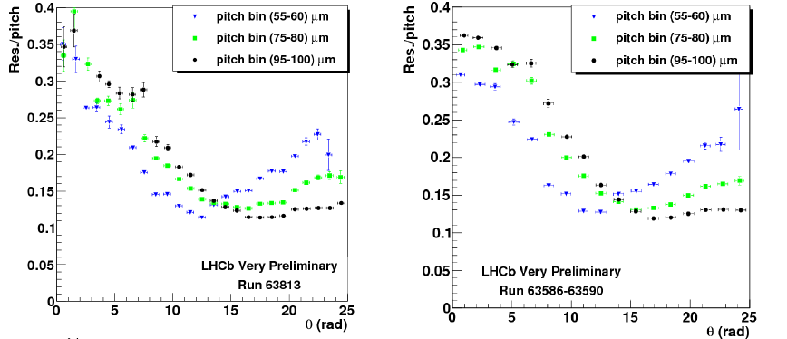
Resolution
R
Phi
Impact parameter resolution strongly depends on the hit resolution
Reasonable agreement between the preliminary results and the simulation

Slide 20
Performance with the first collision data

Slide 21

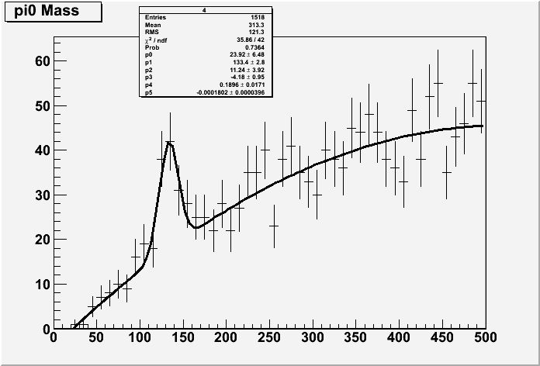
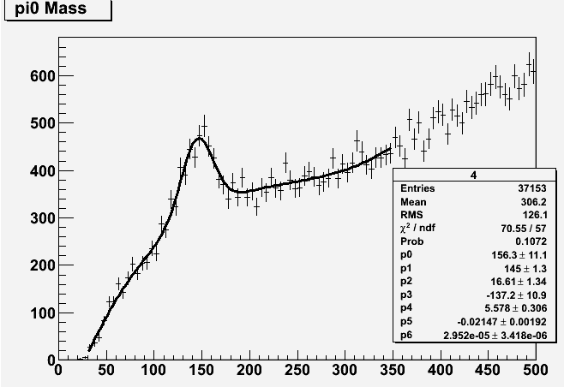
π⁰ signal reconstructed by ECAL
Very first data : 23 November 2009, No B-field
<m> = (133 ± 3) MeV/c²
(perfect agreement with the PDG value)
σ = (11 ± 4) MeV/c²
LHCb data
(preliminary)
Now π⁰ peak can be routinely
monitored on-line:
M_{γγ} (MeV/c²)
M_{γγ} (MeV/c²)

Slide 22
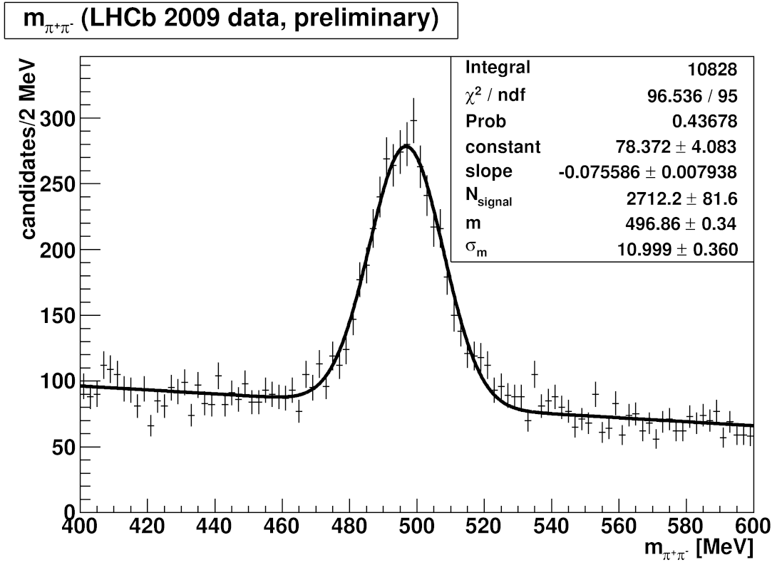
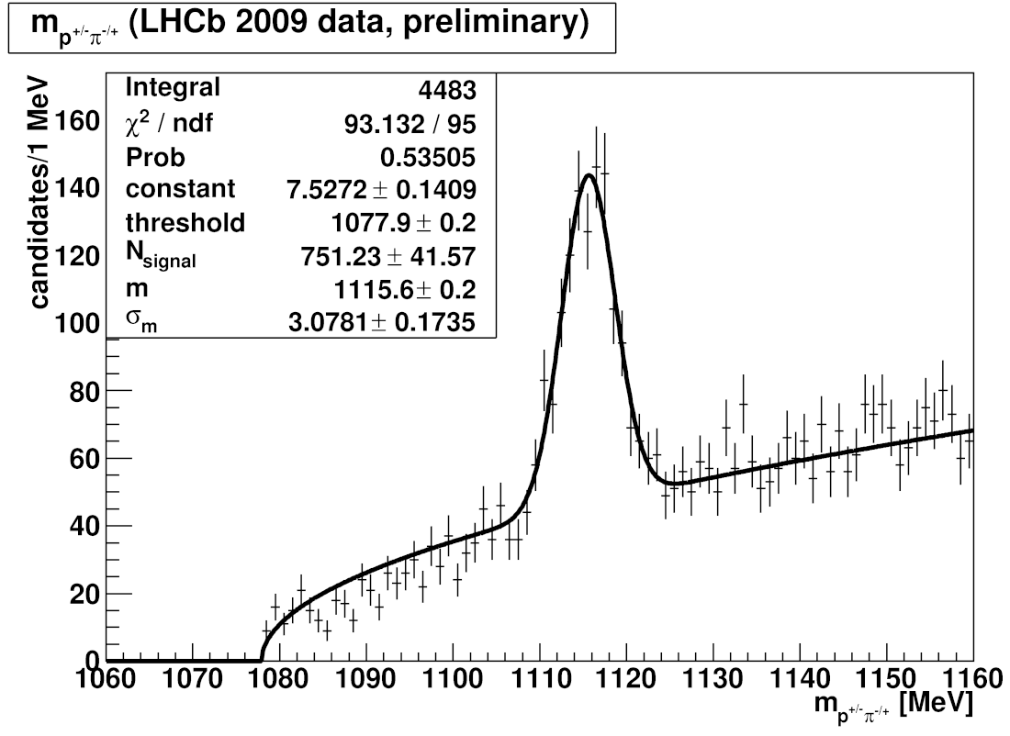
K_{S} and Λ
Tracking without VELO
Tracking detectors were well calibrated at the start-up !
M(K_{S}) = 496.9 ± 0.3 MeV/c²
= 11.0 ± 0.4 MeV/c²
M(K_{S}^{PDG}) =497.7 MeV/c²
M(Λ) = 1115.6 ± 0.2 MeV/c²
= 3.1 ± 0.2 MeV/c²
M(Λ^{PDG}) =1115.7 MeV/c²

Slide 23
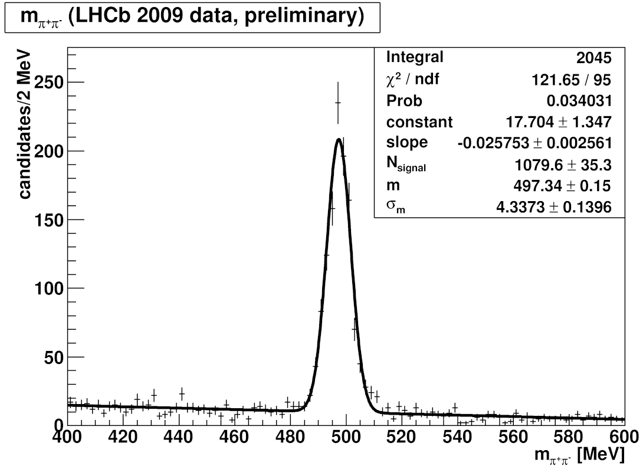
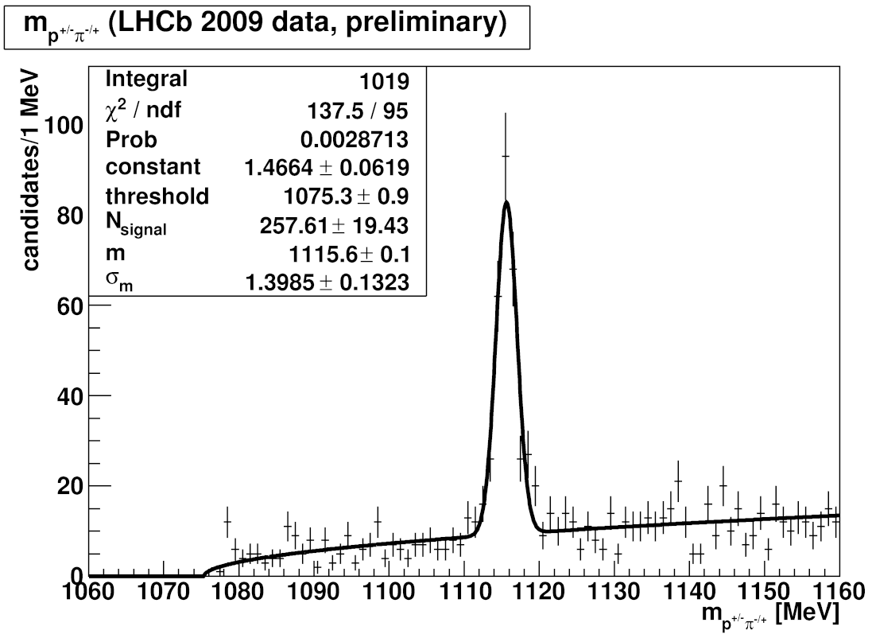
K_{S} and Λ
Using full tracking power, including VELO
M(K_{S}) = 497.3 ± 0.2 MeV/c²
= 4.3 ± 0.1 MeV/c²
M(K_{S}^{PDG}) =497.7 MeV/c²
M(Λ) = 1115.6 ± 0.1 MeV/c²
= 1.4 ± 0.1 MeV/c²
M(Λ^{PDG}) =1115.7 MeV/c²
Accuracy will be further improved after complete alignment

Slide 24
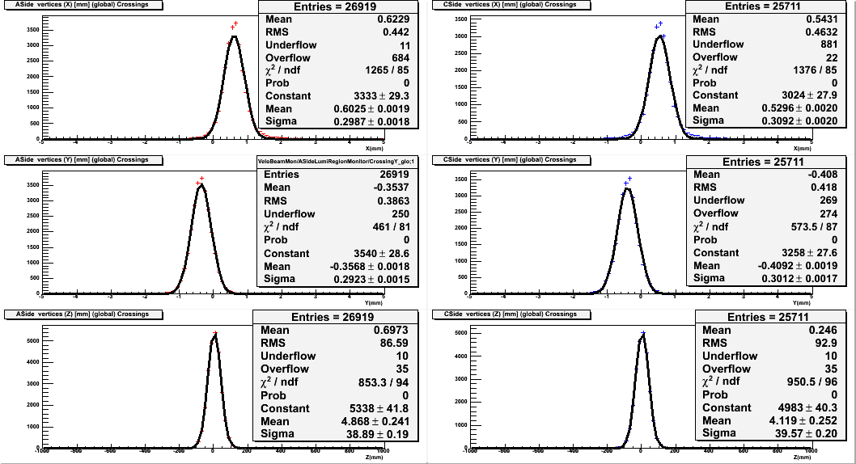
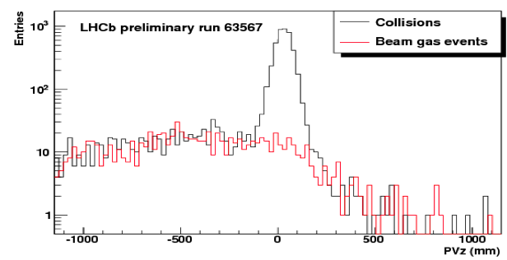
pp interaction vertex (VELO)
VELO can not be fully closed at √s = 900 GeV (LHC is projected for a nominal energy of 7TeV per beam) each side is 15 mm away from the nominal position
VELO moved in and out routinely; Kept 30 mm away during injection
X, mm
Y, mm
Measured dimensions of
the luminous region:
s_{X} ≈ s_{Y} ≈ 0.3 mm
s_{Z} ≈ 40 mm

Slide 25
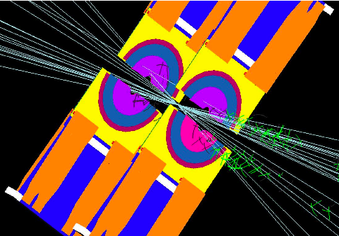

Slide 26
Summary

Slide 27
The LHCb detector is ready for the data in 2010
The calibration data taken in December 2009 allowed to perform both hardware and software tests
Detector performance with the early collision data is very promising
Can measure the shape of proton beams – direct luminosity measurement possible with precision ~5 – 10 % (after a nominal year of data taking)
We are ready for some real physics this year!

Slide 28
Physics priorities for 2010 (200 pb⁻¹)
Calibration and min. bias physics: 10⁸ evts., K_{s} ―> ππ and Λ ―> pπ
PID and momentum calibration (J/ψ trigger on single μ and p_{T} cut)
J/ψ physics and production x-sections (~1.5 pb⁻¹) – differential x-section for promt J/ψ, and b-bbar production x-section
Commissioning the analysis in the hadronic modes: study D ―> hh channels
Charm physics (> 20 pb⁻¹) – LHCb can overtake Belle statistics with just few pb⁻¹ of data
With a data sample of 200 pb⁻¹ LHCb should be able to improve the Tevatron sensitivity for BR(B_{s} ―> μμ) and the phase Φ_{s}
If there is NP LHCb should be able to see it next year!

Slide 29
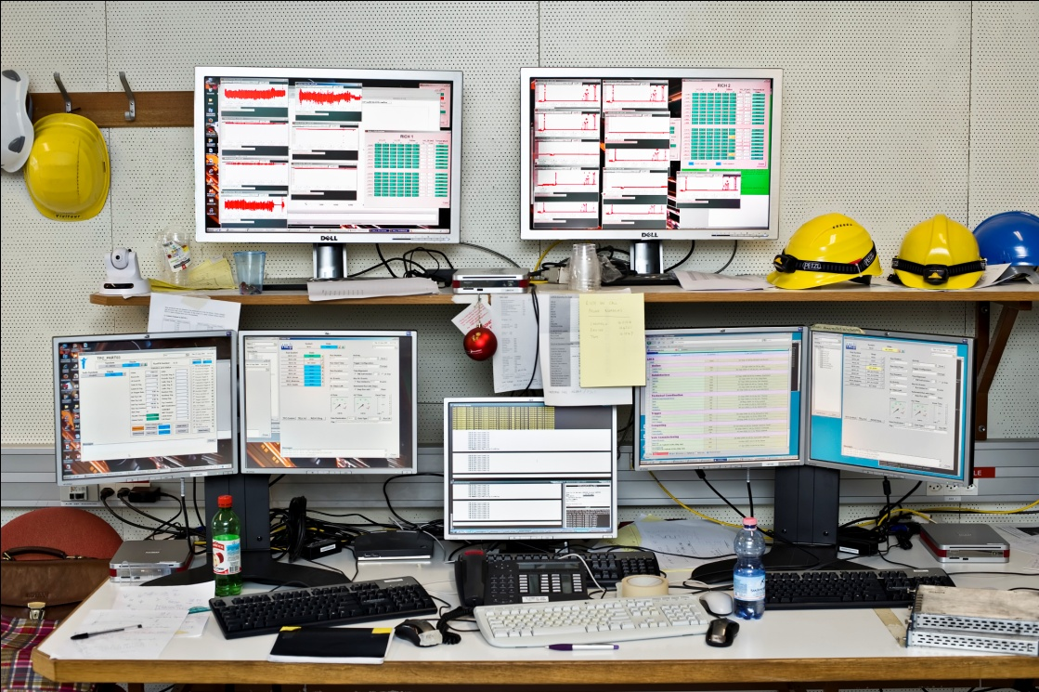
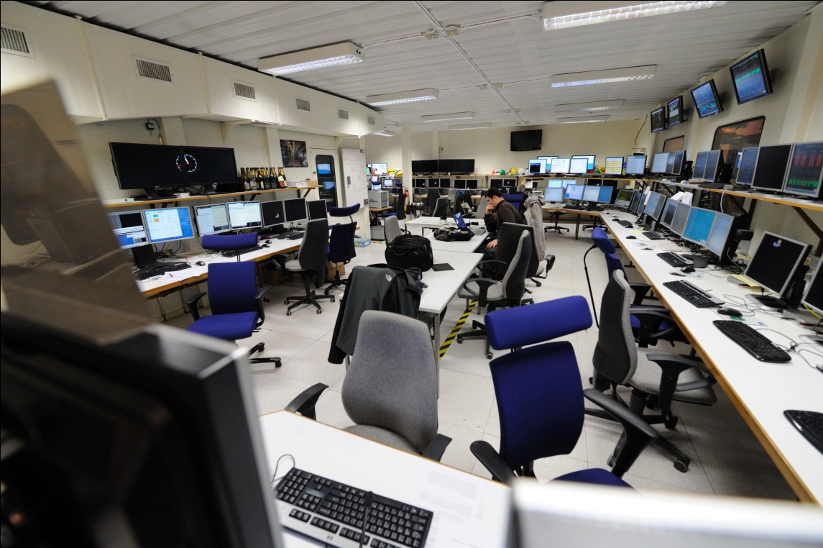

Slide 30
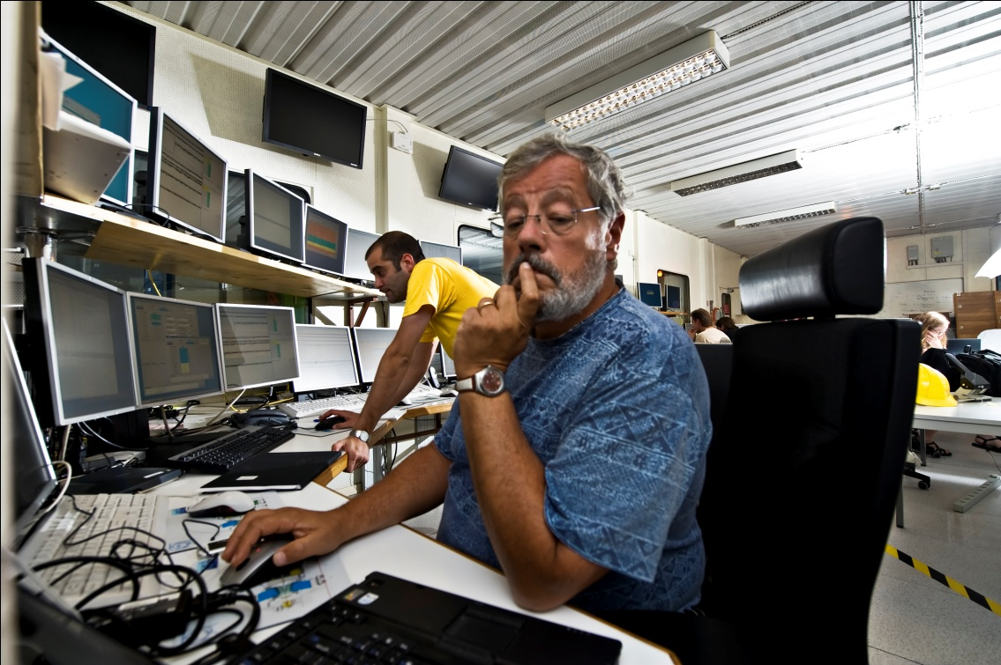
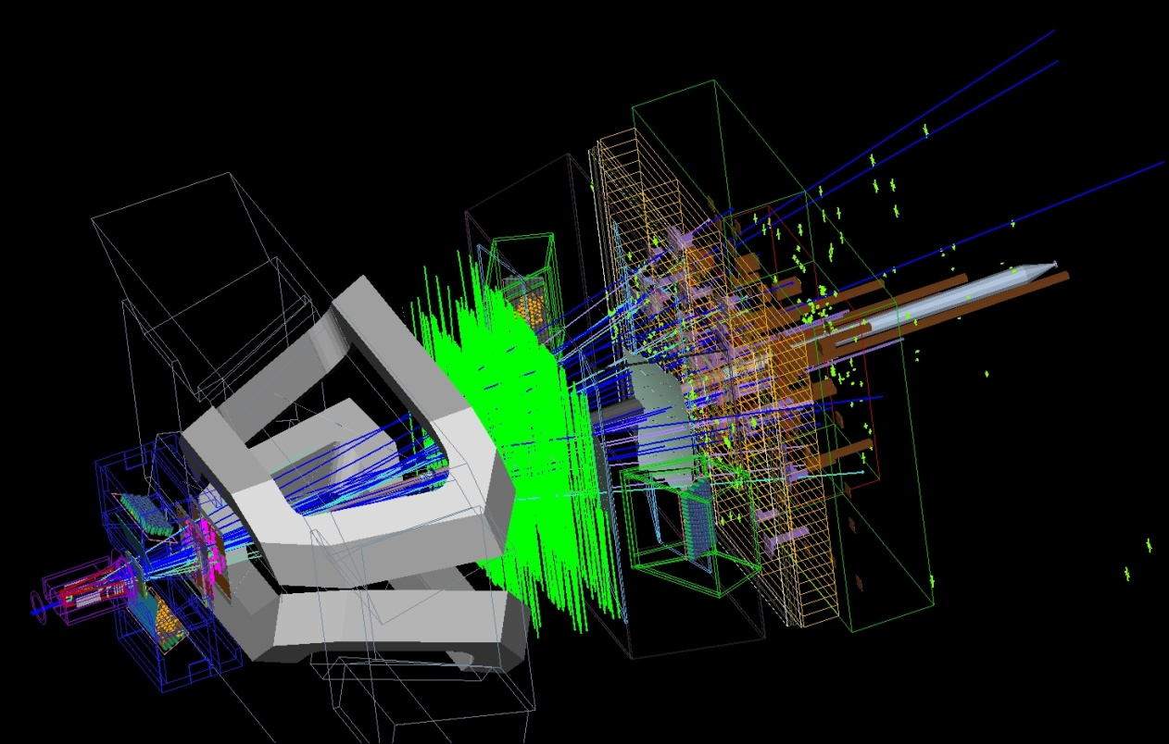

Slide 31
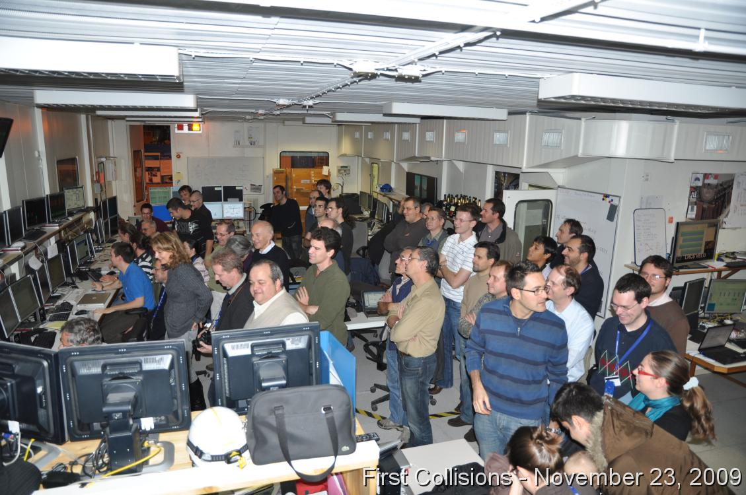

Slide 32
Backup

Slide 33
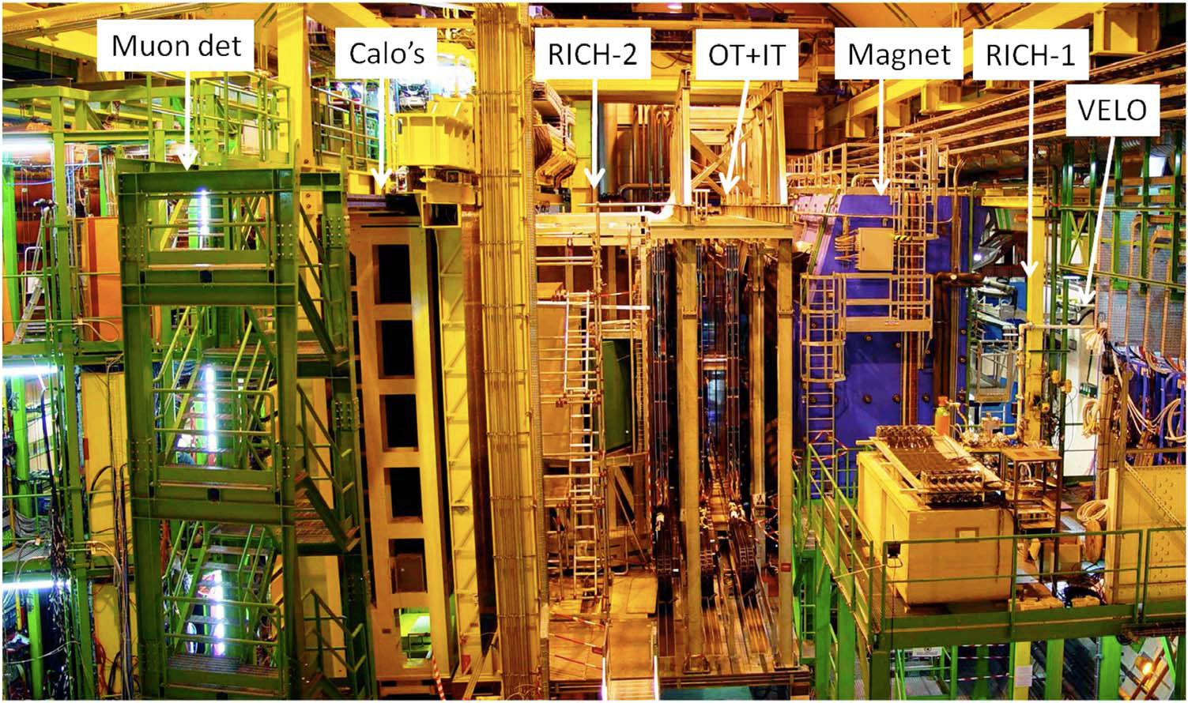


Slide 34
The LHCb tracking
Average # of tracks in bb events:
34 VELO tracks,
33 long tracks,
19 T tracks,
6 upstream tracks
14 downstream tracks
Total 106 reconstructed tracks
Assigned Hits
Reconstructed Tracks
20-50 hits assigned to each long tracks.
98.7% assigned correctly.

Slide 35
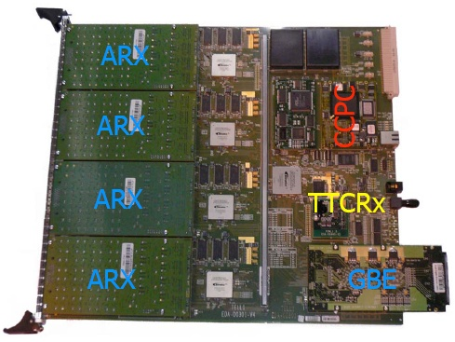
Data processing
VELO front-end
TELL1 board
Hit Processing board – TELL1, FPGA based
Main goal – suppress the data (factor ~ 200)
  From non-zero suppressed (2048 /sensor)
  To zero suppressed (clusters only)
Technically it is a farm of parallel stream processors
Raw cluster buffer
Reconstruction

Slide 36
Clusterisation
Occupancy extremely important – needs to be monitored constantly
Noisy (dead) channels may cause many problems during hit reconstruction phase
Agreement between data and simulation astonishing!

Slide 37
Tracking Performance
δ_{p}/p (%)
IP Resolution (mm)
# of Tracks
# of Tracks
p (GeV)
1/p_{T} (GeV⁻¹)
δp/p = 0.38 – 0.55 %
Resolution dominated by the multiple scattering effect
σ_{IP} = 14 μm + 35 μm/p
Error dominated by material before first measurement

Slide 38
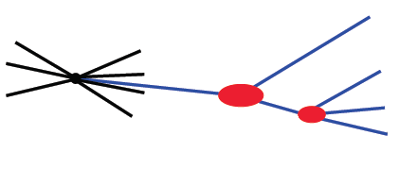
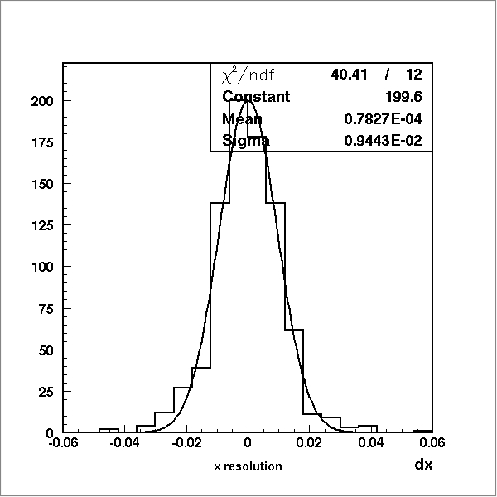

Vertexing
L
π⁺ (K⁺)
B_{S} → D_{S}π
σ = 168 μm
B_{S}
K⁺
K⁻
PV
D_{S}
π⁻
B_{TAG}
σ_{x,y}= 9 μm
σ_{z}= 47 μm
Proper time – τ = Lm_{B}/p_{B}c dominated by B vtx resolution
σ_{τ} ~ 40 fs
σ_{M(B)} ~ 14 MeV

Slide 39
Gas Target
From Accelerator
Measure beam profiles
Inject Xe gas (10⁻⁷ torr) into
VELO region.
Reconstruct beam - gas interaction vertices
Must have
  Vertex resolution in X/Y << beam sizes
  Dependence on X/Y (gas density, efficiency, ...) must be small or well known.
  Ability to distinguish beam1-gas beam2-gas and beam1-beam2 interaction.

