Slide 1
Proton decay in LAr -
Studies for the ICARUS detector
Dorota Stefan
Cracow Epiphany Conference on Physics in Underground Laboratories and Its Connection with LHC
08.01.2010
Introduction
Proton decay in the simulation of LAr detector
Track reconstruction in the ICARUS detector
Particle identification in the ICARUS detector
Many thanks to coraborators: Robert Sulej, Paola Sala, Filippo Varanini, Silvia Muraro, Daniele Gibin

Slide 2
Introduction
The experimental detection of proton decay would be a milestone in particle physics clarifying of the fundamental laws of Nature
Grand Unification Theories (GUTs) predict that at extremely high energies (10¹⁵ – 10¹⁶ GeV) the electromagnetic, weak and strong interactions merge into a single unified force.
Proton decay is predicted by many Grand Unification models, e.g.: SU(5), SO(10), E₆ and their supersymmetric versions, which are named after the mathematical groups of symmetries that connect the forces.

Slide 3
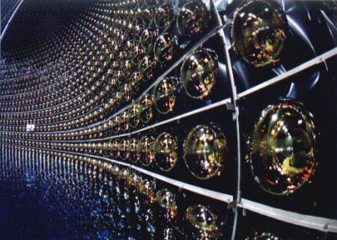
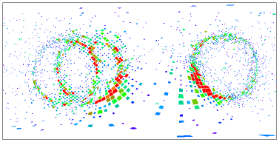
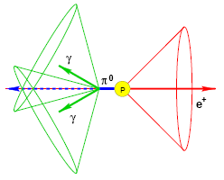
Limits of proton lifetime
The predicted proton decay channels, their branching ratios and the proton lifetime are model dependent.
The lower measured limits of the proton lifetime for the two particularly interesting decay channels are:
PDG: τ (p → e+ π⁰) > 1.6 x 10³³ ( τ(p → e⁺ π⁰) > 1.01 x 10^{34 ***})
PDG: τ (p → K+‾ν) > 0.7 (2.3*) x 10³³ ( τ(p → K⁺‾ν) > 1.5 x 10^{33 **})
The current best limits come from the SuperKamiokande experiment
* hep-ex/0502026v1
**Doctor Thesis: Searches for proton decay with the Super-Kamiokande detector Scott T. Clark, PhD Thesis, Boston University, 2007
***very preliminary – information from 25.11.2009; SK web page

Slide 4
Future projects
Detectors of a mass 10⁵ – 10⁶ tons, presented at this conference, aim at ten times higher lower limits of the proton lifetime.

Slide 5
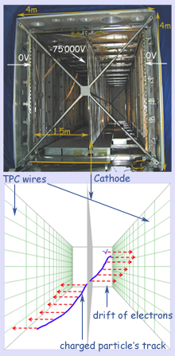
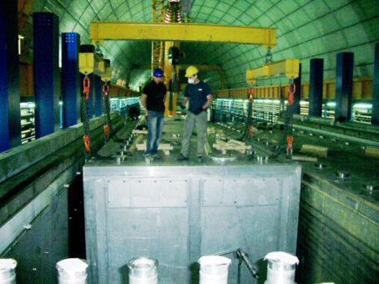
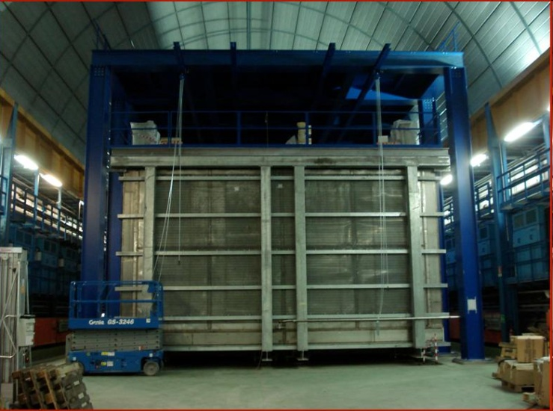
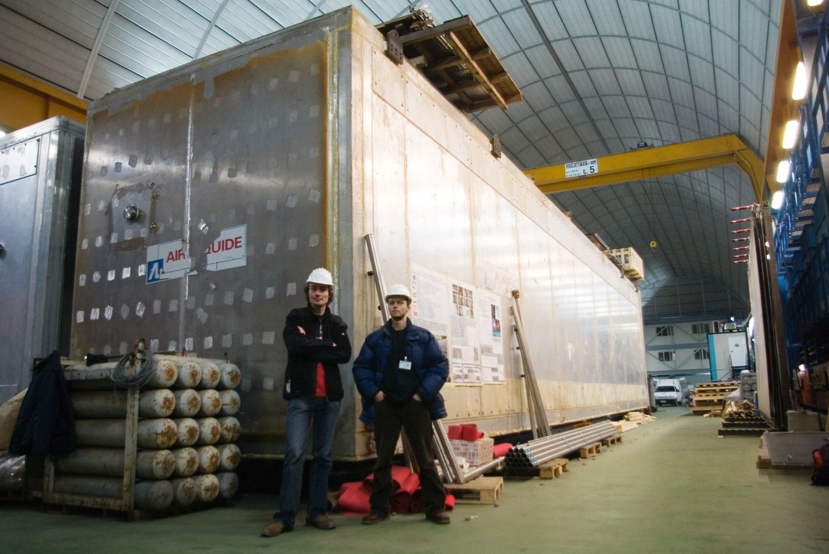
The ICARUS detector

Slide 6
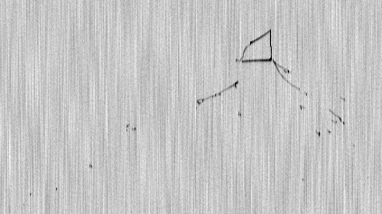
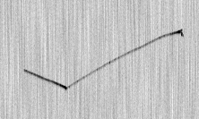
Examples of kaon decays in LAr
μ⁺
π⁺
Kaons come from the simulated proton decays.
FLUKA
K⁺
μ⁺
K⁺
K⁺→ π⁰ π⁺
PDG:
K⁺ → μ⁺ ν_{μ} 63%
K⁺ → π⁺ π⁰ 21%
K⁺ → π⁰ e⁺ ν_{e} 6%
K⁺ → π⁺ π⁺ π⁻ 6%
μ⁺
K⁺
K⁺→ μ⁺ ν_{μ}

Slide 7
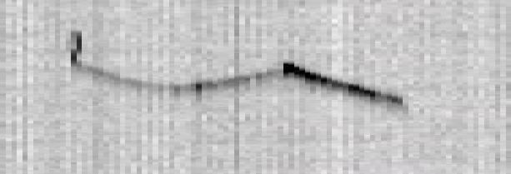
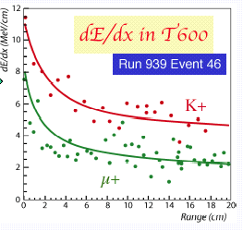
Kaon decay in Liquid Argon
K+
µ+
e+
T600: Run 939 Event 46
The energy losses per unit length of Liquid Argon follow the theoretical calculation by Bethe and Bloch

Slide 8
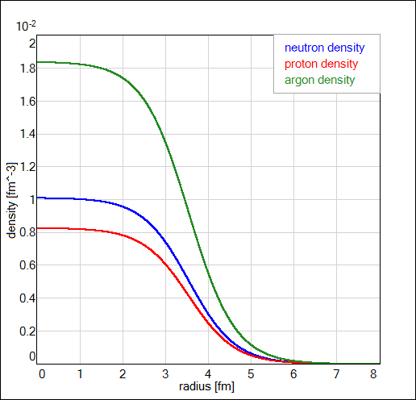
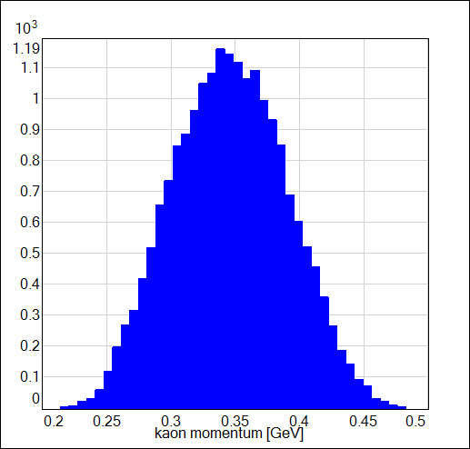
Simulations of proton decay inside nuclei
1. Description of nucleon states inside nuclei.
Existing MC codes rely on the Fermi gas model (p_{F}(r) = [3 π² ρ(r)]^{1/3} )
2. Propagation of particles from proton decay through nuclei could lead to intranuclear cascades.
The distribution of the K⁺ momentum coming from proton decay
Density[fm⁻³]
p → K⁺ ν
Radius[fm]
K⁺ momentum [GeV]

Slide 9
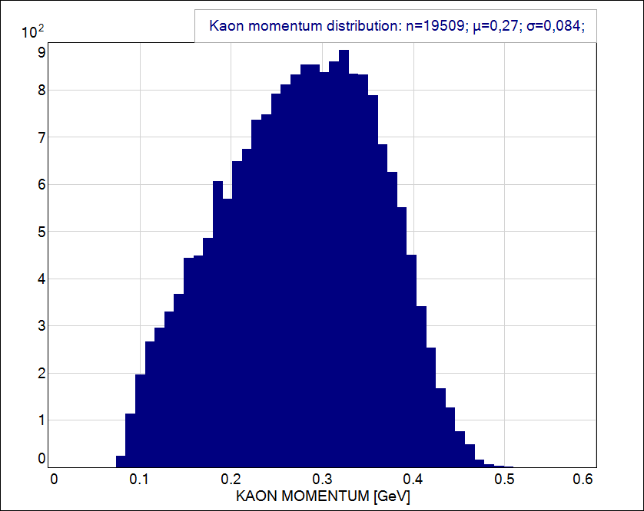
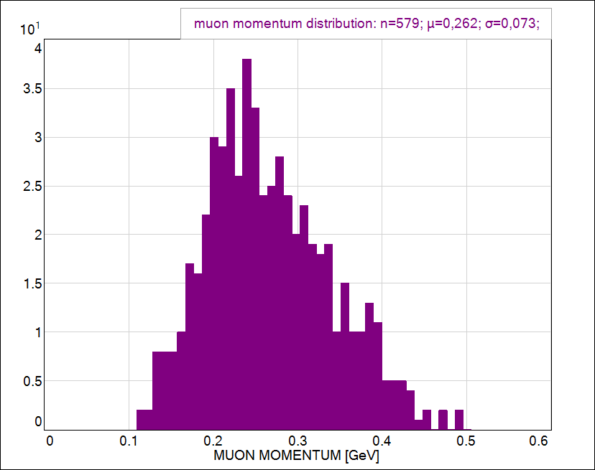
Distribution of total momentum of kaon and muon
KAON
MUON
K⁺ momentum [GeV]
μ⁺ momentum [GeV]
20000 events of proton decay generated in FLUKA
2% of kaons are absorbed in nuclei (K⁺ n → K⁰ p)
63% of these kaons decay into μ+ ν_{μ}
Only 5% out of these 63% of kaons decay in flight
95% out of these 63% of kaons decay at rest - muon momentum is equal 236 MeV

Slide 10
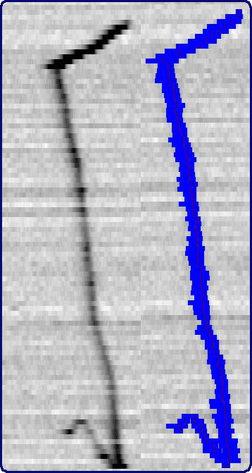
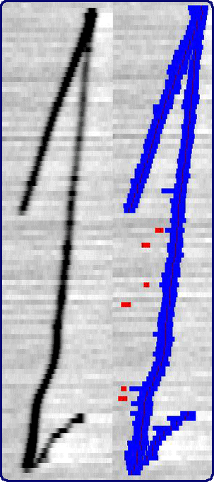
Reconstruction of tracks in the ICARUS detector
Hits and clusters reonst. algorithms are very good.
Problems with the next steps of tracks reconstruction:
one track instead of three independent tracks.
hits are not sorted from the beginning to the end of track.
If hits are properly sorted in both views – the 3D reconstruction is excellent and the seperation of tracks could be based on dE/dx information.
Collection view
Induction view

Slide 11
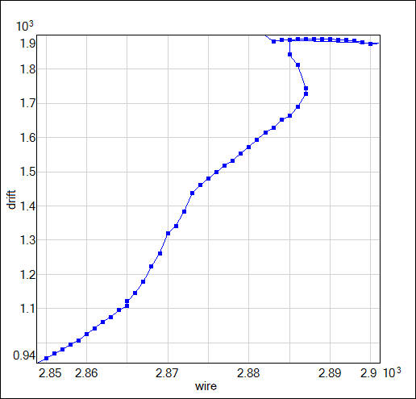
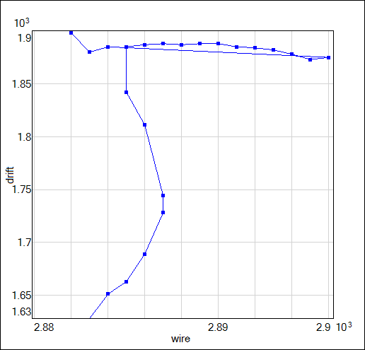
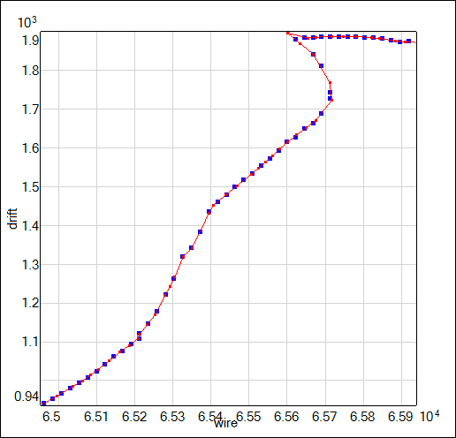
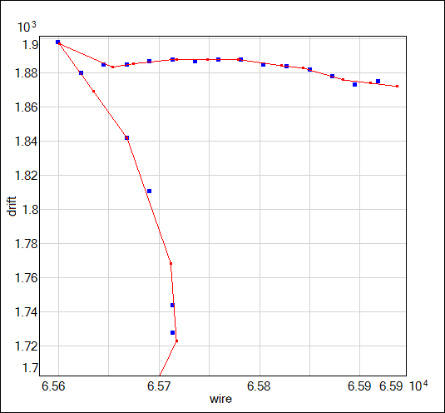
The sorting hits algorithm
The simple algorithm of finding the closest hits seems not to be the best choice.
More inteligent algorithm – Polygonal Line solves the problem.
Description of the method with examples could be found here:
http://www.iro.umontreal.ca/~kegl/research/pcurves/
The code was written according to recipe:
B. Kégl, A. Krzyzak, T. Linder, and K. Zeger "Learning and design of principal curves" IEEE Transactions on Pattern Analysis and Machine Intelligence vol. 22, no. 3, pp. 281-297, 2000.

Slide 12
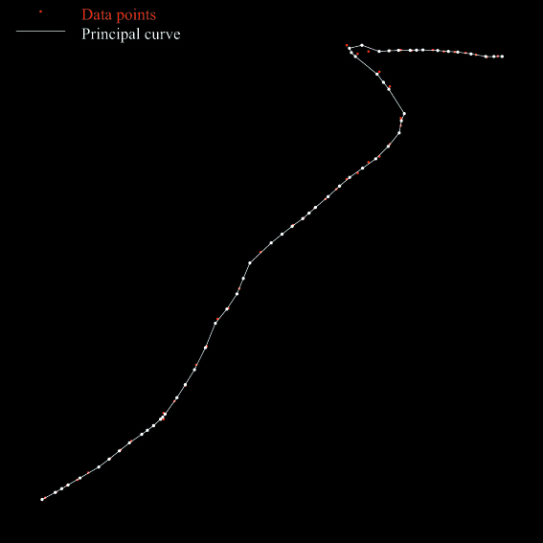
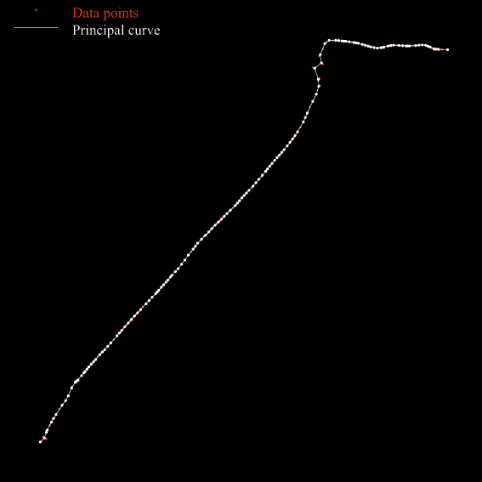
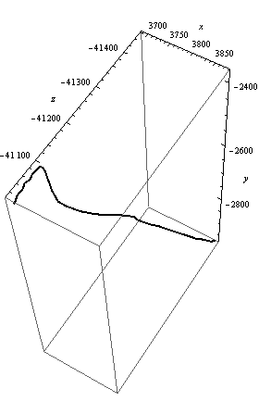
3D reconstruction in the ICARUS detector
Collection view
Induction view
Polygonal Line Algorithm
Hits from two views are merged according to the same drift sample
3D

Slide 13
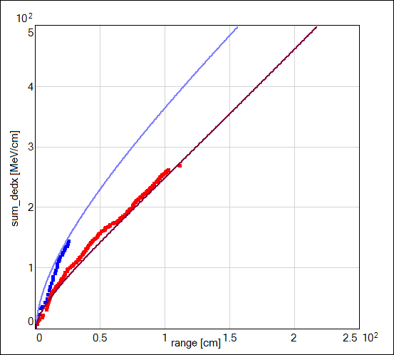
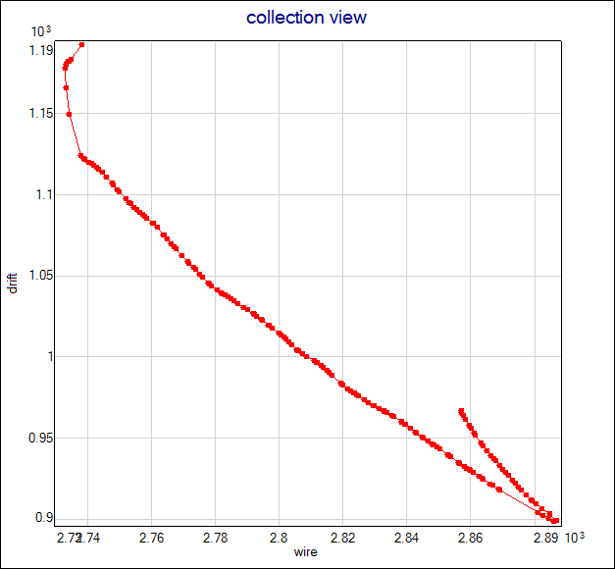
Particle identification in the LAr detector
The identification of particles is based on the fact that energy losses are different for particles with different masses and the same value of momentum, especially for momenta lower than that corresponding to the minimum of ionization.
sorting hits makes identification of particles easier.
dedx is the highest in the point of stopping particle – it helps to seperate tracks.
Σdedx[MeV/cm]
μ⁺
drift
K⁺
VERY PRELIMINARY
Range [cm]
wire

Slide 14
Summary
Searches for proton decay are one of the most important subjects of particle physics nowadays.
In order to improve these searches it is essential to increase the sensitivity of measurements by at least a factor 10.
Both calorimetric and spacial resolution of a detector is important in order to look for proton decay.
Very good 3D track reconstruction of the LAr detector are required in order to fully use its potential.

