Slide 1




The Belle II Project
Introduction | PID
Accelerator | Calorimeter
Vertex | General
Boštjan Golob
University of Ljubljana/Jožef Stefan Institute & Belle/Belle II Collaboration
Introduction
Accelerator
Detector
Vertex
physics example
PID
physics example
Calorimeter
physics example
General requirements
University
of Ljubljana
“Jožef Stefan”
Institute
Epiphany Conference,
Cracow, January 2012

Slide 2
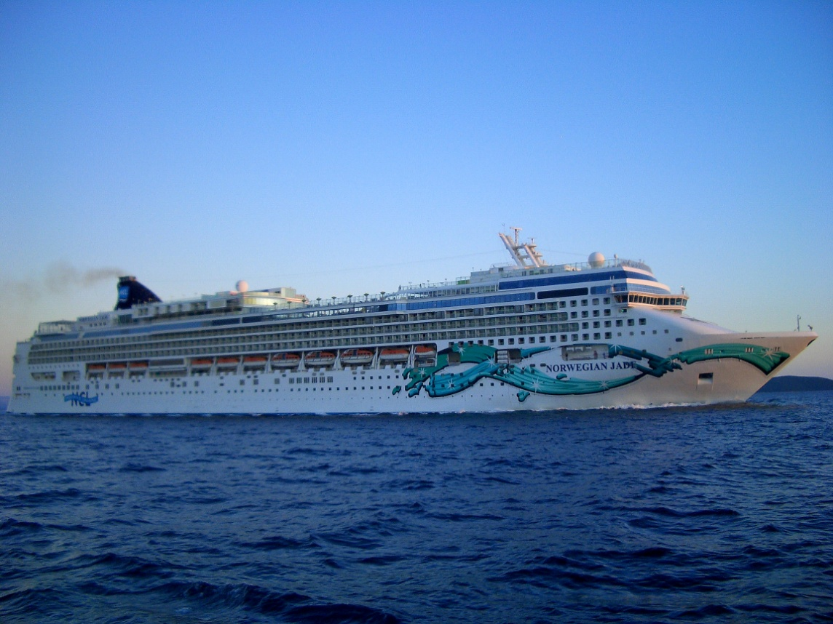
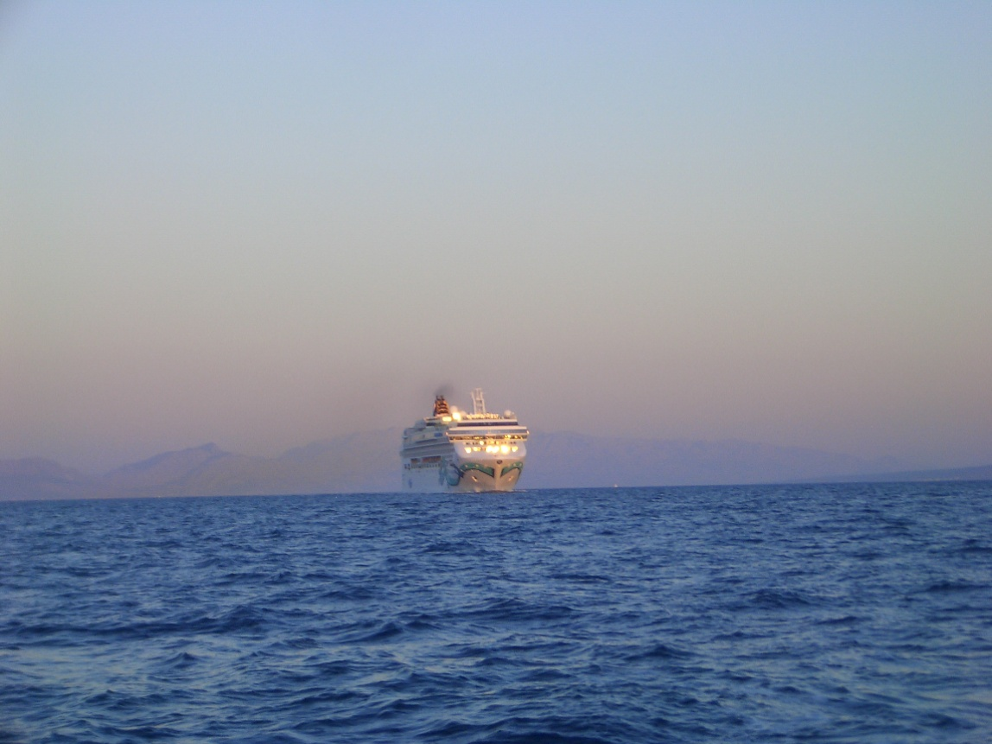

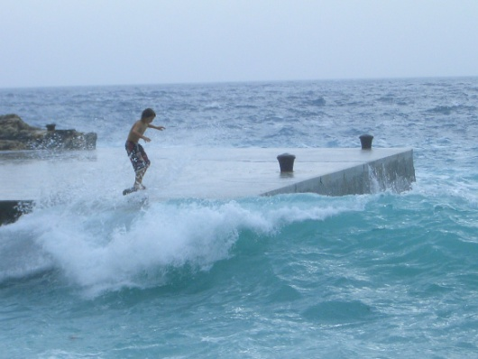
Introduction
Introduction | PID
Accelerator | Calorimeter
Vertex | General
Quest for NP...
....consists of
energy frontier
direct observation
of new particles &
processes using
highest achievable
energies
intensity frontier
indirect observation of
NP effects on (rare)
known processes
(cosmic frontier)
bližina otoka Veli Drvenik, sept. 2011
Energy frontier
Intensity frontier

Slide 3
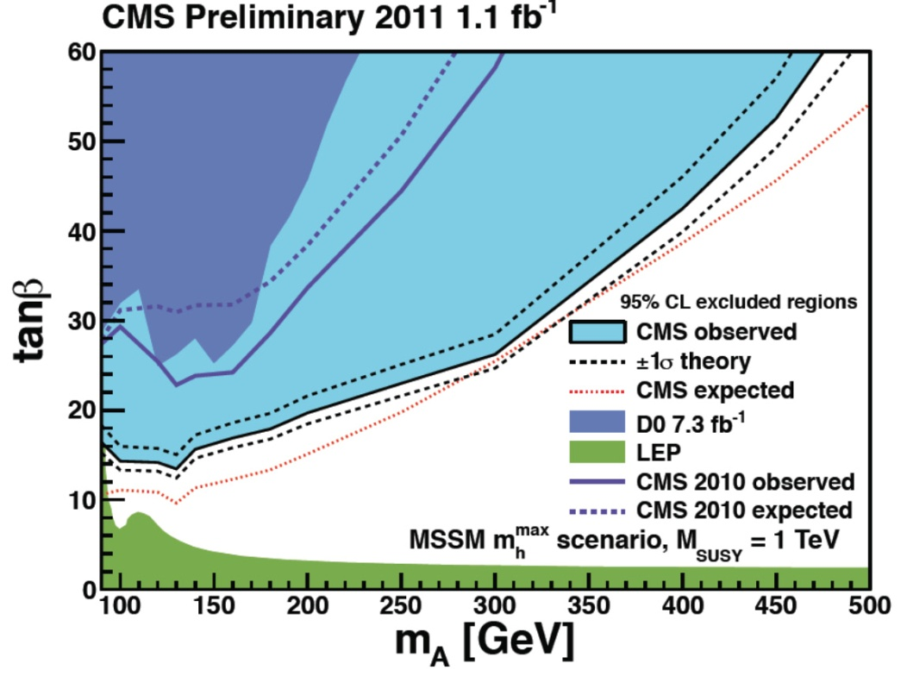
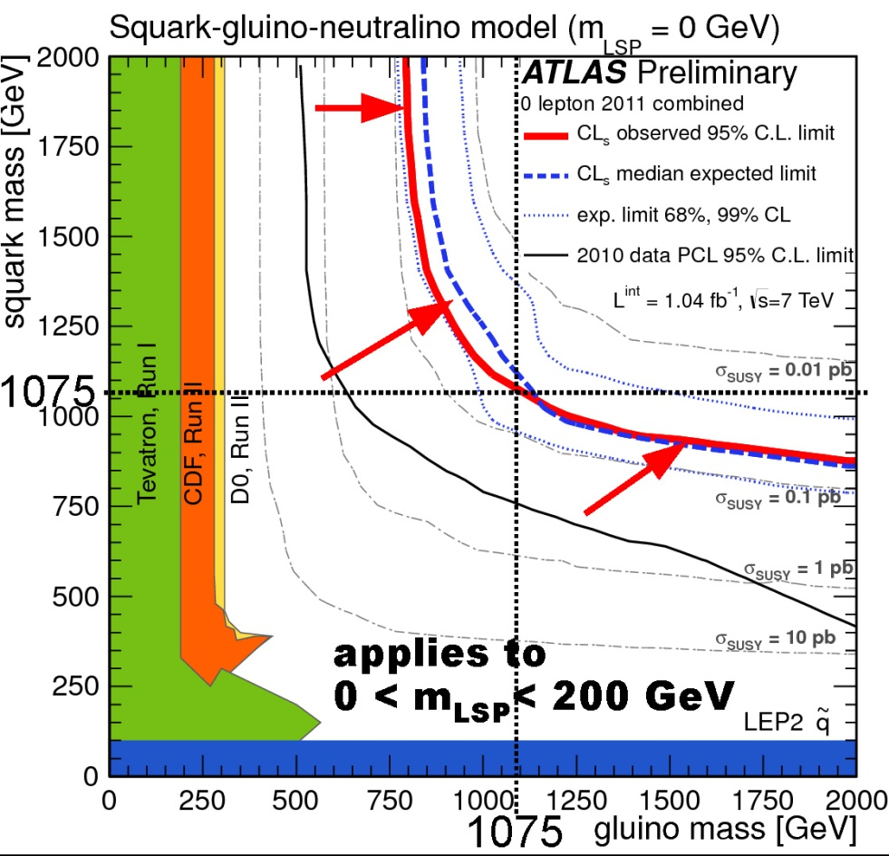
Introduction
Introduction | PID
Accelerator | Calorimeter
Vertex | General
Quest for NP
LHC at the energy frontier
1 TeV
95% C.L. exclusion limits on MSSM A⁰
V. Sharma, LP11 conference
95% C.L. exclusion limits in mass
SUSY plane
SUSY in the simplest forms
seems to be excluded
H. Bachacou, LP11 conference

Slide 4
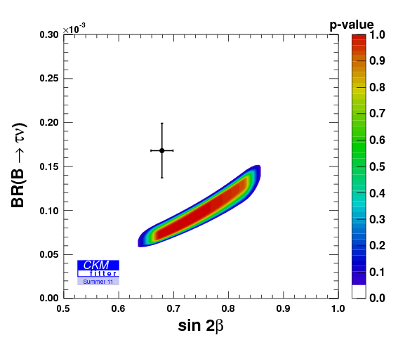
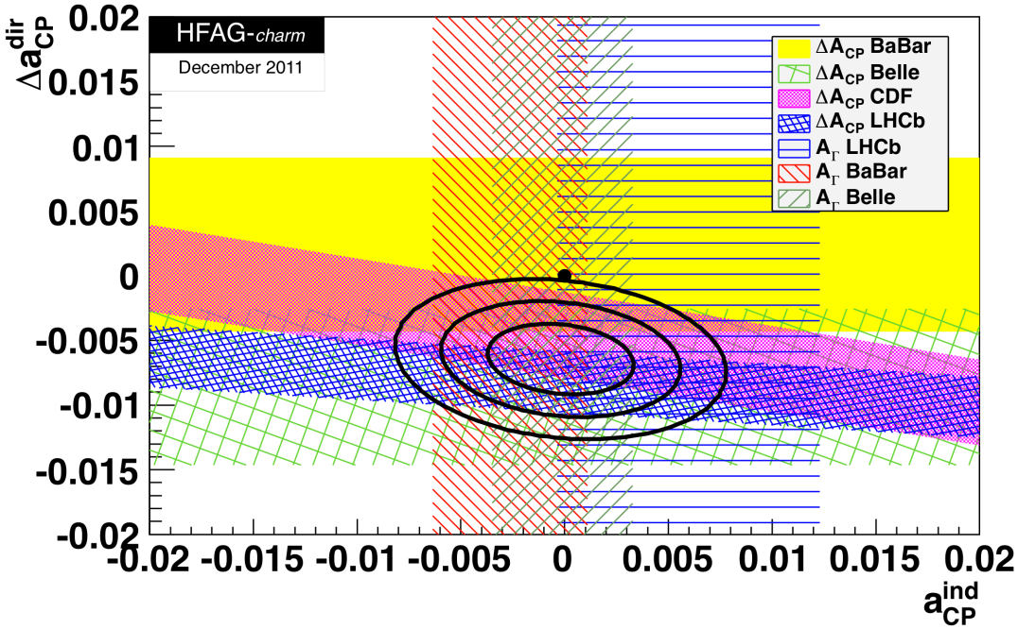
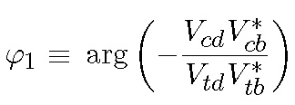
Introduction
Introduction | PID
Accelerator | Calorimeter
Vertex | General
Quest for NP
B factories, LHCb, ... at the intensity frontier
B mesons sector
D mesons sector
CKM Fitter, Summer 2011
HFAG, December 2011
direct
measurement
indirect
determination
β =
Hints of deviations from SM at few σ level

Slide 5
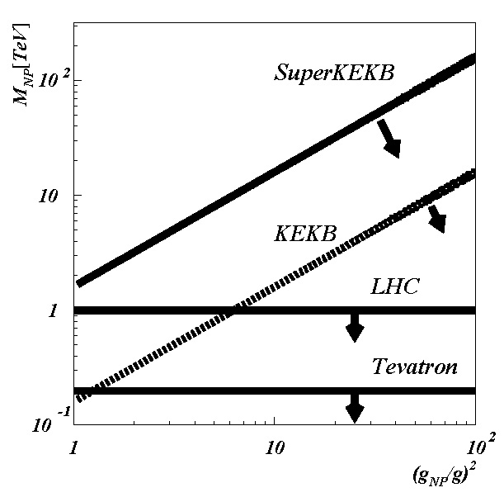



Introduction
Introduction | PID
Accelerator | Calorimeter
Vertex | General
Quest for NP
Intensity frontier
requirements for future facilities
(quark sector)
Illustrative reach of NP searches
NP reach in terms
of mass
σ∝1/√N ⇒ O(10²) higher luminosity
complementarity to other intensity frontiers
experiments (LHCb, BES III, ....);
accurate theoretical predictions to compare to
Terra Incognita
NP flavor violating
couplings( ∼1 in MFV)

Slide 6
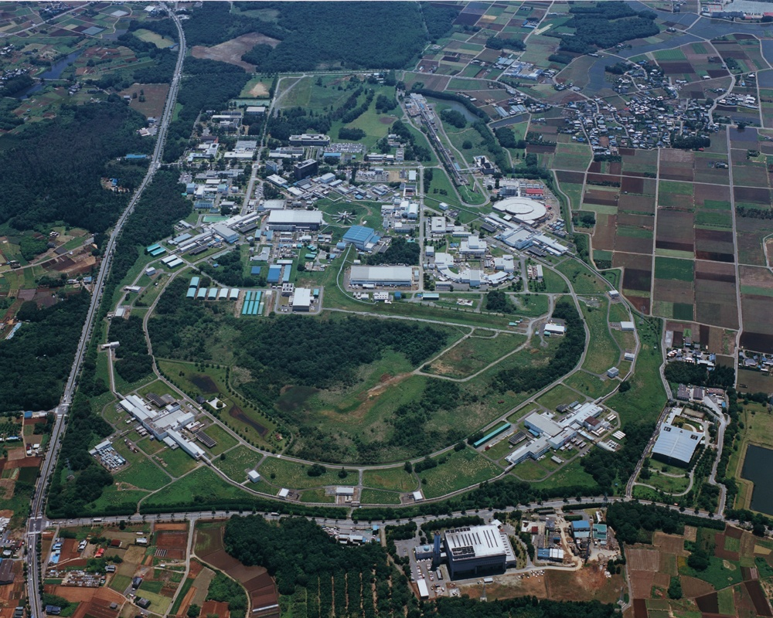
Introduction
Introduction | PID
Accelerator | Calorimeter
Vertex | General
Accelerator
“B-Factory”, KEKB @ KEK
accelerator
institute
Tokyo (40 mins by Tsukuba Exps)
KEKB:
e⁻ (HER): 8.0 GeV
e⁺ (LER): 3.5 GeV
crossing angle:
22 mrad
E_{CMS}=M(Υ(4S))c²
dN_{f}/dt = σ(e⁺e⁻→f) L
LER
HER
e⁻
Belle
e⁺
₂₀₁₀
∫Ldt = 1020 fb⁻¹
¹⁹⁹⁹
(1.02 ab⁻¹)

Slide 7
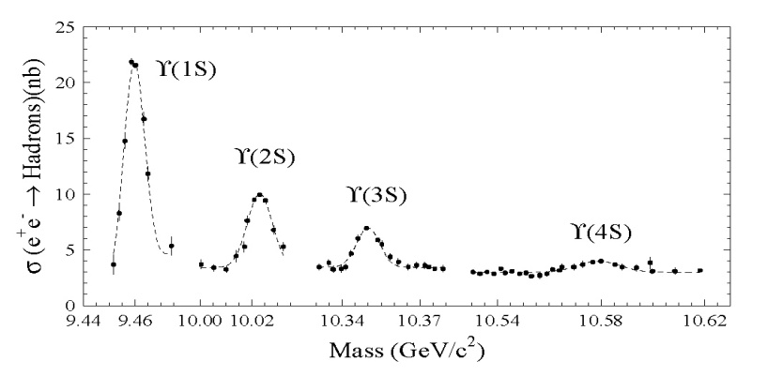
Introduction
Introduction | PID
Accelerator | Calorimeter
Vertex | General
Accelerator
“B-Factory”, KEKB @, KEK
Belle ∫Ldt ≈ 1020 fb⁻¹
b
B_{d}⁰, B⁺
b
b
energ. threshold
for BB production
Υ(4S)
u,d
b
B_{d}⁰, B⁻
u,d
σ(e⁺e⁻→hadroni) [nb]
“on resonance” production
e⁺e⁻ → Υ(4S) → B_{d}⁰B_{d}⁰, B⁺B⁻
σ(e⁺e⁻ → BB) ≈ 1.1 nb (~10⁹ BB pairs)
e⁻
γ*
c
hadrons
”continuum” production
σ(e⁺e⁻ → c c) ≈ 1.3 nb (~1.3x10⁹ X_{c}Y_{c} pairs)
e⁺
c
hadrons
running at Y(nS), e.g. Y(5S) (B_{s}B_{s})

Slide 8
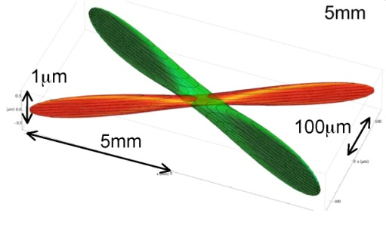
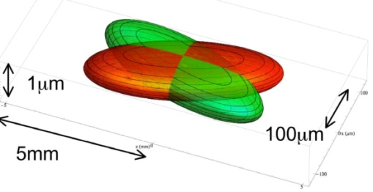
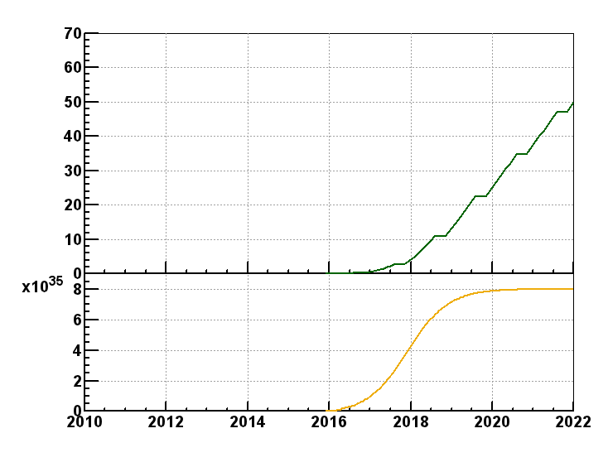
Accelerator
Introduction | PID
Accelerator | Calorimeter
Vertex | General
SuperKEKB
KEKB
σ_{x}~10μm,σ_{y}~60nm
SuperKEKB
σ_{x}~100μm,σ_{y}~2μm
Nano beams design
(P. Raimondi)
e⁻
e⁺
∫L dt
[ab⁻¹]
β*: beta-function (trajectories
envelope) at IP
ξ_{y}: beam-beam parameter
∫L dt=50 ab⁻¹ (2022)
∫L dt=10 ab⁻¹ (2018)
small β_{y}*
large ξ_{y} ∝ √(β_{y}*/ε_{y}) ⇒ small ε_{y}
hourglass effect ⇒ small β_{x}*
increase I
current B factories
L
[s⁻¹cm⁻²]
design L=8·10³⁵ s⁻¹cm⁻²

Slide 9

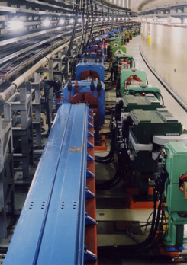
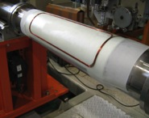

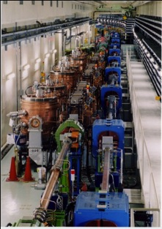

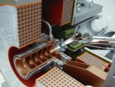
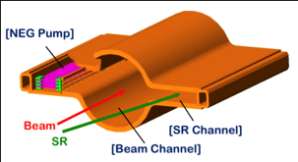
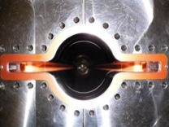
Accelerator
Introduction | PID
Accelerator | Calorimeter
Vertex | General
Super KEKB
e⁺
Belle II
New IR
New superconducting /permanent final focusing quads near the IP
New beam pipe
& bellows
Replace short dipoles with longer ones (LER)
e⁻
Add / modify RF systems for higher beam current
Low emittance positrons to inject
Redesign the lattices of HER & LER to squeeze the emittance
Positron source
Damping ring
Low emittance gun
Low emittance electrons to inject
New positron target / capture section
TiN-coated beam pipe with antechambers

Slide 10
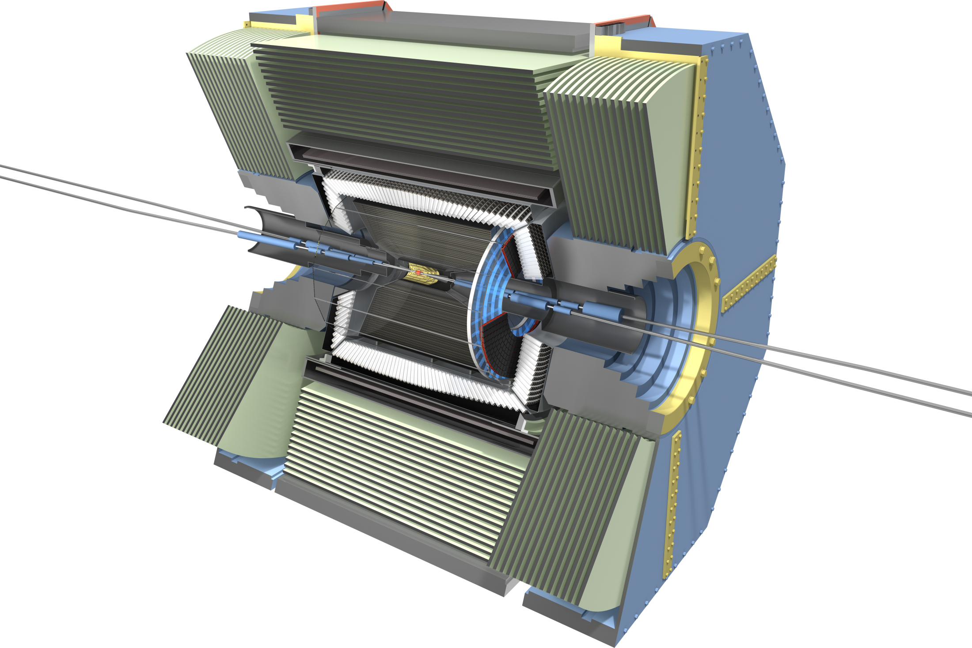

Detector
Introduction | PID
Accelerator | Calorimeter
Vertex | General
Belle II
RPC μ & K_{L} counter:
scintillator + Si-PM
for end-caps
CsI(Tl) EM calorimeter:
waveform sampling
electronics,
pure CsI
for end-caps
7.4 m
3.3 m
1.5 m
4 layers DSSD →
2 layers PXD
(DEPFET) +
4 layers DSSD
7.1 m
Time-of-Flight, Aerogel
Cherenkov Counter →
Time-of-Propagation
counter (barrel),
prox. focusing Aerogel
RICH (forward)
Central Drift Chamber:
smaller cell size,
long lever arm

Slide 11
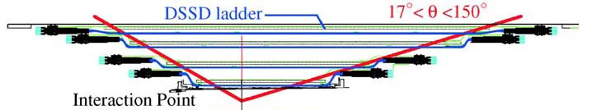
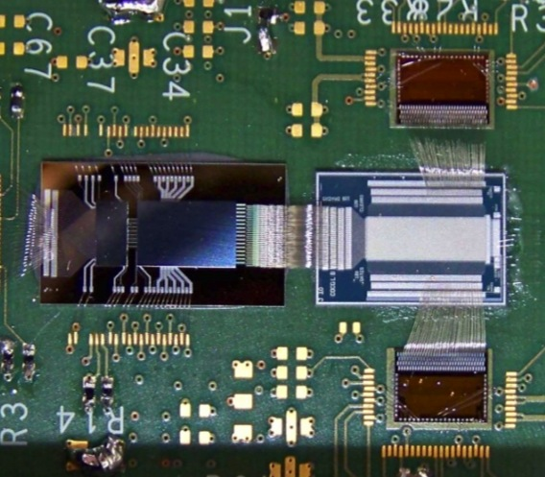
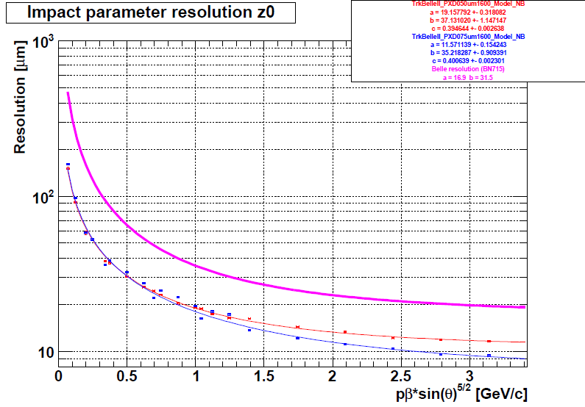
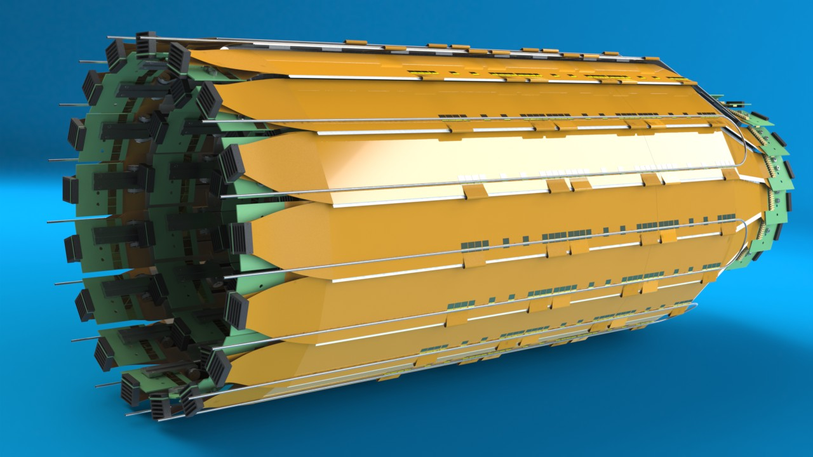
Vertex detector
Introduction | PID
Accelerator | Calorimeter
Vertex | General
r [cm]
PXD+SVD Belle II
SVD Belle
DSSD’s
pixels
z [cm]
sBelle Design Group, KEK Report 2008-7
z [cm]
DCDB
R/O chip
DEPFET matrix
z impact parameter
resolution
DEPFET mockup
Belle
Switcher control chip
20 μm
10 μm
prototype DEPFET
sensor
Belle II
pβ∗sin^{5/2}(θ) [GeV/c]
Si Vertex Det.

Slide 12
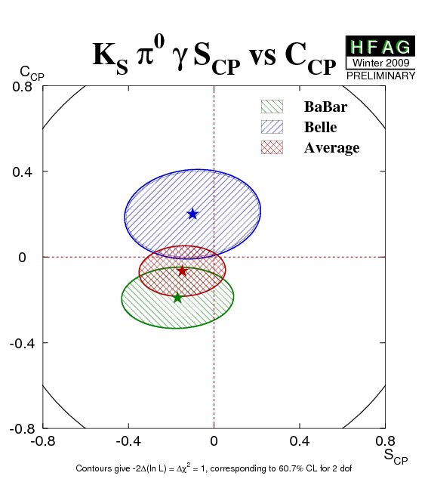
t-dependent CPV
Introduction | PID
Accelerator | Calorimeter
Vertex | General
B → K* (→K_{S}π⁰)γ
t-dependent CPV
SM:
S_{CP}^{K*γ} ∼ -(2m_{s}/m_{b})sin2φ₁ ∼ -0.04
Left-Right Symmetric Models:
S_{CP}^{K*γ} ∼ 0.67 cos2φ₁ ∼ 0.5
S_{CP}^{Ksπ0γ} = -0.15 ±0.20
A_{CP}^{Ksπ0γ} = -0.07 ±0.12
t-dependent decays rate of B → f_{CP};
S and A: CP violating parameters
D. Atwood et al., PRL79, 185 (1997)
B. Grinstein et al., PRD71, 011504 (2005)
5 ab⁻¹
HFAG, Summer’11
σ(S_{CP}^{Ksπ0γ})= 0.09 @ 5 ab⁻¹
0.03 @ 50 ab⁻¹
50 ab⁻¹
(~SM prediction)

Slide 13
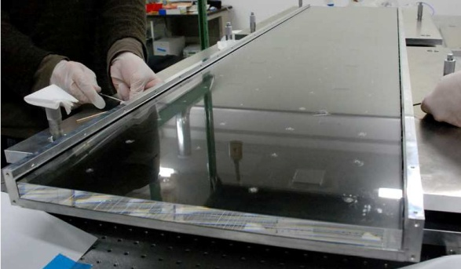
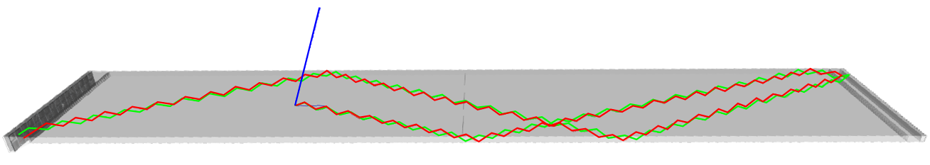
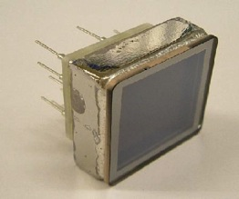
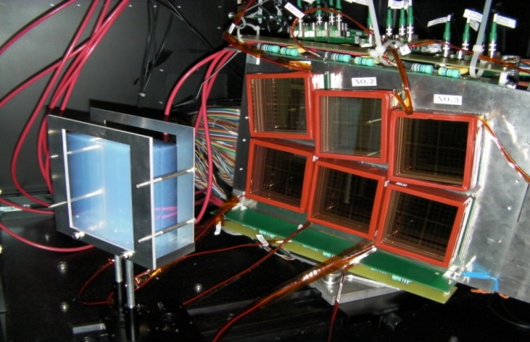
PID
Introduction | PID
Accelerator | Calorimeter
Vertex | General
Time Of Propagation counter (barrel)
y
x
prototype quartz bar
Hamamatsu
16ch MCP-PMT
partial Cerenkov ring reconstruction
from x, y and t of propagation
Proximity focusing Aerogel RICH
(endcap)
Aerogel
200mm
Cherenkov photon
Hamamatsu
HAPD
Aerogel radiator
n~1.05
Hamamatsu HAPD

Slide 14
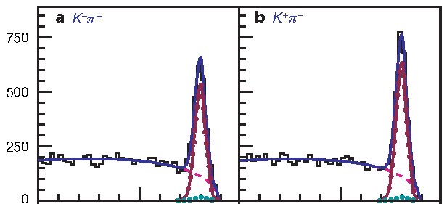
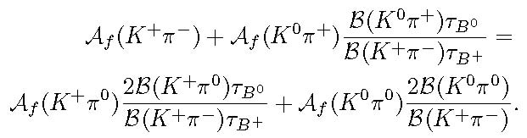
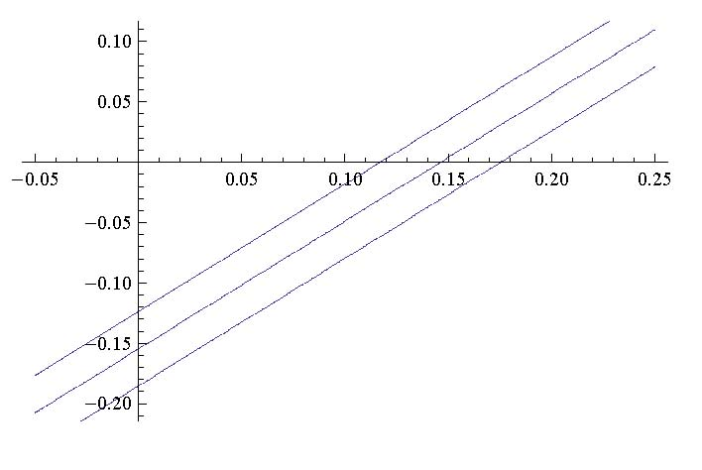
Direct CPV
Introduction | PID
Accelerator | Calorimeter
Vertex | General
B⁰ →K⁺π⁻
DCPV puzzle:
tree+penguin processes, B⁺⁽⁰⁾ →K⁺π⁰⁽⁻⁾
ΔA_{Kπ}= A(K⁺π ⁻)- A(K⁺π ⁰)= -0.127±0.022
model independent sum rule:
A(K⁰π⁺)=0.009 ±0.025
A(K⁺π⁰)=0.050 ±0.025
A(K⁺π⁻)=-0.098 ±0.012
A(K⁰π⁰)=-0.01 ±0.10
misidentif.
bkg.
P. Chang, EPS’11
Belle, Nature 452, 332 (2008), 480 fb⁻¹
A(K⁰π⁰)
δA(K⁺π⁰)
M. Gronau, PLB627, 82 (2005);
D. Atwood, A. Soni, PRD58, 036005 (1998)
measured
(HFAG)
A(K⁰π⁺)
sum rule
Belle II 50 ab⁻¹
expected
(sum rule)
HFAG, Summer’11

Slide 15
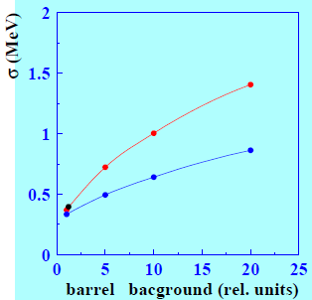
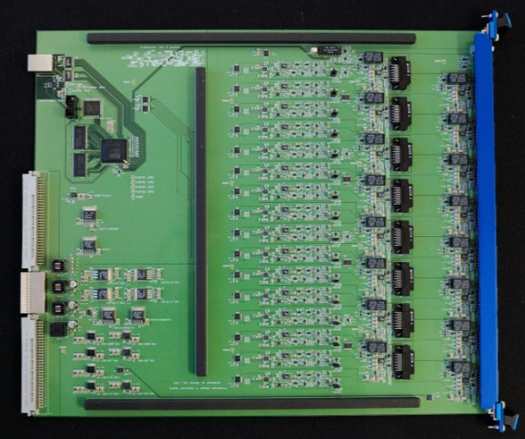
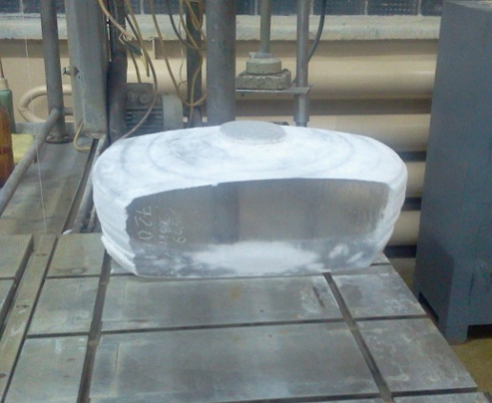
EM Calorimeter
Introduction | PID
Accelerator | Calorimeter
Vertex | General
ECL
signal
amplitude
ECL
signal
time sampling
ECL (barrel):
new electronics with
2MHz wave form sampling
ECL (endcap):
pure CsI crystals;
(may be staged)
faster performance and better
rad. hardness than Tl doped CsI
off-time
bkg.
signal
t
t
trigger
trigger
2x improved
σ at 20x bkg.

Slide 16
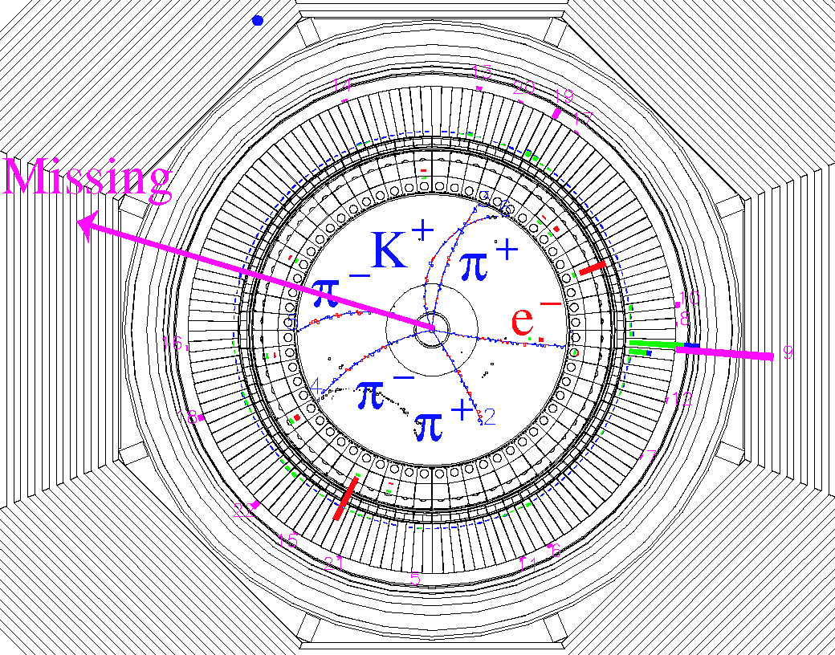
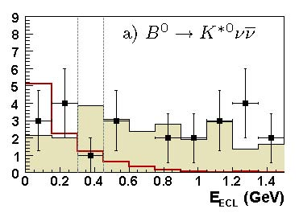
E_{miss} measurements
Introduction | PID
Accelerator | Calorimeter
Vertex | General
B → τν, hνν, ...
fully (partially) reconstruct B_{tag};
reconstruct h from B_{sig}→hνν or τ(→ hν)ν;
no additional energy in EM calorim.;
signal at E_{ECL}~0;
B_{tag} full reconstruction:
NeuroBayes;
TOP detector;
ECL, increased background;
Example of B → hνν
measurement:
Missing E
(ν)
B_{tag}
B_{sig}
B_{sig} → τν
candidate
event
signal
region
hadr. tag
B(B⁰ →K*⁰ nn) < 3.4 ·10⁻⁴ @ 90% C.L.
Belle, PRL99, 221802 (2007), 490 fb⁻¹
-- exp. signal (20xBr)
exp. bkg. (scaled to sideband)

Slide 17
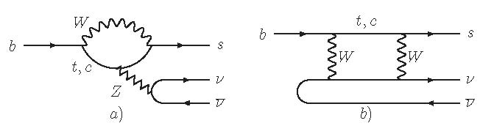

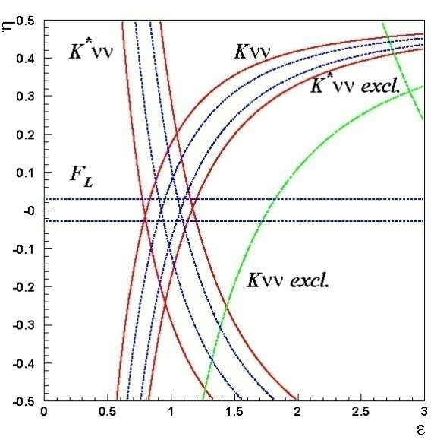
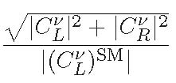
E_{miss} measurements
Introduction | PID
Accelerator | Calorimeter
Vertex | General
B →hνν
B_{sig}B_{tag} →(hνν)(Xlν) semil. tag
→(hνν)(X) hadr. tag
B(B⁺ → K⁽*⁾⁺νν) can be measured
to ±30% with 50 ab⁻¹;
limits on right-handed
currents
SM
W. Altmannshofer et al.,
arXiv:0902.0160

Slide 18
SuperKEKB requirements
Introduction | PID
Accelerator | Calorimeter
Vertex | General
∫L dt
[ab⁻¹]
O(10²) higher luminosity
SuperKEKB will deliver 50 ab⁻¹
complementarity to other intensity frontiers
experiments (LHCb, BES III, ....);
accurate theoretical predictions to compare to
∫L dt=50 ab⁻¹ (2022)
current B factories
2010 2012 2014 2016 2018 2020 2022

Slide 19
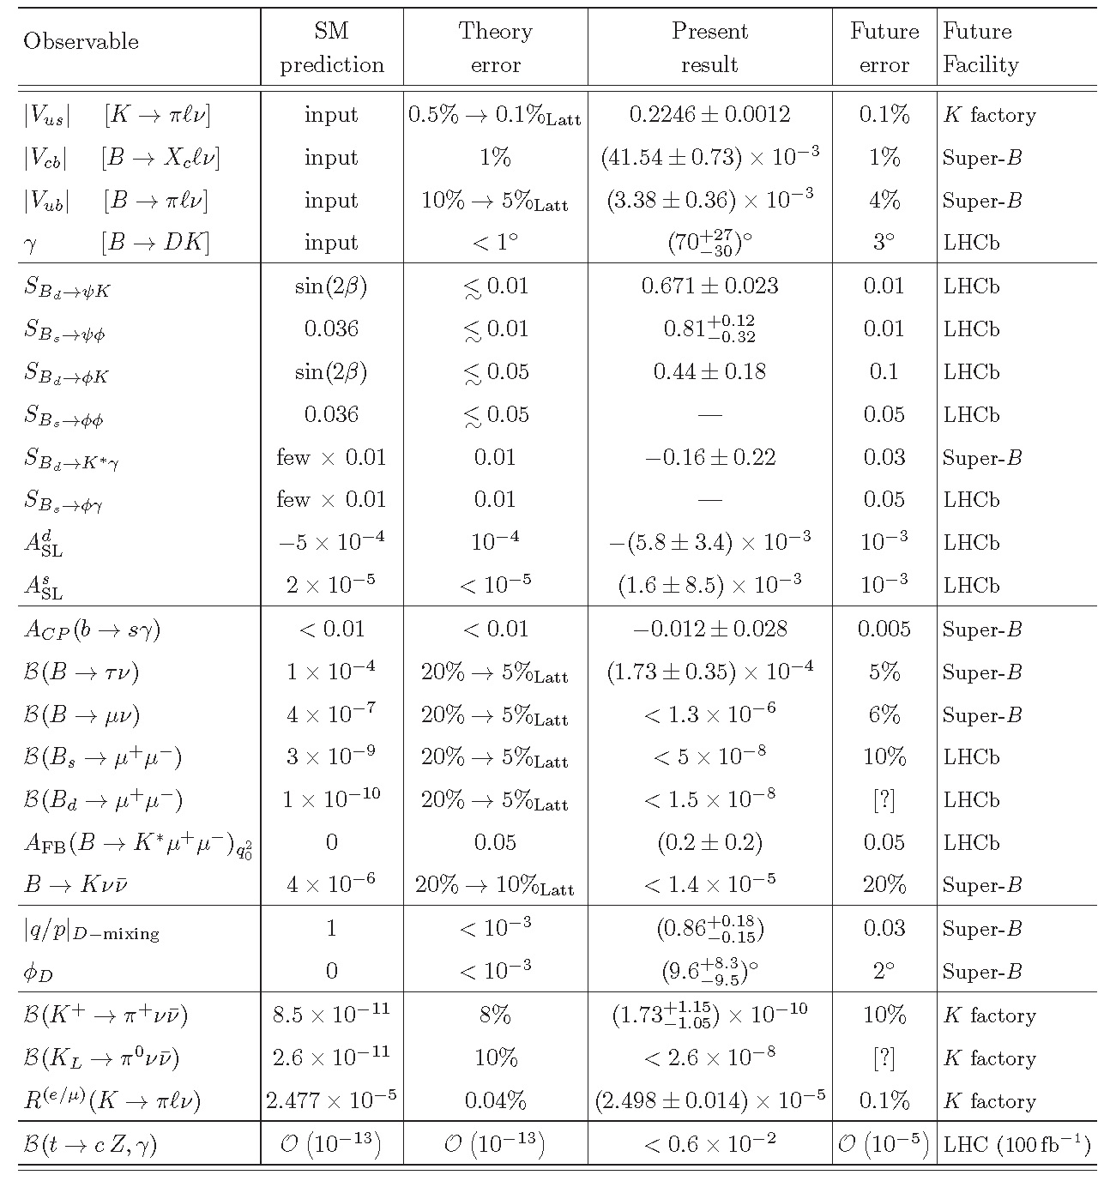
SuperKEKB requirements
Introduction | PID
Accelerator | Calorimeter
Vertex | General
O(10²) higher luminosity
complementarity to other intensity frontiers
experiments (LHCb, BES III, ....);
accurate theoretical predictions to compare to
G. Isidori et al.,
Ann.Rev.Nucl.Part.Sci.
60, 355 (2010)
Super B factory
LHCb
K experiments
B(B →X_{s}γ) 6% Super-B
B(B →X_{d}γ) 20% Super-B
S(B →ργ) 0.15 Super-B
B(τ →μγ) 3 ·10⁻⁹ Super-B (90% U.L.)
B(B⁺ →Dτν) 3% Super-B
B(B_{s} →γγ) 0.25 ·10⁻⁶ Super-B (5 ab⁻¹)
sin²θ_{W} @ Υ(4S) 3 ·10⁻⁴ Super-B

Slide 20

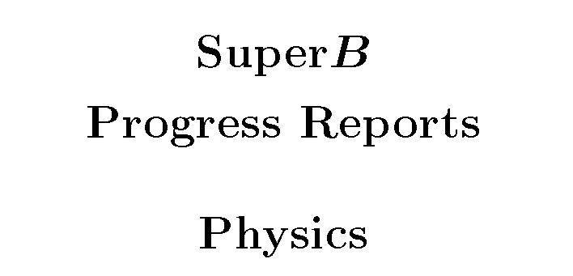

SuperKEKB requirements
Introduction | PID
Accelerator | Calorimeter
Vertex | General
Methods and processes where Super B factory can provide
important insight into NP complementary to other experiments:
(shown are expected sensitivities @ 50 ab⁻¹)
E_{miss}:
B(B→ τν), B(B → X_{c}τν), B(B → hνν),...
±3% ±3% ±30%
Inclusive:
B(B → sγ), A_{CP}(B → sγ), B(B → sll ), ...
±6% ±5 ·10⁻³ ±1 ·10⁻⁷
Neutrals:
S(B → K_{S}π⁰γ), S(B → η’ K_{S}), S(B → K_{S}K_{S}K_{S}), B(τ → μγ), B(B_{s} → γγ), ...
±0.03 ±0.02 ±0.03 ±3 ·10⁻⁹ ±3 ·10⁻⁷
Detailed description of physics program at Super B factories at:
A.G. Akeroyd et al., arXiv: 1002.5012
B. O’Leary et al., arXiv: 1008.1541

Slide 21
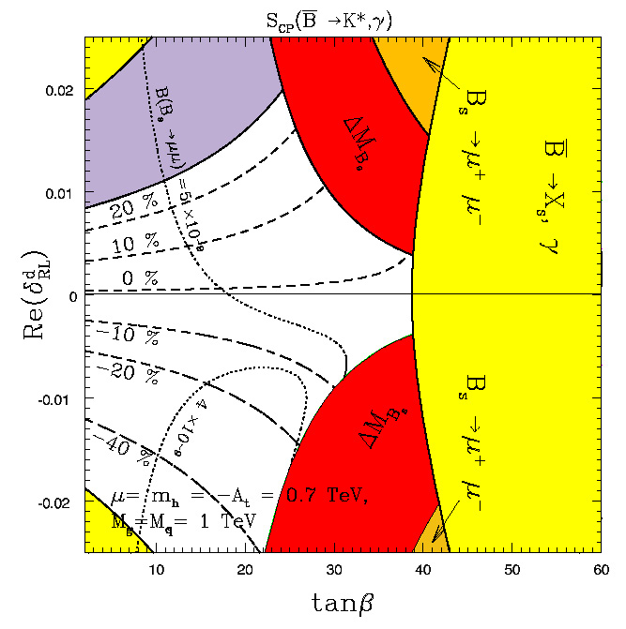
SuperKEKB requirements
Introduction | PID
Accelerator | Calorimeter
Vertex | General
Example of complementarity:
MSSM searches
Belle II constraints shown @ 5 ab⁻¹
LHCb: Br(B_{s} →μ⁺μ⁻)~ (4-5)x10⁻⁹
(@ 3 fb⁻¹)
contours of S(K_{S}π⁰γ)
S(K_{S}π⁰γ) ~ -0.4±0.1
S(K_{S}π⁰γ) ~ 0.1±0.1
Re(δ^{d}_{RL})₂₃
Belle II/LHCb combination:
stringent limits on Re(δ^{d}_{RL})₂₃ , tanβ
tan β
A.G. Akeroyd et al., arXiv:1002.5012

Slide 22
SuperKEKB requirements
Introduction | PID
Accelerator | Calorimeter
Vertex | General
O(10²) higher luminosity
complementarity to other intensity frontiers
experiments (LHCb, BES III, ....);
accurate theoretical predictions to compare to
theory uncertainty
matches the expected
exp. precision
theory uncertainty will
match the expected
exp. precision with
expected progress in
LQCD
G. Isidori et al.,
Ann.Rev.Nucl.Part.Sci. 60, 355 (2010)

Slide 23
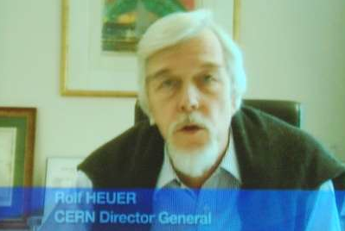
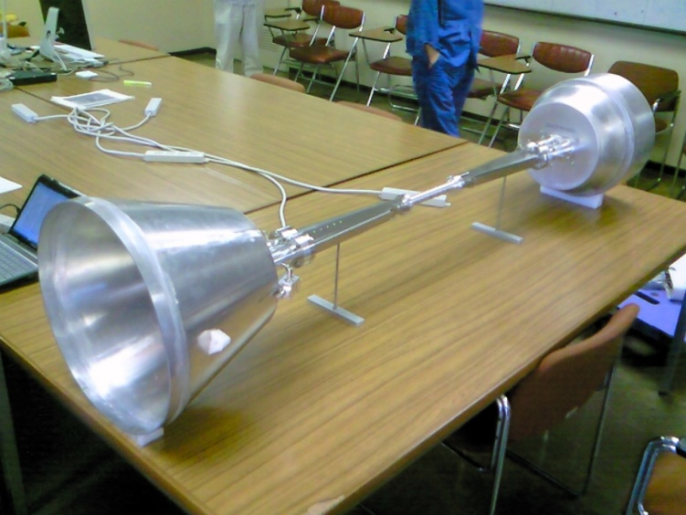
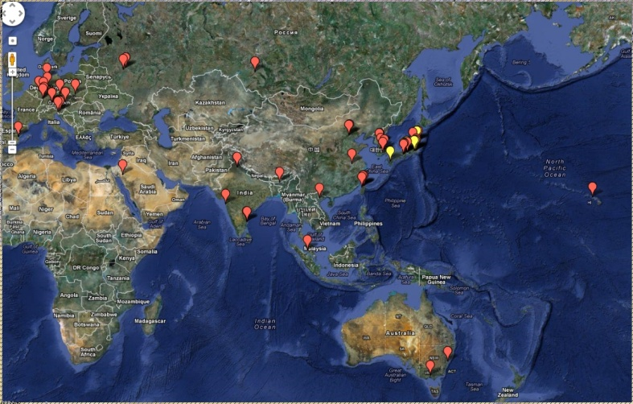
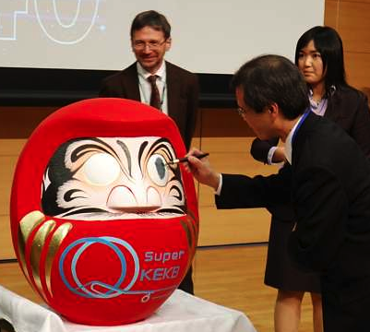
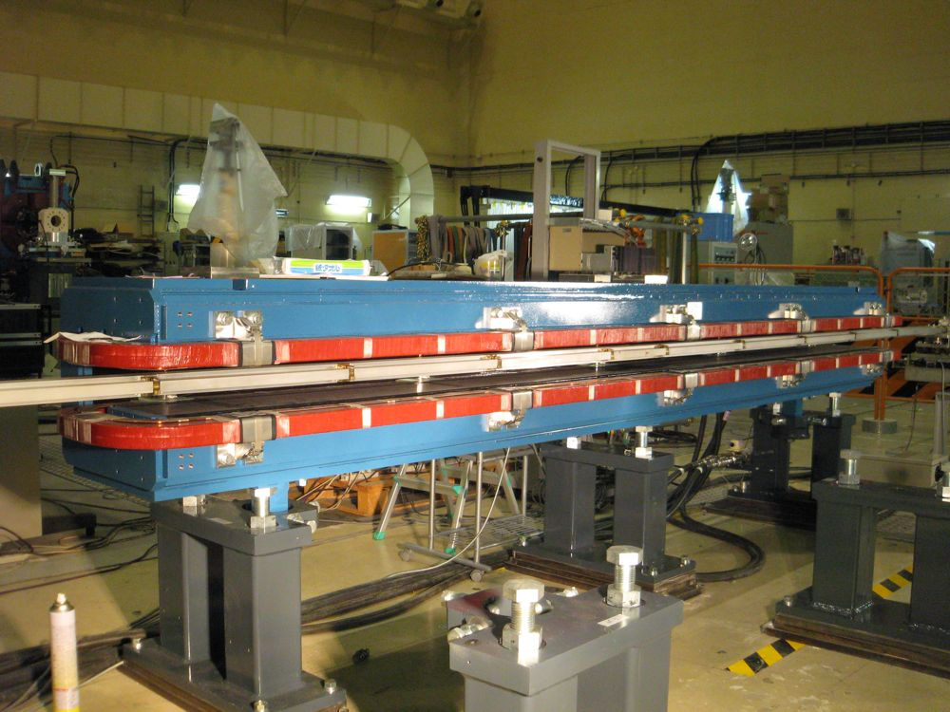
Summary
Introduction | PID
Accelerator | Calorimeter
Vertex | General
The SuperKEKB and Belle II project approved
by the Japanese government
Truly int. coll. with strong European participation
Groundbreaking ceremony in November last
year
Both accelerator upgrade and detector
re-building are well on track
SuperKEKB will provide 50 ab⁻¹ by 2022,
Belle II detector with equal or better performance
than Belle under higher backgrounds
Next collaboration meeting: March 2012, open
to everyone

