Slide 1
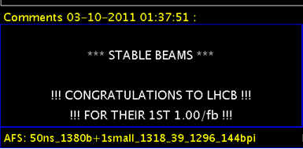
Overview of the LHCb experiment
Status and Results
Federico Alessio, CERN
on behalf of the LHCb Collaboration
Epiphany Conference, Krakow
09-01-2012

Slide 2
Outline
Introduction to LHCb
  The detector
  Physics scope
Detector operation
  Luminosity Leveling
  Trigger
  Detector performance
Selected physics results
  Direct CPV and CPV in charm physics
  CPV in B systems
  Rare decays
  Heavy flavour spectroscopy
  b and c cross sections
  Lifetime measurements
  ElectroWeak
4. The LHCb Upgrade
2

Slide 3

The LHCb experiment at the LHC
LHCb is a collaboration of ~700 authors from 15 countries and 54 institutes
3

Slide 4
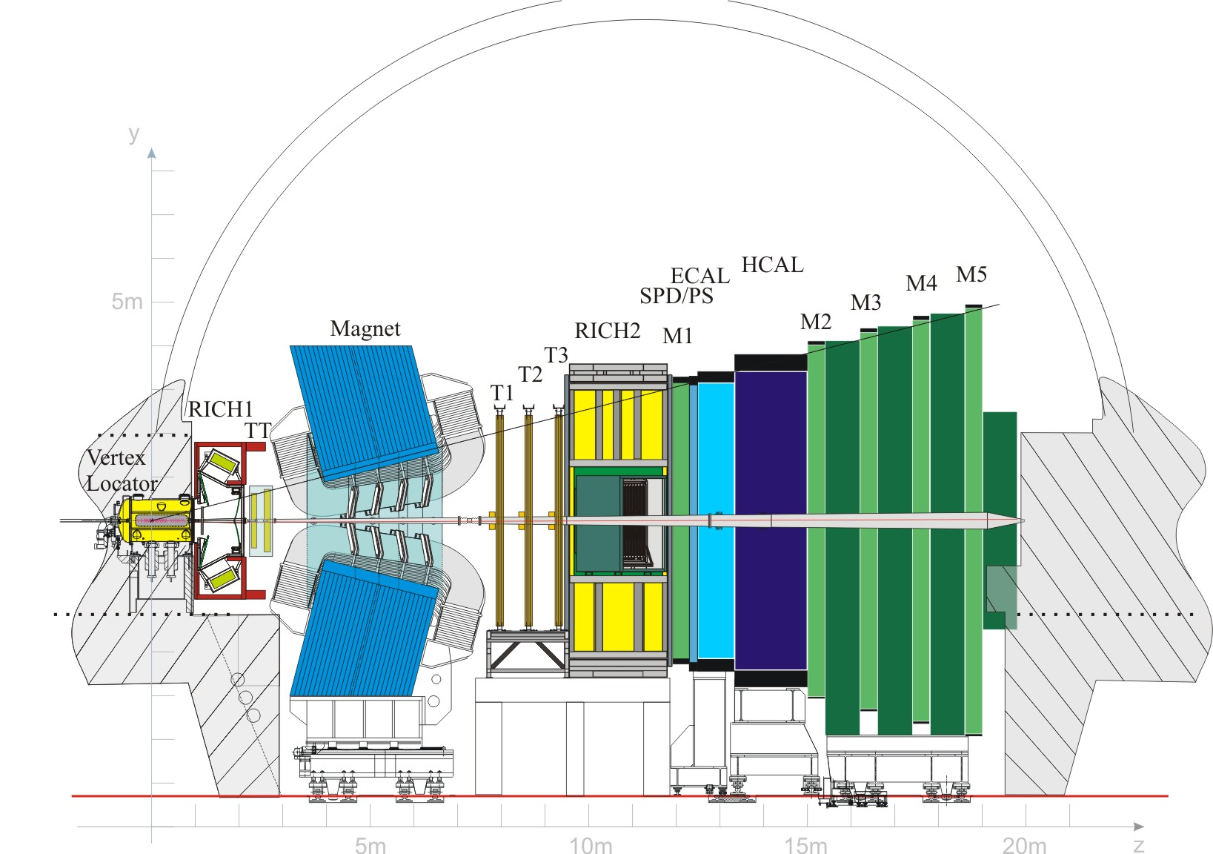

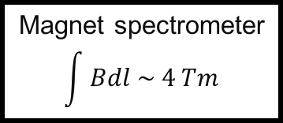
The LHCb experiment
Dedicated flavour physics experiment
→ forward precision spectrometer
→ optimised for beauty and charm decays
Tracking
Particle Identification
10 - 300mrad
Vertexing
Magnet spectrometer
$$\int{Bdl \sim 4 Tm}$$
4
4

Slide 5
An optimised forward spectrometer
High B hadron production at the LHC
10¹¹ B decays in LHCb acceptance
10¹² D decays in LHCb acceptance
2x10⁸ inclusive J/ψ triggers on tape
Most B hadrons produced along beam axis
acceptance: 2 < η < 5 + planar detectors
vertex detector (VELO) close to beam (~8mm)
with excellent resolution
5

Slide 6
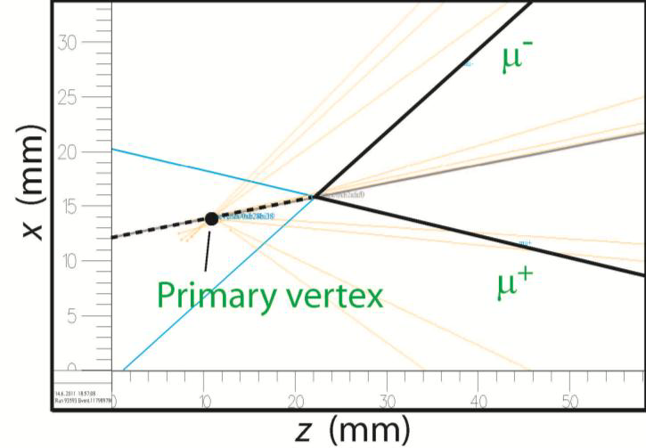
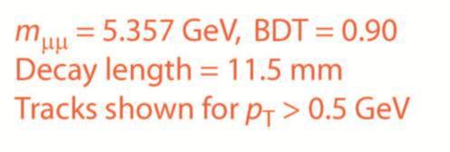
A typical LHCb event
6

Slide 7
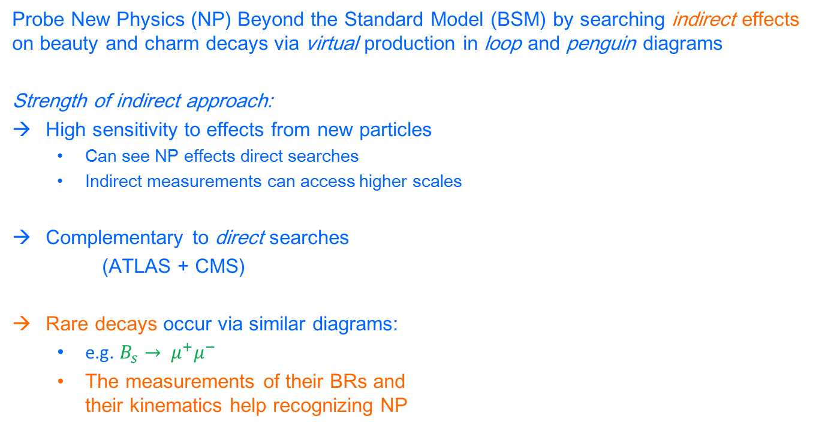
LHCb physics scope
Probe New Physics (NP) Beyond the Standard Model (BSM) by searching indirect effects on beauty and charm decays via virtual production in loop and penguin diagrams
Strength of indirect approach:
High sensitivity to effects from new particles
  Can see NP effects direct searches
  Indirect measurements can access higher scales
Complementary to direct searches
(ATLAS + CMS)
Rare decays occur via similar diagrams:
  e.g. $B_{s}→ μ^{+}μ^{−}$
  The measurements of their BRs and their kinematics help recognizing NP
7

Slide 8
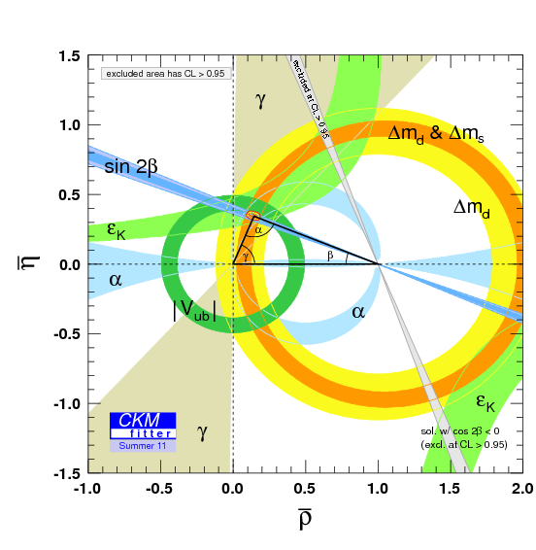

LHCb physics scope
CP Violation and rare decays of beauty and charm are the main focus of LHCb
CKM Fitter picture
All measurements are coherent with CKM of SM
BUT
SM fails to explain matter-antimatter asymmetries
Present knowledge of CKM mostly thanks to B factories
LHCb will help reducing uncertainty on γ angle
NP is still expected in CP violation
Current fit results
$$\overline{ρ}=0.144{}_{−0.026}^{+0.023}$$
$$\overline{η}=0.343{}_{−0.014}^{+0.015}$$
8

Slide 9
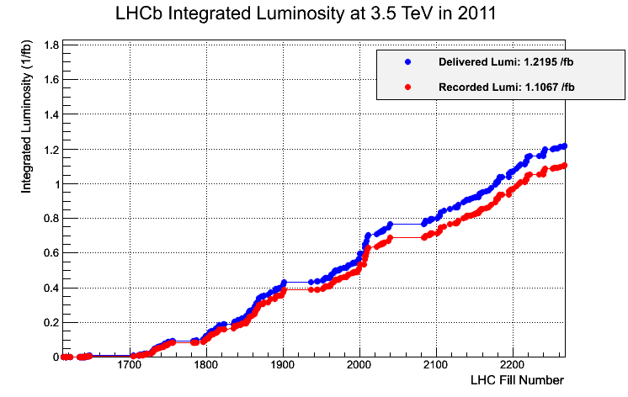
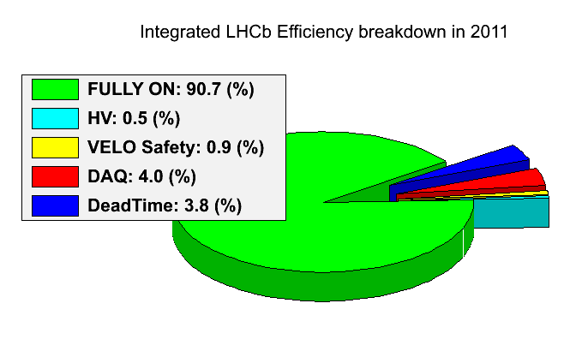
Data taking at LHCb
Thanks to LHC and its increasingly good performance!
# of bunches
Beam characteristics
Peak luminosities
1.1 fb⁻¹ of data recorded out of 1.2 fb⁻¹ of data delivered
efficiency > 90%, with > 98% of detector active channels
99% of recorded data is good for physics analyses
used about 30% or 50% of lumi for most analyses shown here
9

Slide 10
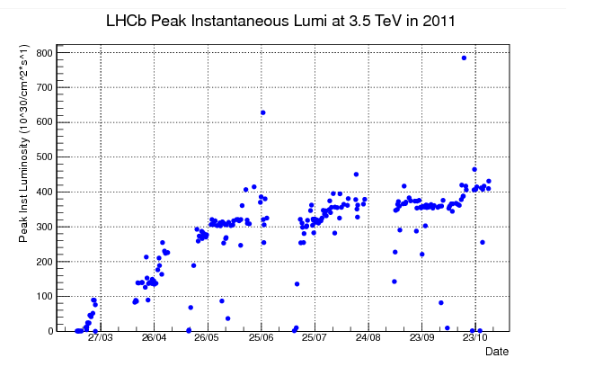
Almost a nominal LHCb year
Design values:
L = <2*10³² cm⁻²s⁻¹ > @ 7 TeV
Pileup = 1
→ (<# pp collisions/crossing> )
μ = 0.4
→ (<#> of visible pp interactions/ crossing)
4*10³² cm⁻²s⁻¹ :
2x designed value!
3.5*10³² cm⁻²s⁻¹
3*10³² cm⁻²s⁻¹
Luminosity design value
2*10³² cm⁻²s⁻¹ →
L = <2*10³² cm⁻²s⁻¹ >
L = <10*10³² cm⁻²s⁻¹ >
Running at higher μ (higher lumi but same beam characteristics) means increasing number of interactions/crossing
  Not good for B physics !
  keep this value low in a controlled way: luminosity leveling
10

Slide 11
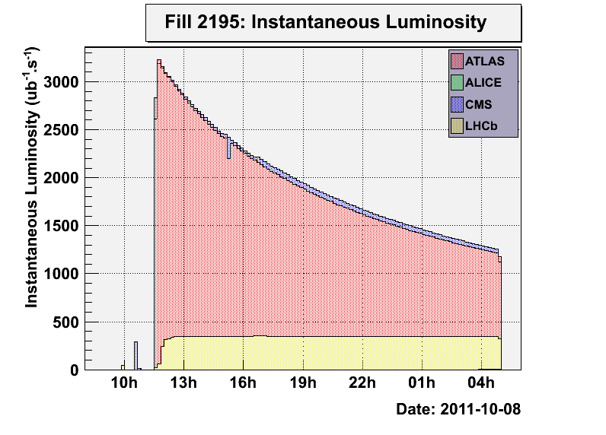
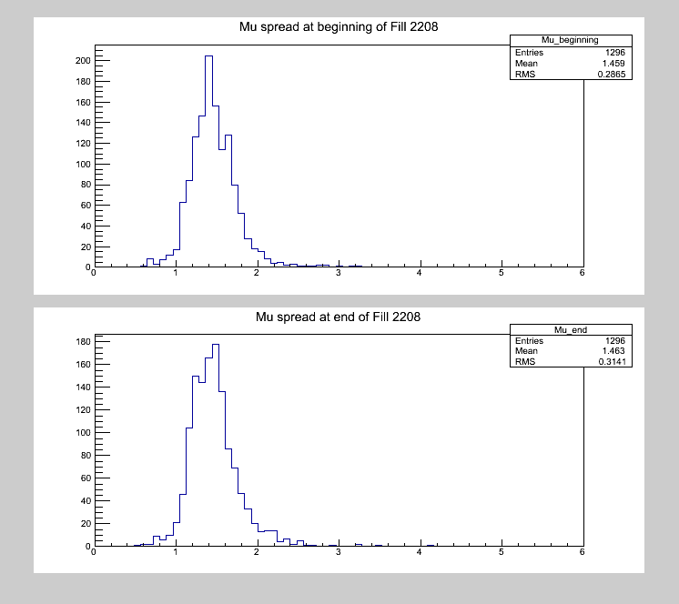
Luminosity leveling
Luminosity leveling as real breakthrough: luminosity kept constant throughout entire fill
Fantastic operational stability
  Constant occupancies and trigger rates throughout fill
  Possibility of choosing the operational point: luminosity value is selected according to running conditions
Automatic procedure between LHCb and LHC
  Value of requested luminosity obtained by separating vertically the beams at the LHCb IP
ATLAS/CMS
LHCb
μ = <1.5>: ~3x designed value
Majority of data sample with similar μ
  Similar occupancies, similar time to process events
  Operational stability: identical dataset for particular period of running
  Optimization of online trigger cuts!
μ per bunch distribution
RMS ~ 0.3
11

Slide 12
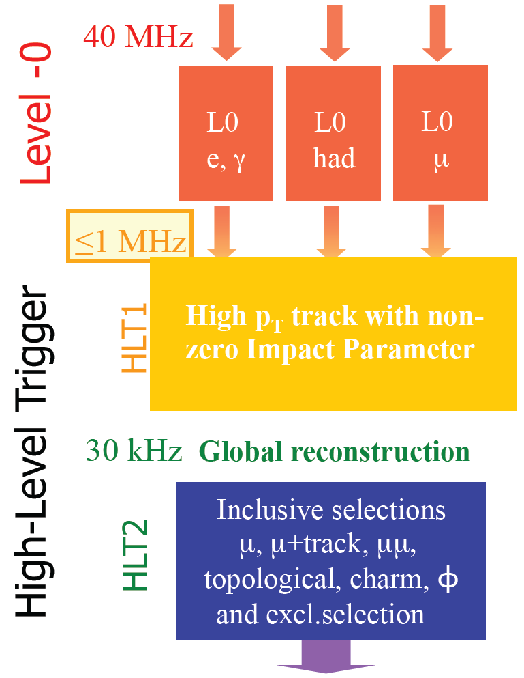
The LHCb trigger system
~1 kHz charm physics
~1 kHz B physics
~1 kHz others (dimuons, EW…)
3 kHz
Dedicated output trigger lines
630 TB of physics data,
peak output of 920 MB/s,
11,157,775,209 physics events gathered
3 kHz
12

Slide 13
Detector performance I
Momentum resolution
Vertex resolution
Y(1S)
Y(2S)
Y(3S)
Primary vertex resolution ~16 μm
Accurate field map and alignment
Momentum resolution: 0.2% - 0.4%
Mass resolution: J/ψ = 13 MeV
13

Slide 14
Detector performance II
Lifetime resolution
Particle IDentification
prompt J/ψ
Resolution from prompt J/ψ: σ_{t} = 50 fs
[LHCb-CONF-2011-049]
Particle ID with RICH:
~ 96% Kaon ID efficiency
~ 7% misID π → K
14

Slide 15
Offline processing and production
Re-processed entire dataset (1.1fb⁻¹) by end-November already!
Thanks to availability of computing groups
Thanks of usage of Tier-2 sites for re-processing
Allowed LHCb to write 3 kHz on tape
15
15

Slide 16
Selected LHCb physics results
See A.A. Alves Jr,
“Heavy flavour spectroscopy in LHCb”
17:00 on 9 January
See A. Martens,
“CPV violation in B systems in LHCb”
12:10 on 9 January
See A. Ukleja,
“Results on charm physics in LHCb”
17:35 on 9 January
See A. Dziurda,
“The measurement of branching ratio of Bs->DsK and Bs->Dspi in the LHCb experiment”
10:50 on 11 January
See F. Soomro,
“Search for rare decays in LHCb”
10:15 on 10 January
See P. Morawski,
“The measurement of fs/fd from hadronic modes in LHCb experiment”
11:10 on 11 January
16

Slide 17





Direct CP Violation
LHCb excellent Particle Identification capability helps isolating different contributions from 2-bodies decays: $B→hh^{′} (where h= π, K …$)
$B^{0}→K^{+}π^{−} vs \overline{B^{0}}→K^{−}π^{+}$: direct CP violation visible in raw distributions
$∆A_{CP}= \frac{Γ\left(\overline{B^{0}}→K^{−}π^{+}\right)− Γ\left(B^{0}→K^{+}π^{−}\right)}{Γ\left(\overline{B^{0}}→K^{−}π^{+}\right)+ Γ\left(B^{0}→K^{+}π^{−}\right)}$ = (-0.088 ± 0.011 ± 0.008)% → 5σ evidence
→ even better than world average = -0.098 ± 0.012 ± 0.011
$$320 {pb}^{−1}$$
$$320 {pb}^{−1}$$
$$B^{0}→K^{+}π^{−}$$
$$\overline{B^{0}}→K^{−}π^{+}$$
[LHCb-CONF-2011-042]
17

Slide 18





Direct CP Violation
Tweaking the selection, allows enhancing the $B_{s}→ K^{−}π^{+}$ and $\overline{B_{s}} → K^{+}π^{−}$ contributions
$∆A_{CP}(B_{s}→ K^{−}π^{+})$= (0.27 ± 0.08 ± 0.02)% → 3σ evidence
$$320 {pb}^{−1}$$
$$320 {pb}^{−1}$$
$$B_{s}→K^{−}π^{+}$$
$$\overline{B_{s}}→K^{+}π^{−}$$
[LHCb-CONF-2011-042]
See more in A. Martens,
“CPV violation in B systems in LHCb”
12:10 on 9 January
18

Slide 19


CPV in B systems, $Φ_{s}$
Phase of $B^{0}$ mixing in the $B_{s}$ system is expected to be very small
Precisely predicted: $Φ_{s}=0.036 ±0.002$
New particles in box diagrams can modi the measured phase: $Φ_{s}= Φ^{SM}+ Φ^{NP}$
Two decay modes for this study:
$$B_{s}→\frac{J}{ψ}Φ\left(1020\right)→\frac{J}{ψ}K^{+}K^{−}$$
$B_{s}→\frac{J}{ψ}f_{0}\left(980\right)→\frac{J}{ψ}π^{+}π^{−}$→ first seen by LHCb last winter
→ Lower statistics: ${BR=20\% of B}_{s}→\frac{J}{ψ}Φ$
[LHCb-CONF-2011-049]
[LHCb-CONF-2011-051]
19

Slide 20


CPV in B systems, $Φ_{s}$
$B_{s}→\frac{J}{ψ}Φ\left(1020\right)→\frac{J}{ψ}K^{+}K^{−}$ has vector-vector final state:
Mixture of CP-odd and CP-even components , separated using angular analysis
Results correlated with $∆Γ_{s}$ (width difference of $B_{s}$ mass eigenstates): plotted as contours plot in $∆Γ_{s} vs B_{s}$ plane
${ B}_{s}→\frac{J}{ψ}Φ\left(1020\right)→\frac{J}{ψ}K^{+}K^{−}$ $B_{s}→\frac{J}{ψ}f_{0}\left(980\right)→\frac{J}{ψ}π^{+}π^{−}$
$Φ_{s}=0.13 ±0.18\left(stat\right)±0.07(sys)$ $Φ_{s}=−0.44 ±0.44\left(stat\right)±0.02(sys)$
20

Slide 21
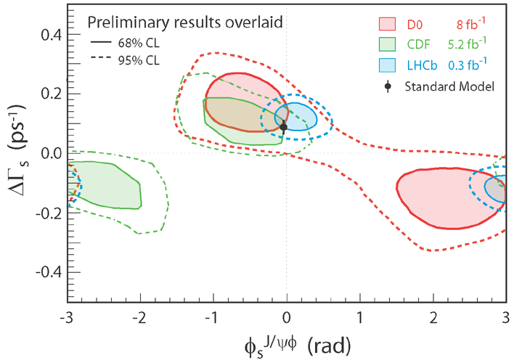

CPV in B systems, $Φ_{s}$
Combined result
$Φ_{s}=0.03 ±0.16\left(stat\right)±0.07\left(sys\right)$ (+ ambiguous solution for $Φ_{s}→π−Φ_{s},{∆Γ}_{s}→−{∆Γ}_{s}$)
Comparison with Tevatron
LHCb measurement tends to favour the SM positive solution
→ only solution possible!
[LHCb-CONF-2011-049]
21

Slide 22



CPV in B systems, ${∆m}_{s}$
${∆m}_{s}: B_{s}−\overline{B_{s}}$ mixing frequency using $B_{s}→D_{s}π$
Flavour specific final state
Necessary to resolve fast $B_{s}$ oscillations: decay time resolution ~45fs
${∆m}_{s}$ exctracted from unbinned ML fit to $B_{s}→D_{s}π$ candidates
$B_{s}$ oscillations
Most precise measurement
[LHCb-CONF-2011-049]
Events yield in 340 pb⁻¹
$$∆m_{s}=17.725 ±0.041\left(stat\right)±0.025\left(sys\right) {ps}^{−1}$$
22

Slide 23

CPV in charm
See more in A. Ukleja,
“Results on charm physics in LHCb”
17:35 on 9 January
CP mixing established in the charm sector, but CP violation not yet seen
In SM, expected to be small effect (~10⁻³ or less)
LHCb has huge potential in charm physics
Dedicated trigger lines for charm decays ( O(1kHz for charm lines) )
Large statistics available: $>{10}^{6} D^{0}→K^{+}K^{−}$ from $D^{∗+}→D^{0}π^{+}$
$∆A_{CP}=$difference in CP asymmetries for
$D^{0}→K^{+}K^{−}$ and $D^{0}→π^{+}π^{−}$
[LHCb-CONF-2011-023]
[LHCb-CONF-2011-061]
${∆A}_{CP}=\left(−0.82±0.21\left(stat\right)±0.11 \left(syst\right) \right) \%$
signficance of 3.5σ
First evidence of CP violation in charm sector!
23

Slide 24


Rare decays, $B_{s,d}→ μ^{+}μ^{−}$
LHCb will set world limit for the very rare decays:
$BR\left( B_{s}→μ^{+}μ^{−}\right)=\left(3.2 ±0.2\right) x {10}^{−9}$
$BR\left( B_{d}→μ^{+}μ^{−}\right)=\left(1.0 ±0.5\right) x {10}^{−10}$
Large contributions in SUSY models
Recent excitement from CDF showing an excess of a few events, giving a
$BR\left( B_{s}→μ^{+}μ^{−}\right)=\left(1.8 ±1\right) x {10}^{−8}=(5.6 x SM)$
LHCb selection is based on multivariate
estimator (BDT) combining vertex
and geometrical information
SM expectations
[A.J.Buras, arXiv:1012.1447]
See more in F. Soomro,
“Search for rare decays in LHCb”
10:15 on 10 January
24

Slide 25
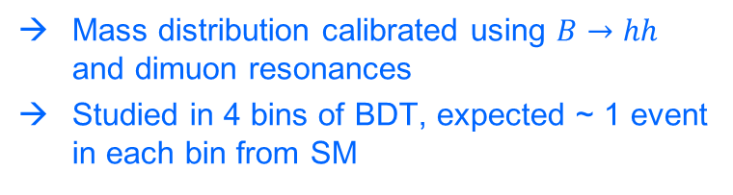
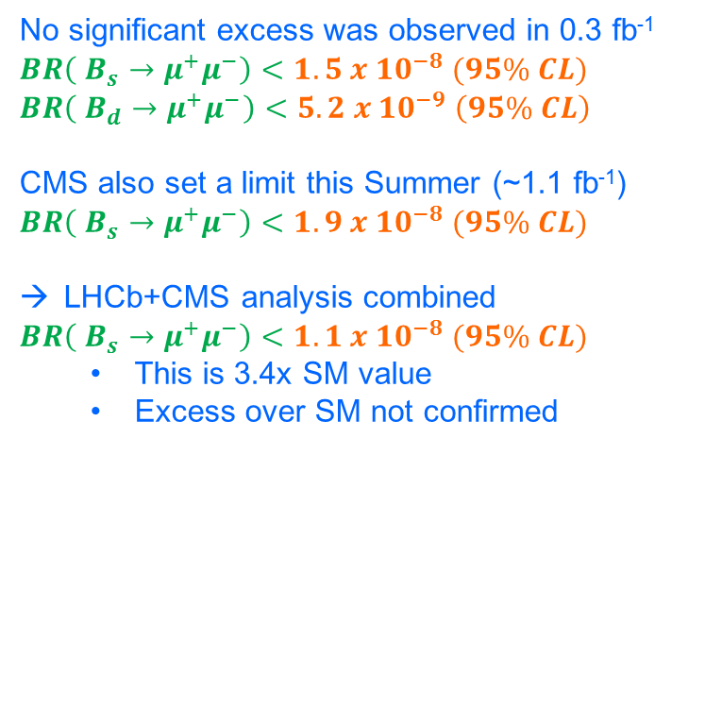

Rare decays, $B_{s,d}→ μ^{+}μ^{−}$
[LHCb-CONF-2011-037]
Mass distribution calibrated using $B→hh$ and dimuon resonances
Studied in 4 bins of BDT, expected ~ 1 event in each bin from SM
No significant excess was observed in 0.3 fb⁻¹
$BR\left( B_{s}→μ^{+}μ^{−}\right)<1.5 x {10}^{−8} (95\% CL)$
$BR\left( B_{d}→μ^{+}μ^{−}\right)<5.2 x {10}^{−9} \left(95\% CL\right)$
CMS also set a limit this Summer (~1.1 fb⁻¹)
$BR\left( B_{s}→μ^{+}μ^{−}\right)<1.9 x {10}^{−8} (95\% CL)$
LHCb+CMS analysis combined
$BR\left( B_{s}→μ^{+}μ^{−}\right)<1.1 x {10}^{−8} (95\% CL)$
  This is 3.4x SM value
  Excess over SM not confirmed
Small excess in most sensitive bin, compatible with SM
(event shown earlier)
25

Slide 26
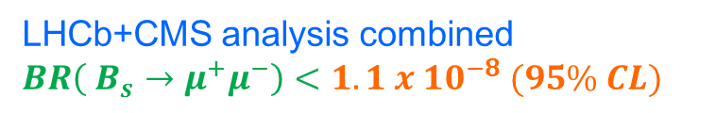
Rare decays, $B_{s,d}→ μ^{+}μ^{−}$
LHCb+CMS analysis combined
$BR\left( B_{s}→μ^{+}μ^{−}\right)<1.1 x {10}^{−8} (95\% CL)$
[arXiv:1108.3018]
Now…
End of 2012…?
26

Slide 27
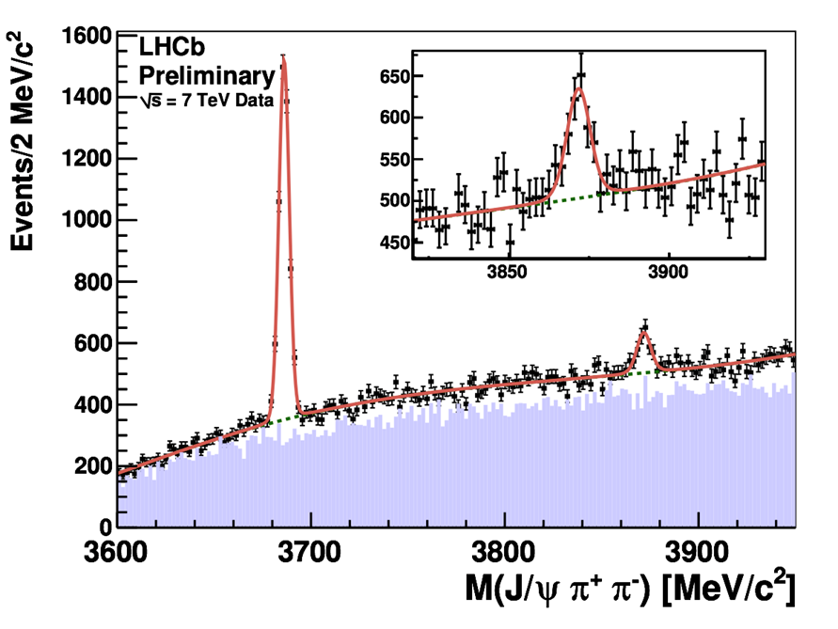
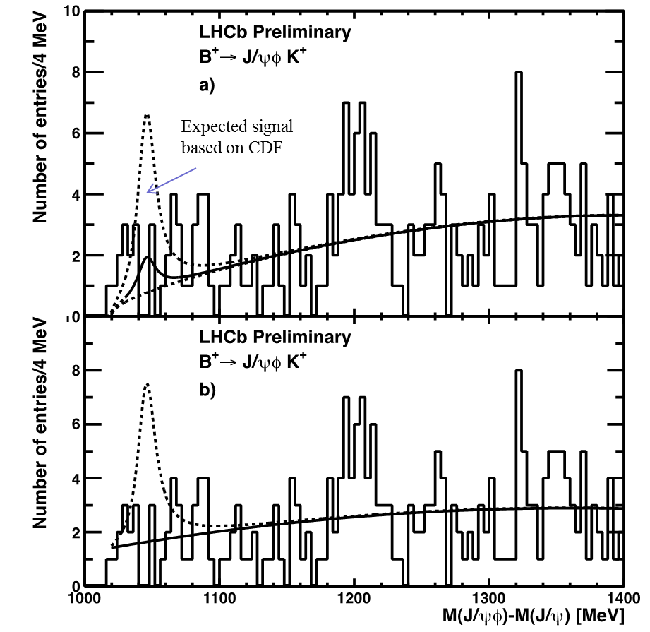
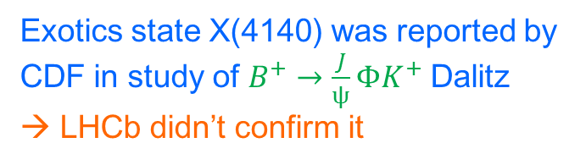
Exotics, X(3872) and (non observation) of X(4140)
See more in A.A. Alves Jr,
“Heavy flavour spectroscopy in LHCb”
17:00 on 9 January
[LHCb-CONF-2011-021]
ψ(2S)
X(3872)
Exotics state X(4140) was reported by CDF in study of $B^{+}→\frac{J}{ψ}ΦK^{+}$Dalitz
LHCb didn’t confirm it
27

Slide 28
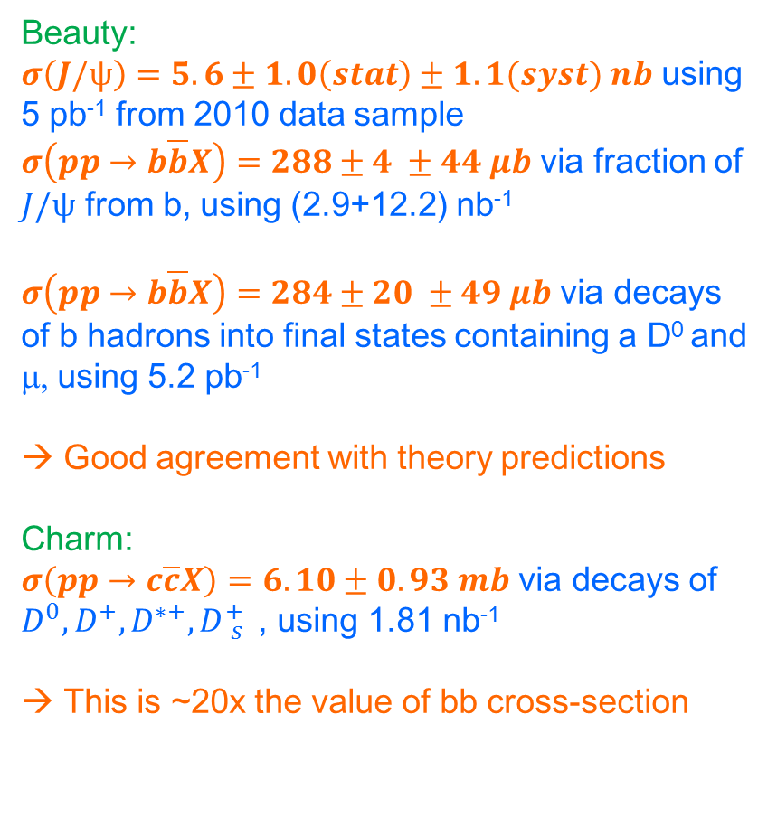
Beauty and Charm cross-sections
Analyses performed already in 2010
Beauty:
$σ\left(J/ψ\right)=5.6±1.0\left(stat\right)±1.1(syst) nb$ using 5 pb⁻¹ from 2010 data sample
$σ\left(pp→b\overline{b}X\right)=288±4 ±44 μb$ via fraction of $J/ψ$ from b, using (2.9+12.2) nb⁻¹
$σ\left(pp→b\overline{b}X\right)=284±20 ±49 μb$ via decays of b hadrons into final states containing a D⁰ and μ, using 5.2 pb⁻¹
Good agreement with theory predictions
Charm:
$σ\left(pp→c\overline{c}X\right)=6.10±0.93 mb$ via decays of $D^{0}, D^{+},D^{∗+}, D{}_{s}^{+}{ }$, using 1.81 nb⁻¹
This is ~20x the value of bb cross-section
[Eur. Phys. J. C71 (2011) 1645]
[Eur. Phys. J. C71 (2011) 1645]
[PLB 694 (2010) 209-216]
[LHCb-CONF-2010-013]
Differential LHCb J/ψ from b wrt to theorethical predictions
28

Slide 29
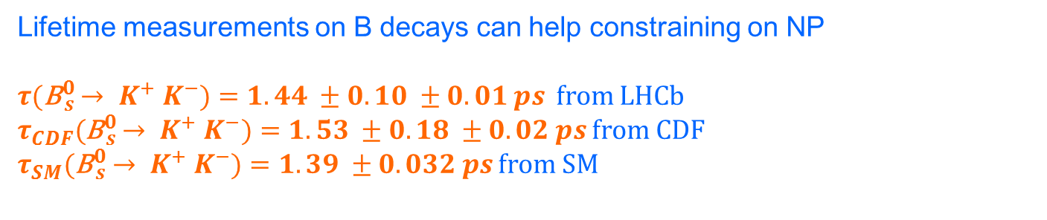
Lifetime measurements
Lifetime measurements on B decays can help constraining on NP
$τ($B${}_{s}^{0}{ → K^{+} K^{−})=1.44 ±0.10 ±0.01 ps}$ from LHCb
$τ_{CDF}($B${}_{s}^{0}{ → K^{+} K^{−})=1.53 ±0.18 ±0.02 ps}$ from CDF
$τ_{SM}($B${}_{s}^{0}{ → K^{+} K^{−})=1.39 ±0.032 ps}$ from SM
[arXiv:1111.0521v2]
[CDF note 06-01-26]
[Eur. Phys. J. C71:1532,2011]
Analyses performed already in 2010
with 37 pb⁻¹
29

Slide 30
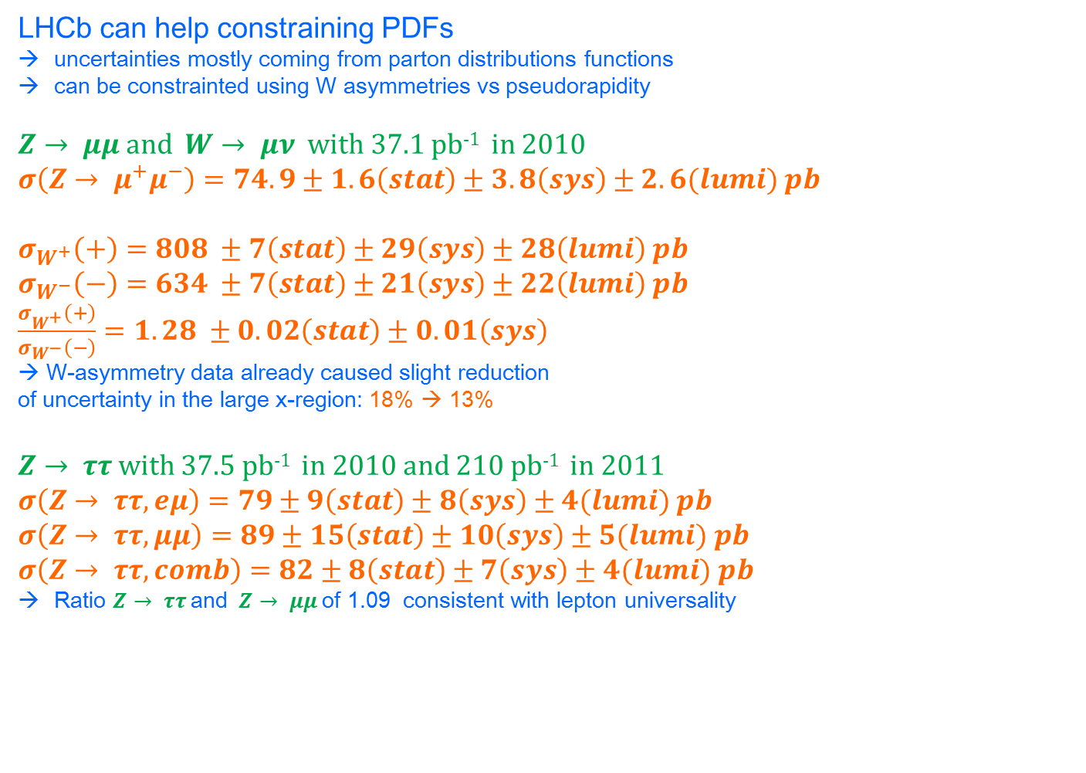
EW measurements
LHCb can help constraining PDFs
uncertainties mostly coming from parton distributions functions
can be constrainted using W asymmetries vs pseudorapidity
$Z→ μμ$ and $W→ μν$ with 37.1 pb⁻¹ in 2010
$σ\left(Z→ μ^{+}μ^{−}\right)=74.9±1.6\left(stat\right)±3.8\left(sys\right)±2.6(lumi) pb$
$σ_{W^{+}}\left(+\right)=808 ±7\left(stat\right)±29\left(sys\right)±28\left(lumi\right) pb$
$σ_{W^{−}}\left(−\right)=634 ±7\left(stat\right)±21\left(sys\right)±22\left(lumi\right) pb$
$\frac{σ_{W^{+}}\left(+\right)}{σ_{W^{−}}\left(−\right)}=1.28 ±0.02\left(stat\right)±0.01\left(sys\right)$
→ W-asymmetry data already caused slight reduction of uncertainty in the large x-region: 18% → 13%
$Z→ ττ$ with 37.5 pb⁻¹ in 2010 and 210 pb⁻¹ in 2011
$σ\left(Z→ ττ, eμ\right)=79±9\left(stat\right)±8\left(sys\right)±4(lumi) pb$
$σ\left(Z→ ττ, μμ\right)=89±15\left(stat\right)±10\left(sys\right)±5(lumi) pb$
$σ\left(Z→ ττ, comb\right)=82±8\left(stat\right)±7\left(sys\right)±4(lumi) pb$
Ratio $Z→ ττ$ and $Z→ μμ$ of 1.09 consistent with lepton universality
[LHCb-CONF-2010-039]
[LHCb-CONF-2010-041]
30

Slide 31
LHCb Upgrade
See C. Parkes,
“Upgrade of the LHCb experiment”
15:20 on 10 January
LHCb is foreseeing to upgrade its detector in first LHC long shutdown (~2018?)
To run at 10x design luminosity: L = <2*10³³ cm⁻²s⁻¹ >
To collect 10x more integrated luminosity: ~50fb⁻¹
To improve trigger efficiencies
Removing hardware trigger and having all events available in the software trigger
31

Slide 32
LHCb Upgrade
This can be achieved with a trigger-less readout architecture:
record all LHC events!
  require modification of readout system
  many Front-End electronics + detectors will be replaced
  readout electronics will be replace
To write to tape ~20kHz of triggered events!
Letter of Intent already submitted and approved by LHCC [LHCC-I-018]
Work is already progressing intensively with the aim of complete the upgrade in 2018!
3 kHz
~20 kHz
32

Slide 33
Conclusions
Thanks to:
the outstanding performance of the LHC accelerator
  Provided the LHC experiments with L > expectations
the outstanding work of the LHCb operation team
  Reached the milestone of 1 fb⁻¹ data recorded
  Online efficiency above 90% and offline efficiency > 99%
the outstanding work of the LHCb analysis working groups
  > 60 analysis have been published as conference proceedings
  > 20 papers have been submitted to international journals
LHCb set itself as the world leading experiment in flavor physics providing world class measurement for CP violation, charm physics, B hadrons physics, loop and penguin processes, exotics….
The dataset will be doubled, reaching a total of ~2.5 fb⁻¹ by end of 2012
Many results will be finalized and an upgrade is envisaged for 2018
Stay tuned for the winter conference with the full 1.1 fb⁻¹ dataset!
33

Slide 34
Backup
34

Slide 35

Rare decays, $B^{0}→ K^{∗}μ^{+}μ^{−}$
Another rare decay from related b → s diagram
Analysis of angular distribution allow extracting information about NP
LHCb has largest sample in world, as clean as the B factories
A_{FB} consistent with SM: data consistent with SM predictions
A_{FB} changing sign as predicted by SM
[arXiv:1006.5013]
303 signal events
[LHCb-CONF-2011-038]
35

Slide 36
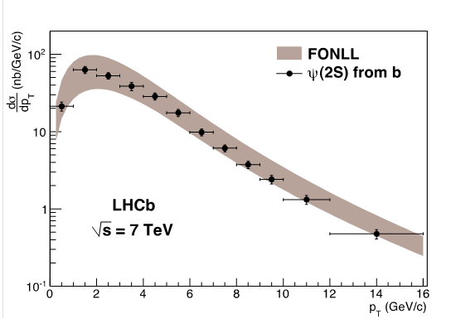


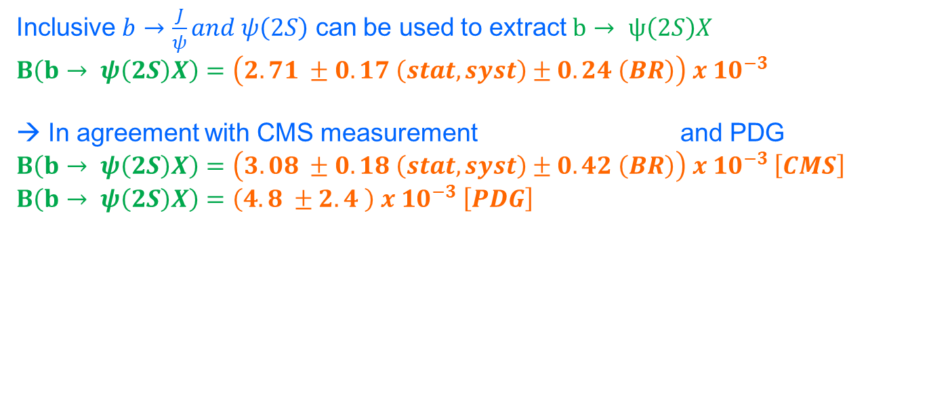
Quarkonia, $ψ(2S)$
Study of quarkonia production provides important tests for Non-Relativistic QCD
[LHCb-CONF-2011-026]
Results for prompt $ψ\left(2S\right)$ presented in summer
Now, also includes $b→ ψ\left(2S\right)X$
$σ_{prompt}\left(ψ\left(2S\right)\right)=1.41±0.01±0.12{}_{−0.39}^{+0.20}{ μb }$
$σ_{b}\left(ψ\left(2S\right)\right)=0.25±0.01±0.2 μb$
Inclusive $b→\frac{J}{ψ}and ψ\left(2S\right)$ can be used to extract $b→ ψ\left(2S\right)X$
$B\left(b→ ψ\left(2S\right)X\right)=\left(2.71 ±0.17 \left(stat,syst\right)±0.24 \left(BR\right)\right) x {10}^{−3}$
In agreement with CMS measurement and PDG
$B\left(b→ ψ\left(2S\right)X\right)=\left(3.08 ±0.18 \left(stat,syst\right)±0.42 \left(BR\right)\right) x {10}^{−3} \left[CMS\right]$
$B\left(b→ ψ\left(2S\right)X\right)=\left(4.8 ±2.4 \right) x {10}^{−3} \left[PDG\right]$
[CMS-BPH-2011-026]
36

Slide 37
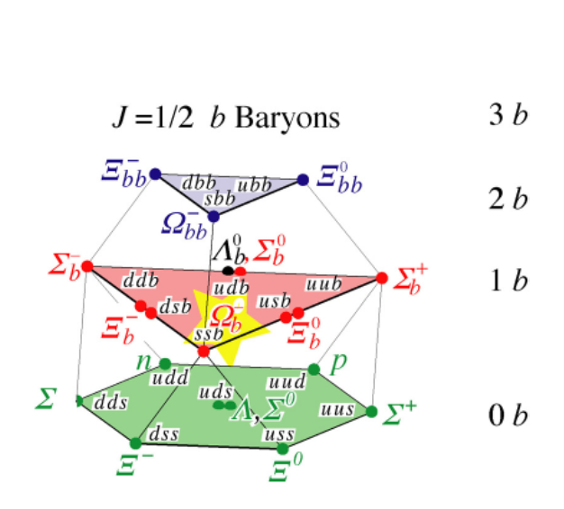
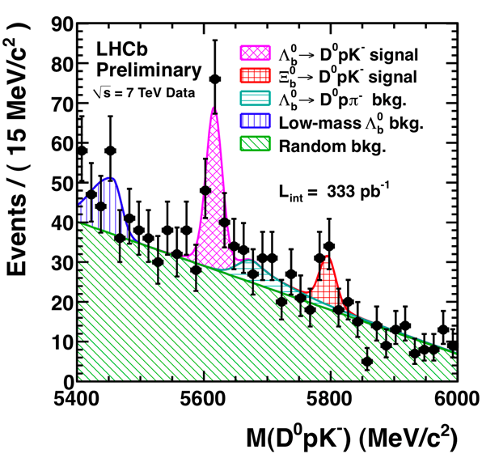
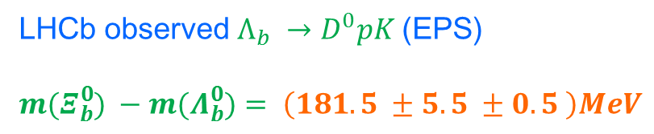
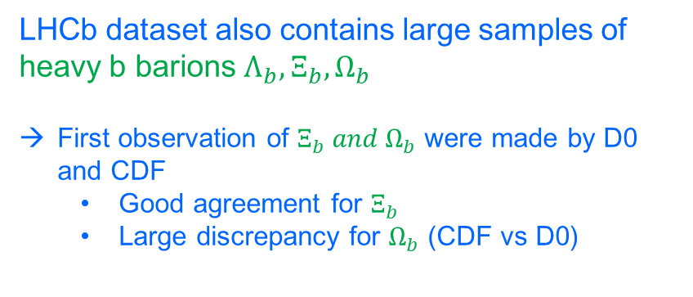
Heavy b barions
LHCb dataset also contains large samples of heavy b barions $Λ_{b},Ξ_{b},Ω_{b}$
First observation of $Ξ_{b} and Ω_{b}$ were made by D0 and CDF
  Good agreement for $Ξ_{b}$
  Large discrepancy for $Ω_{b}$ (CDF vs D0)
LHCb observed$Λ_{b} →D^{0}pK$ (EPS)
$m(Ξ{}_{b}^{0}{) −m(Λ{}_{b}^{0}{)= \left(181.5 ±5.5 ±0.5 \right)MeV}}$
[LHCb-CONF-2011-036]
37

Slide 38
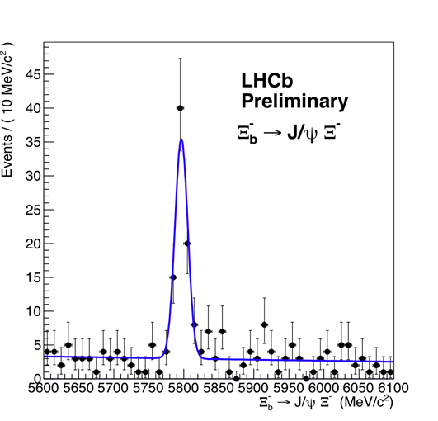
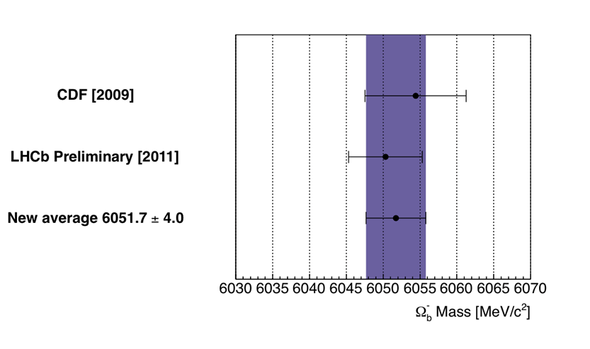
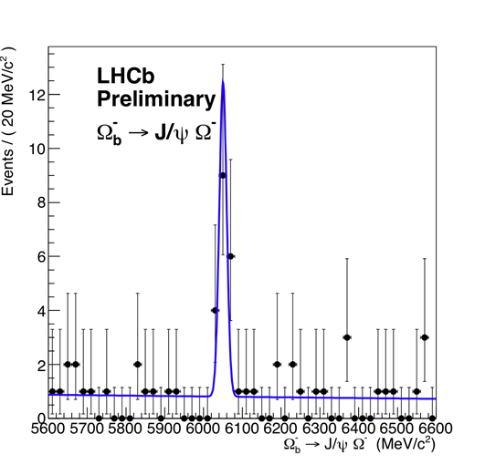
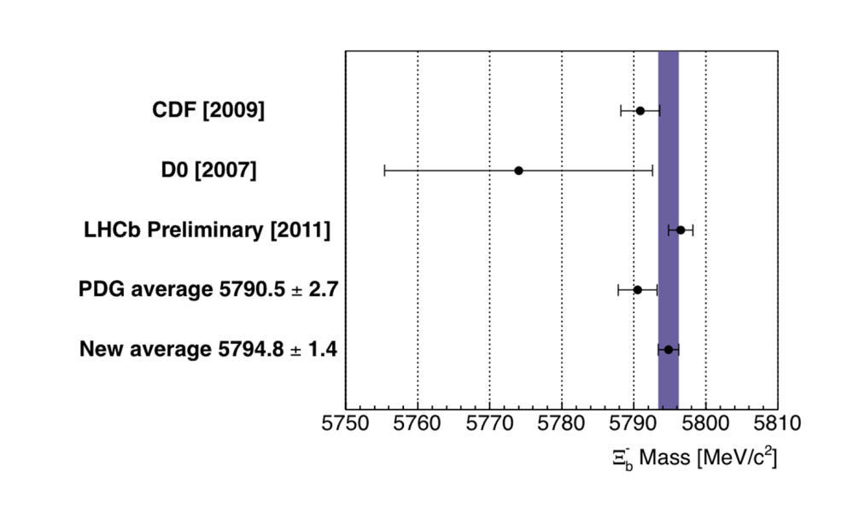
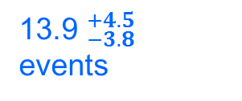
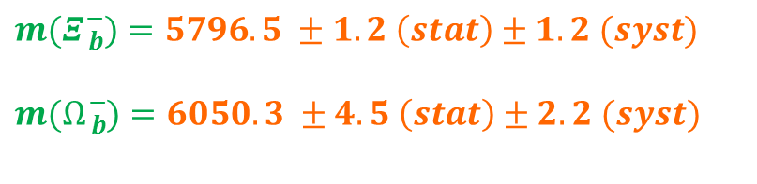


Heavy b barions
LHCb also observed$Ξ_{b},Ω_{b}$with 576 pb⁻¹ of data
[LHCb-CONF-2011-060]
$m(Ξ{}_{b}^{−}{)=5796.5 ±1.2 \left(stat\right)±1.2 (syst)}$
$m(Ω{}_{b}^{−}{)=6050.3 ±4.5 \left(stat\right)±2.2 (syst)}$
72.2 ± 9.4
events
$$Ω_{b}$$
13.9 ${}_{−3.8}^{+4.5}$
events
$$Ξ_{b}$$
38

